Slide 1
Breast Cancer Diagnosis Using Machine Learning
CSTE 3207 — End-to-End ML Project
Team: [Student 1], [Student 2], [Student 3]

Slide 2
1. Problem Formulation
Supervised learning → binary classification
Target: malignant vs benign tumor diagnosis
Goal: compare baseline and advanced models using a rigorous pipeline
Dataset: Breast Cancer Wisconsin (Diagnostic)

Slide 3
2. Dataset
569 samples and 30 continuous predictive features
212 malignant and 357 benign cases
Features derived from digitized FNA images of breast masses
Public UCI dataset accessed through scikit-learn

Slide 4
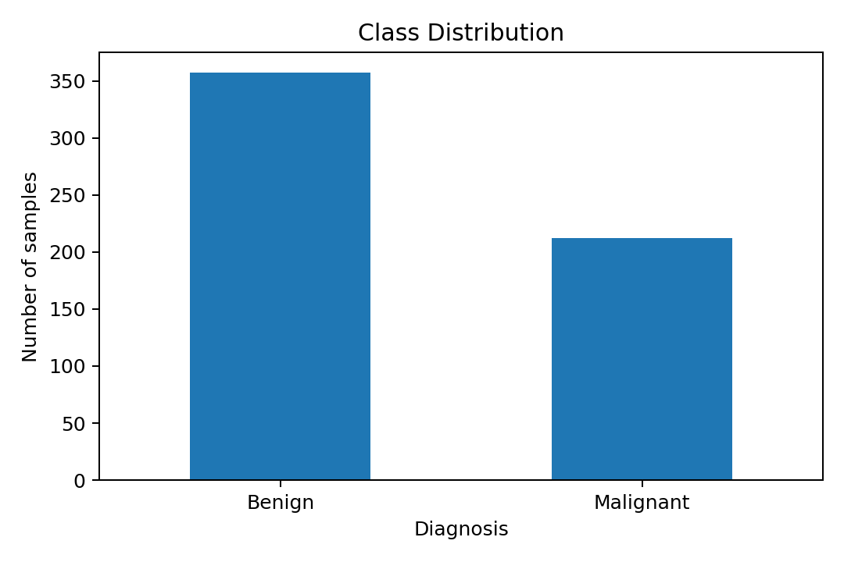
3. Exploratory Data Analysis
Class distribution

Slide 5
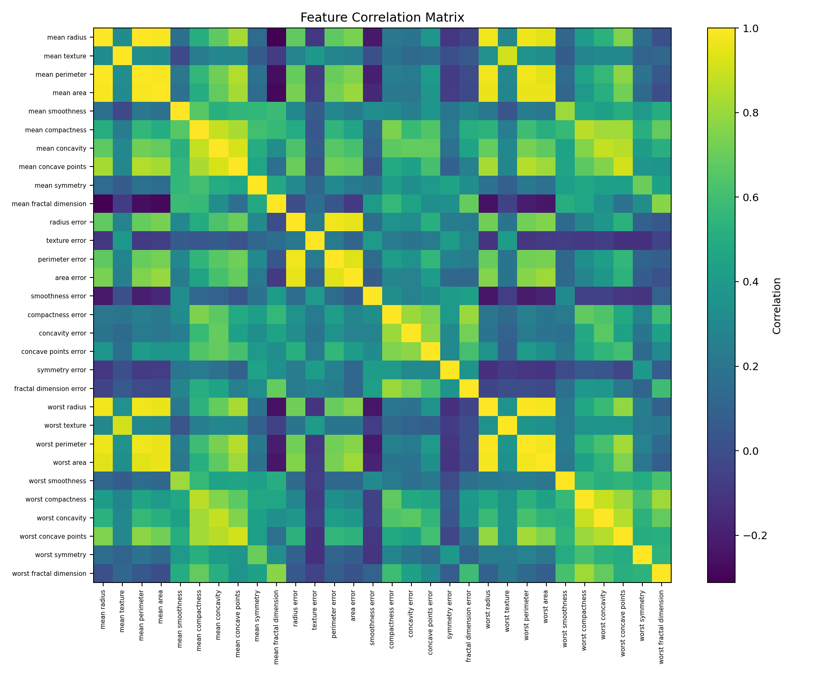
4. Feature Correlations
Correlation matrix

Slide 6
5. Preprocessing & Feature Engineering
80/20 stratified train-test split
Median imputation inside pipelines
StandardScaler for Logistic Regression and SVM
Engineered: area/perimeter, concavity/compactness, worst-radius/mean-radius ratios
No original missing values; imputation retained for robustness

Slide 7
6. Models
Baseline: Dummy Classifier
Simple model: Logistic Regression
Advanced: Random Forest
Advanced: Support Vector Machine (RBF)
Hyperparameter tuning: GridSearchCV + 5-fold Stratified CV

Slide 8
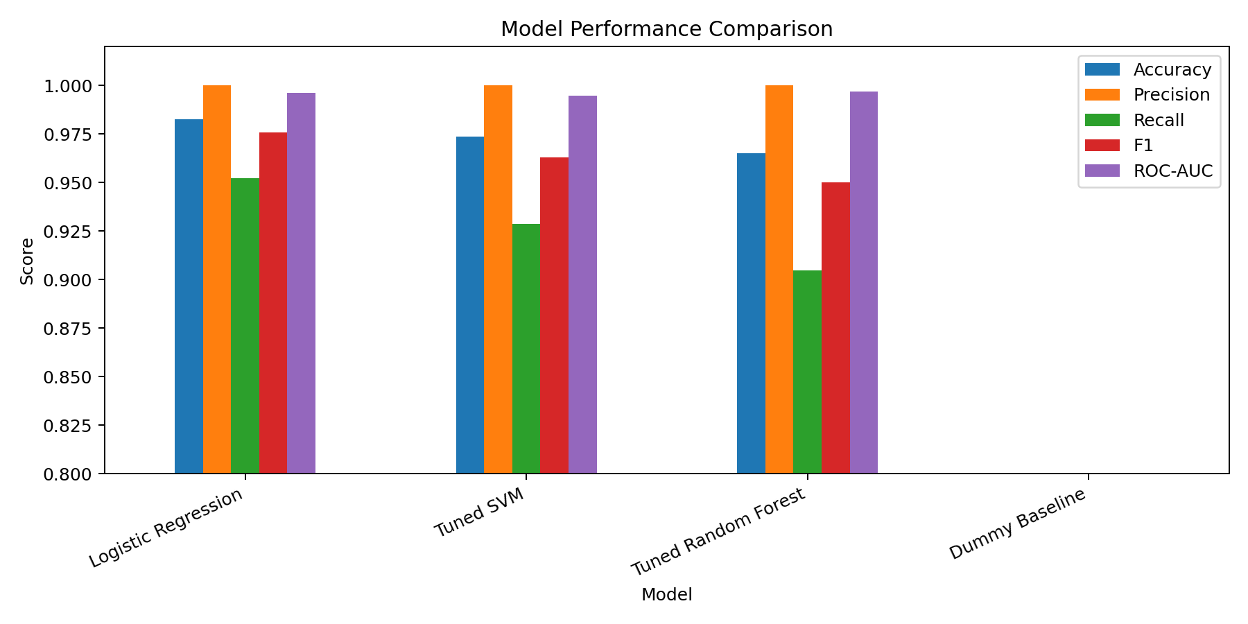
7. Model Comparison
Held-out test-set metrics

Slide 9
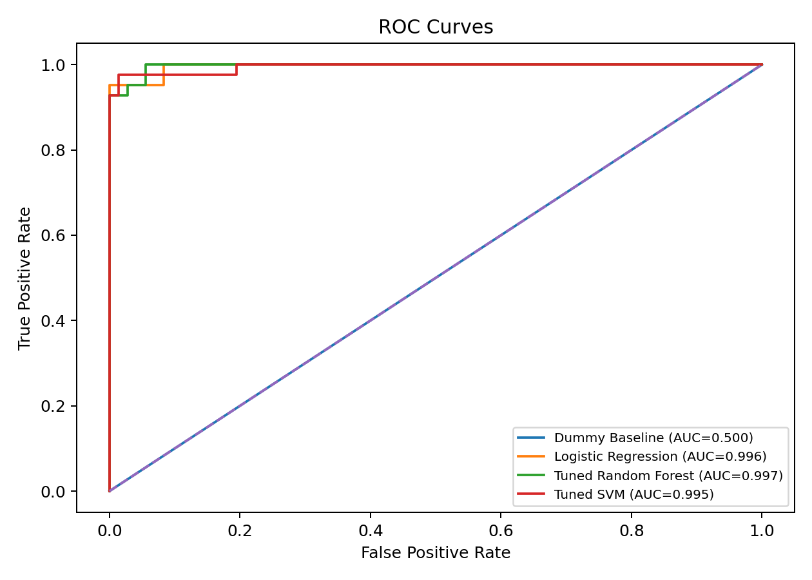
8. ROC Curves
ROC-AUC comparison

Slide 10
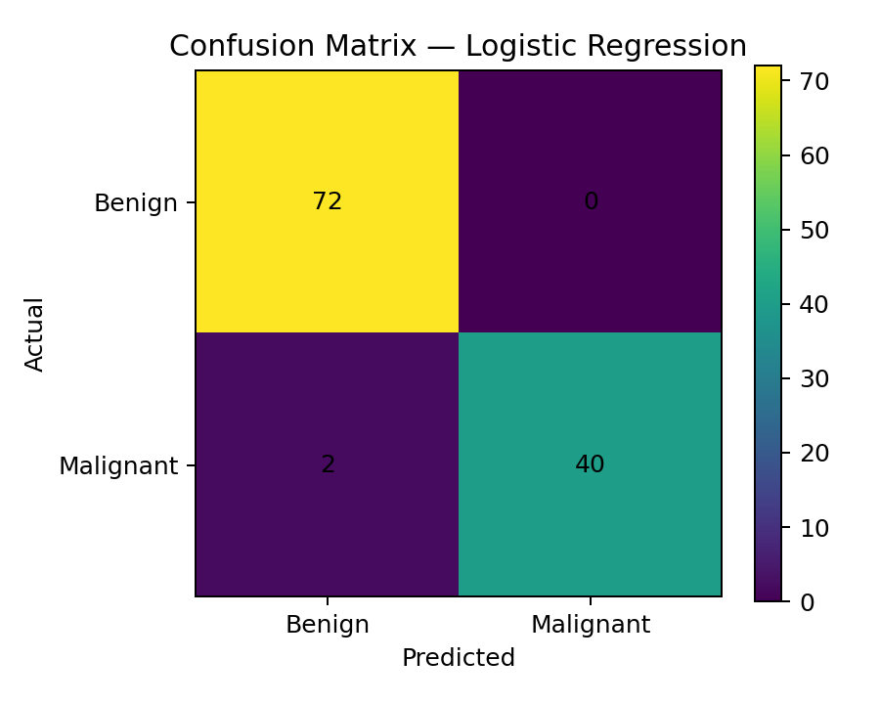
9. Error Analysis
Confusion matrix — Logistic Regression

Slide 11
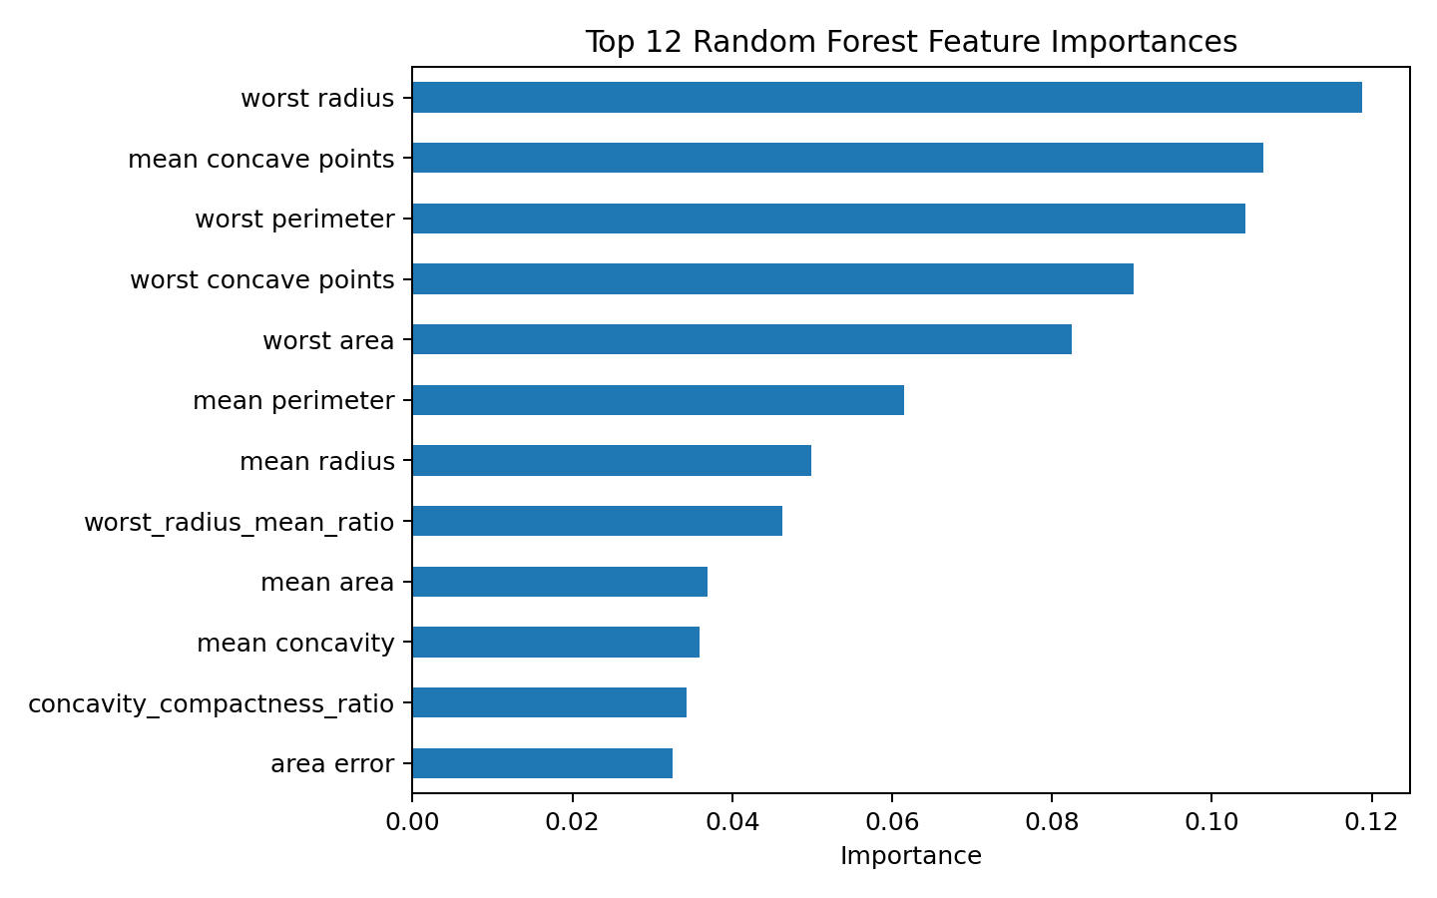
10. Feature Importance
Top Random Forest features

Slide 12
11. Results & Discussion
Best model in this run: Logistic Regression
Accuracy: 0.982
Precision: 1.000
Recall: 0.952
F1: 0.976 | ROC-AUC: 0.996
Misclassified test samples: 2
Results are academic benchmarks, not clinical evidence

Slide 13
12. Conclusion & Future Work
Completed the required end-to-end ML pipeline
Systematic preprocessing and tuning improved model selection
Future: nested CV, calibration, external validation, gradient boosting/neural networks
Final system should not be used as a clinical diagnostic tool

Slide 14
13. References
UCI Machine Learning Repository — Breast Cancer Wisconsin (Diagnostic)
Scikit-learn documentation — load_breast_cancer
Agarap (2017) — ML algorithms on Wisconsin Diagnostic dataset
CSTE 3207 Project Guideline

