Slide 1
PROJECT TITLE
CAPSTONE PROJECT
Presented By : J Suma
Student Name : J Suma
College Name & Department : East West Institute Of Technology,
Bengaluru.560091
CSE(IoT, CyS & BCT)

Slide 2
OUTLINE
Problem Statement
Technology used
Wow factor
End users
Result
Conclusion
Git-hub Link
Future scope

Slide 3
Problem Statement
With the increasing need for secure communication, traditional encryption techniques often draw attention and can be intercepted.
Steganography provides an alternative by concealing data within digital images, ensuring confidentiality without raising suspicion. However, existing methods may suffer from poor imperceptibility, low embedding capacity, and vulnerability to attacks.
This project aims to develop a robust and secure steganographic technique that enhances data hiding while maintaining image quality and resilience against detection.
The proposed approach will focus on improving security, efficiency, and imperceptibility for safe data transmission.

Slide 4
Technology used
Programming Language:
Python – Used for building encryption and decryption logic.
Libraries & Frameworks:
OpenCV – Handles image processing and manipulation.
NumPy – Supports array-based operations for embedding messages.
Platforms:
Runs on Windows, Linux and macOS with python installed.

Slide 5
Wow factors
Why is this project unique?
High Security– Uses advanced techniques to make hidden data undetectable.
Better Image Quality – Ensures minimal distortion after embedding data.
Fast Processing – Optimized for efficiency and quick encoding/decoding.
Secure Communication – Used in military, confidential messaging, and cybersecurity.
Stealth Factor – Prove how the hidden message remains undetectable to the human eye.
Future Scope – Can be extended to video, audio, and AI-powered encryption.

Slide 6
End users
Government & Military Organizations – Secure transmission of classified information without detection.
Cybersecurity & Intelligence Agencies – Covert communication to prevent data breaches.
Journalists & Whistleblowers – Safe sharing of sensitive information without attracting attention.
Medical Industry – Protecting confidential patient records embedded in medical images.
Corporate Sector – Securing trade secrets and confidential data from industrial espionage.
Digital Forensics & Law Enforcement – Hiding investigation data for secure communication.
Content Creators & Copyright Holders – Watermarking images to prevent piracy and unauthorized

Slide 7
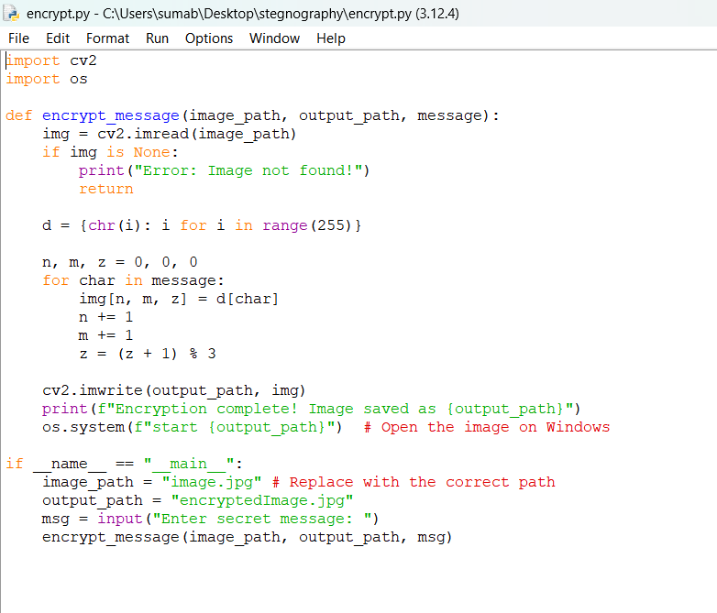
Results
Encryption code

Slide 8
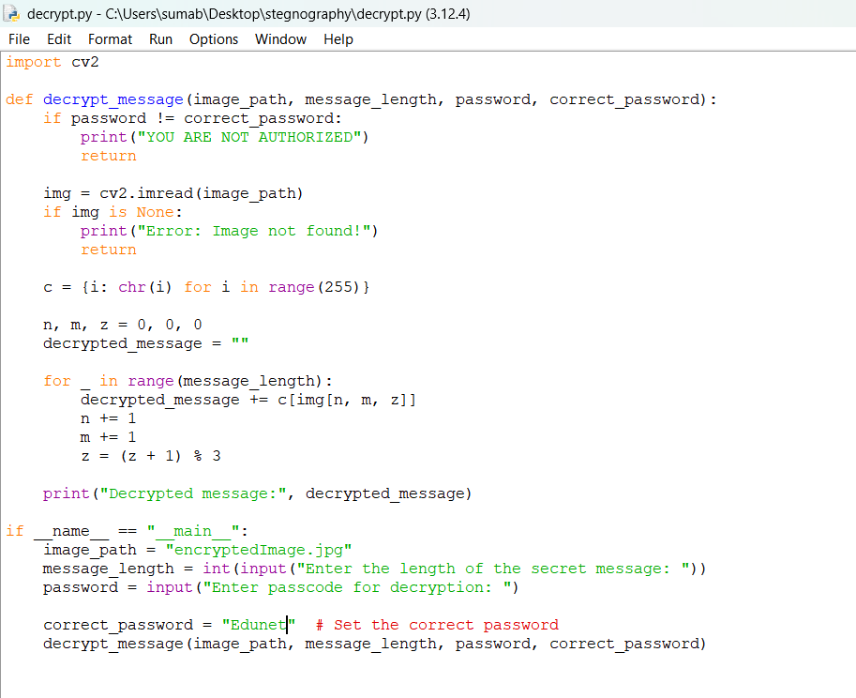
Decryption code

Slide 9
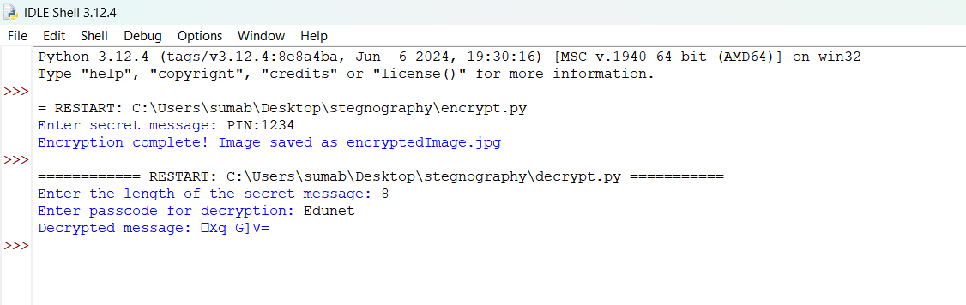
Output

Slide 10

Encrypted image

Slide 11
Conclusion
Steganography offers a powerful approach to secure data hiding by embedding information within images without raising suspicion.
This project enhances security, imperceptibility, and robustness, making it suitable for confidential communication, watermarking, and cybersecurity applications.
The proposed method ensures minimal image distortion while maintaining high embedding capacity and resistance to attacks. With increasing threats to data privacy, this technique provides a reliable solution for secure information exchange.
Future advancements can extend its application to videos, audio, and AI-driven steganographic methods for even greater security.

Slide 12
GitHub Link
https://github.com/suma3100/DATA-HIDING_USING_STEGANOGRAPHY.git

Slide 13
Future scope(optional)
Advanced Steganographic Techniques – Implement AI/ML-based steganography for adaptive and intelligent data hiding.
Higher Security & Encryption – Integrate cryptographic methods with steganography for dual-layer protection.
Extension to Other Media – Apply the technique to videos, audio, and 3D images for broader applications.
Cloud & IoT Integration – Secure data transmission in cloud storage and Internet of Things (IoT) networks.
Resilience Against Attacks – Improve robustness against steganalysis, compression, and noise-based attacks.
Quantum Steganography – Explore quantum computing for next-gen secure data hiding methods.

Slide 14
THANK YOU

