Slide 1
DATA ANALYTICS AND VISUALIZATION | SPORTS
OLYMPIC PREDICTIVE
ANALYTICS
Turning Olympic history into clear patterns, useful insights, and medal forecasts.
Power BI dashboard • Random Forest predictions • KDD process
Project presentation

Slide 2
The Problem
Historical data tells us what happened—but analysis can help explain patterns and support forecasts.
A large history
Many influences
Need for insight
Olympic records cover countries, athletes, sports, events, and medal results.
Participation, sport mix, host advantage, and changes between editions may affect results.
A useful tool should make comparisons easier and provide forecasts—not just show old totals.
Project challenge
Build an interactive platform that explores historical Olympic performance, examines possible relationships, and estimates country-wise and sport-wise medal outcomes.
OLYMPIC PREDICTIVE ANALYTICS | KDD-BASED PROJECT
02
02

Slide 3
Our Solution
One workflow: explore the past, look for patterns, then present predictions clearly.
1. Explore
2. Model
3. Communicate
Use Power BI pages to review medal totals, years, countries, sports, and athlete participation.
Use a Random Forest model to estimate medal counts from the prepared data.
Show country-level and sport-level results in charts and tables that users can filter.
What the application adds
• A consistent view of historical performance.
• Side-by-side comparisons between countries and sports.
• A clear way to inspect forecasts instead of relying only on past medal totals.
OLYMPIC PREDICTIVE ANALYTICS | KDD-BASED PROJECT
03
03

Slide 4
Project Objectives
The goals that guide the analysis and the dashboard.
Review history
Explore medal trends across Olympic editions.
Compare countries
Compare medal performance by region.
Study possible factors
View athlete participation alongside medal totals.
Forecast outcomes
Estimate country-wise and sport-wise medal counts.
Make results usable
Present results in a clear, interactive report.
OLYMPIC PREDICTIVE ANALYTICS | KDD-BASED PROJECT
04
04

Slide 5
Method: The KDD Process
KDD means Knowledge Discovery in Databases: a step-by-step path from raw data to useful knowledge.
1. Selection
2. Preprocessing
3. Transformation
Choose relevant Olympic records and fields.
Check missing values, inconsistent labels, and data quality.
Prepare fields and summaries in a form suitable for analysis.
4. Data mining
5. Pattern recognition & evaluation
6. Knowledge
Apply a Random Forest model to learn patterns from the prepared data.
Review trends, compare results, and assess model errors.
Turn the patterns into understandable findings and decision support.
Important: KDD is iterative. Findings can lead to better data preparation or a revised model.
OLYMPIC PREDICTIVE ANALYTICS | KDD-BASED PROJECT
05
05

Slide 6
Data and Preparation
The report uses historical Olympic information to compare medal results, participation, countries, and sports.
Main data themes
Preparation goal
Prediction inputs
Medal counts • Olympic year • Region/country • Sport • Athlete participation and sex
Make fields consistent and connect the tables so filters and visuals show related information.
Use prepared historical information to create country-wise and sport-wise medal estimates.
Data quality matters
Missing values, changes in country names, event changes, and the choice of training years can affect results. These checks should be documented as part of the KDD process.
OLYMPIC PREDICTIVE ANALYTICS | KDD-BASED PROJECT
06
06

Slide 7
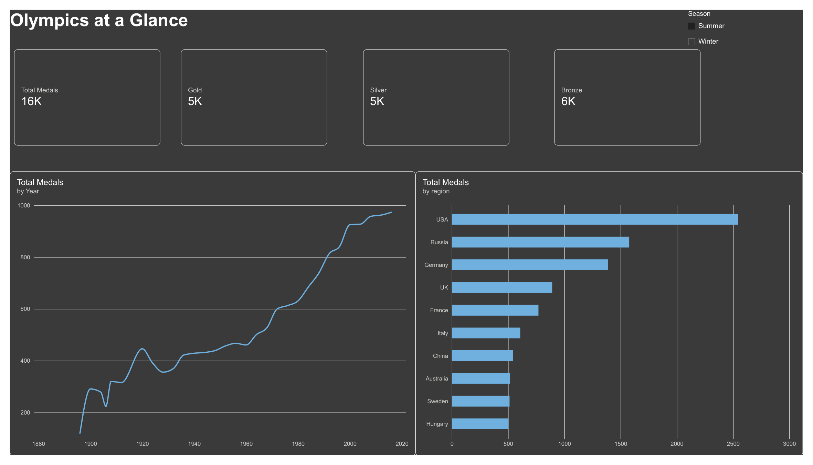
Dashboard 1 | Olympics at a Glance
The overview page gives a quick summary of medal totals and historical patterns.
What it shows
• Headline totals for medals and medal types.
• Total medals by Olympic year.
• Regions ranked by total medals.
• A Summer/Winter selector for exploring the report.
Use it to start the story: scale, trend, and leading regions.
OLYMPIC PREDICTIVE ANALYTICS | KDD-BASED PROJECT
07
07

Slide 8
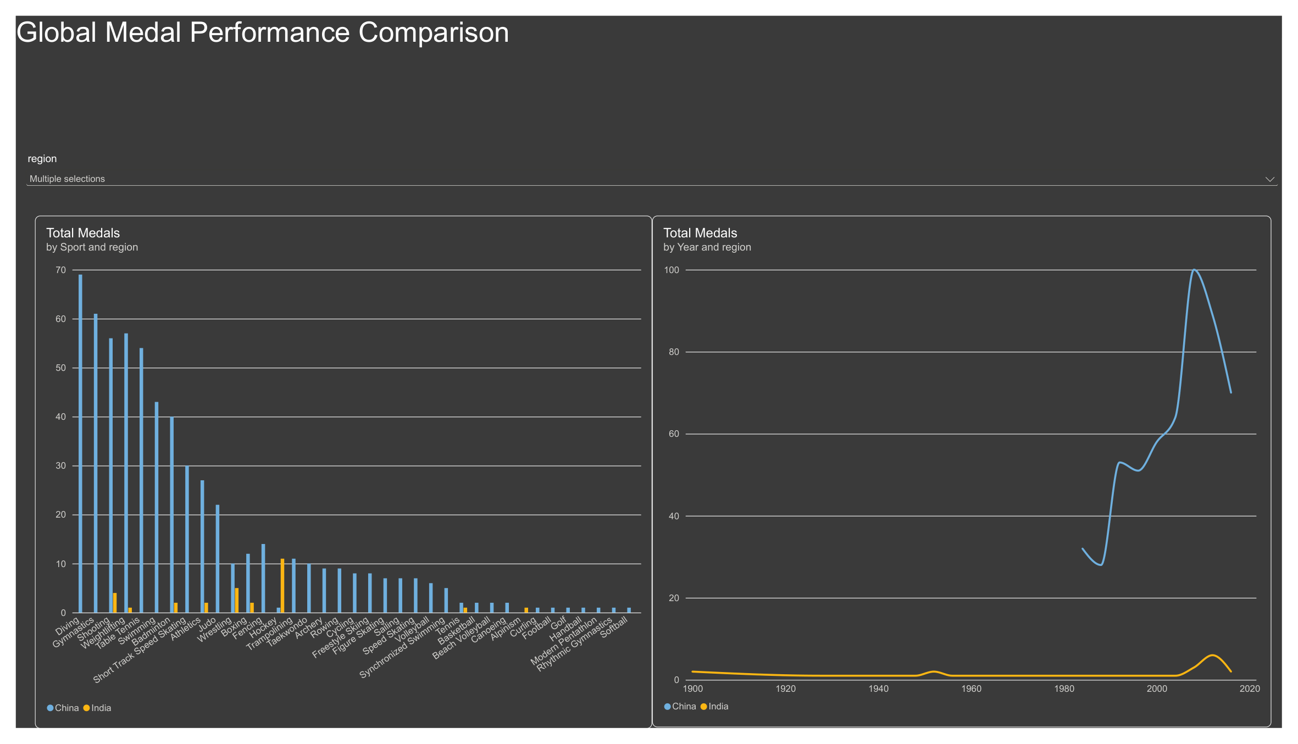
Dashboard 2 | Country Comparison
Compare medal totals by sport and review how results change over time for selected regions.
Questions it helps answer
• Which sports contribute medals for a selected region?
• How does medal performance change across years?
• How do selected regions compare across sports?
Filters make the comparison interactive rather than fixed.
OLYMPIC PREDICTIVE ANALYTICS | KDD-BASED PROJECT
08
08

Slide 9
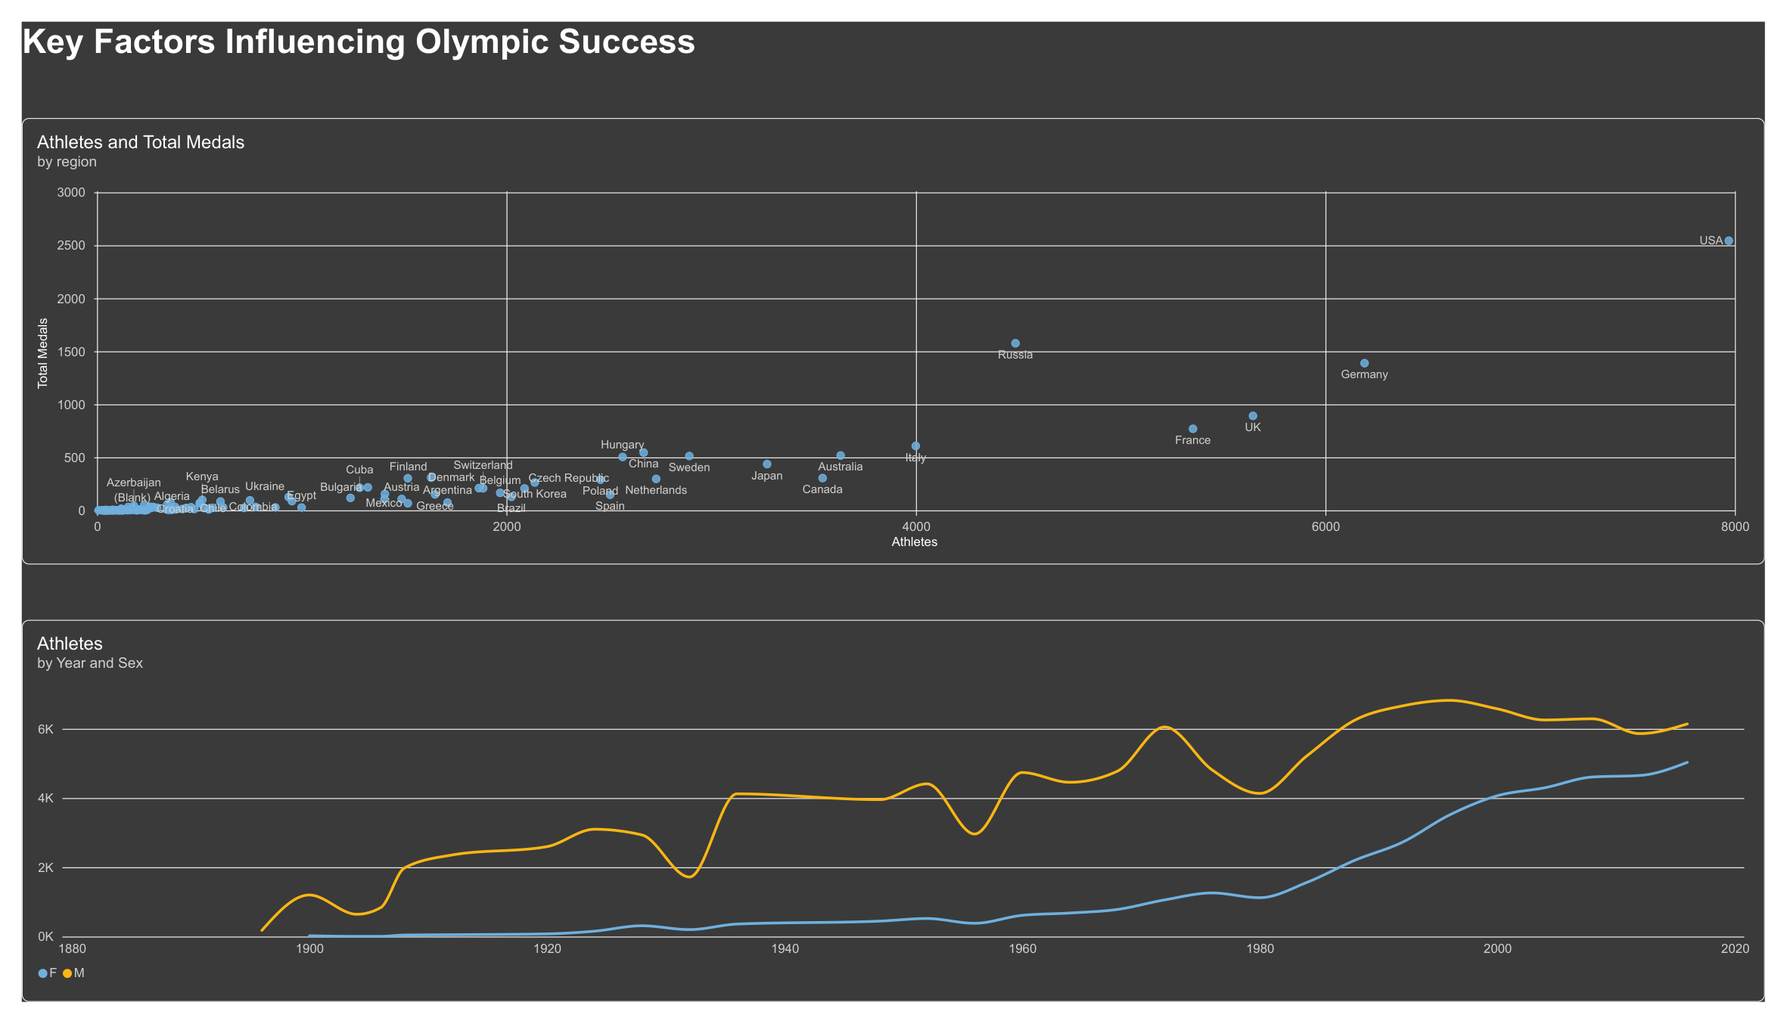
Dashboard 3 | Factors Linked to Performance
The page explores relationships in the historical data; it does not by itself prove cause and effect.
What to look for
• The relationship between athlete participation and medal totals.
• Differences in participation by year and sex.
• Countries that stand out from the overall pattern.
A visible relationship is a clue for further study—not proof that one factor causes another.
OLYMPIC PREDICTIVE ANALYTICS | KDD-BASED PROJECT
09
09

Slide 10
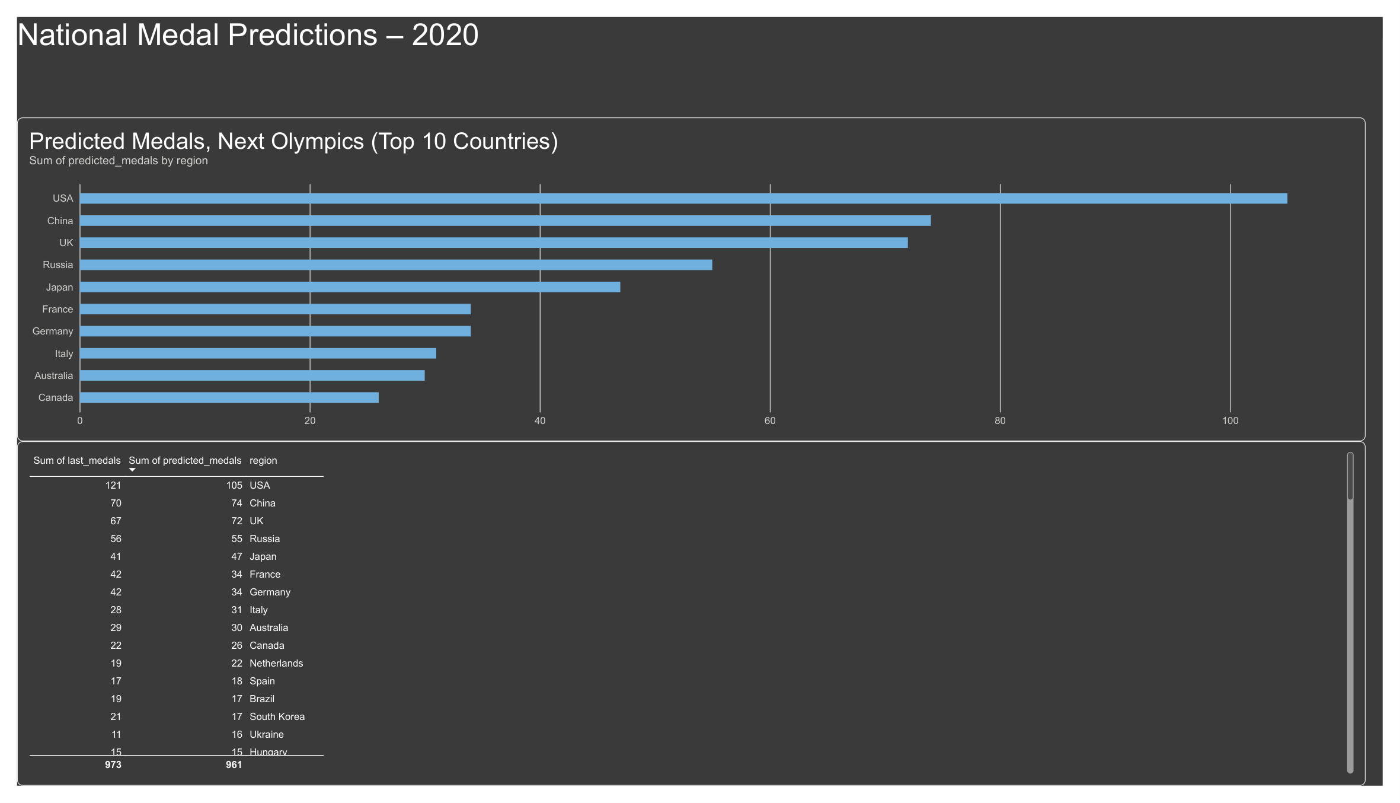
Dashboard 4 | Country-wise Medal Forecast
The page compares previous medal counts with the model's 2020 estimates.
Examples from the table
USA
121 previous medals → 105 predicted
China
70 previous medals → 74 predicted
Japan
41 previous medals → 47 predicted
These are model estimates shown in the supplied report, not guaranteed outcomes.
OLYMPIC PREDICTIVE ANALYTICS | KDD-BASED PROJECT
10
10

Slide 11
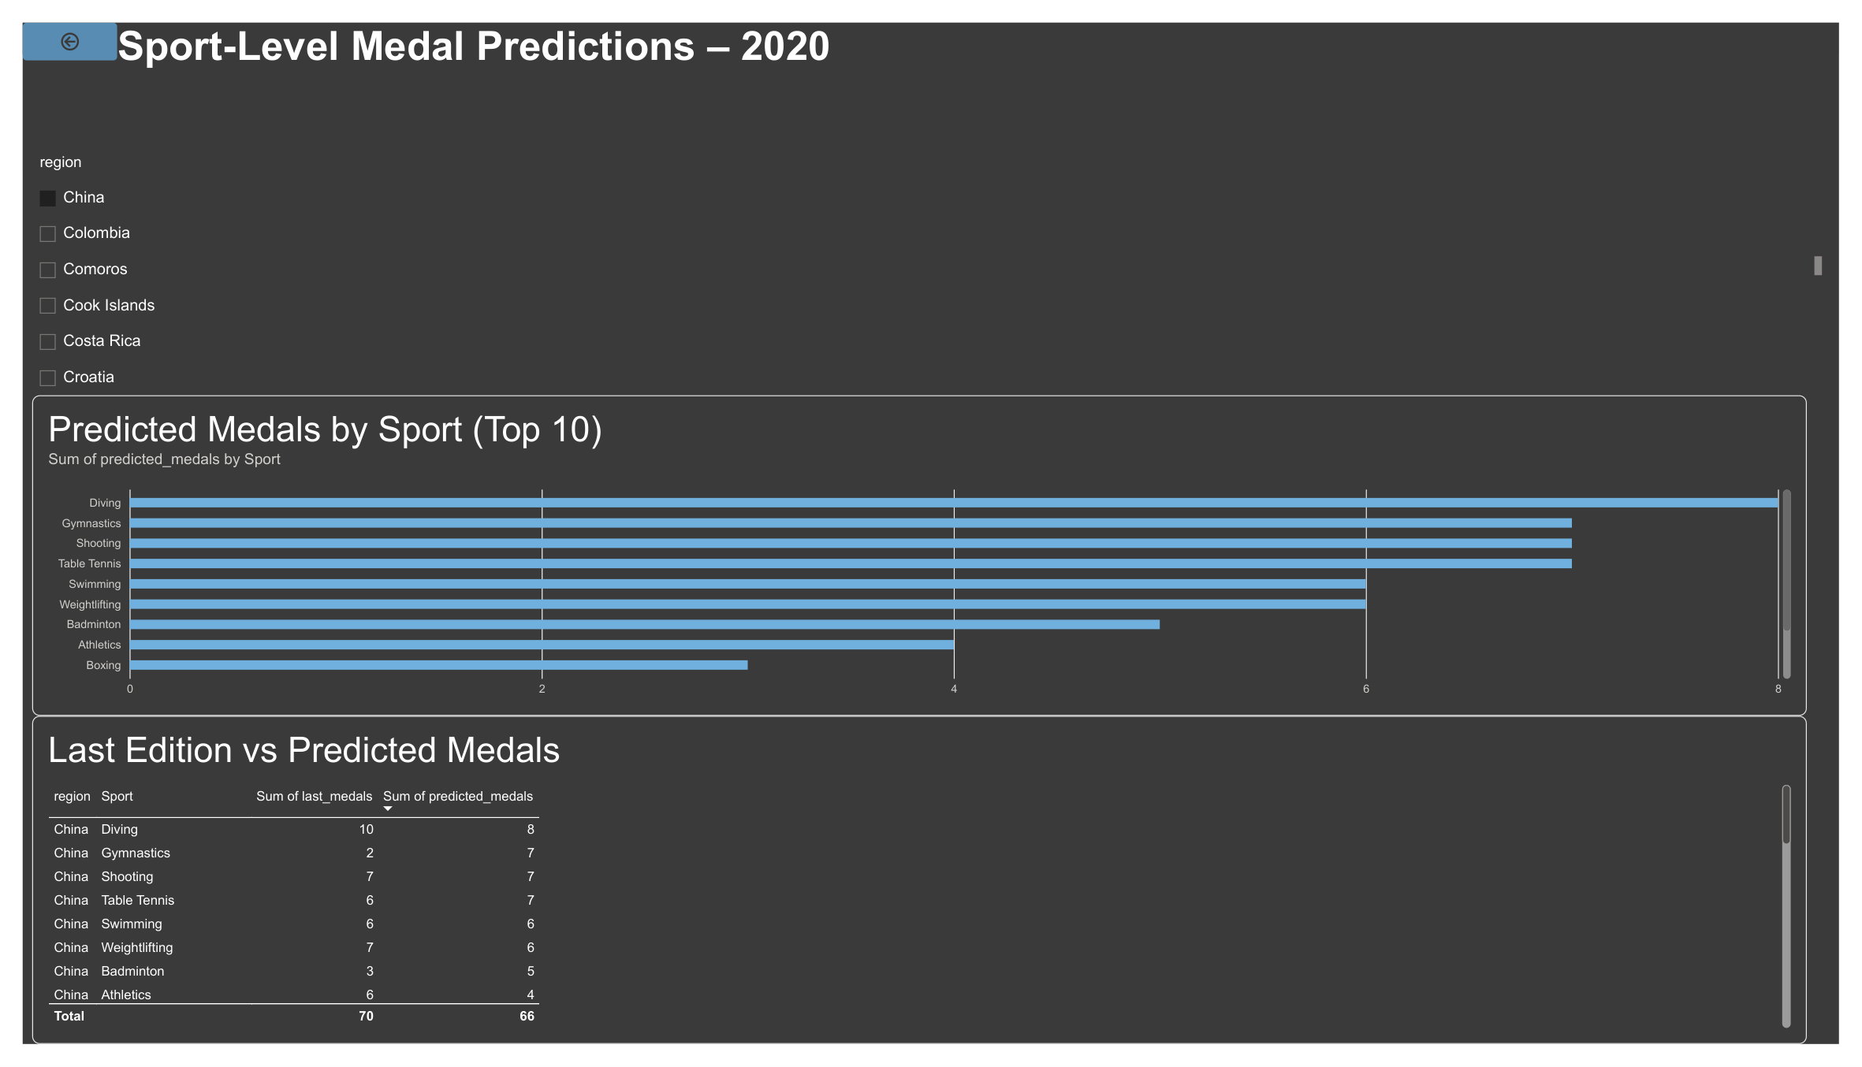
Dashboard 5 | Sport-wise Medal Forecast
Select a region to inspect the sports with the highest predicted medal counts.
Example: China
• Gymnastics: 2 previous → 7 predicted
• Shooting: 7 previous → 7 predicted
• Table Tennis: 6 previous → 7 predicted
• Diving: 10 previous → 8 predicted
The slicer lets users change the region and inspect that country's sport-level estimates.
OLYMPIC PREDICTIVE ANALYTICS | KDD-BASED PROJECT
11
11

Slide 12
From Pattern Recognition to Knowledge
This is the key KDD step: explain what the patterns mean and what users can do with them.
Pattern 1 | Country differences
Pattern 2 | Participation
Pattern 3 | Sport mix
The dashboard shows medal totals are not evenly distributed across regions.
Athlete counts and medal totals can be explored together to identify possible relationships.
A country's forecast differs by sport, so national totals can hide sport-level strengths and gaps.
Knowledge gained
• Country totals alone do not explain where medals may come from; sport-level views add detail.
• Participation is useful context, but it should not be treated as the only reason for success.
• Forecasts can support planning and discussion, but should be checked against actual outcomes and model error.
Knowledge is the interpreted insight—not simply the chart or the model output.
OLYMPIC PREDICTIVE ANALYTICS | KDD-BASED PROJECT
12
12

Slide 13
Why Power BI in Data Analytics?
Power BI helps people move from raw tables to an interactive view of the evidence.
Interactive
Visual
Connected
Slicers let users explore a report by country, season, or other available fields.
Charts and tables make comparisons and trends easier to spot.
A well-built data model lets related tables work together across visuals.
Shareable
Decision support
Works with models
Reports can be presented to teams and decision-makers in a common format.
Users can compare evidence and ask more focused questions.
Predictions made in Python can be brought into Power BI for exploration and communication.
Power BI is widely used in business intelligence because it combines data modelling, interactive reporting, and sharing. It supports analysis; it does not replace sound data preparation or statistical judgement.
OLYMPIC PREDICTIVE ANALYTICS | KDD-BASED PROJECT
13
13

Slide 14
Model, Evaluation, and Responsible Use
A forecast is useful only when its method and limits are understood.
Model shown
Evaluation
Time context
Random Forest is the stated approach for producing the medal predictions.
Use the model's measured error from the training notebook; do not treat a forecast as certain.
The report is labelled as a forecast for 2020, based on historical data through 2016.
Checks before presenting
• Explain which years were used for training and which period was held out for testing.
• Report the actual country-wise and sport-wise error values from the notebook.
• Compare forecasts with the real 2020 results only as a separate validation step; do not mix them into training data.
The supplied PDF does not show the sport-wise error value, so it is intentionally not invented here.
OLYMPIC PREDICTIVE ANALYTICS | KDD-BASED PROJECT
14
14

Slide 15
Conclusion
The project brings historical analysis, factor exploration, and medal forecasting into one interactive Power BI experience.
Understand
Compare
Plan
Review how Olympic performance has changed over time.
Explore differences between countries and sports.
Use forecasts as a starting point for questions and planning—not as promises.
Thank you
Questions and discussion
15

