Slide 1
Statistical Analysis of Automobile Data Under the guidance of :Prof. Xinyan Cao
OMIS 645
Group: 5
Lakshmi Suma Latha Gandham - Z1983150
Leela Sai Kiran Baru - Z1981392
Siruvuri Sai Ganesh Varma - Z2007457
Hasitha Sharon Sigatapu – Z1983992

Slide 2
Agenda
Introduction
About the Dataset
Statistical Analysis
Conclusion

Slide 3
INTRODUCTION
Consumer needs and technology improvements are the driving forces behind the continuous evolution of the automobile industry.
For manufacturers, dealers, and customers alike, it is essential to comprehend the connections between car attributes and critical performance measures.
This study provides a thorough statistical analysis of car data using methods including multiple linear regression models, t-tests, and ANOVA.
The objective is to obtain knowledge about variables impacting cost, fuel economy, and other important areas to guide industrial decision-making processes eventually.

Slide 4
About the Dataset
Dataset Overview: This is a comprehensive collection of automobile information covering various attributes crucial for analysis and modeling.
Attributes: key attributes such as make, fuel type, dimensions, engine specifications, and drive configuration, each providing unique insights into automobile characteristics.

Slide 5
Analysis 1 - ANOVA for Body Style and Highway Mileage
Objective: To determine whether a car body style has a statistically significant impact on the highway mileage.
Analysis Method: One-way ANOVA Test and pairwise comparisons
Key Findings:
Statistically significant difference in highway mileage between car body styles (p-value from Welch's ANOVA test < 0.05). Levene's test suggests homogeneity of variance assumption likely met (p-value > 0.05). The Car body style does have statistical significance effect on the highway mileage where the Hatchbacks offer the most most fuel efficiency.

Slide 6
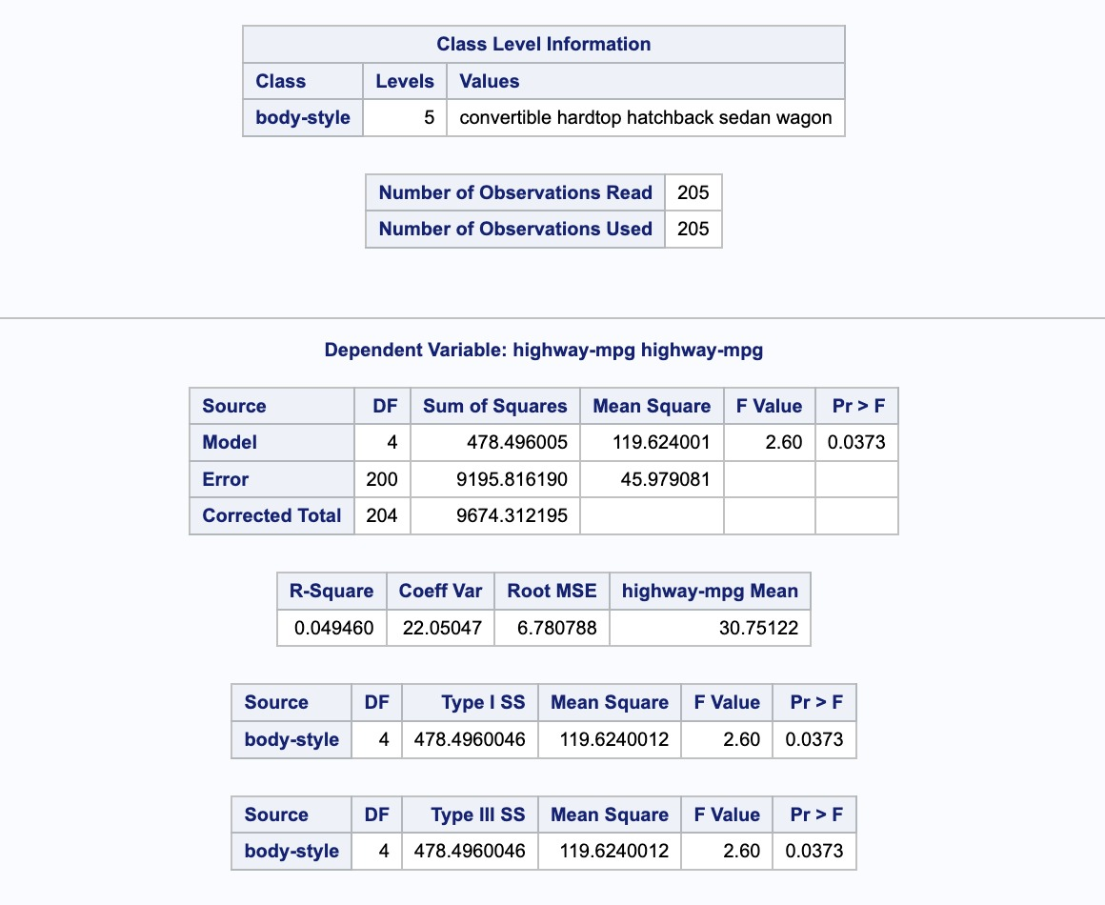

Slide 7
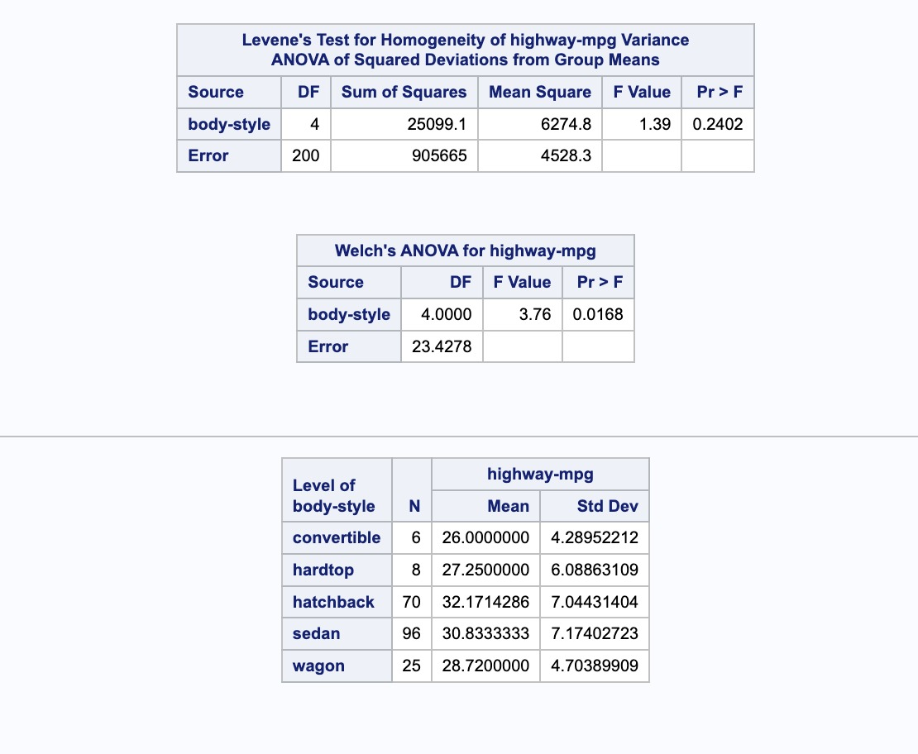
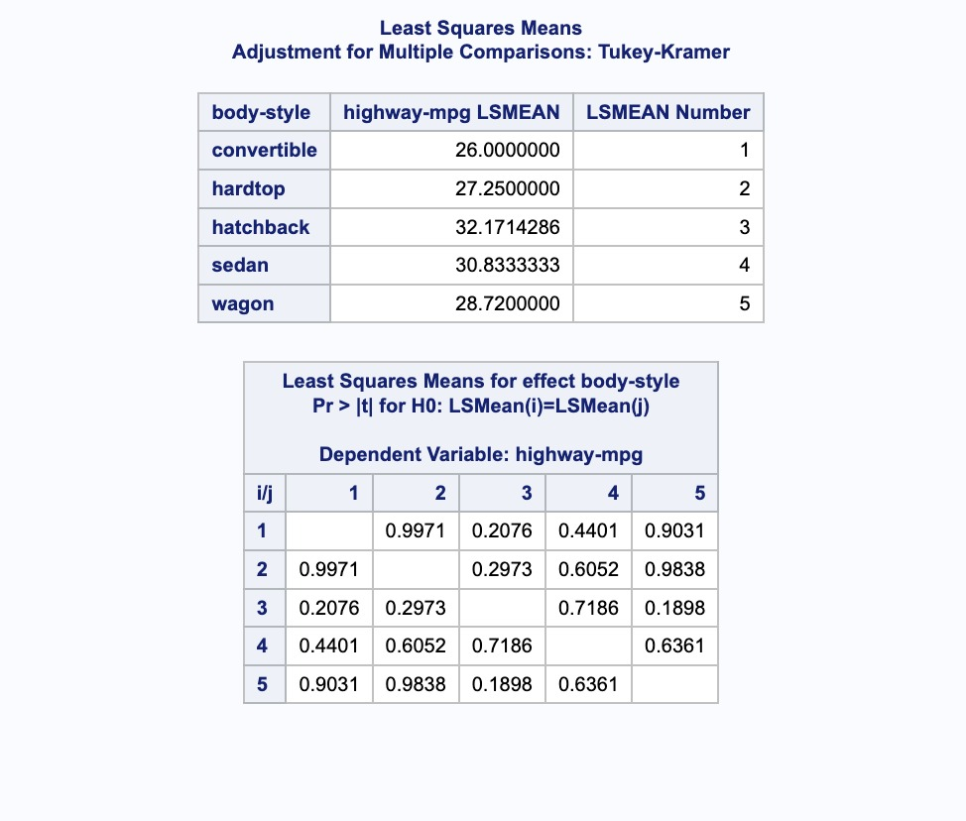

Slide 8
Analysis 2 - Regression for Highway MPG
Objective: Estimate highway MPG using the features of the car
Analysis Method: Multiple regression using Log Transformation
Key Findings:
Larger engine sizes are associated with higher highway and higher horsepower and curb weight are associated with lower highway MPG.
Relationships are all statistically significant
More powerful and heavier vehicles tend to have lower fuel efficiency.

Slide 9
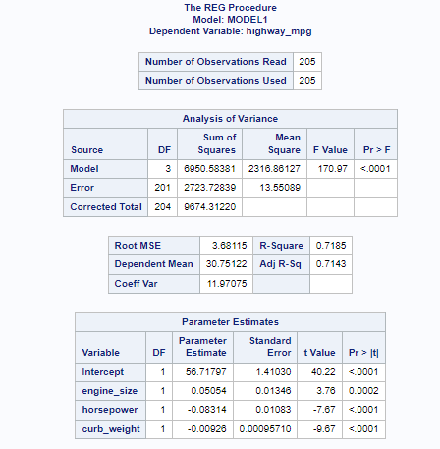
${\hat{Y}}_{i}$= 56.71797 + 0.05054 engine_size - 0.08314 horsepower - 0.00926 curbweight

Slide 10
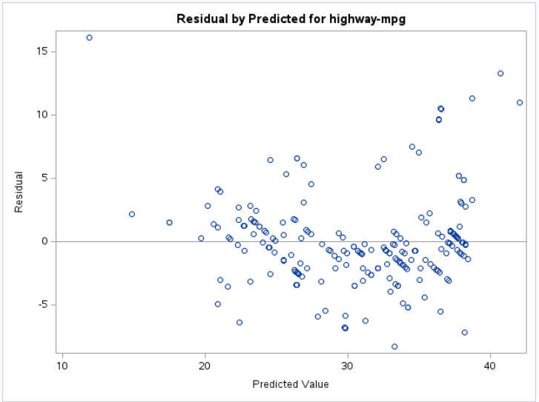
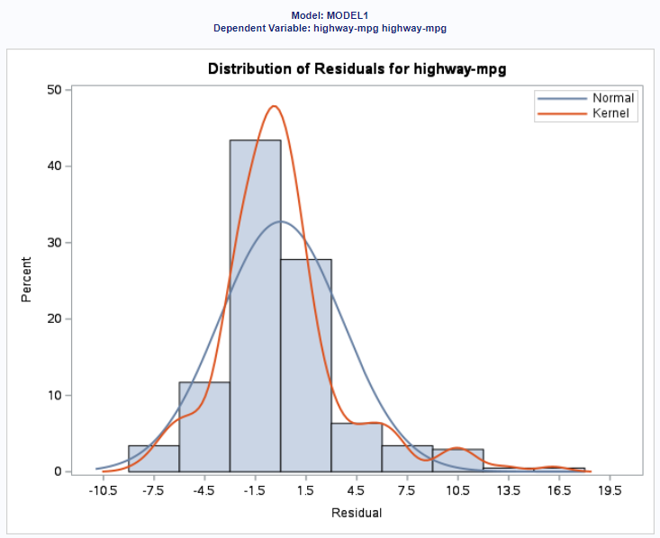
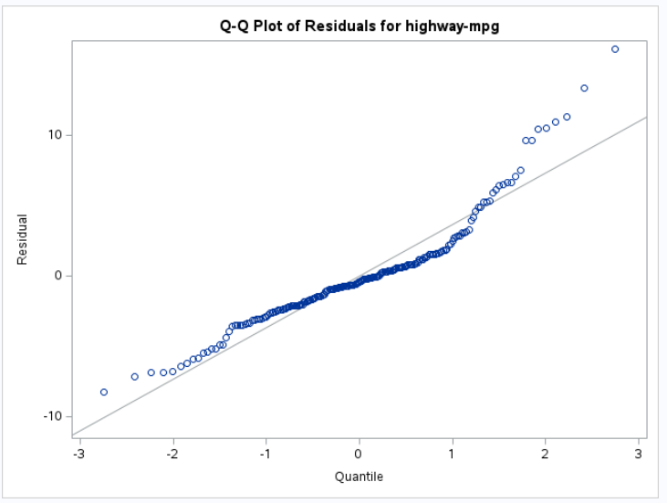

Slide 11
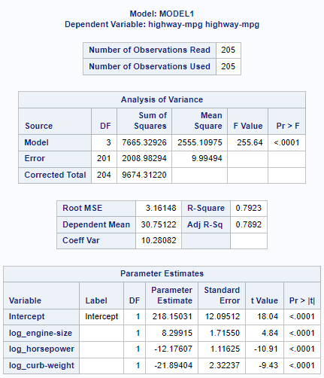
${\hat{Y}}_{i}$= 218.15031 + 8.29915 log_engine-size – 12.17607 log_horsepower – 21.89404 log_curb-weight

Slide 12
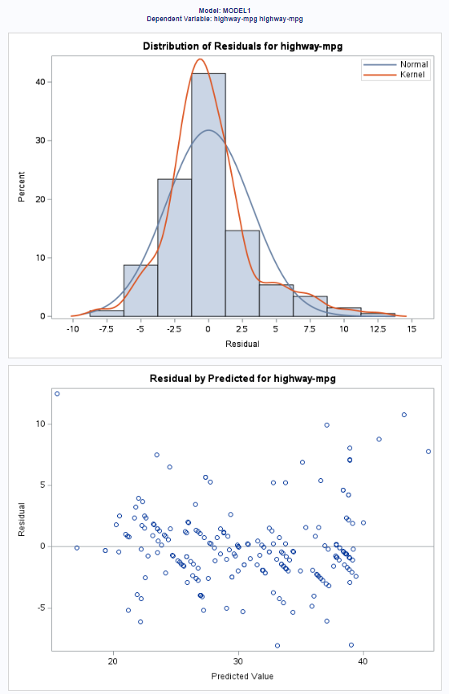
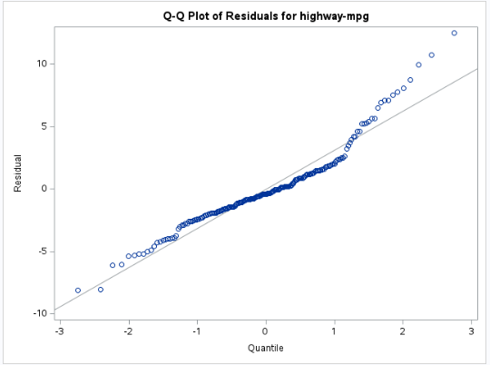

Slide 13
Analysis 3 - Regression for Price
Objective: Determine car costs based on features
Analysis Method: Multiple regression
Key Findings: The model accounts for 75.11% of the range in car pricing.
Higher horsepower and larger engine sizes are correlated with higher costs.
In general, gas-powered cars are less expensive than the reference class.
There are statistically strong correlations between engine size, horsepower, and fuel type (gas).

Slide 14
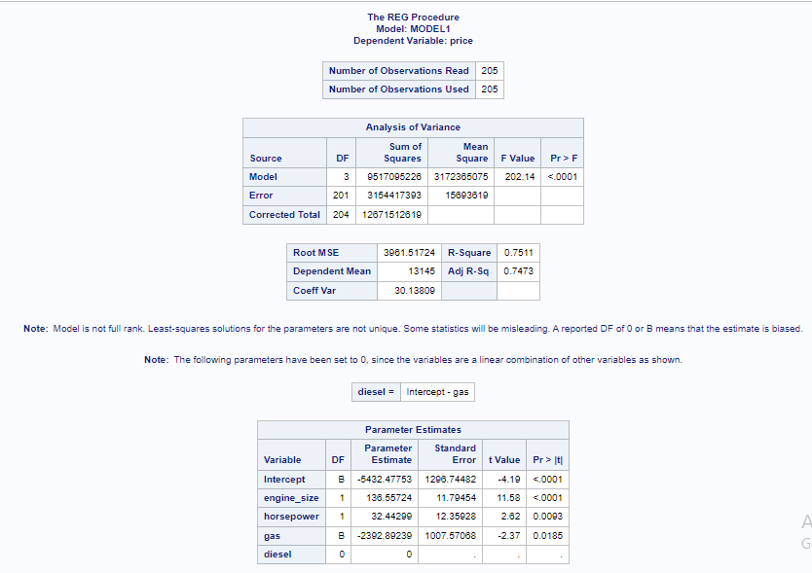
${\hat{Y}}_{i}$= -5432.47753 + 136.55724 engine_size + 32.44299 horsepower - 2392.89239 gas

Slide 15
Analysis 4 – Moderation Analysis
Objective: Determine if horsepower moderates the relationship between curb weight and price?
Analysis Method: Moderation Analysis
Key Findings: A statistically significant model was created to explain the variation in the dependent variable. (R-square = 0.7218) Horsepower has a negative relationship with the dependent variable. (Coefficient = -83.9557, p-value = 0.0392) Curb weight has a positive relationship with the dependent variable. (Coefficient = 4.7039, p-value = 0.0032) The interaction between horsepower and curb weight is statistically significant, suggesting a moderation effect. (Coefficient = 0.0468, p-value = 0.0006)

Slide 16
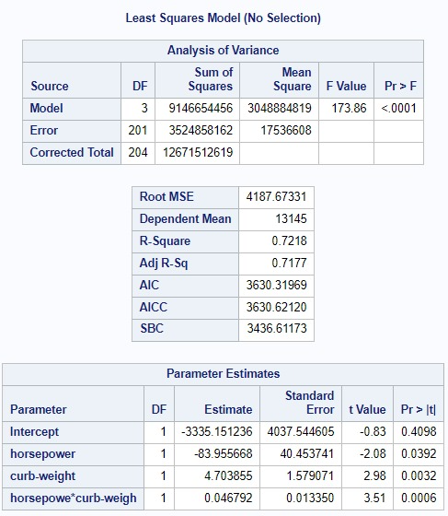
${\hat{Y}}_{i}=−3335.151236 −83.955668 horsepower+4.703855 curbweight+0.046792 (horsepower X curbweight)$

Slide 17
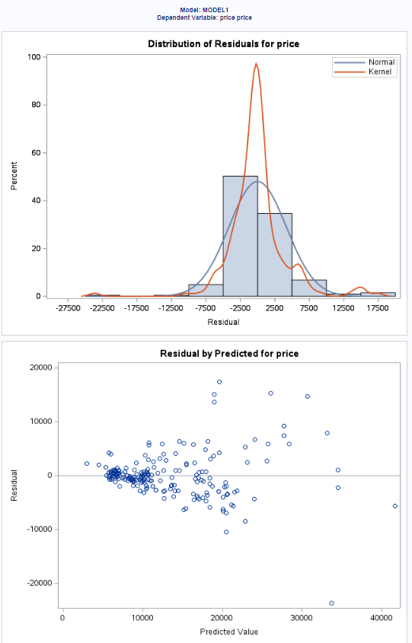
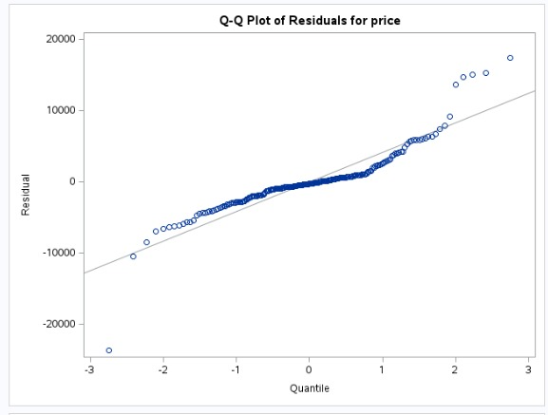

Slide 18
CONCLUSION
In conclusion, this statistical analysis of automobile data has offered valuable insights into the precise correlations between vehicle characteristics and essential performance metrics.
Using advanced analytics, we've identified strong connections between engine size, horsepower, curb weight, fuel type, highway miles per gallon, and pricing.
These findings have broad implications for automakers, allowing them to fine-tune design and pricing strategies to match fuel efficiency and affordability consumer preferences.
Moreover, consumers can utilize these insights to make informed decisions when choosing vehicles that best match their individual needs and preferences.

Slide 19


Slide 20


