Slide 1
NEXT GENERATION FINANCIAL THREAT DETECTION SYSTEM
Submitted By: Team-3
Date: 16/03/2026

Slide 2
Table of contents
Introduction
Literature survey
Area & Problem Statement
Aim & Objective
Methodology
System Architecture
Implementation
Technologies & Algorithms Used
Outcomes
Results
Conclusion

Slide 3
Introduction
The rapid growth of digital banking and online payment systems has increased the number of financial transactions worldwide.
Along with this growth, financial fraud such as unauthorized transactions, identity theft, and cyber-attacks has also increased.
Traditional fraud detection systems mainly use rule-based methods, which are not effective in detecting new fraud patterns.
Machine Learning provides an intelligent approach to analyse transaction data and identify suspicious activities automatically.
This project proposes a Next Generation Financial Threat Detection System that uses machine learning techniques to detect fraudulent financial transactions and improve financial security.

Slide 4
Literature Survey
Paper Title | Year | Pros | Cons | Research Gap (Why Our project is needed)
Credit Card Fraud Detection with Subspace Learning-based One-Class Classification | 2023 | Handles highly imbalanced datasets and improves detection of rare fraud cases. | Limited evaluation in real-world financial transaction environments. | Does not incorporate user behavior analysis or multi-source data.
Enhancing Credit Card Fraud Detection using Neural Network and SMOTE | 2024 | Improves detection accuracy by balancing datasets using SMOTE technique. | Oversampling methods may generate synthetic data that does not reflect real fraud patterns. | Does not address dynamic fraud detection and online transaction monitoring.
Securing Transactions: Hybrid Ensemble ML Model for Fraud Detection | 2024 | Uses hybrid ensemble models combining several ML algorithms to improve accuracy. | High model complexity and difficult deployment in large-scale systems. | Needs scalable architecture and real-time fraud prediction capabilities.
Heterogeneous Graph Auto-Encoder for Credit Card Fraud Detection | 2024 | Uses Graph Neural Networks to capture relationships between transactions, users, and merchants. | Graph models require large structured datasets and complex computation. | Lack of integration with user behavioral analytics and explainable Al systems.
A Comparative Study of ML Models for Credit Card Fraud Detection | 2025 | Compares multiple ML models such as SVM, Random Forest, and Neural Networks. | Focuses on model comparison rather than building a full fraud detection system. | Lacks a practical framework for real-time fraud monitoring.

Slide 5
Area & Problem Statement:
Area of the Project:
This project falls under the fields of Machine Learning, Data Science, and Financial Technology (FinTech). It focuses on using machine learning algorithms to analyze financial transaction data and detect fraudulent activities in digital payment systems such as online banking, credit cards, and mobile payments.
Problem Statement:
Traditional fraud detection systems are rule-based and depend on predefined conditions. These systems cannot easily detect new fraud patterns. Therefore, an intelligent system is required that can analyze transaction data and identify suspicious activities automatically.

Slide 6
Aim & Objectives
Aim:
To develop a Next Generation Financial Threat Detection System using machine learning techniques to identify and prevent fraudulent financial transactions across digital payment platforms.
Objectives:
To analyze financial transaction data to identify patterns related to fraudulent activities.
To develop a machine learning model capable of detecting suspicious transactions.
To improve the accuracy and efficiency of fraud detection systems.
To reduce financial losses by identifying fraudulent activities at an early stage.
To design a system that can support secure digital banking and online payment systems.

Slide 7
Methodology
Data Collection Financial transaction datasets are collected from reliable sources such as public datasets or banking transaction records.
Data Preprocessing The collected data is cleaned by handling missing values, removing duplicates, and normalizing the data to improve model performance.
Feature Selection Important features such as transaction amount, time, location, and user behaviour are selected to help identify fraud patterns.
Model Development Machine learning algorithms such as Logistic Regression, Random Forest, or XGBoost are applied to train the fraud detection model.
Model Evaluation The performance of the model is evaluated using metrics like accuracy, precision, recall, and F1-score.
Fraud Detection System The trained model is used to classify transactions as fraudulent or legitimate to help financial institutions detect suspicious activities.

Slide 8
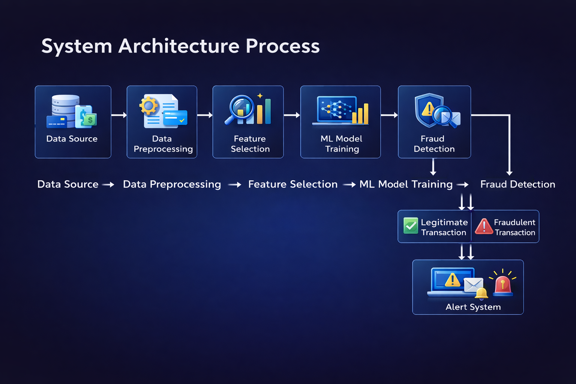
System Architecture

Slide 9
Implementation
Data Collection Financial transaction data is collected from publicly available datasets such as Kaggle or simulated banking transaction datasets.
Data Preprocessing The dataset is cleaned by handling missing values, removing duplicates, and normalizing numerical features to prepare the data for model training.
Feature Engineering Important features such as transaction amount, time, location, and user behaviour patterns are selected to improve fraud detection accuracy.
Model Training Machine learning algorithms such as Logistic Regression, Random Forest are used to train the fraud detection model.
Model Evaluation The trained model is evaluated using performance metrics like Accuracy, Precision, Recall to measure its effectiveness in detecting fraudulent transactions.
Fraud Detection System The final model is deployed to analyze new transactions and classify them as legitimate or fraudulent, helping financial institutions detect suspicious activities.

Slide 10
Technologies & Algorithms Used
Technologies Used:
Python – Programming language used for developing the system
Pandas – Data preprocessing and data analysis
NumPy – Numerical computations and array operations
Scikit-learn – Machine learning model development
Matplotlib / Seaborn – Data visualization
Algorithms Used:
Logistic Regression – Used for classification of transactions
Random Forest – Used for accurate fraud detection
User Interface:
Streamlit

Slide 11
Outcomes
Automated fraud detection – the system automatically identifies whether a transaction is fraudulent or legitimate using machine learning.
Fraud probability prediction – displays the fraud probability percentage for each transaction.
Interactive dashboard – provides a real-time dashboard showing total transactions, fraud transactions, and fraud rate.
Transaction data visualization – graphs such as transaction activity and fraud vs legitimate distribution help analyze transaction patterns.
Multi-currency transaction support – the system accepts transactions in different currencies and converts them to INR for analysis.
Fraud monitoring and reporting – displays fraudulent transactions in a report table and allows downloading the fraud report.
User-friendly interface – built using streamlit for easy interaction and real-time analysis.

Slide 12
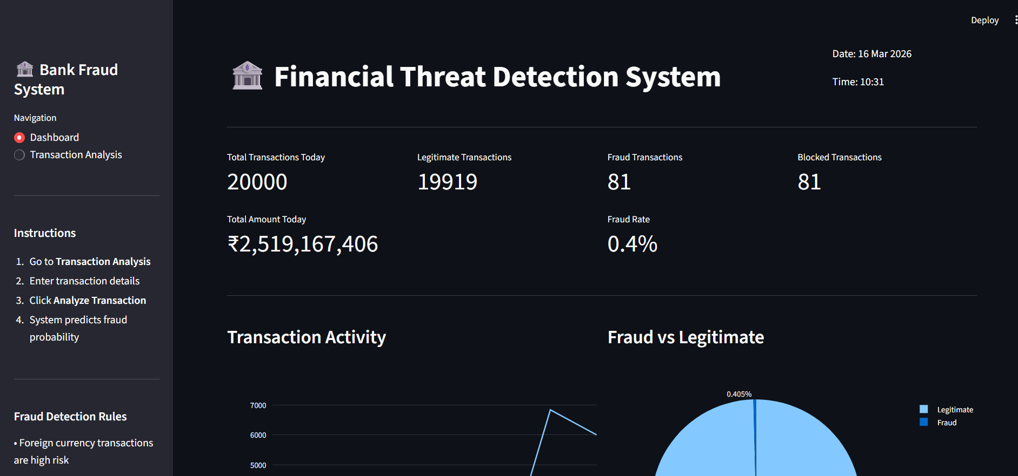
Results: Dashboard

Slide 13
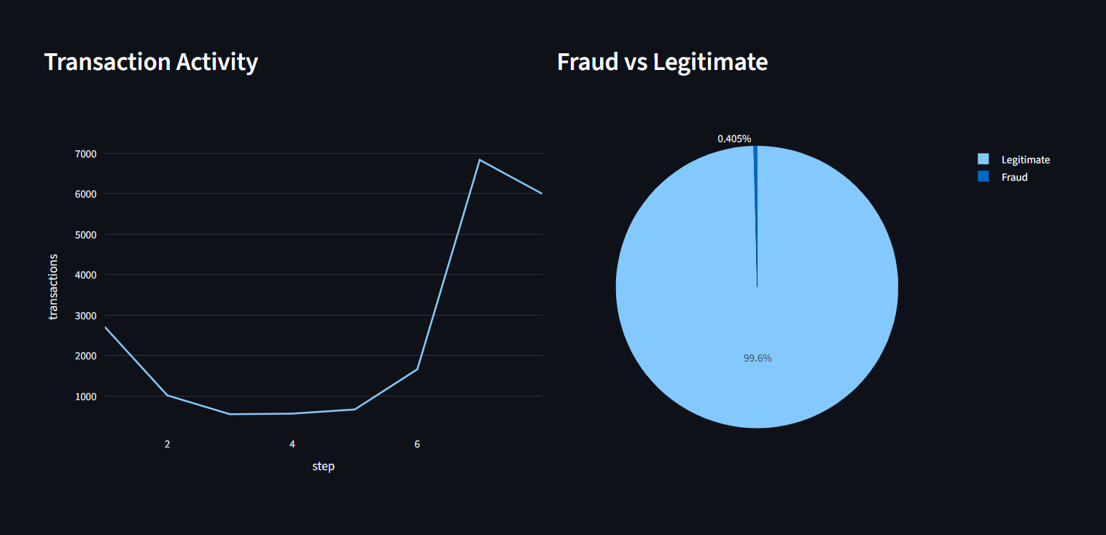
Graphs:

Slide 14
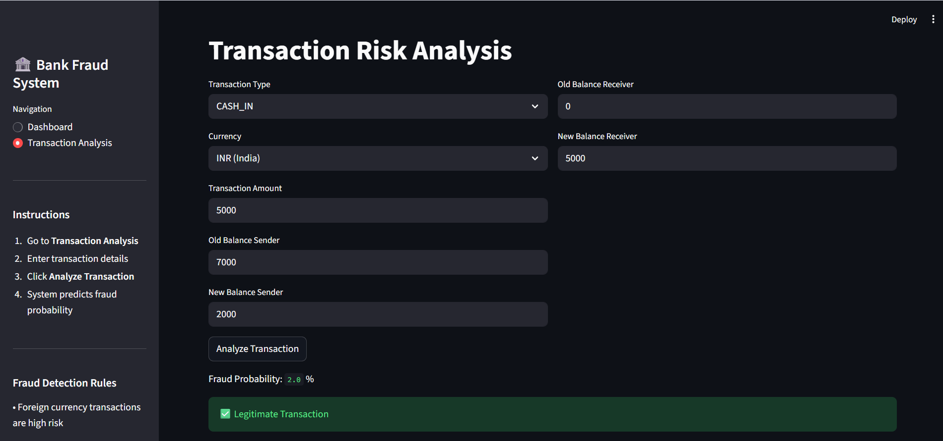
Transaction Analysis:

Slide 15
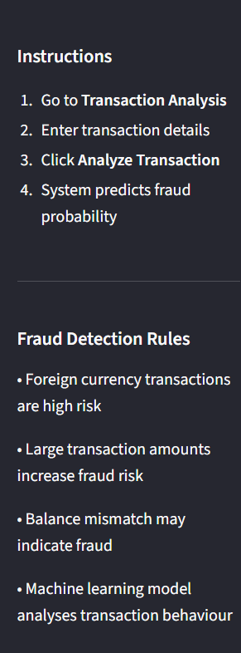
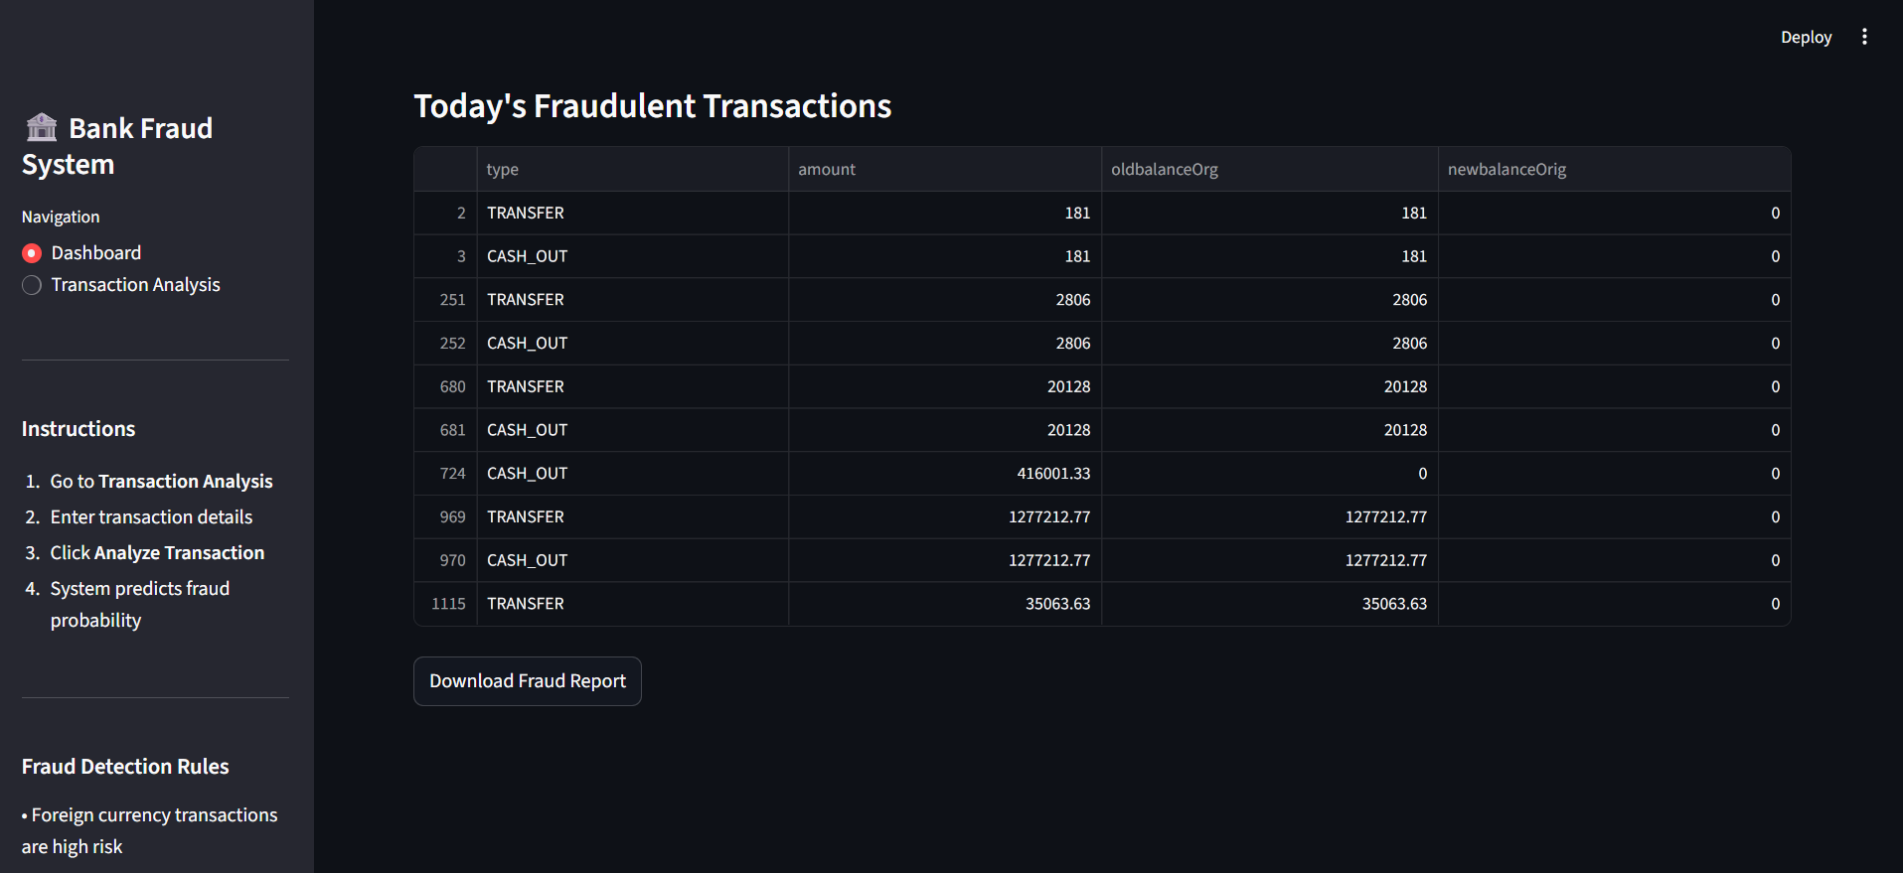
Instructions and Rules:

Slide 16
Conclusion:
The Financial Fraud Detection System demonstrates how machine learning can be used to identify fraudulent financial transactions effectively. The system analyses transaction details such as transaction type, amount, and account balances to detect suspicious patterns. It provides real-time predictions to classify transactions as fraudulent or legitimate through an interactive interface developed using Streamlit. Additionally, the system supports multi-currency transactions by converting different currencies into Indian Rupees before analysis. Overall, this project shows that machine learning can improve the efficiency and accuracy of fraud detection, helping enhance security and reduce financial risks in digital financial systems.

