Slide 1
Name: Sumaia Akter Anu
Department: Statistics
Institute: University of Barishal
Topic: Project on Covid-19 effect on Liver Cancer Prediction

Slide 2
Beyond the Virus: The Impact of COVID-19 on Liver Cancer Diagnosis and Care
A Data-Driven Analysis Using Machine Learning

Slide 3


Introduction
The COVID-19 pandemic disrupted healthcare systems globally, leading to delays in cancer diagnosis and treatment.
Primary liver cancer (HCC and ICC) requires timely diagnosis and multidisciplinary care, making it particularly vulnerable to such disruptions.

Slide 4
How did the COVID-19 pandemic impact the diagnosis and outcomes of liver cancer patients?
Delayed Diagnoses: Reduced referrals and cancellations of cancer screenings resulted in fewer newly diagnosed cases of liver cancer (HCC and ICC).
Treatment Delays: Postponed surgeries, chemotherapy, and other treatments worsened outcomes for liver cancer patients.
Increased Mortality: Delays in diagnosis and treatment likely contributed to higher cancer-related mortality rates during the pandemic.

Slide 5

Dataset overview
Source: Kaggle (Fedesoriano, 2022).
Time Period:
Pre-pandemic: March 2019–February 2020.
Pandemic: March 2020–February 2021.
Variables:
Patient demographics, diagnosis dates, treatment delays, and outcomes.
Inclusion Criteria:
Confirmed cases of HCC or ICC (radiological/histological evidence).

Slide 6
Methodology
1.Data Preprocessing:
Cleaned the dataset by handling missing values and removing duplicates.
Normalized numerical features to ensure consistent scaling.
Performed feature selection to identify the most relevant variables for analysis.

Slide 7
Methodology
2. Machine Learning Models:
Trained and evaluated five models:
Logistic Regression
K-Nearest Neighbors (KNN)
Decision Tree
Random Forest
Support Vector Machine (SVM)
Used default hyperparameters for initial evaluation.

Slide 8
Methodology
3. Evaluation Metric:
Accuracy was used as the primary metric to compare model performance.
4. Tools and Libraries:
Python programming language.
Libraries: Pandas (data manipulation), Scikit-learn (machine learning), Matplotlib and Seaborn (visualization).

Slide 9
Results - Model Performance
Accuracy Scores:
Logistic Regression: 84.44%
KNN: 88.89%
Decision Tree: 90.00%
Random Forest: 91.11% (Best Model)
SVM: 87.78%

Slide 10
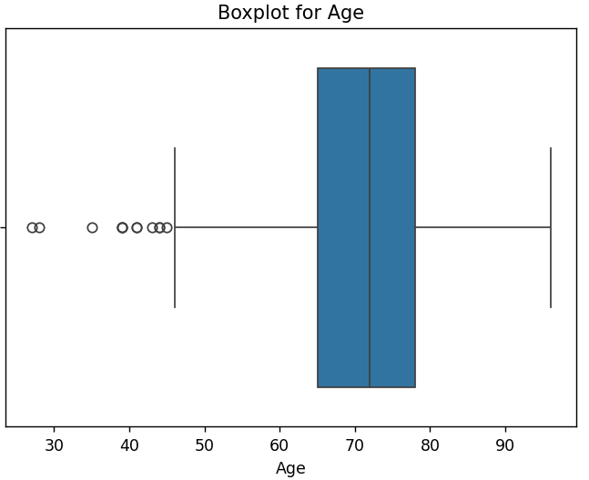
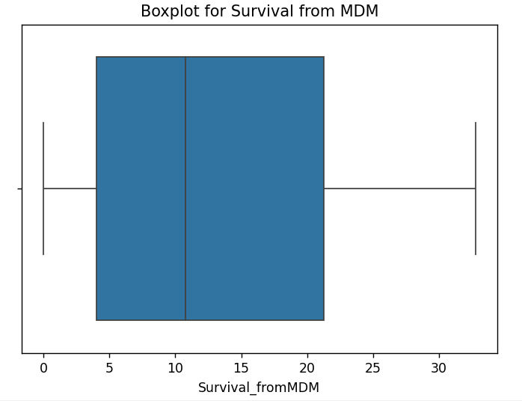
Visualization

Slide 11
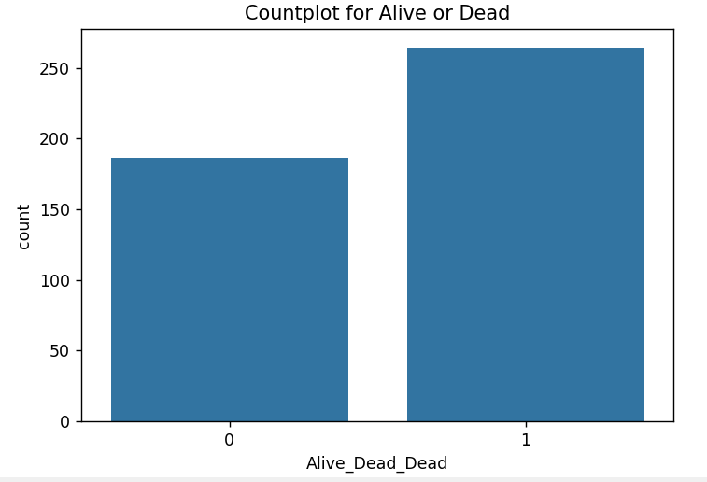
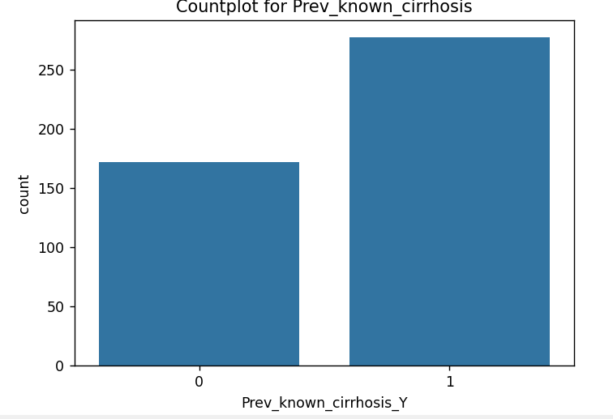
Visualization

Slide 12
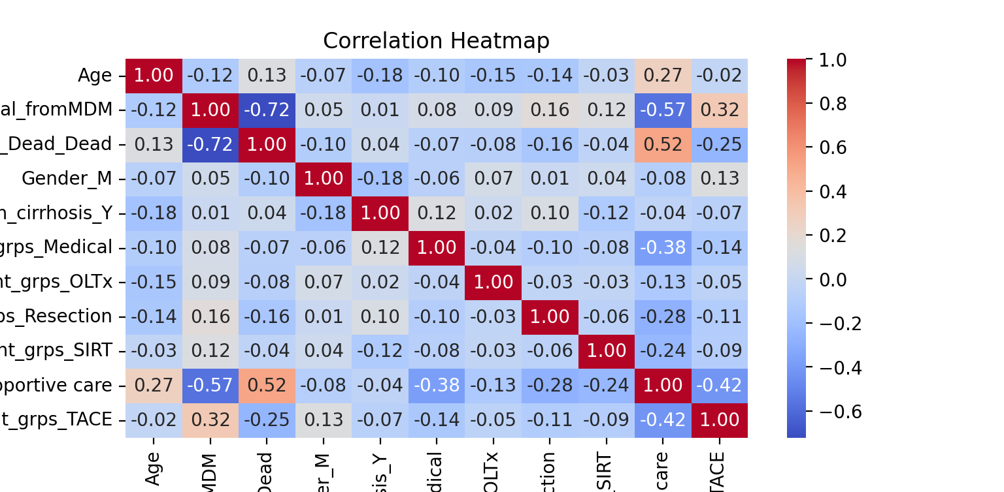
Correlation Analysis

Slide 13
Decision Tree Classification Report
Class | Precision | Recall | F1-score | Support
0 | 0.82 | 0.90 | 0.86 | 31
1 | 0.95 | 0.92 | 0.92 | 59
Accuracy |  |  | 0.90 | 90
Macro avg | 0.88 | 0.90 | 0.89 | 90
Weighted avg | 0.90 | 0.90 | 0.90 | 90

Slide 14
Conclusion
The COVID-19 pandemic significantly disrupted liver cancer care, leading to fewer diagnoses and delays in treatment.
The Random Forest model and decision tree model achieved the highest accuracy, demonstrating its effectiveness in analyzing this dataset.
Future Directions:
Expand the study to include multi-center data for broader insights.
Investigate long-term impacts of delayed diagnoses and treatments.

