Slide 1

Corporate Bankruptcy Prediction
Shaik sumair pasha

Slide 2




Agenda
About the Project
Corporate bankruptcy prediction with ensemble models
Features
Performance
Survey Results
Results
Performance of the ensemble models on the training data and test data.
Closing
Conclusion

Slide 3

About Corporate Bankruptcy Prediction
Introduction to Bankruptcy
Dataset Information
About Features
Development of the Model
Results and Conclusion

Slide 4

Introduction
Bankruptcy is the inability of a person or a business to pay their debts.
It involves the sale of property and some other arrangement to pay as much as possible of the money a person or business entity owe.
When a company declares bankruptcy, it’s a sign that it is no longer able to pay the debts as originally agreed and it can seriously damage the company’s credit history for more than 10 years.

Slide 5

Mission
To evaluate the performance and accuracy we rely on raw datasets.
64 features indication are considered to predict the bankruptcy.

Slide 6

DATASET INFORMATION
In the dataset there are 64 features indicating the financial health of the corporate entities and one feature to indicate whether an entity in a period of 3 years was bankrupted or not. The dataset contains observations year wise and there are 43405 observations spread over a period of 5 years. It is a supervised classification problem.

Slide 7

Feature Details
The dataset is available in 5 files with respect to year. We have to merge the data these five files into a dataset as a whole.
In preprocessing we often split the observations in 8:2 ratio where 80% is used for training and 20% is used for testing purpose. The performance of classifiers is measured using the confusion matrix.

Slide 8

Model Development
The aim of this project is to come up with a best classification model for predicting the bankruptcy of corporate entities. The following models can we used:
Logistic Regression
BERNOULLI NAÏVE BAYES
Neural Network
XgBOOST Classifier
SVM
LIGHTgBM CLASSIFIER

Slide 9
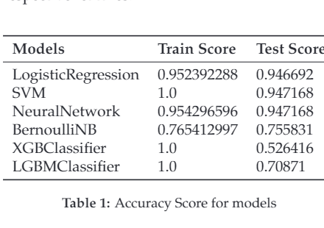
PERFORMANCE

Slide 10
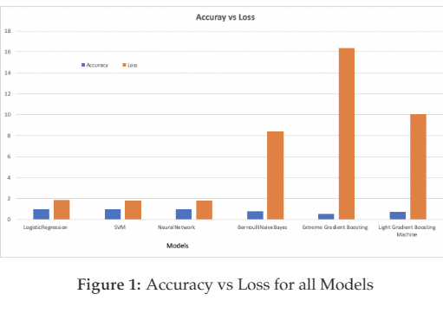
RESULT

Slide 11

CONCLUSION
The SVM, Logistic regression and Neural network performs very well in terms of accuracy on train data as well as on test data. Surprisingly, we observed that ensemble models performed well on train data but their accuracy on test data is very low.

Slide 12
Thank you
Questions?
SHAIKSUMAIRPASHA3030@GMAIL.COM

