Slide 1
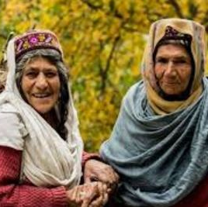
English to Burushaski Translation System
Group members
Chand Safi
Kainat
Sumaira Jahan
Shahina Nisar

Slide 2
Problem Statement "The Need for Burushaski Language Preservation"
Burushaski is a vulnerable language with limited resources
Lack of language documentation and translation tools
Risk of language extinction due to urbanization and cultural assimilation

Slide 3
Proposed Solution
Develop an NLP-based translation system using the existing vocabulary dataset
Create a sentence generation module to generate Burushaski sentences
Train a machine translation model using the generated sentences

Slide 4
Steps to Achieve the Solution
Data Preprocessing: Clean and preprocess the existing vocabulary dataset
Sentence Generation: Develop a module to generate Burushaski sentences using the preprocessed data
Machine Translation Model Training: Train a machine translation model using the generated sentences
System Integration: Integrate the translation model with a user-friendly interface
Testing and Evaluation: Test and evaluate the system using various metrics

Slide 5
Challenges
Limited dataset: The existing vocabulary dataset may not be sufficient for training a robust machine translation model
Linguistic complexity: Burushaski language has a complex grammar and syntax, making it challenging for machine translation.
Resource constraints: Limited computational resources and expertise may hinder the development of the system

Slide 6
Any Questions?

