Slide 1
✈
WAYFARER
AI Travel Planner Using Gemini Prompting Techniques
Comparing Zero-Shot, Few-Shot, and Structured Reasoning prompting on the same trip
Sumaira
AI & Data Science — SMIT
Assignment: Prompt Engineering — AI Travel Planner

Slide 2
OBJECTIVE
One trip, three prompting strategies
Build an AI Travel Planner on the Google Gemini API that turns a traveler's preferences into a day-by-day itinerary — then hold the trip constant and vary only the prompting technique, to see how Zero-Shot, Few-Shot, and Structured Reasoning change the result.
Analyze preferences
Interests, budget, days, and travel style all shape the plan
Suggest places to visit
Attractions matched to the traveler's interests
Day-by-day itinerary
Morning / afternoon / evening structure, every day
Stay within budget
Every recommendation respects the stated total budget
AI Travel Planner — Gemini Prompting Techniques
02

Slide 3
SCENARIO
What the traveler tells us
Field | Example value
Name | Alex
Destination | Dubai
Number of days | 4
Budget | $800
Interests | Food, Beaches, Shopping
Travel style | Family
Six fields drive the entire experience
The same six-field form feeds all three prompting techniques, so the comparison in this deck is apples-to-apples: identical trip, three different prompts.
Interests supported
Adventure · Food · Nature · Shopping · History · Beaches · Nightlife · Art & Culture
AI Travel Planner — Gemini Prompting Techniques
03

Slide 4
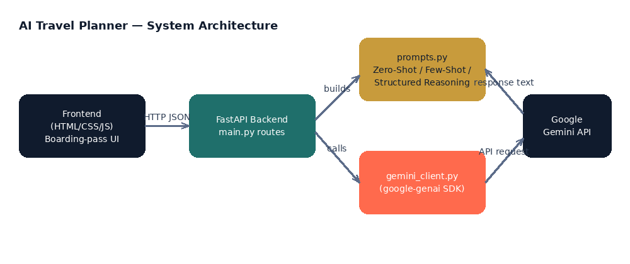
SYSTEM ARCHITECTURE
Full-stack, Python + web
AI Travel Planner — Gemini Prompting Techniques
04

Slide 5
01
Prompt skeleton
Zero-Shot
Prompting
Without referring to any prior examples, analyze the
traveler's preferences below, suggest suitable places to
visit, create a day-by-day itinerary, and recommend
activities that fit within the stated budget.
Traveler: Alex | Dubai | 4 days | $800
Interests: Food, Beaches, Shopping | Style: Family
No examples. Gemini gets a direct instruction and the raw trip details, and has to invent its own structure.
What we observed
Cheapest and fastest — the shortest prompt of the three
Output format varies more between runs; nothing anchors the structure
Good fit for quick, low-stakes drafts
AI Travel Planner — Gemini Prompting Techniques
05

Slide 6
02
Example travelers in the prompt
Few-Shot
Prompting
Sara
Bangkok · 3 days · $450
Food, Shopping · Solo
The Ahmed Family
Istanbul · 5 days · $1,500
History, Food · Family
Three worked example travelers, each with a full sample itinerary, come before the real request — so Gemini has a pattern to follow.
Jordan
Costa Rica · 6 days · $1,200
Adventure, Nature · Friends
What we observed
Most consistent output format of the three techniques
Longest, most expensive prompt — 3 full examples add tokens
Best when matching a specific house style matters
AI Travel Planner — Gemini Prompting Techniques
06

Slide 7
03
The 6-step internal checklist
1
Analyze the traveler's preferences
Structured
Reasoning
2
Consider the available budget
3
Consider the number of travel days
4
Select suitable attractions and activities
A 6-step checklist guides Gemini internally. It is told not to reveal that reasoning — only to return the plan with a short justification per day.
5
Create a day-by-day itinerary
6
Justify each day's main pick in one sentence
"Do NOT show your internal reasoning, step numbers, or working" — only a short "Why:" line per day.
What we observed
Visible, concise justification per day — no wall of reasoning text
More directly grounded in budget and day-count limits
AI Travel Planner — Gemini Prompting Techniques
07

Slide 8
COMPARATIVE ANALYSIS
Same trip, three outcomes
Aspect | Zero-Shot | Few-Shot | Structured Reasoning
Examples given | None | 3 travelers | None — 6-step checklist
Format consistency | Variable | High | High
Justification depth | Rarely explains why | Echoes example style | Explicit "why" per day
Prompt cost | Lowest | Highest | Medium
Best for | Quick drafts | Matching a house style | Transparent, justified picks
AI Travel Planner — Gemini Prompting Techniques
08

Slide 9
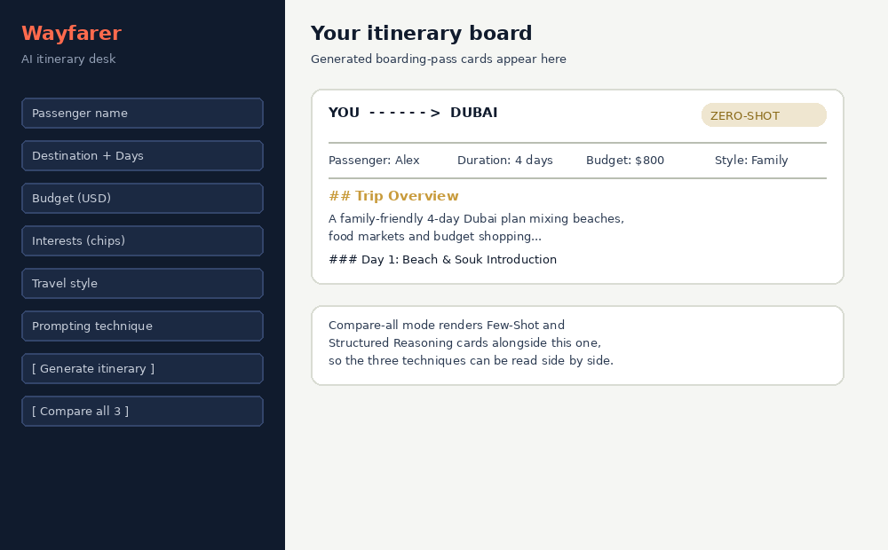
APPLICATION WALKTHROUGH
One form, boarding-pass results
AI Travel Planner — Gemini Prompting Techniques
09

Slide 10
BEYOND THE SPEC
Bonus features
Compare-all mode
View prompt used
Print / export
Run the same trip through all 3 techniques in one click
Every card can reveal the exact prompt sent to Gemini
Each boarding-pass card has a dedicated print stylesheet
Trip history
Full validation
Clean API design
Recent trips shown as a strip below the results
Frontend chips + backend Pydantic constraints on every field
4 documented REST routes, ready for grading or extension
AI Travel Planner — Gemini Prompting Techniques
10

Slide 11
Conclusion
Prompt design alone changes what a model delivers
Zero-Shot is the simplest, cheapest baseline. Few-Shot trades prompt length for format consistency. Structured Reasoning gives the best balance for this use case — itineraries that stay grounded in the traveler's budget and day count, with a short justification for every day's main pick.
Thank you
Sumaira · AI & Data Science — SMIT
AI Travel Planner — Gemini Prompting Techniques
11

