Slide 1
Marginalia
AI & Data Science | SMIT
1
Research Paper Assistant using RAG
Ask your papers. Every answer points to the page.
paper.pdf p. 4
Anushay Ayat
Notes:
Introduce the project: a research paper assistant that answers only from uploaded PDFs and always shows the source document and page.

Slide 2



Why papers need an assistant
Papers are long and dense
Plain chatbots guess
Answers must be checkable
Finding the method, dataset or limitation means scanning many pages across several papers.
A general LLM answers from memory, so it can invent details that the paper never states.
A useful answer shows exactly which document and page supports each claim.
Notes:
Three motivations: long papers, hallucinating chatbots, and the need for verifiable answers.

Slide 3


What is RAG?
Retrieve
Augment
Generate
Find the passages of the uploaded papers that are most similar to the question.
Put those passages into the prompt as numbered excerpts.
The LLM writes an answer using only the excerpts and cites them.
The model reads your papers at question time instead of relying on its memory.
Notes:
RAG = Retrieval-Augmented Generation. Retrieval gives the model evidence, generation turns evidence into a readable answer.

Slide 4

What the assignment asks for
Upload one or many research PDFs
Extract text, chunk, embed, store in a vector DB
Chat interface for questions
Retrieve context before answering
Show source document and page number
Handle empty, missing and invalid input
Answer only from the uploaded papers
Python, FastAPI, LangChain, ChromaDB, Gemini
Notes:
Every requirement from the brief is implemented; the next slides show how.

Slide 5





Technology stack
FastAPI
LangChain
ChromaDB
Gemini
HTML, CSS, JS
Python REST API: upload, list, delete, chat.
Text splitting, prompts and the Chroma integration.
Persistent vector store with cosine similarity.
Embeddings and answer generation.
Custom frontend served by FastAPI.
Notes:
The whole app runs from one command; FastAPI also serves the frontend.

Slide 6
System architecture
When a paper is uploaded
PDF upload
Extract
Chunk
Embed
ChromaDB
validate
page by page
1000 / 150
Gemini
file + page
When a question is asked
Question
Embed
Search
Gemini
Answer
plus history
query vector
top-k chunks
strict prompt
with sources
Notes:
Two paths share one vector database. Metadata (file name, page, chunk index) is stored with every chunk.

Slide 7
Turning a PDF into searchable chunks
1
Validate
Extension, %PDF header, size limit, empty file.
Stored with every chunk
2
Extract
source: "paper.pdf"
page: 4
chunk_index: 17
doc_id: "a1b2c3d4e5f6"
pypdf reads every page and cleans the text.
3
Chunk
1000 characters with 150 overlap, split per page.
Embed and store
Page numbers come from this metadata, never from the model.
4
Batches of 32 with retry, saved in ChromaDB.
Notes:
doc_id is a hash of the file contents, so uploading the same paper twice is detected.

Slide 8

Retrieval and grounded answers
Retrieve first
Summaries get coverage
Top-8 passages, filtered to the papers you ticked. Each paper gets its share when several are selected.
Summary questions sample passages across the whole paper, from introduction to conclusion.
Strict prompt
Honest not-found
Use only the excerpts, cite with [n], never add outside knowledge.
If the excerpts do not cover it, the answer is: not available in the uploaded documents.
Notes:
The prompt also tells the model to ignore instructions inside excerpts, since PDFs are untrusted text.

Slide 9
Every answer cites its source
Model cites numbers
What methodology is used?
It writes [1], [2] next to each claim.
1
Backend maps the numbers
Each [n] becomes file name, page and passage from stored metadata.
Sources
1 resnet_study.pdf
p. 4
Click to verify
Retrieved passage, highlighted
Opening a source shows the exact retrieved text.
Notes:
Because page numbers are read from metadata, the model cannot make up a page.

Slide 10
Handled gracefully
Situation | What the user sees
No document uploaded | Friendly message; asking is blocked until a PDF is added
Empty question | Type a question first
Unsupported or fake PDF | That file is rejected with the reason; others still upload
Scanned, corrupt or locked PDF | Clear error; nothing is stored
Answer not in the papers | Not available in the uploaded documents
Missing API key or rate limit | Actionable message instead of a crash
Notes:
Both the frontend and the API validate input, so the rules hold even when the API is called directly.

Slide 11
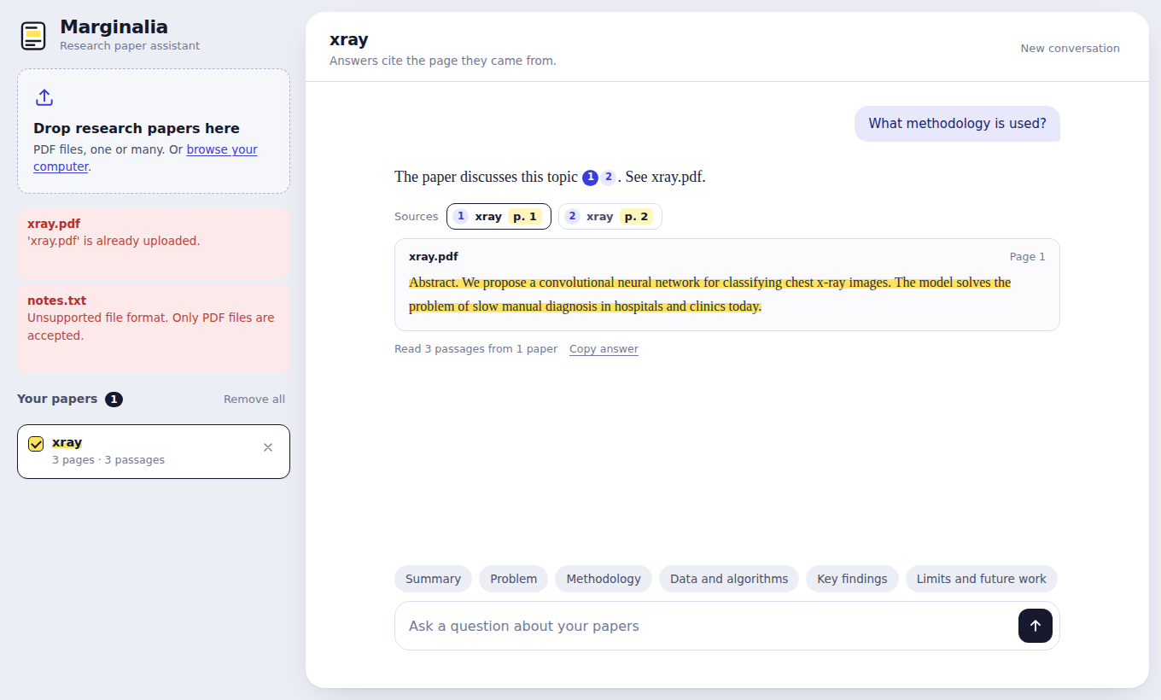




The interface
Drag and drop several PDFs
Tick which papers to ask about
One-tap starter questions
Click a citation to see the passage
Works on phones too
Interface preview with demo data
Notes:
Highlighter-style evidence is the main visual idea: the cited passage is marked like on paper. The screenshot uses demo data; replace it with one from your own run.

Slide 12
Testing
Upload validation: wrong type, fake PDF, corrupt PDF
14
Correct file name and page in every source
Summary requests read the whole paper
automated tests, all passing
Not-found answers return no sources
Duplicates, deletion and multi-paper selection
Offline: fake embeddings and a fake LLM
Follow-up questions and missing API key
Notes:
Run with: pytest -q. Real Gemini calls need your own API key.

Slide 13
Limitations and future work
Limitations
Future work
Scanned PDFs need OCR, which is not included
Tables and equations can lose their layout
Free-tier rate limits slow very large papers
OCR for scanned papers
Hybrid search with re-ranking
Streaming answers
A retrieval-quality evaluation set
User accounts and saved chats
Notes:
Be upfront about what is not covered: OCR and layout-aware table extraction are the biggest gaps.

Slide 14
Grounded, citable answers
Answers only from your uploaded papers
Document name and page on every answer
Clear handling of every failure case
Thank you. Questions?
Notes:
Close by restating the three guarantees: grounded, cited, graceful.

