Slide 1
Assignment Reviewer
An AI that marks student answers and sends borderline scores to a teacher
Prepared by Sumaira | Artificial Intelligence and Data Science

Slide 2
The problem and the idea
Marking short answers by hand is slow and inconsistent.
An AI can score against a fixed rubric in seconds.
But AI scores can be wrong, so uncertain scores go to a teacher.
Question
Explain supervised and unsupervised learning. Give one example of each.
The AI returns a score out of 10, short feedback and a status.

Slide 3
What each library does
LangChain
LangGraph
Joins the prompt and the Groq model and returns a structured review (Pydantic).
Runs the evaluate step and routes scores 4 to 6 to teacher review.
LangSmith
Groq
Traces every run: prompts, answers and graph steps, when enabled.
Fast LLM that scores the answer with the rubric.

Slide 4
LangGraph flow with a decision
Yes: borderline
teacher_review
Answer in
evaluate
Score 4 to 6?
finish
No: clear result
Both branches end the graph. Teacher review is an on-screen flag, not a saved queue.

Slide 5
The rubric: 10 marks
3
3
2
2
Supervised learning explained
Unsupervised learning explained
Supervised example
Unsupervised example
Marks are given only for correct content that is present. The student answer is treated as data, so instructions hidden inside it are ignored.

Slide 6
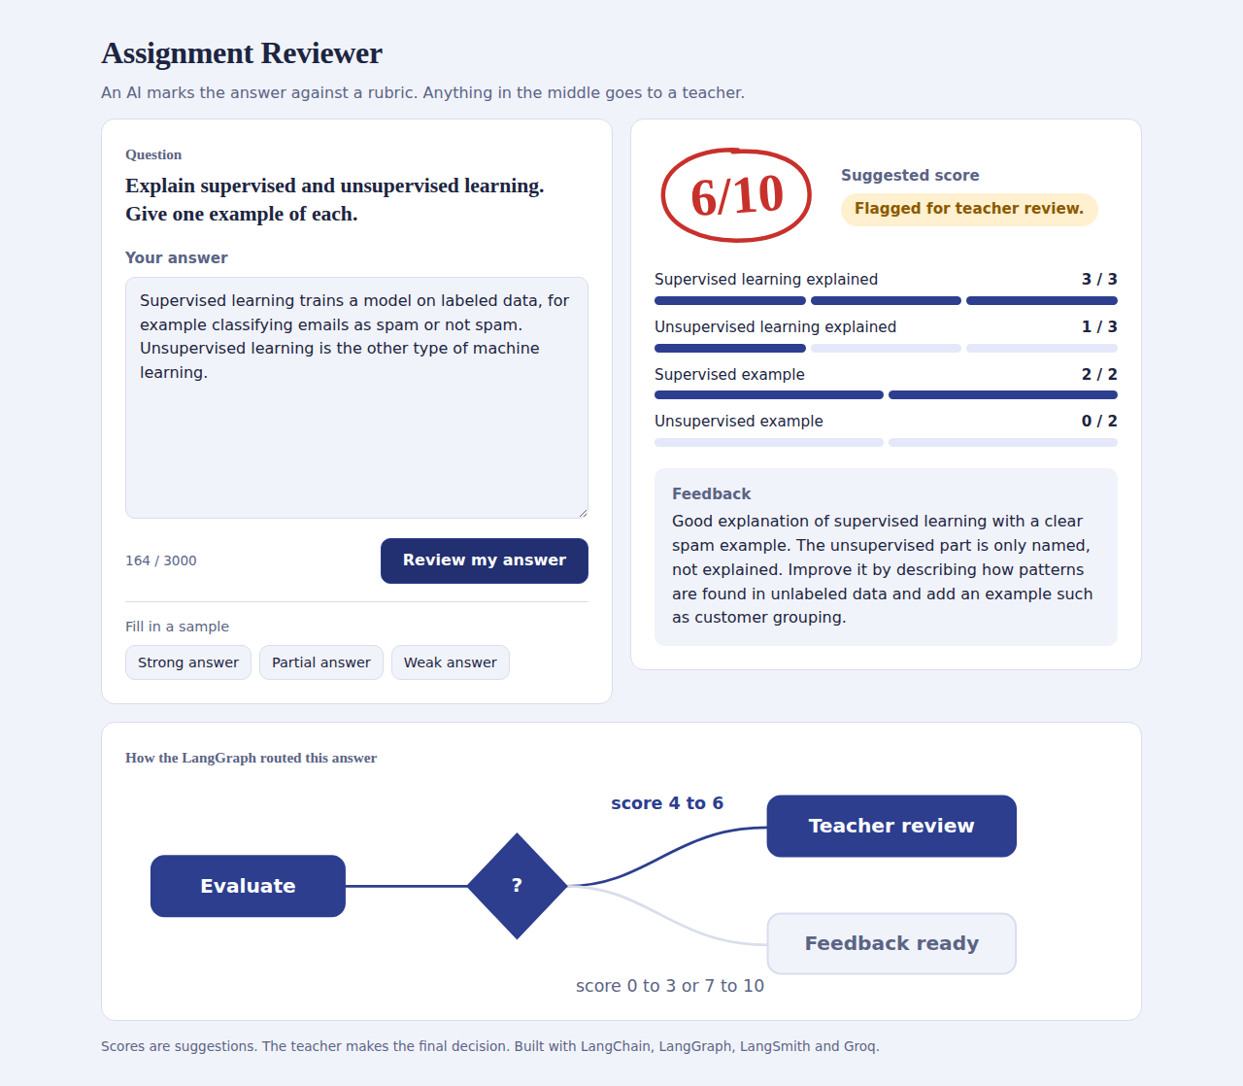
The web interface
Write an answer or fill in a sample
Score circled like a teacher's red pen
Rubric bars for each of the 4 criteria
Feedback and review status
Diagram showing the branch the graph took

Slide 7
Sample run
Student answer
6/10
Teacher review
"Supervised learning trains a model on labeled data, for example classifying emails as spam or not spam. Unsupervised learning is the other type of machine learning."
Supervised: 3/3, example 2/2
Unsupervised: 1/3, example 0/2
Feedback: describe how patterns are found in unlabeled data and add an example.

Slide 8
Conclusion
A LangChain + LangGraph reviewer with tracing and a human-in-the-loop branch. Next: a saved teacher queue, multiple questions, and teacher approval.

