Slide 1
SmartTask AI
Turn messy to-do messages into an organized, prioritized task list
LangGraph • Google Gemini • FastAPI
Presented by: ____________________
Notes:
Introduce the project: SmartTask AI converts informal task messages into a prioritized to-do list.

Slide 2
The Problem
“I need to finish my assignment tomorrow, buy groceries today, and prepare for my meeting next week.”
3 separate tasks
Hidden inside a single sentence.
3 different deadlines
Today, tomorrow and next week.
People think in sentences, not in structured lists.
No clear order
What should be done first?
Notes:
Explain why informal text is hard to act on.

Slide 3
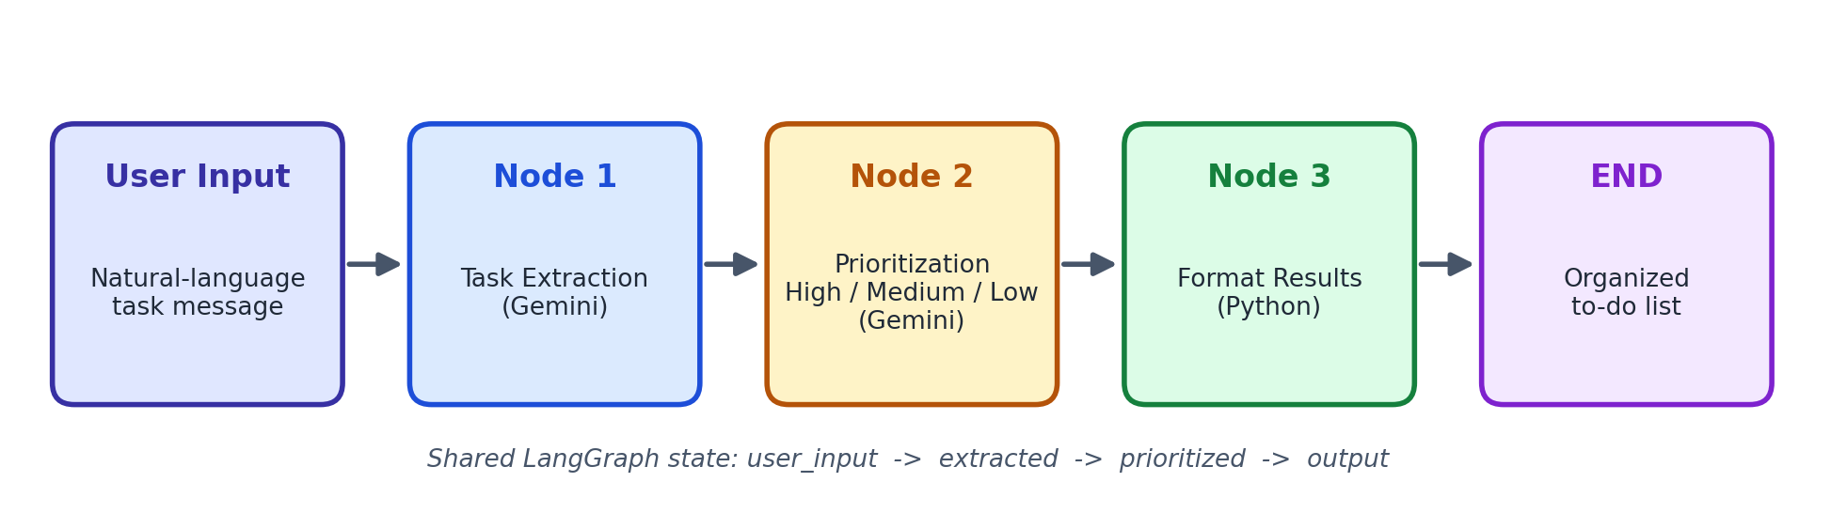
Workflow Architecture
LangGraph connects the nodes and passes a shared state from one step to the next.
Notes:
Walk through the five boxes left to right.

Slide 4
What Each Node Does
Node 1: Extraction
Node 2: Prioritization
Node 3: Formatting
Gemini splits the message into individual tasks and keeps the deadline phrase of each one.
Gemini labels every task High, Medium or Low and gives a one-line reason.
Plain Python groups tasks by priority and builds the readable list. No LLM call needed.
Structured output (Pydantic schemas) keeps Gemini's answers valid and easy to parse.
Notes:
Mention that Node 3 is deterministic code, which saves an API call.

Slide 5
Technology Stack
LangGraph
Google Gemini
Workflow graph and shared state.
Understands informal language.
FastAPI
HTML / CSS / JS
REST API: POST /api/organize.
Responsive web interface.
Notes:
Briefly say why each tool was chosen.

Slide 6
Web Interface
Type or pick an example message
One click: Organize my tasks
Three color-coded columns: High, Medium, Low
Deadline tag and reason on every task
Checkboxes and “Copy as text” button
High
Medium
Low
Notes:
Show the live UI here if possible.

Slide 7
Example: Input and Output
INPUT
OUTPUT
Priority | Task | Due
High | Buy groceries | today
High | Finish assignment | tomorrow
Medium | Prepare for meeting | next week
I need to finish my assignment tomorrow, buy groceries today, and prepare for my meeting next week.
Notes:
Reasons returned by Gemini may vary slightly between runs.

Slide 8
Limitations, Future Work and Conclusion
Limitations
Future work
Priority is the model's judgment.
Dates stay as text.
Tasks are not saved.
Needs internet and an API key.
Real calendar dates and sorting.
Database and user accounts.
Reminders and calendar export.
Urdu / mixed-language input.
LangGraph + Gemini + FastAPI turn everyday messy text into a clear, prioritized plan.
Notes:
Close with the one-sentence takeaway, then take questions.

