Slide 1
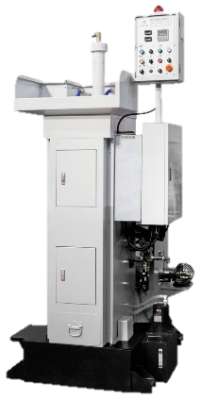
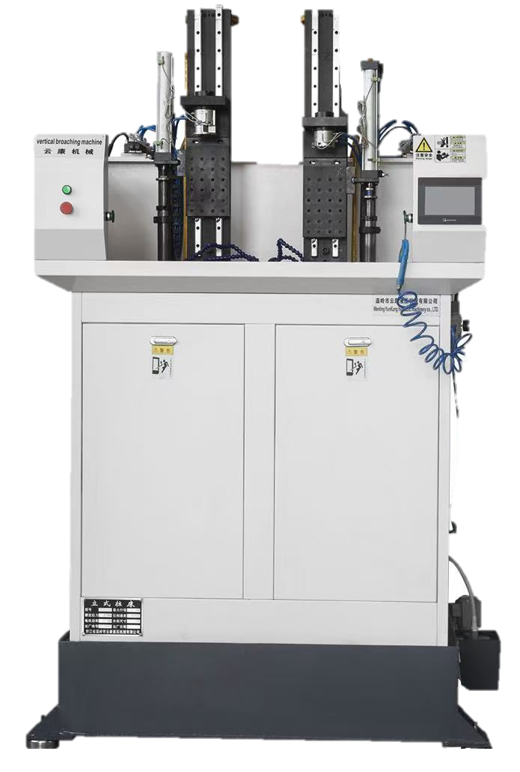



CLUTCH CG 125 – CLUTCH CENTER NEW BROACHING MACHINE JUSTIFICATION
Existing Machine (BROACHING)
New Machine (BROACHING)
Maker
China
Cost
5.5M
High Energy Consumption: Peak-time usage leads to higher utility costs. Labor-Intensive Operation: Labor costs are higher due to non-automated processes. Low Productivity: Frequent stoppages reduce overall output efficiency. High Man hours: Demand more manual effort, increasing man-hours. Maintenance Issues: Spare parts for old machine are hard to source. Limited Flexibility: High changeover time (CG125 to Pridor/CG150)
Energy Savings
Process Optimization
Manpower Reduction
Cost Savings Annual
1.8M
Existing: 4,179Kwh
New: 1,849Kwh
Manual
Automatic
56%

