Slide 1





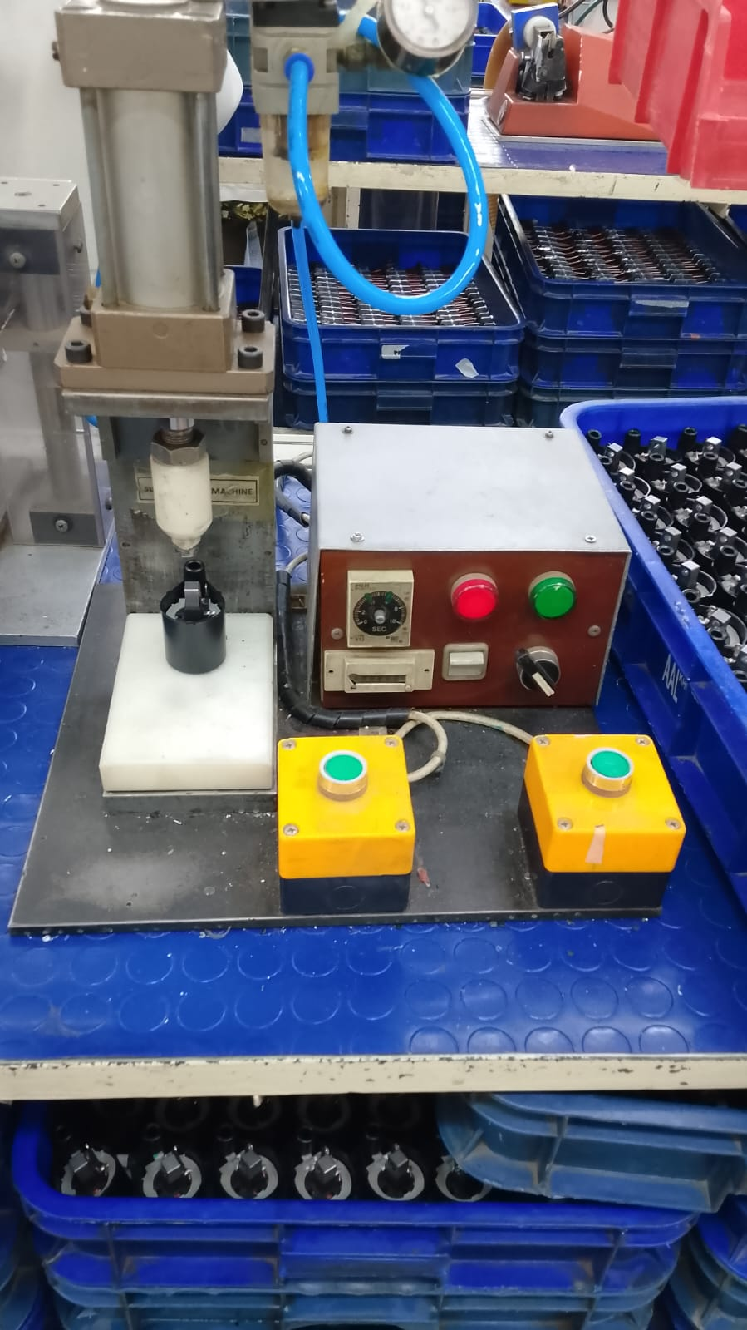
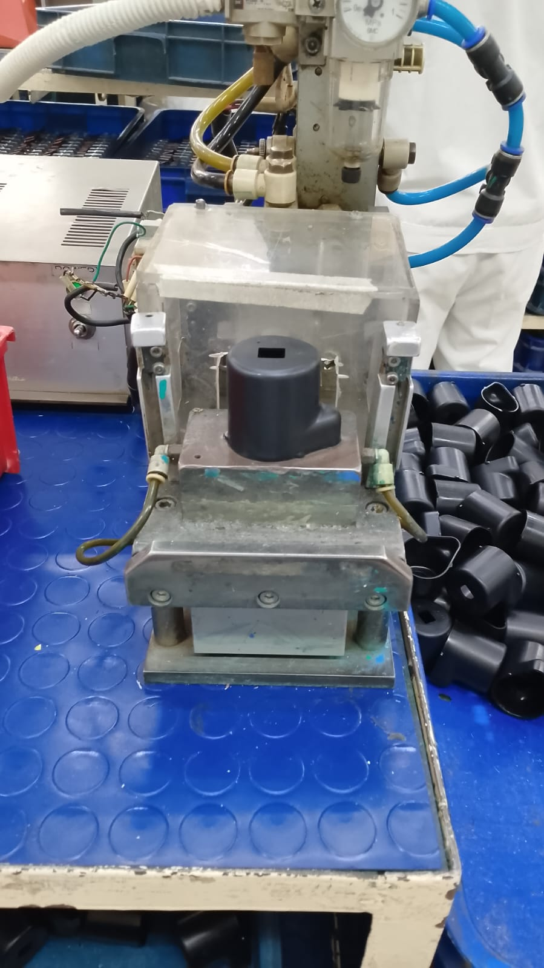
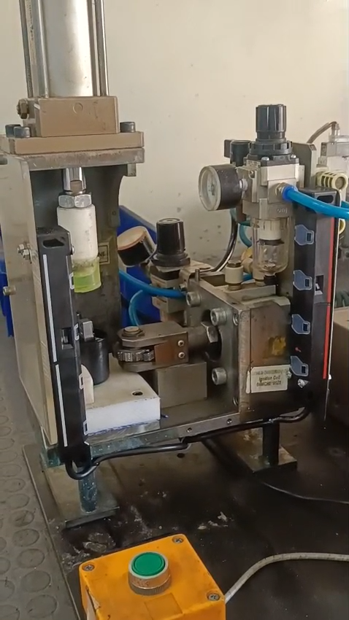


AUTOMATION PROJECT – SUB ASSEMBLY (IGNITION COIL)
Atlas Engineering
BEFORE — 2 SEPARATE MACHINES | 2 OPERATORS
AFTER — 1 COMBINED MACHINE | 1 OPERATOR
BENEFITS
Current Scenario:
Two separate process (Heat fastening and Case stamping) used for sub-assembly of Case Coil and Bobbin assembly
Proposal:
Two separate process (Heat fastening and Case stamping) used for sub-assembly of Case Coil and Bobbin assembly
CAPACITY INCREASE
20%
10s → 8s per unit
Objective:
Automate separate processes in one activity station, reducing manpower requirement
Project Objectives:
ENERGY SAVING
116 KWh
36% annual reduction
MANPOWER SAVED
1 MP
Annual 1.0M PKR saved
PKR 1.8 M
Annual Cost
PKR 1.8 M
Annual Cost
ANNUAL SAVING 1.1M PKR
KEY ACHIEVEMENTS
INITIAL INVESTMENT
0 Capex
HEAT FASTENING
CASE STAMPING
DUAL PRESS
MANUFACTURING
IN-HOUSE
IDEA GENERATION
Monthly Kaizen
Annual Capacity:
2 million
Annual energy cons.:
326 kWh
Labor requirement:
02 / shift
Annual Capacity:
2.2 million
Annual energy cons.:
210 kWh
Labor requirement:
01 / shift
TIMELINE
1 Month

