Slide 1

Group Member: Shoaib Khan, Sumair Rathore, Olivia Bryant
Project 4: EA Sports FIFA Player Ranking Prediction and Salary Explanation

Slide 2

Objective:
Pip install
Import Libraries
Data Transferring & Data Cleaning
Machine Learning
Salary/Wages Prediction/Explanation with SHAP values

Slide 3
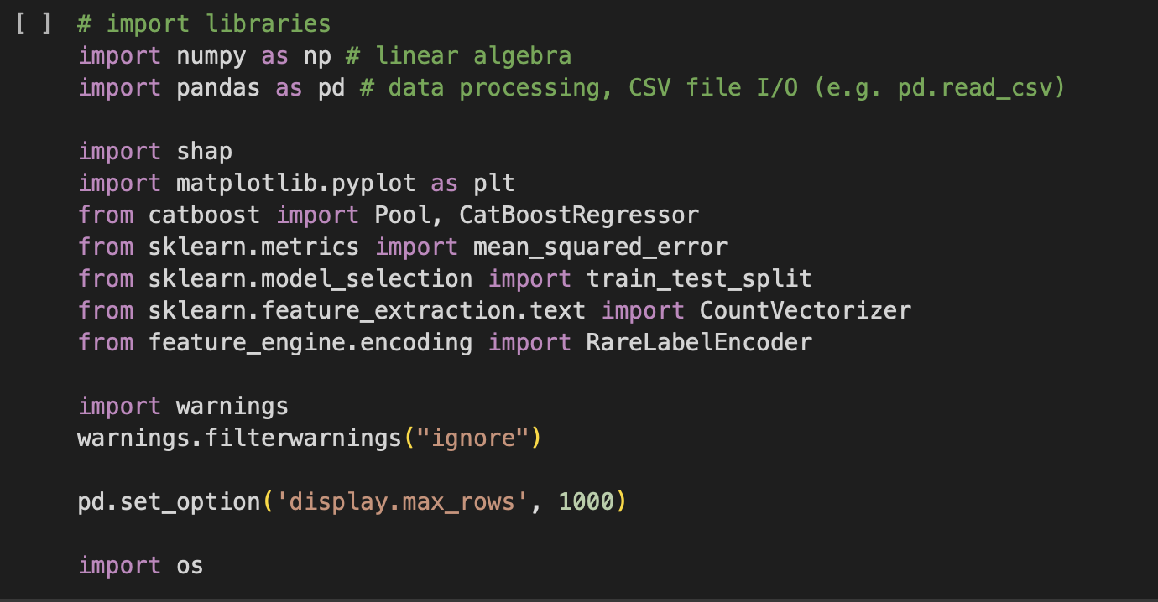
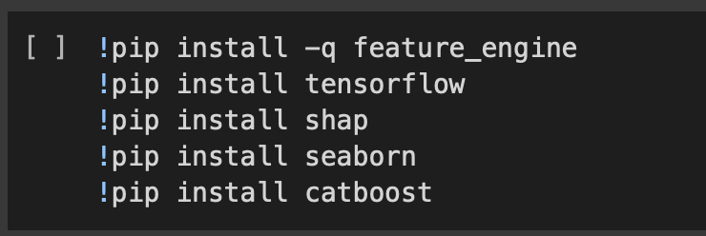
Pip installs and Import Libraries

Slide 4
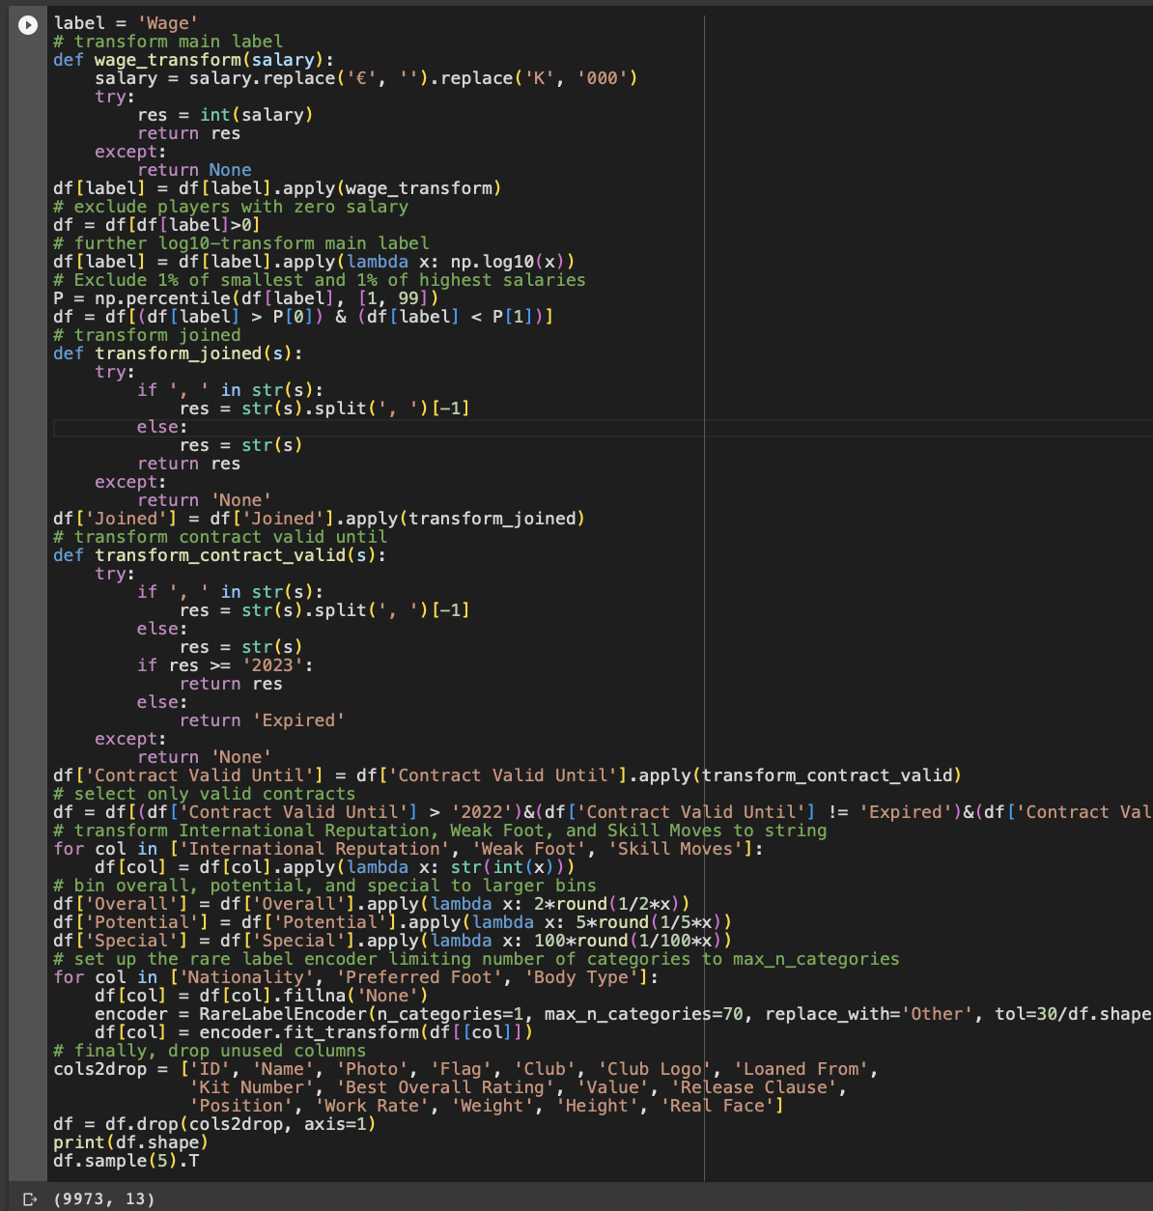
Data Transformation & Data Cleaning

Slide 5
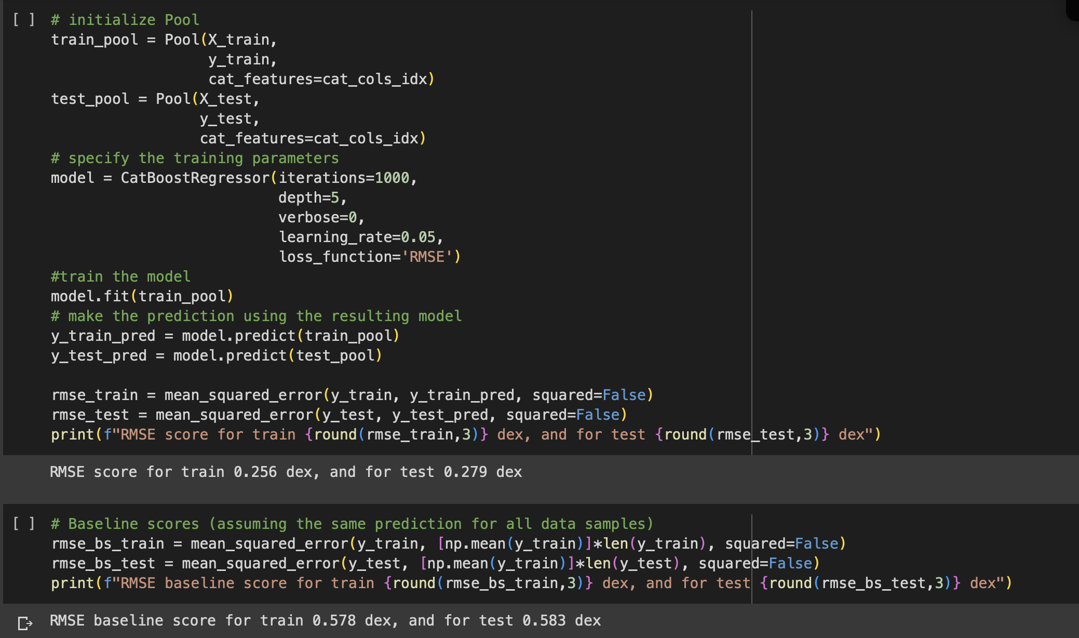

Machine Learning

Slide 6
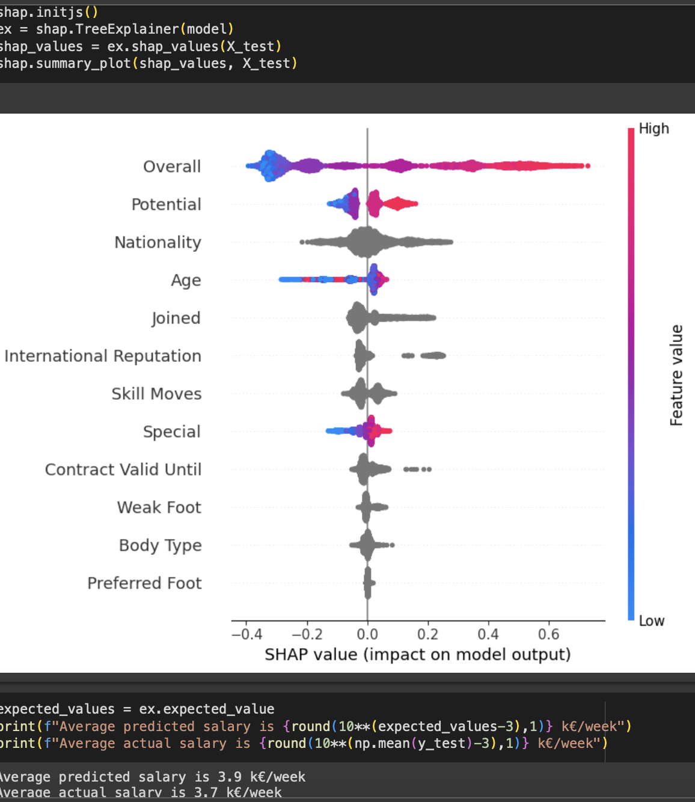
Salary/Wages Prediction/Explanation with SHAP values

Slide 7
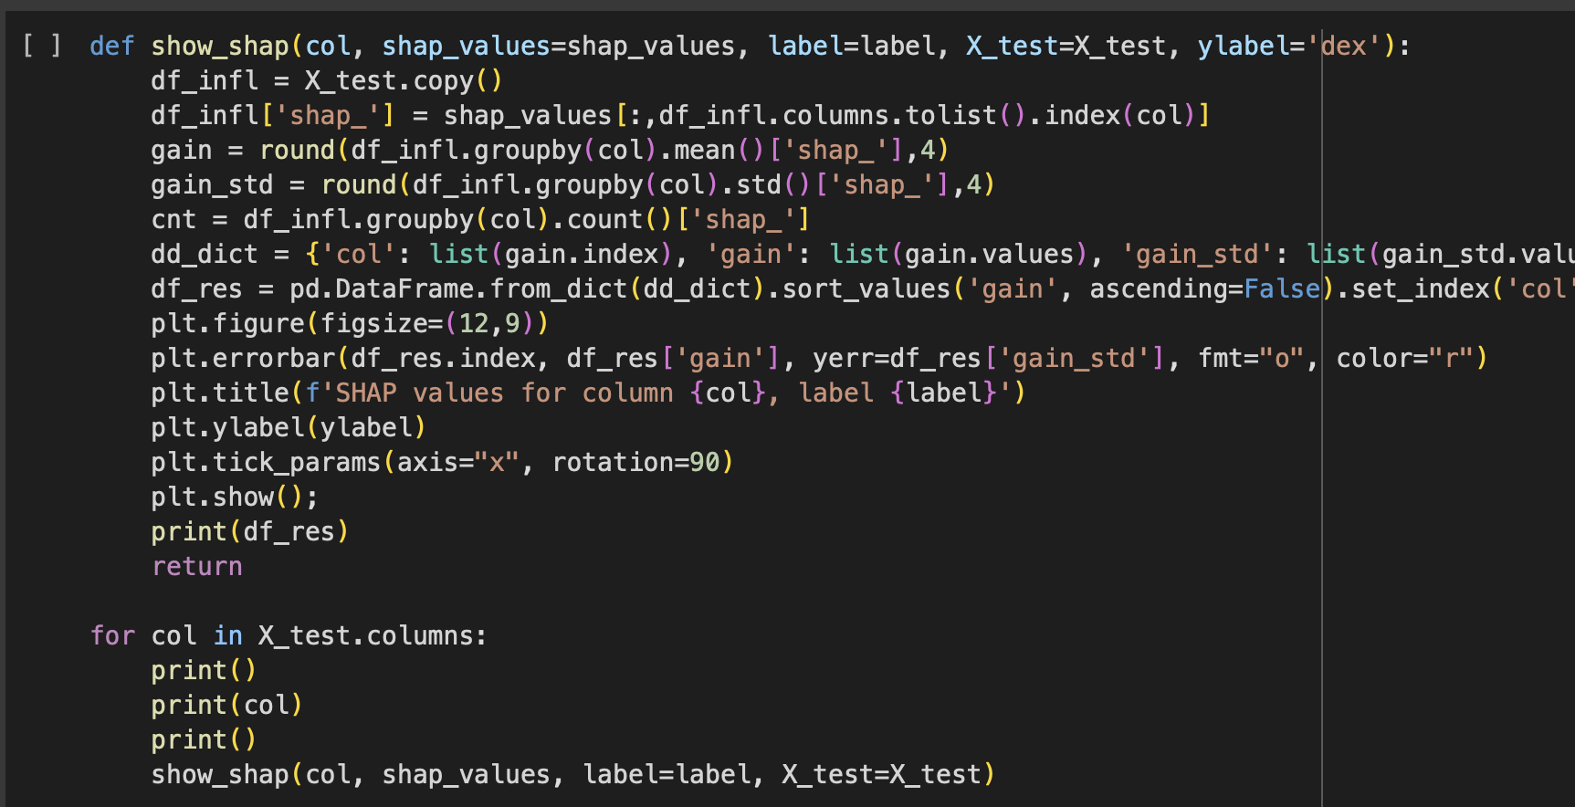

Slide 8
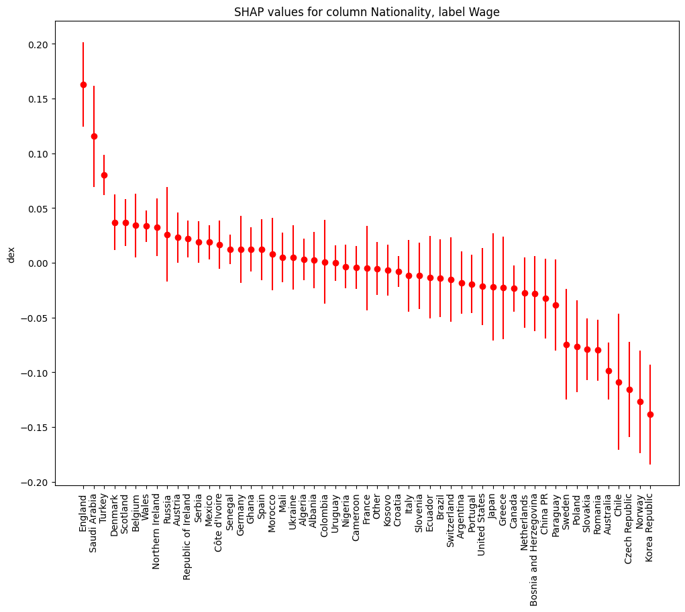
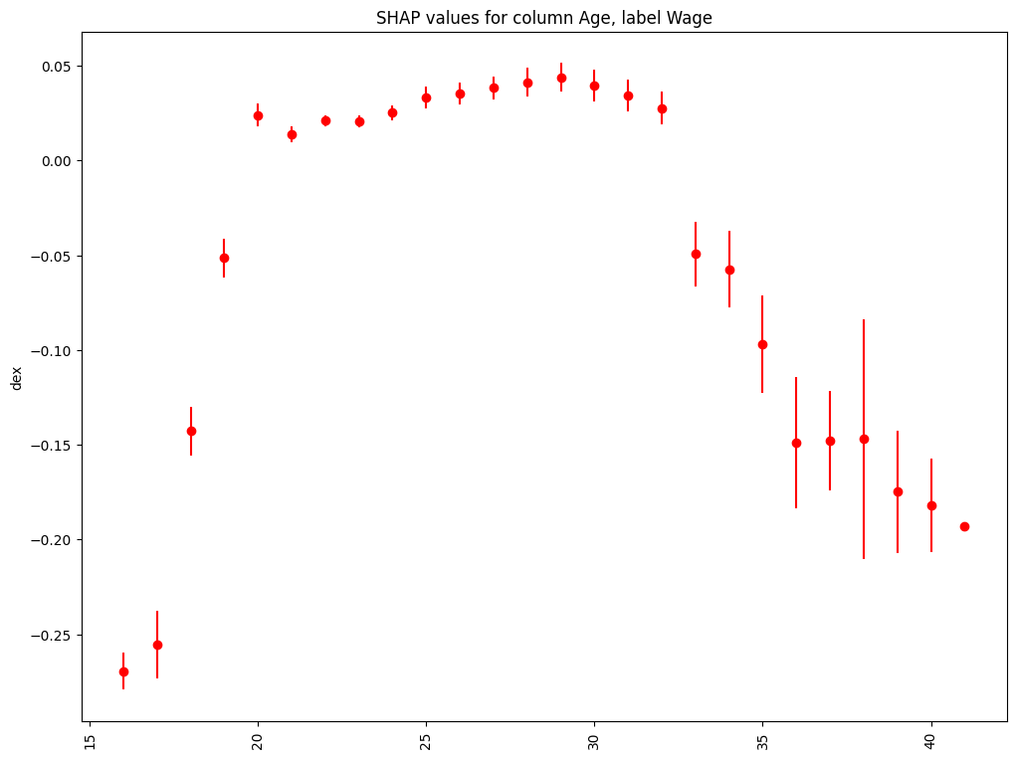

Slide 9
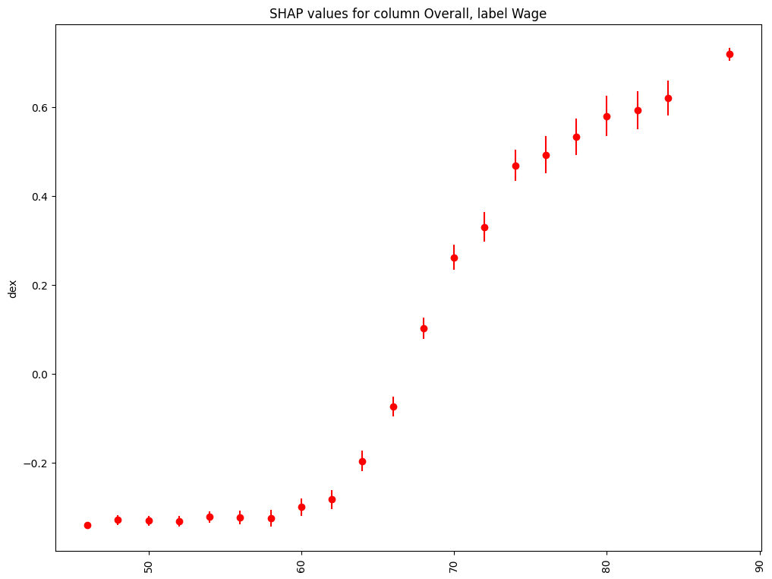
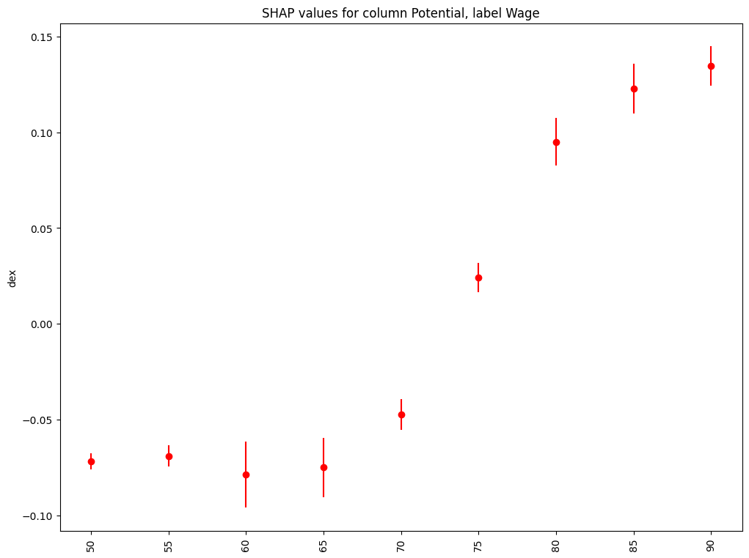

Slide 10
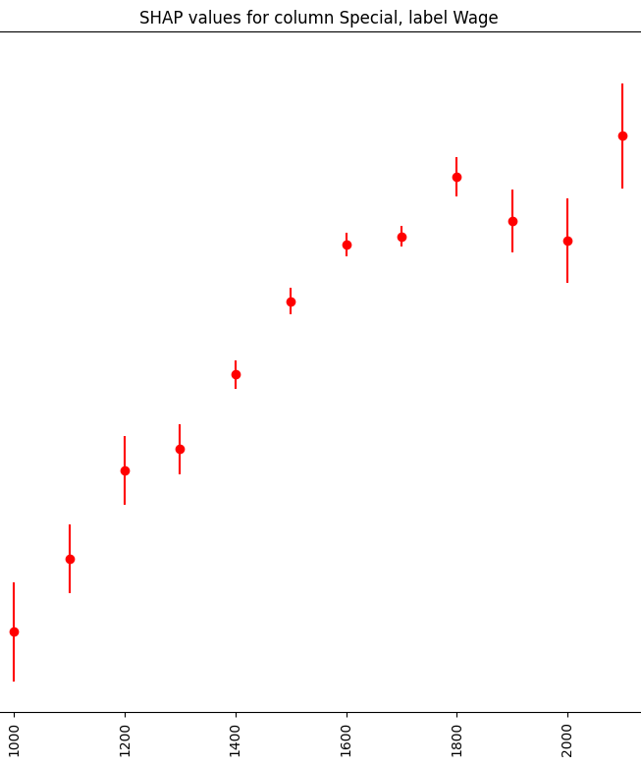
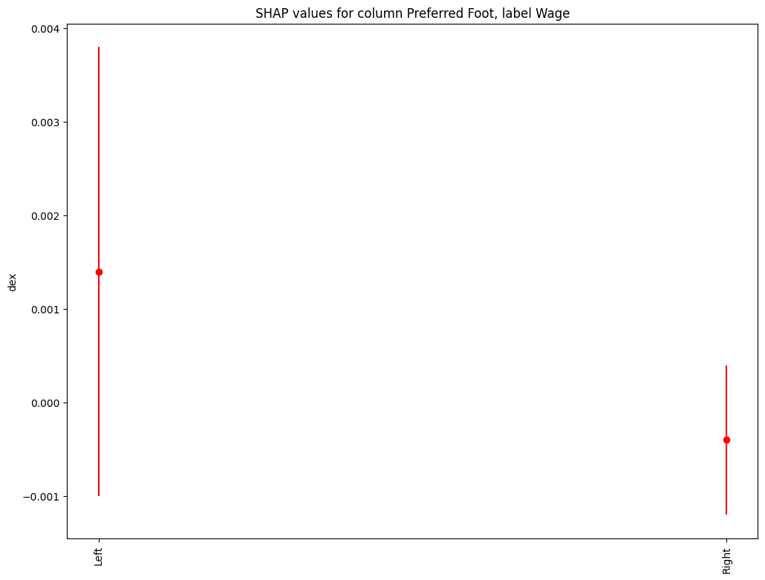

Slide 11
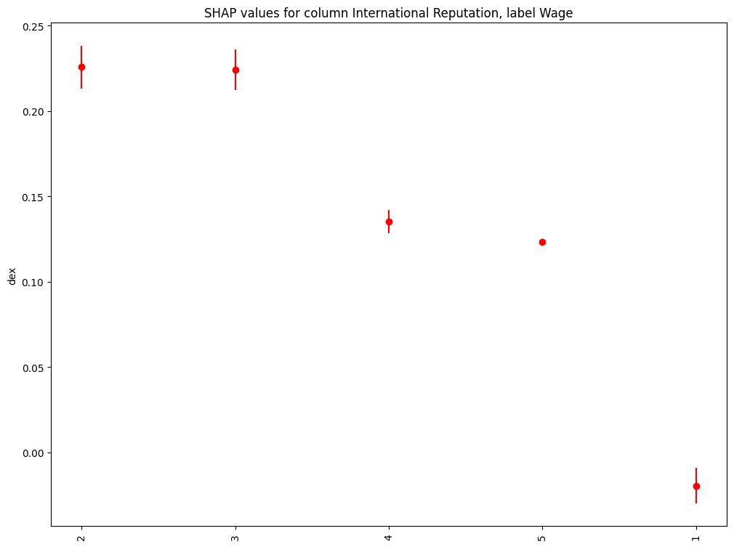
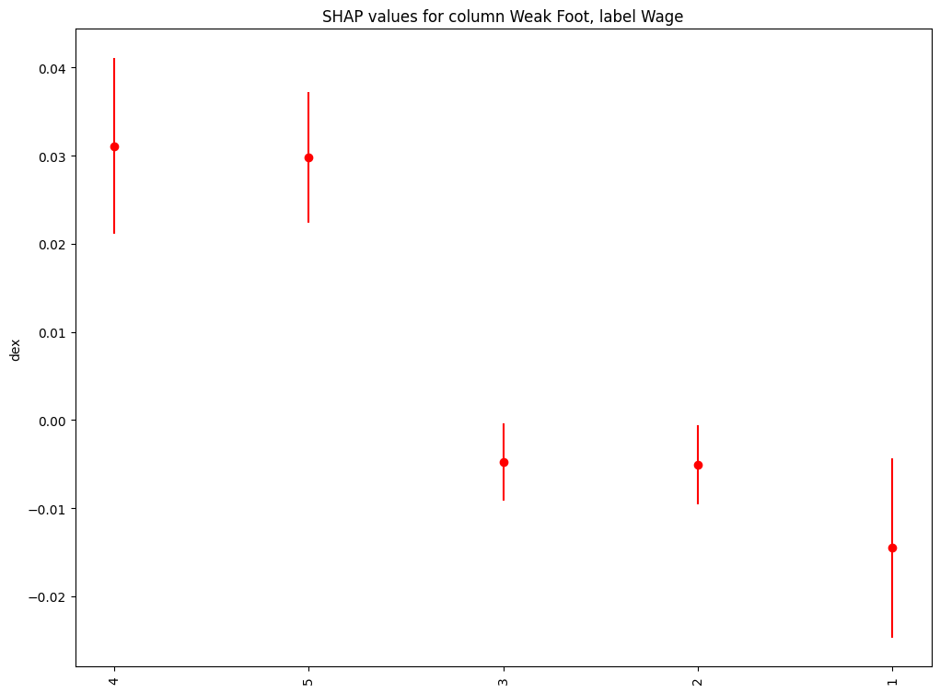

Slide 12
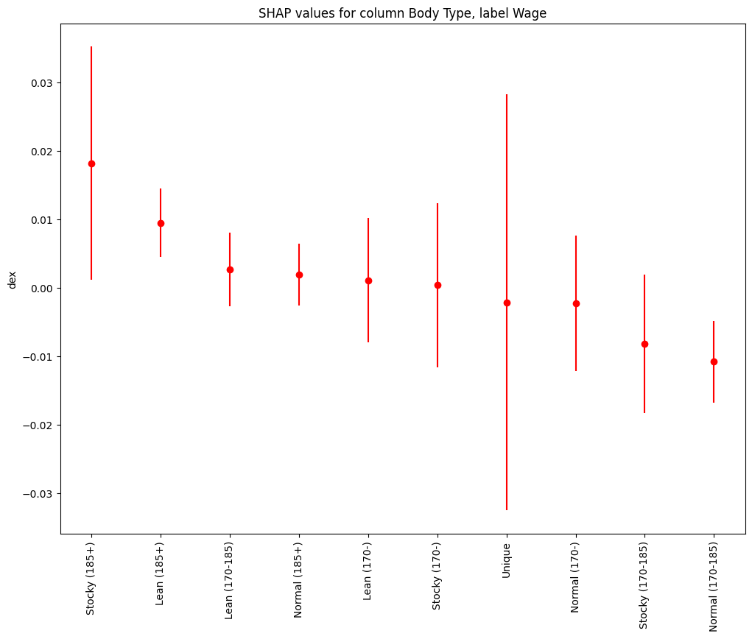
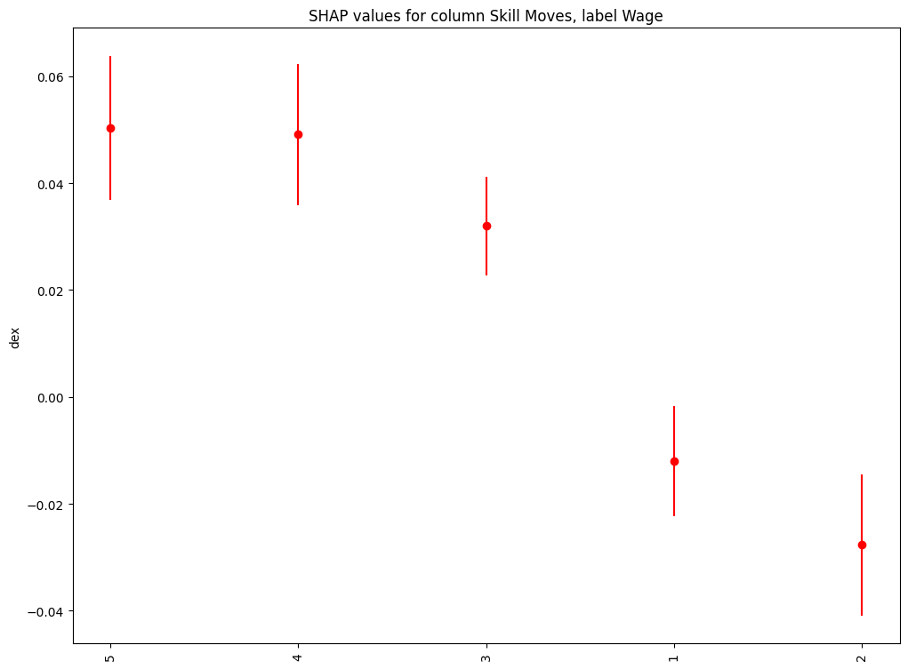

Slide 13
