Slide 1
Deep Learning on Cityscape DS

Slide 2
AGENDA
Problem
Architecture
Data
Model Building
Conclusion

Slide 3
AGENDA
Problem
Architecture
Data
Model Building
Conclusion

Slide 4
Introduction to the Project
Project Objective : The main objective of the task to build ML or CV model for detection of carcass contamination since we don't have the data on carcass so we would be working on the cityscape dataset
Project Outcome : The project objective is to make sure that model is able to predict the output without resulting in overfitting and making sure that the model makes better predictions on unseen data.

Slide 5
AGENDA
Problem
Architecture
Data
Model Building
Conclusion

Slide 6
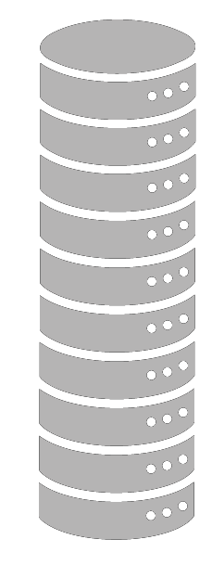






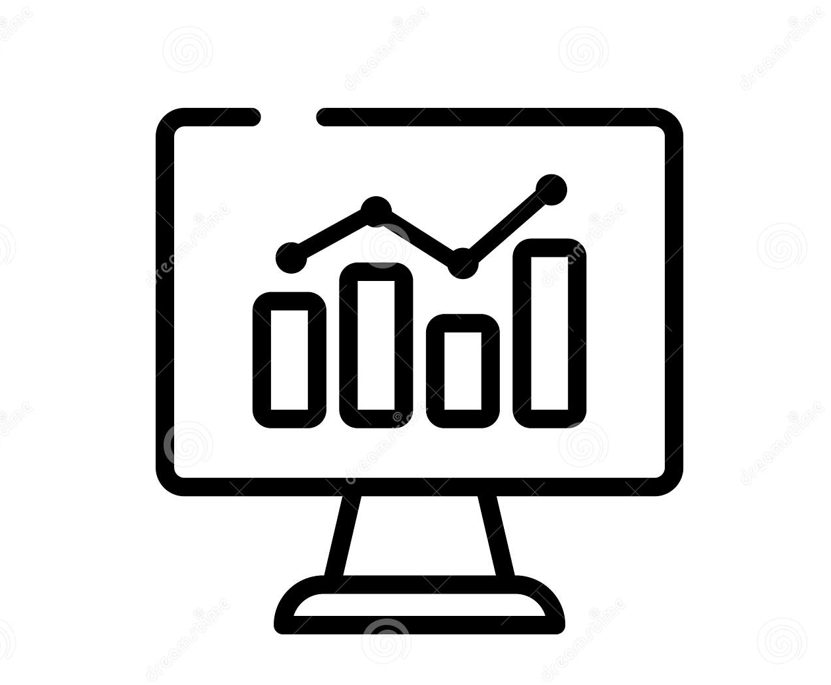


Architecture
Raw Data
Raw data conversion
Converted data
Data filtering
Training data and testing data
Viewing the result on the test data
running on unseen data
Predicted Output on train data
Model Building on train data

Slide 7
AGENDA
Problem
Architecture
Data
Model Building
Conclusion

Slide 8
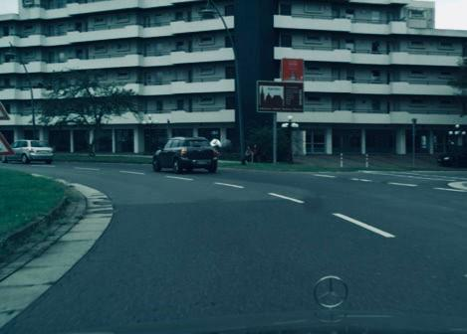
ABOUT THE DATA
01
WHERE DID THE DATA COME FROM ?
Donec risus dolor porta venenatis
Pharetra luctus felis
Proin in tellus felis volutpat
02
HOW WAS THE DATA OBTAINED ?
Donec risus dolor porta venenatis
Pharetra luctus felis
Proin in tellus felis volutpat
03
WHY CAN’T WE USE IT DIRECTLY
Donec risus dolor porta venenatis
Pharetra luctus felis
Proin in tellus felis volutpat

Slide 9

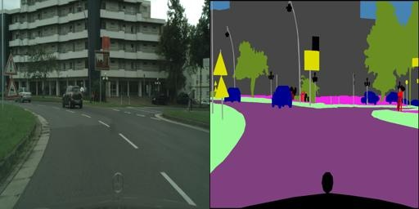
DATA CONVERSION
DATA CONVERSION
https://towardsdatascience.com/training-road-scene-segmentation-on-cityscapes-with-supervisely-tensorflow-and-unet-1232314781a8
WHAT THE WEBSITE IS?
HOW IS IT HELPFUL ?
WHAT IS THE RESULT ?

Slide 10
PACKAGES
MODELLING
CONV2D
CONV2D TRANSPOSE
MAX POOL 2D
ADAM
DATA VISUALISATION
MATPLOTLIB
1
2
3
NECESSARY
KERAS
NUMPY
TENSORFLOW
DATA CONVERSION
Img_to_array
array_to_img
4

Slide 11
AGENDA
Problem
Architecture
Data
Model Building
Conclusion

Slide 12
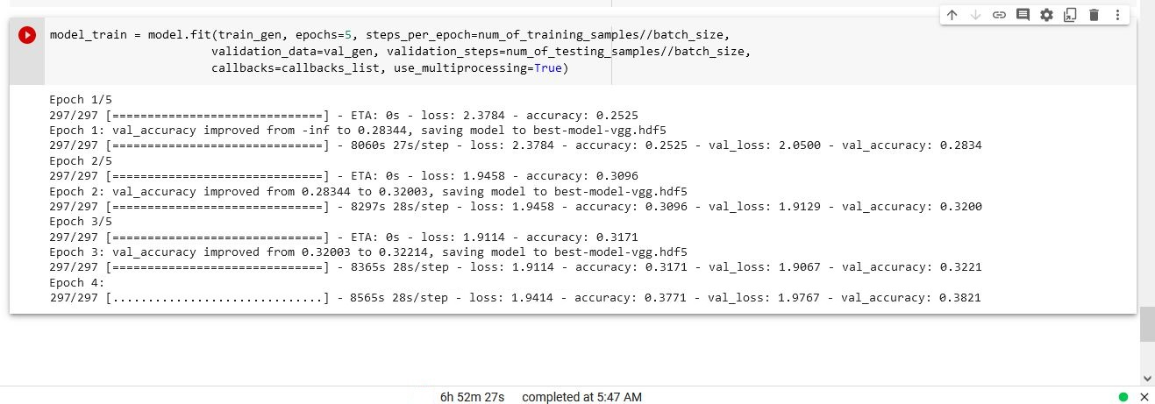
Data Model – FCN-08

Slide 13
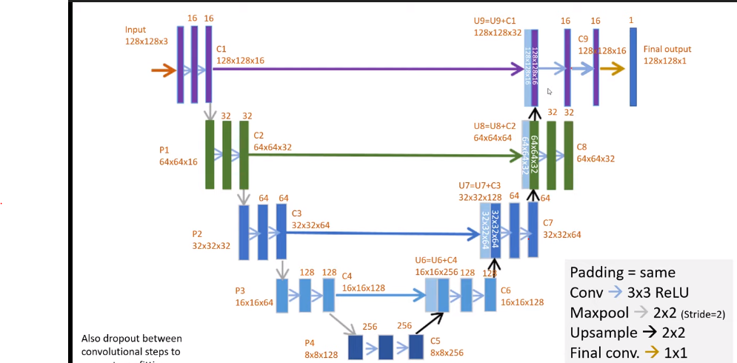
UNET

Slide 14
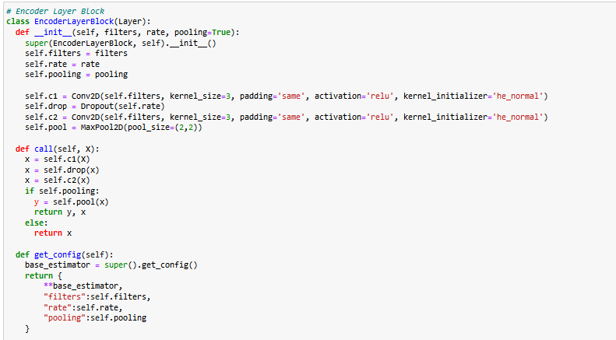
U-Net Encoder Layer Block

Slide 15
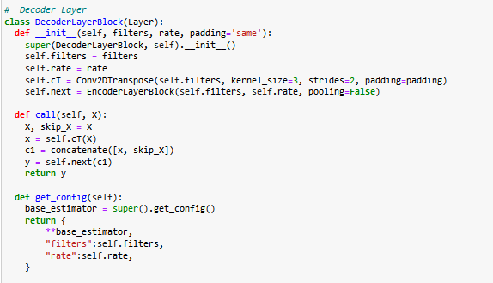
U-Net Decoder Layer Block

Slide 16
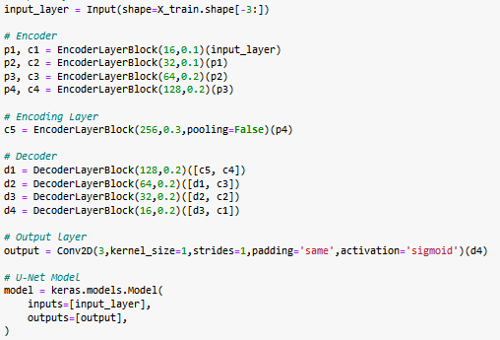
Defining model
Notes:
This model architecture is famously known for its segmentation abilities and In this image data set it does its job. The model seems to lose some of the spatial information. This is because of the smaller size of the input images. I found something wrong with these true mask images. Which I used for validation purpose.

Slide 17
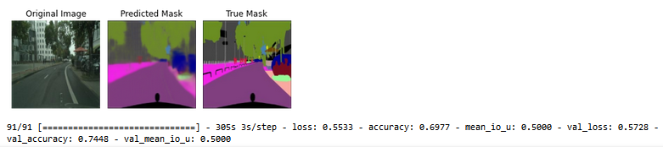
Results

Slide 18
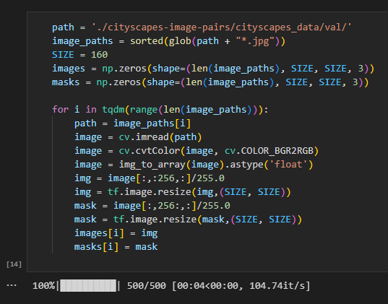
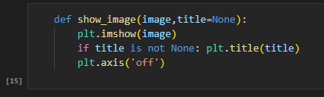
Evaluation Process on Test data

Slide 19
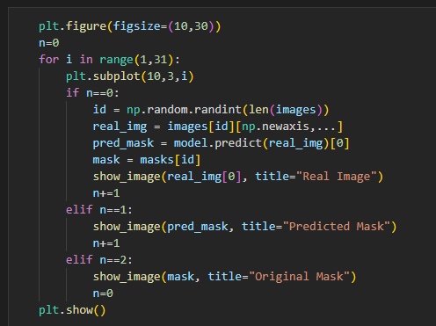
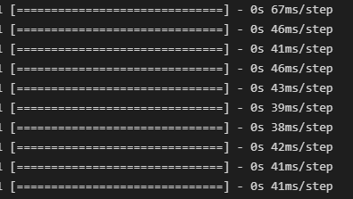
Evaluation Process on Test data

Slide 20
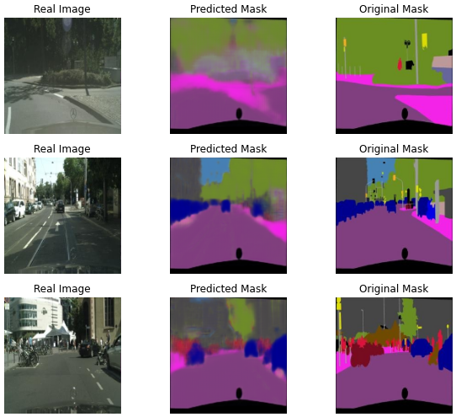
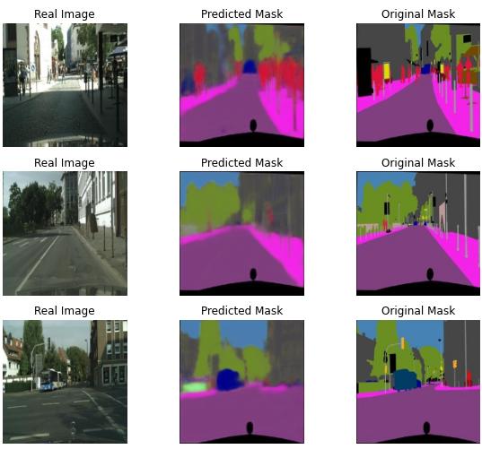
Model Performance

Slide 21
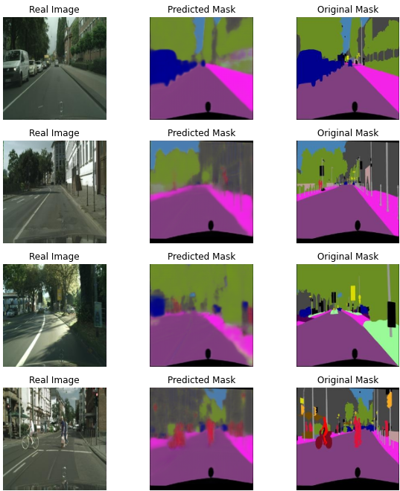
Model Performance

Slide 22
AGENDA
Problem
Architecture
Data
Model Building
Conclusion

Slide 23
Conclusion
From downloading the dataset to studying it, creating export transformations, and building the model with Tensorflow and Keras, we have completed every step.
For almost every image, the model predicted the right segmentation.
Categorized Images based on the amount of pixel.
Overall performance was satisfactory.

Slide 24
Future Recommendation
For better results, Use a Bigger image input size.
For smaller input size model perform well similar if we use more number of data for input it can perform even more better.
Trying with various other models that can give a better result than the current one.
Trying with real time camera could also improve the model performance resulting in good object identification.

Slide 25
Thank You

