Slide 1
Education AI Analyst
A Multi-Agent System for Education Document & Social-Sentiment Analysis
Computer Science Applications and Advancements — 2nd Semester, MSc
Tarin · Saif · Shohana · Fahim
30 August 2026

Slide 2
The Problem
Scattered evidence. Teacher-performance and enrollment signal lives across result sheets, scanned forms, spreadsheets, and Facebook comments — nowhere unified.
Slow, manual synthesis. Reading and cross-referencing all of it by hand takes days per term, for every department.
High stakes, low tolerance for error. Any AI-generated judgment about staff performance is sensitive — it must be checked by a real person before anyone acts on it.
Goal: automate the reading and analysis — keep a human firmly in control of what's released.
Education AI Analyst
2

Slide 3
Solution Overview
One Manager, seven Specialists. A Supervisor agent plans and routes; seven worker agents each do one job — reading documents, reading images, analyzing numbers, reading sentiment, remembering context, writing the report, fact-checking it.
End-to-end flow. Upload documents + Facebook data → agents analyze → draft report → a human approves → download the finished report.
Built to be demo-ready on a free budget. LangGraph + FastAPI + Streamlit, powered by free-tier OpenRouter models with automatic fallback, local embeddings (no extra API cost), and a CSV-import path so the demo never blocks on Facebook app review.
Education AI Analyst
3

Slide 4
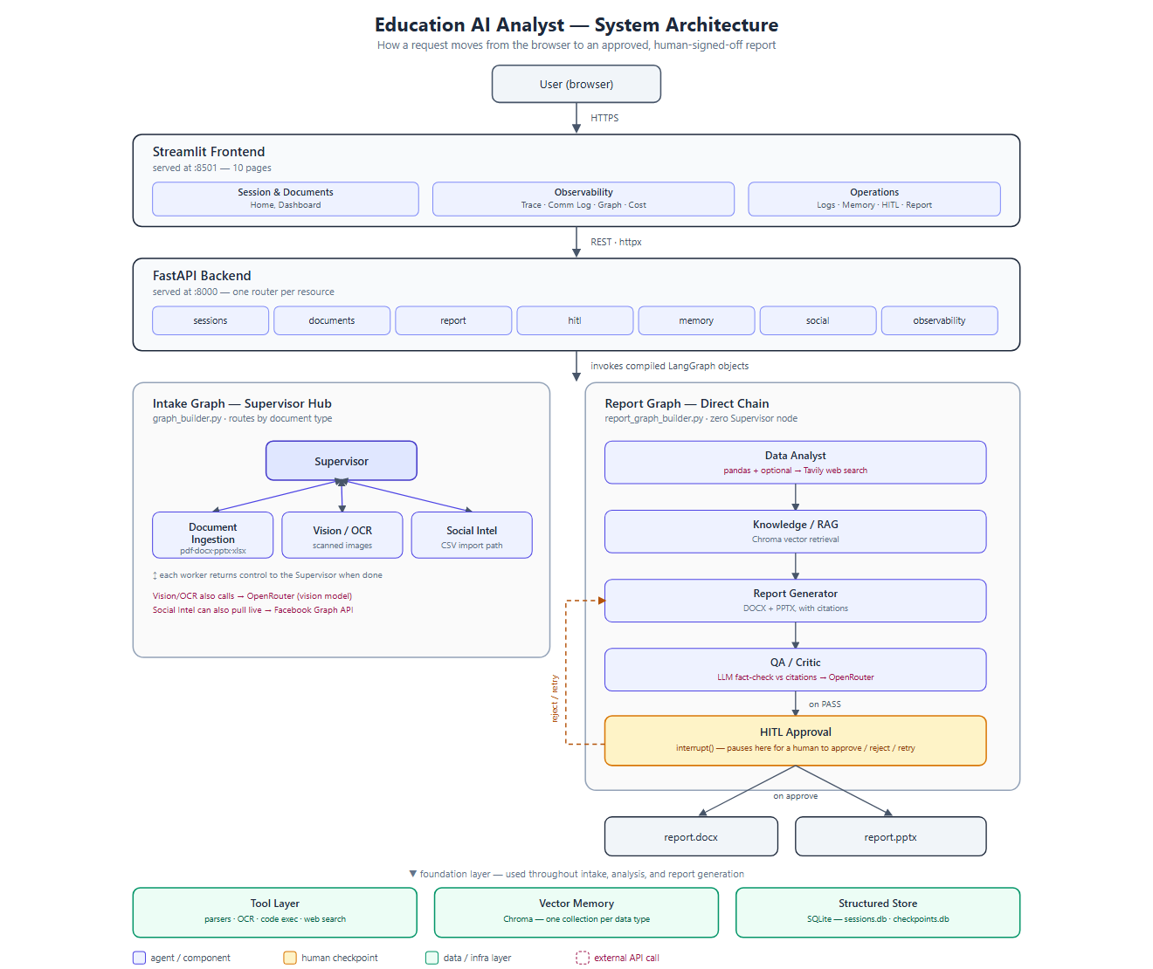
System Architecture
Education AI Analyst
4

Slide 5
Supervisor + 7 Worker Agents
Supervisor
Plans work, routes documents, aggregates results
Social Intelligence
Facebook comments → sentiment (live API or CSV import)
Document Ingestion
PDF / DOCX / PPTX / XLSX → structured text & tables
Knowledge / RAG
Chroma-backed semantic memory shared across the run
Vision / OCR
Scanned forms, screenshots → text (vision LLM)
Report Generator
Compiles a cited DOCX + PPTX report
Data Analyst
pandas over enrollment/results, optional web-search context
QA / Critic
Fact-checks the draft against source data before a human sees it
Education AI Analyst
5

Slide 6
Two Collaboration Patterns, Chosen Deliberately
Intake Graph — Supervisor Hub
A type-based dispatch problem.
Every worker (Document Ingestion, Vision/OCR, Social Intel) returns control to the Supervisor when done — routing logic stays centralized.
Adding worker #9 doesn't require touching worker #4's code.
Report Graph — Direct Chain
An inherently sequential problem.
Data Analyst → Knowledge/RAG → Report Generator → QA/Critic → HITL — zero Supervisor node, each agent hands off straight to the next.
Confirmed straight from the compiled graph objects (.get_graph().draw_mermaid()), not just claimed.
The Execution Graph panel renders both live from the running code — the diagram cannot lie or go stale.
Education AI Analyst
6

Slide 7
Key Features
Human-in-the-loop approval. interrupt() pauses before release — approve, reject with feedback, or retry.
Live token & cost tracking. Every LLM call's tokens and estimated cost recorded per agent, visible in the UI.
Dual export. Every approved report is written as both DOCX and PPTX, with citations.
Two independent Facebook input paths. CSV import and the live Graph API both feed the exact same sentiment-scoring step.
Resilient by design. Session state survives a backend restart (SQLite) and a browser refresh (URL-persisted session id) — found and fixed by breaking the app on purpose.
Free-tier LLM resilience. An ordered OpenRouter fallback list with retry/backoff, degrading gracefully instead of crashing when a model goes unavailable.
Education AI Analyst
7

Slide 8
Tech Stack
Orchestration LangGraph — StateGraph, interrupt() for HITL
Backend FastAPI
Frontend Streamlit — 10 pages
LLMs OpenRouter — free-tier models, fallback list
Embeddings sentence-transformers (local, free)
Vector memory Chroma — one collection per data type
Structured data SQLite — sessions + HITL checkpoints
Live external data Facebook Graph API, Tavily web search
Deployment Docker Compose + GitHub Actions CI
Education AI Analyst
8

Slide 9
Status & Results
118 automated backend tests passing. Unit + integration + end-to-end coverage per tool and agent.
Full pipeline verified live, end to end. Upload → intake → analysis → report → QA → human approval → download, run against a real OpenRouter key.
Real LLM integration confirmed. Actual token usage and cost tracked per call, not simulated.
All 10 required frontend panels implemented and wired to the live backend, not mock data — Dashboard, Trace, Comm Log, Graph, Cost, Logs, Memory, HITL, Report, Home.
Deployable. Docker Compose (backend + frontend + Postgres + Chroma) with GitHub Actions CI running tests on every push.
Education AI Analyst
9

Slide 10
Team & What's Next
Tarin Core backend, agent pipeline foundation, testing, deployment
Saif Knowledge/RAG, data analysis, frontend UI
Shohana Sample data, Social Intelligence agent, documentation
Fahim Report generation, QA/Critic, CI/CD, demo prep
Next
Full Facebook Graph API OAuth polish for production Page access
Postgres for production deployment (SQLite covers local dev)
Expanded test coverage as remaining edge cases surface
Education AI Analyst
10

