Slide 1
CSE 322: Computer Networks Sess.
Project Presentation
Name: Sumaiya Azad
Student ID: 1705048

Slide 2
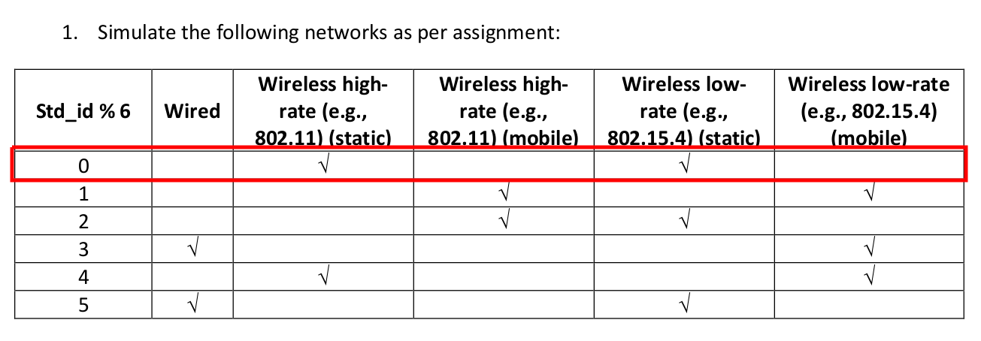
Network Specification
Student ID: 48
48 % 6 == 0
Wireless high-rate (e.g. 802.11) (static)
Wireless low-rate (e.g. 802.15.4) (static)

Slide 3
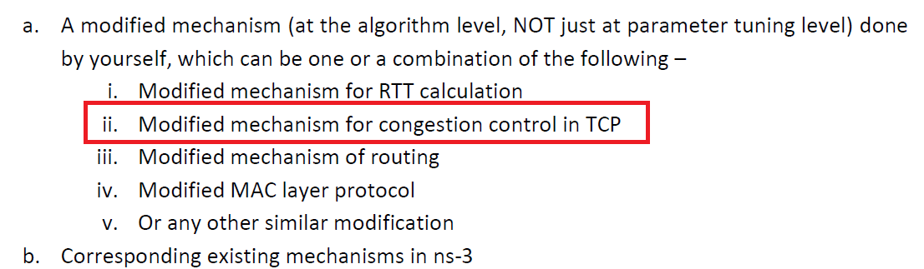
Modified Mechanism Specification
Modified mechanism for congestion control in TCP with it’s RTT calculation

Slide 4
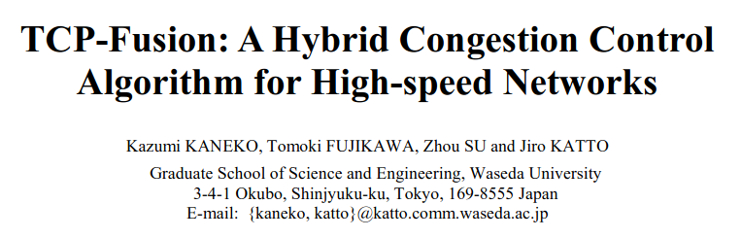
Targeted Paper Specification
Journal: Proceedings of Protocols for fast long-distance network
2007
Tokyo, Japan

Slide 5
Paper Summary
Workings on the congestion window size to increase performance
TCP-Fusion maintains two congestion window size
One has two properties of TCP-Vegas and TCPW, which provide efficiency in large leaky pipe
Other one is updated like TCP-Reno, i.e., the value is increased by 1 MSS/RTT and halved upon packet losses

Slide 6
Effectiveness of TCP-Fusion
TCP-Fusion adopts either big one as its new congestion window size
Therefore, TCP-Fusion ensures at least TCP-Reno performance.

Slide 7
Paper Link
In this paper, they presented a new hybrid congestion control algorithm, called TCP-Fusion. This protocol integrates three characteristics; TCP-Reno, TCP-Vegas and TCP-Westwood, which provides good balance between efficiency and friendliness even in high-speed networks with large bandwidth delay product and non-negligible random packet losses. They claimed that TCP-Fusion can achieve the highest throughput in existing protocols.
https://www.researchgate.net/publication/242414090_TCP-Fusion_A_Hybrid_Congestion_Control_Algorithm_for_High-speed_Networks

