Slide 1



Automation of JSON file from PDF document
5466
Author 1
Photo
Author 2
Photo
Sumaiya Dabeer
Asra Ansari
Zakir Husain College Of Engineering & Technology, AMU
Aligarh

Slide 2
Challenge Statement
Automation of JSON file from a PDF document

Slide 3
Concept / Scope of solution
The Concept of the solution is :
Design a system that can extract multiple tabular data from PDF document.
Developed a system that can convert the extracted data into JSON file.
Design a GUI based platform for the data visualization & operation.
Create an API to access it over internet from anywhere in the world.
0005466

Slide 4
SWOT Analysis
STRENGTH
WEAKNESS
It can be used for any general purpose application which requires PDF to JSON conversion.
It can read multiple tables in a single PDF.
Maintaining MongoDB through which converted data can be referenced later.
Multiple system & browser compatibility.
It handles errors due to invisible cells in the table.
Visualization of data using GUI.
It ignore pictures that are present in pdf.
OPPORTUNITIES
THREATS
It can be used by Booking, Finance Marketing and HR dept of companies and institutions like L&T, Railways, Aviation and universities.
User can access it from anywhere using internet through API.
Data security is being ensured.
API may be attacked at the client side or server side.
0005466

Slide 5
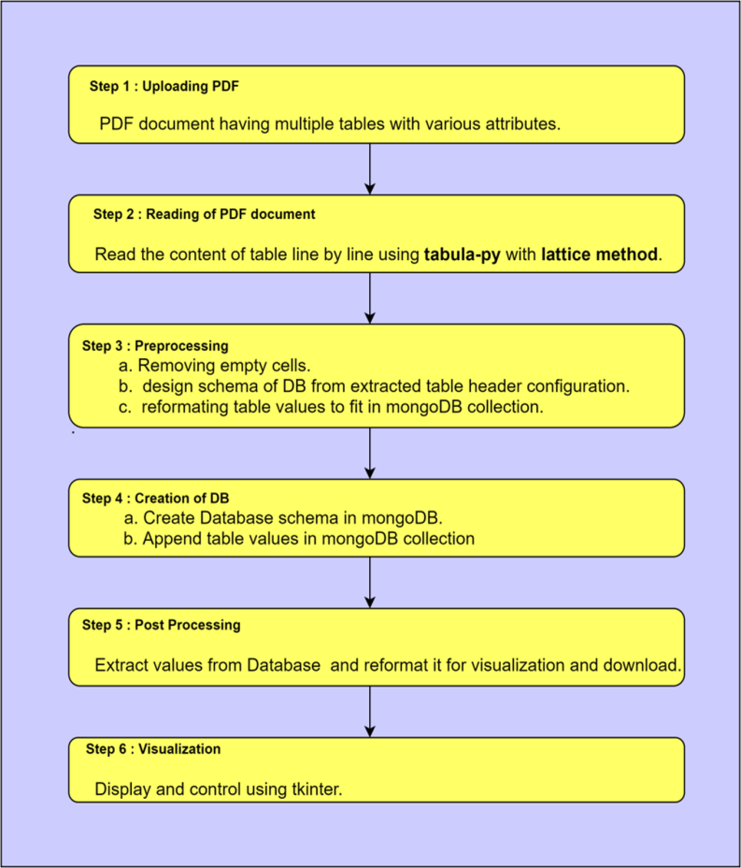

Implementation (1/2)
Development of “Desktop Application” has designed using :
Python : As a programming language.
Tabula : Library to read table.
MongoDB : As database.
Json : library to store and process data.
5466
Design flow of the system from PDF to JSON

Slide 6
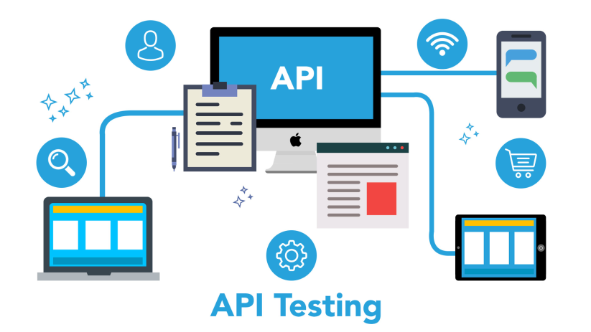
Implementation (2/2)
Development of API.
With the development of API any type of app can be efficiently developed over it.
Django Rest API : framework for API development.
Django : To develop webapp.
Python : Programming language.
Basic function: user accounting and data conversion.
Json : library to store and process data.
API Testing
0005466

Slide 7

POC Video
POC Video
5466

Slide 8
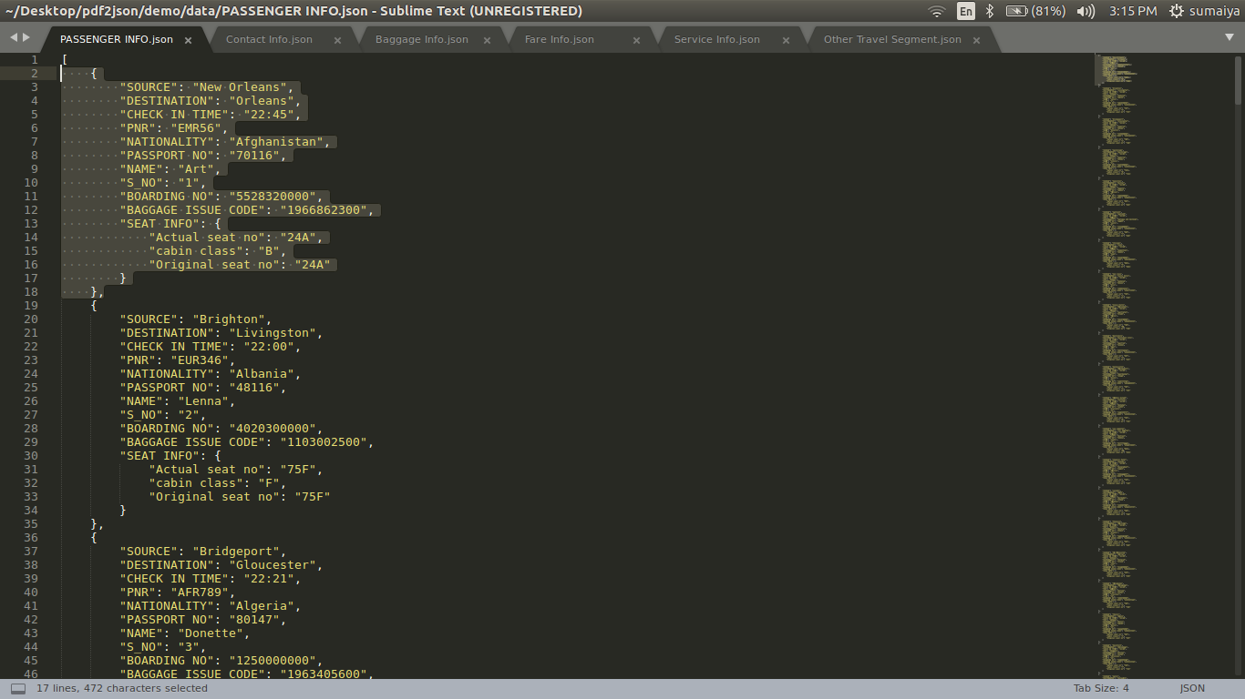
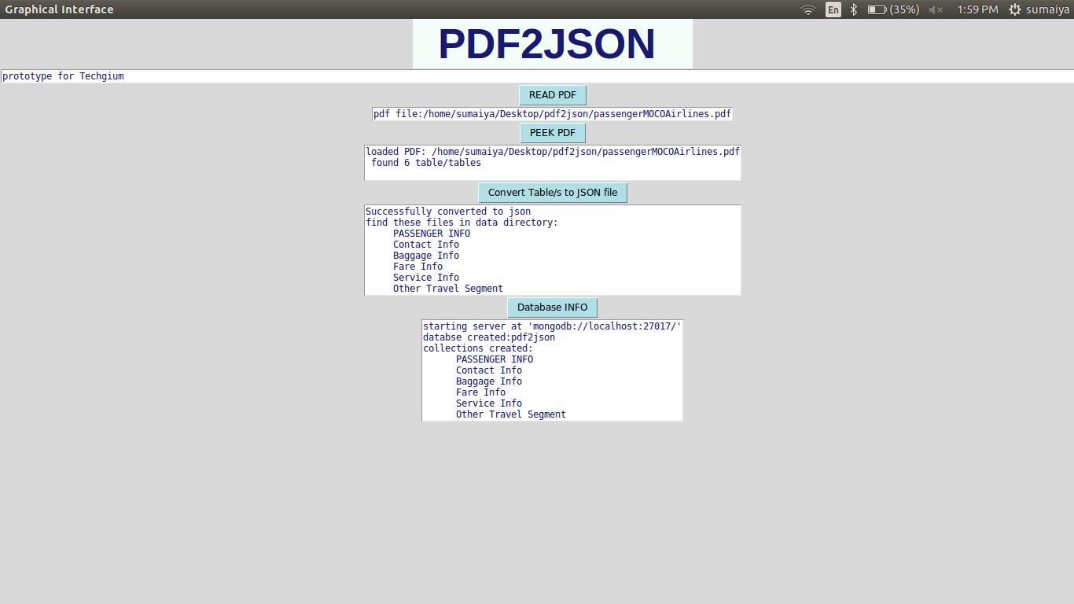
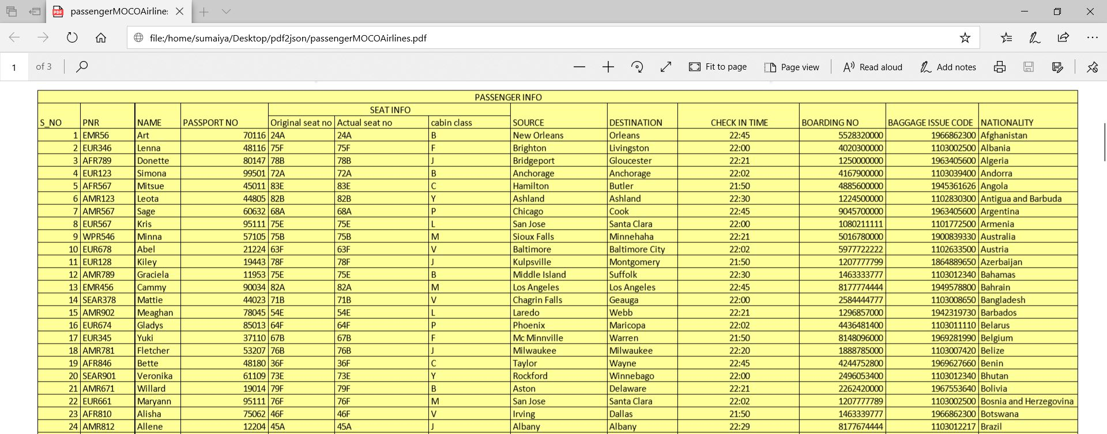
Testing / Analysis (1/2)
5466

Slide 9
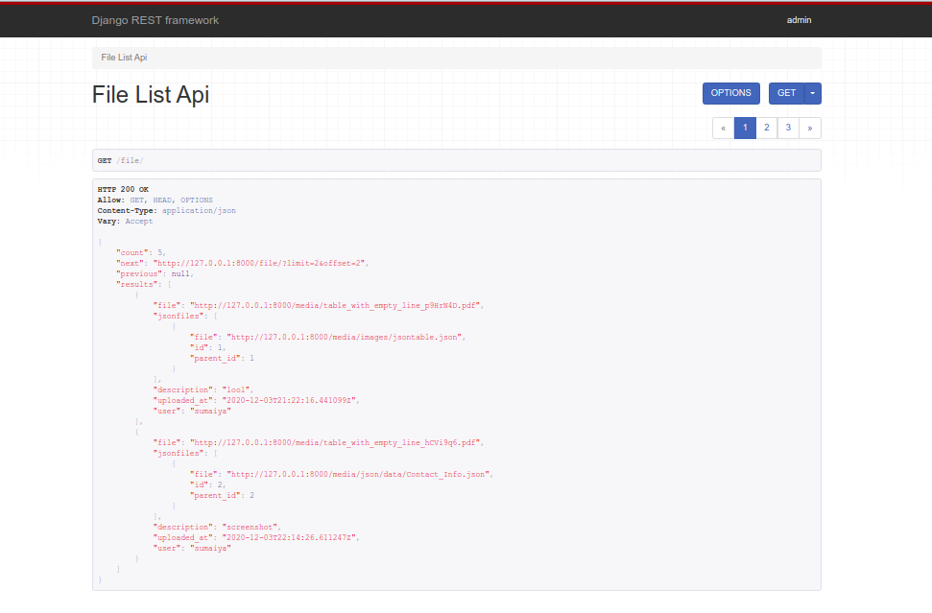
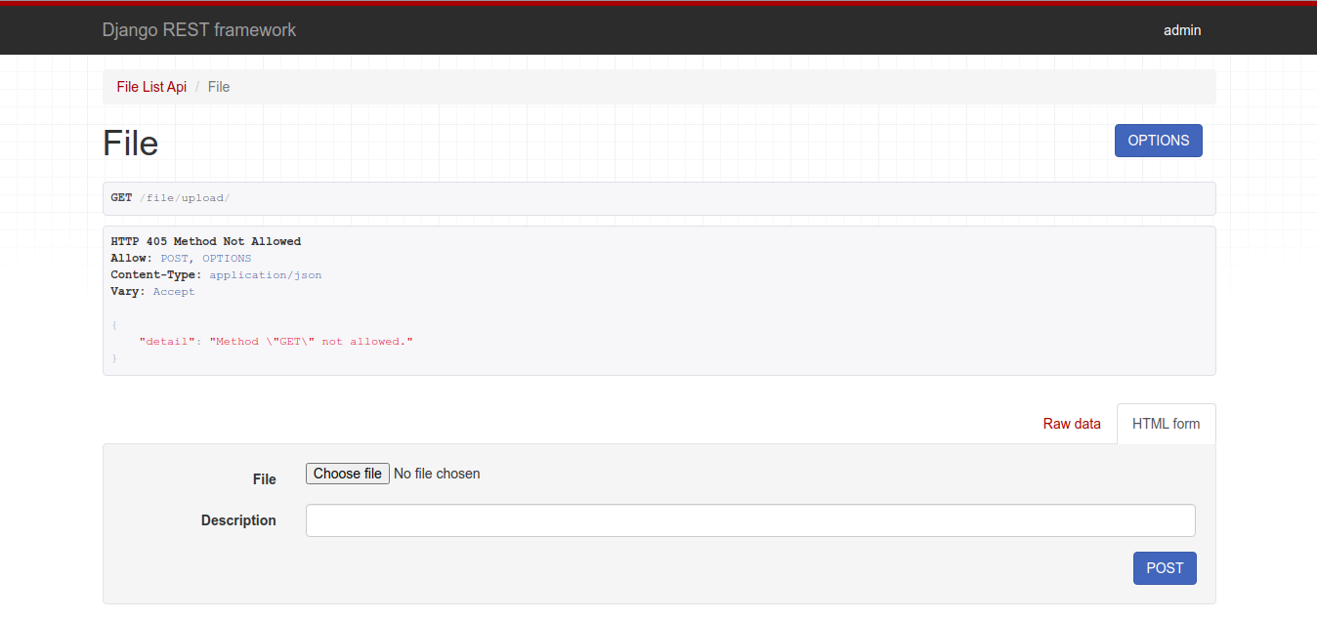
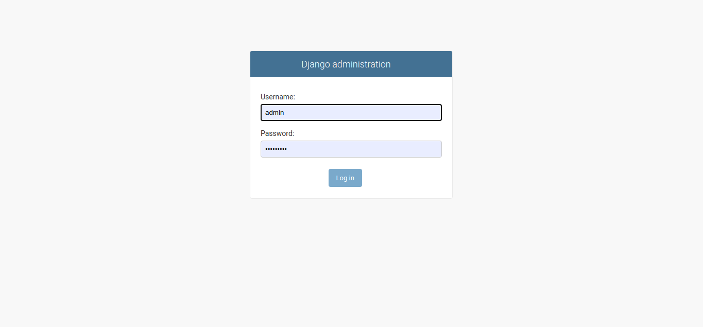
Testing / Analysis (2/2)
API Testing is done using Postman.
5466

Slide 10
Cost for POC vs MVP
Cost for Developing POC
Approximate cost for POC to Product
S.NO | Components | Cost
1 | Development cost | Total Coding Hours = 130
2 | Testing cost | Total coding Hours = 20
3 | Infrastructure cost | PC/Workstation with OS (Win/Mac/Linux) Server and Client devices(PC/Tab/Mobile)
4 | Database selection | NIL
5 | Installation cost | NIL
According to scalability of product.
5466

Slide 11
POC to MVP
S.NO | Components | cost
1 | Development cost | Total Coding Hours = 200
2 | Testing cost | Total coding Hours = 100
3 | Infrastructure cost | Server: $100 to $200/month. (convert to INR approx.) Maintenance cost: 40k/month
4 | Database Selection | As per requirement
5 | Installation cost | 2 hours
5466

Slide 12
Result / Conclusion
Conclusion
Multiple and complicated tables in PDF document are successfully & faithfully transformed into JSON data.
Database of table content is successfully stored for later usage.
It is versatile, secure and user Friendly (no domain expertise required).
It is fast and reduces the human effort by 1000x.
It can be used by Booking, Finance Marketing and HR dept of companies and institutions like L&T, Railways, Aviation and universities.
Data visualization and operation.
Web GUI.
Sample pdf creation module.
5466

Slide 13
Future Work
Future Work
Support for other output data formats.
Can release Python package of PDF to JSON conversion.
Integration testing will be done after merging of front and back end.
Performance can be improved by using openmp or mpi.
5466

Slide 14
References
“Passenger and Airport data interchange standards ” version 13.1 (approved and published by the WCO/IATA/ICAO API Contact Committee). October 2013 .
George Tillmann .“Usage-Driven Database Design”. Apress .
Mark Lutz ."Programming Python" second Edition. O'Reilly Media, Inc.
Kristina Chodorow ,MichaelDirolf ."MongoDB: The Definitive Guide" Third Edition. O'Reilly Media, Inc.
Steven Keller. " Json Book ". CreateSpace Independent Publishing Platform.
William S. Vincent. "Django for APIs". WelcomeToCode.
5466

Slide 15

Thank You

