Slide 1
A Full-Stack Mobile Application for Premium Coffee Ordering & Customization
AURA BREW
Course:
CSE413: Mobile Application Design Lab
The Ultimate
Coffee Experience
Institution:
Daffodil International University, Dhaka
Supervisor:
Tanjir Ahmed Anik, Lecturer, Dept. of CSE
Submitted:
April 19, 2026
TECHNOLOGY STACK
Flutter
Django REST
PostgreSQL
Cloudinary
Render
github.com/aaporosh/Aura-Brew

Slide 2
Presented By
CSE413 — Mobile Application Design Lab
01
02
03
Md Abir Ahmed Porosh
Sohi Bilkis Binte Yer
Most. Sumaiya Akter Sithi
ID: 0242220005101814
ID: 0242220005101917
ID: 0242220005101915
Login, Authentication & Onboarding Flow
Menu, Cart, Profile & Home Pages
Order Processing & Feedback System
▸ Custom User model & PIN auth
▸ Products, Cart, Stores, Banners apps
▸ Orders app (place, history, reorder)
▸ Serializers, Views, URL routing
▸ Home, Cart, Profile, Settings screens
▸ Feedback app (ratings, tags, suggestions)
▸ Splash, Login, Signup screens
▸ ProductProvider & CartProvider
▸ Order History & Success screens
▸ Auth Provider & API client
▸ 9 reusable Flutter widgets
▸ Feedback screen with slider & tags
▸ Render deployment config
▸ Admin seeding & management commands
▸ OrderProvider with full state mgmt
Supervised by: Tanjir Ahmed Anik | Lecturer, Department of Computer Science and Engineering, Daffodil International University

Slide 3
PROJECT OVERVIEW
Aura Brew — Full-Stack Coffee Ordering Application
Aura Brew is a comprehensive, production-grade full-stack mobile application built with Flutter (cross-platform frontend) and Django REST Framework (backend API). It delivers a seamless premium coffee ordering experience — from browsing and customization to cart management, order placement, rewards, and feedback.
16
23
7
Flutter Screens
API Endpoints
Django Apps
Full UI workflow
RESTful, versioned
Modular architecture
12
5
9
Database Models
State Providers
Widget Components
Relational schema
Provider pattern
Reusable library

Slide 4
TECHNOLOGY STACK
Frontend · Backend · Infrastructure
FRONTEND
BACKEND
INFRASTRUCTURE
Flutter (Dart ^3.9.2)
Django >=5.1
Render (PaaS)
Cross-platform mobile UI framework
Python web framework
Django backend hosting + auto-deploy
Provider ^6.1.5
Django REST Framework
Neon.tech
State management — ChangeNotifier
RESTful API toolkit >=3.15
Serverless PostgreSQL database
Google Fonts
django-jazzmin >=3.0.1
Cloudinary
Playfair Display + Poppins typography
Premium admin dashboard
Cloud media & avatar storage (CDN)
http ^1.6.0
django-cors-headers
PostgreSQL
REST API communication
CORS for mobile clients
Production relational database
shimmer ^3.0.0
Pillow >=11.0
SQLite
Skeleton loading animations
Image processing & uploads
Local development database
carousel_slider
Gunicorn >=23.0
GitHub
Banner carousel on Home & Tea screens
WSGI production HTTP server
Version control + APK releases
image_picker
WhiteNoise >=6.8
dj-database-url
Avatar upload from gallery/camera
Compressed static file serving
Seamless DB connection management

Slide 5
SYSTEM ARCHITECTURE
Three-Tier Client-Server Design
PRESENTATION TIER
APPLICATION TIER
DATA TIER
Flutter Mobile Application
Django REST Framework API
PostgreSQL + Cloudinary
✓
Provider State Management (ChangeNotifier)
✓
7 Modular Django Apps
✓
Neon.tech Serverless PostgreSQL
✓
12 Named Routes + MainShell Navigator
✓
TokenAuthentication (DRF built-in)
✓
Cloudinary CDN (media & avatars)
✓
IndexedStack — Preserved Tab States
✓
Versioned endpoints: /api/v1/
✓
12 Database Models
✓
9 Reusable Widget Components
✓
JSON + Multipart/form-data support
✓
dj-database-url connection config
✓
Material Design 3 + Custom Theming
✓
Jazzmin Admin Dashboard
✓
WhiteNoise static file serving

Slide 6
KEY FEATURES
Core Functional Capabilities
🔐
PIN-Based Authentication
☕
Drink Customization Engine
🛒
Smart Cart Management
Phone number + 4-digit PIN with PBKDF2 hashing. Token-based sessions for all protected endpoints. Fast and secure login flow.
Granular options: milk type, toppings (M2M), size, and sugar level slider (0–100%). Real-time price recalculation on every selection.
Add, update, remove, and clear cart items. Subtotal computed as base + size + milk + toppings × quantity.
📦
Order Management System
🏆
Rewards & Membership Tiers
⭐
Customer Feedback Module
Place orders from cart with automatic tax (8%), service fee ($0.85). Status: Pending → Preparing → Ready → Delivered.
Earn beans (10× order total) per purchase. Automatic tier upgrades: Bronze (0) → Silver (500+) → Gold (2000+ beans).
Star rating (1–5), taste satisfaction slider (0–100%), selectable tags, and free-text suggestions linked per order.

Slide 7
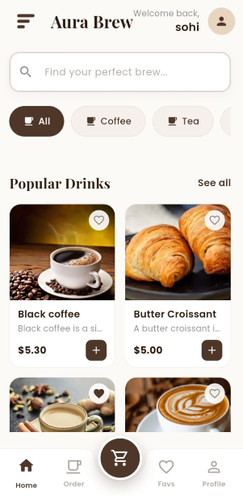
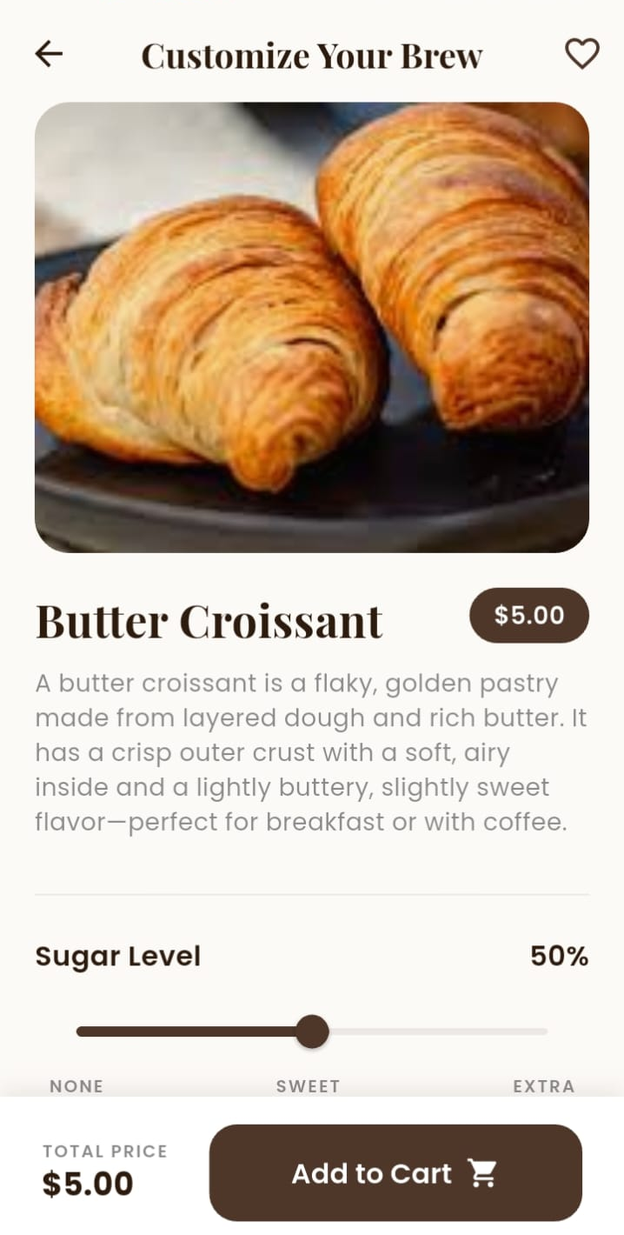
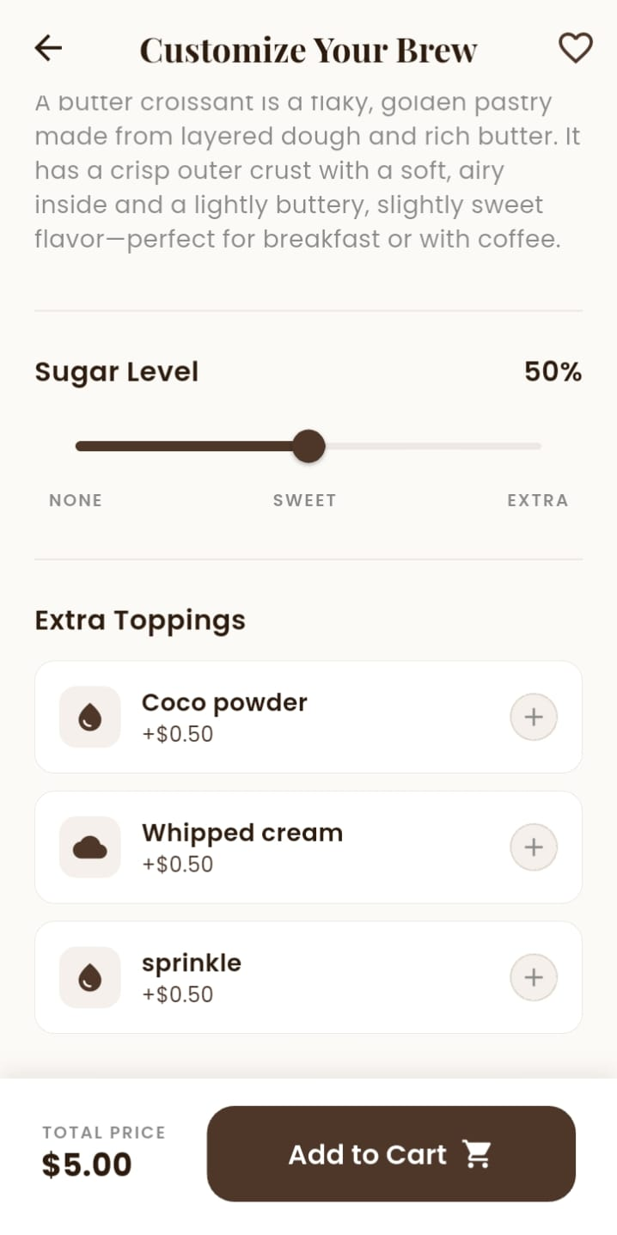
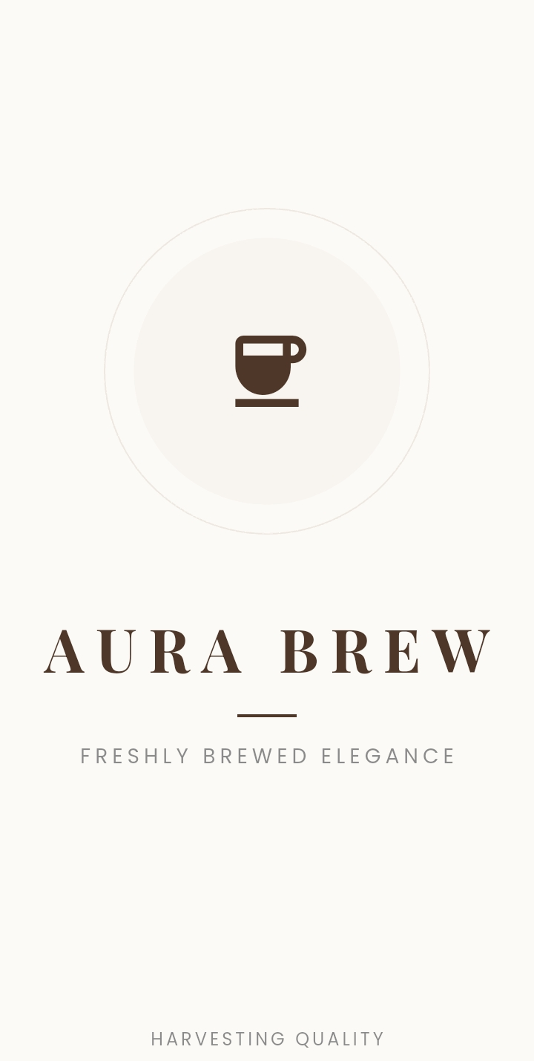
15+ Fully Designed Flutter Screens
UI SCREENS INVENTORY
Splash
Home
Customization(1)
Customization(2)

Slide 8
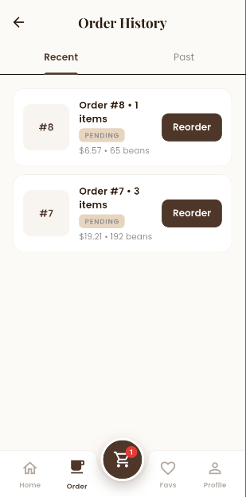
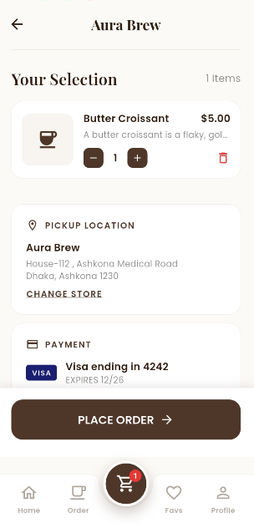
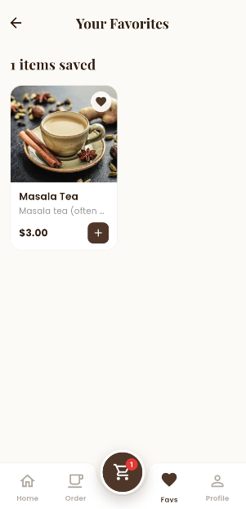
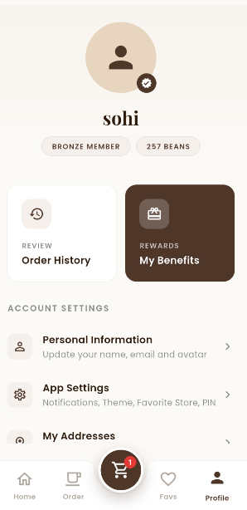
15+ Fully Designed Flutter Screens
UI SCREENS INVENTORY
Order History
Placing Order
Favorite
Profile

Slide 9
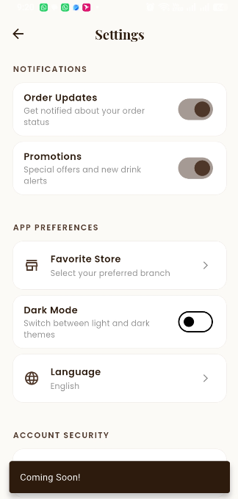
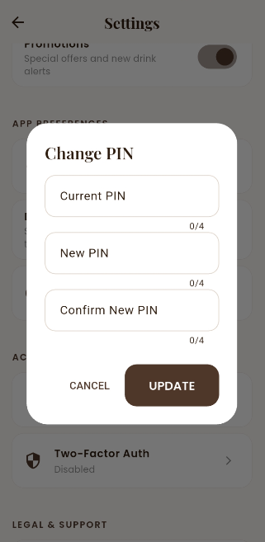
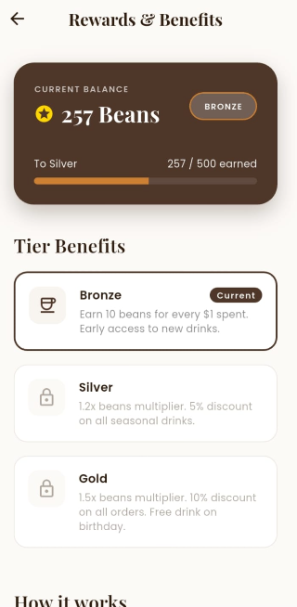
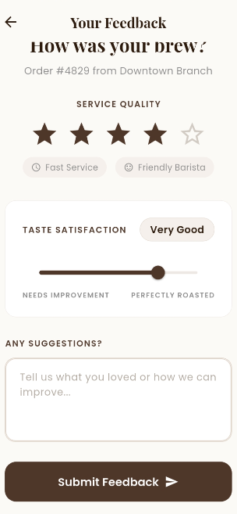
15+ Fully Designed Flutter Screens
UI SCREENS INVENTORY
Settings
Settings (2)
Rewards
Feedback

Slide 10
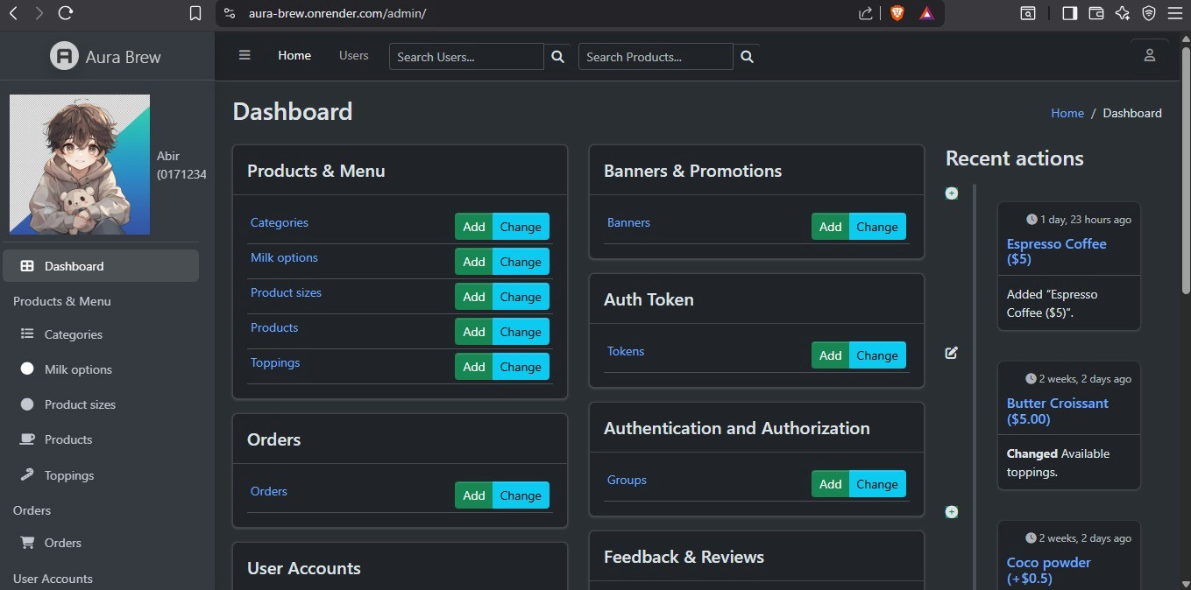
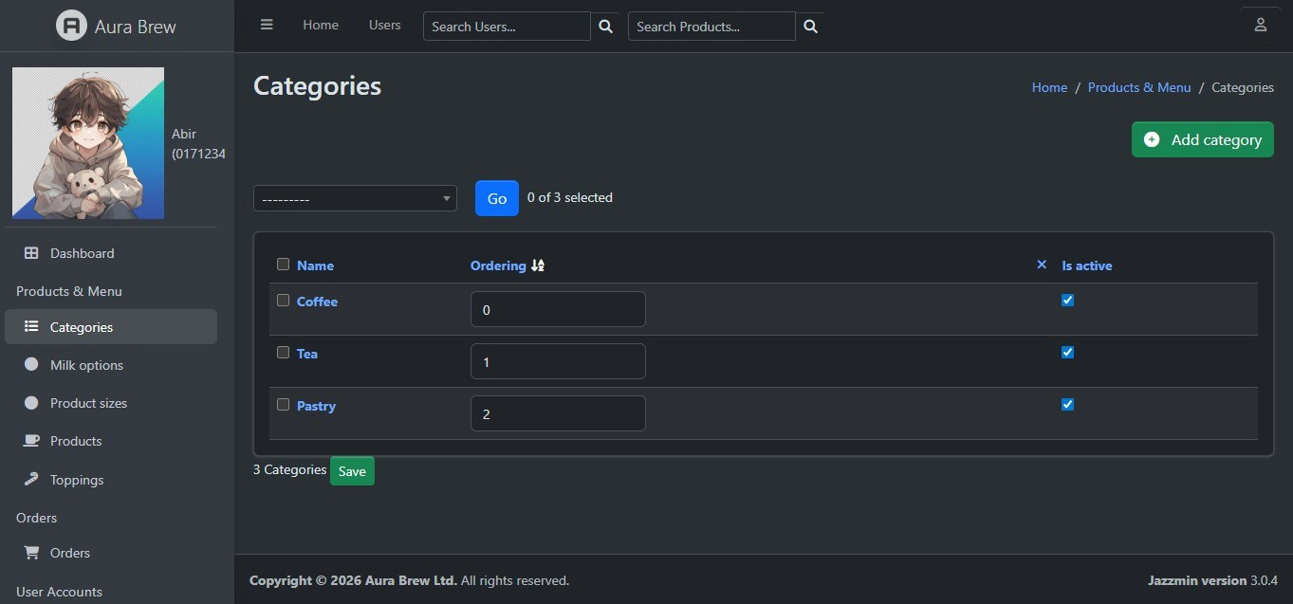
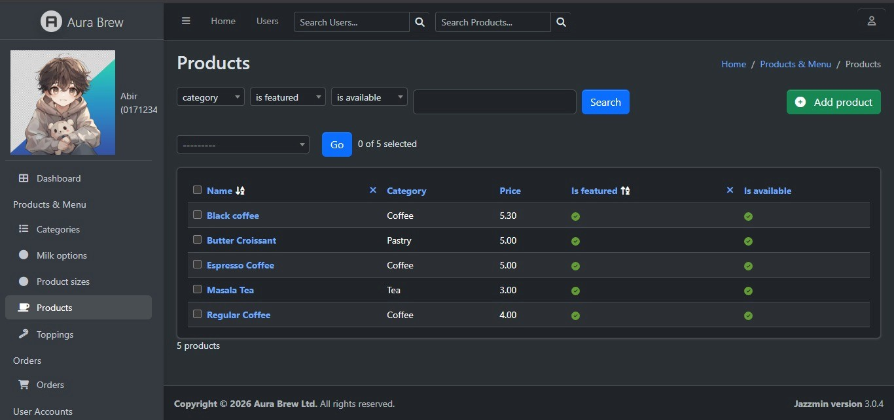
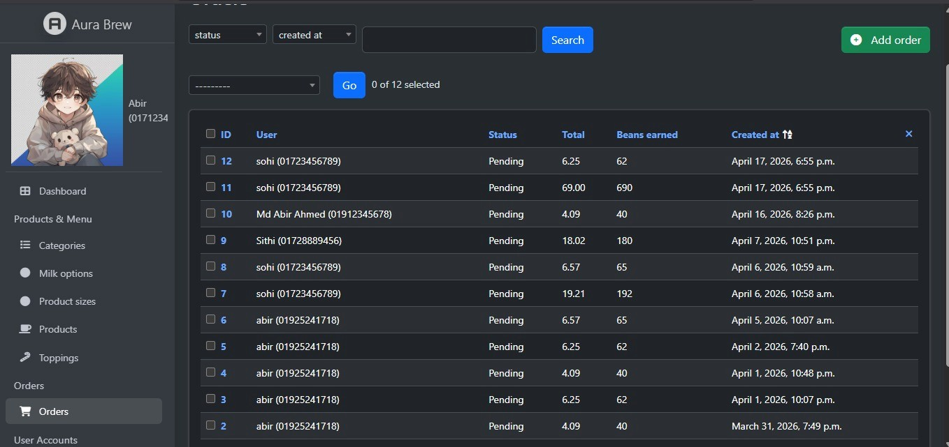
15+ Fully Designed Bckend Screens
UI SCREENS INVENTORY

Slide 11
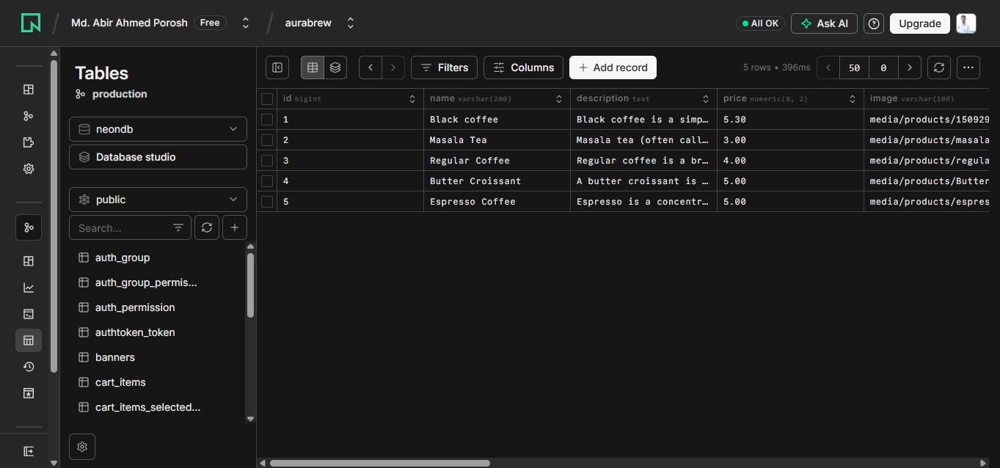
15+ Fully Designed Bckend Screens
UI SCREENS INVENTORY

Slide 12
CONTRIBUTIONS
BACKEND — Django REST API (api_server/)
FRONTEND — Flutter (mobile_app/lib/)
▸ accounts/models.py — Custom User (phone auth, PIN hashing, membership tiers, beans balance, avatar, UserAddress)
▸ screens/splash/splash_screen.dart — Animated logo + auto-login from stored token
▸ screens/onboarding/onboarding_screen.dart — Multi-page intro with page indicators
▸ accounts/serializers.py — RegisterSerializer, LoginSerializer, UserProfileSerializer, UserAddressSerializer
▸ screens/auth/login_screen.dart — Phone + PIN, validation, error handling
▸ accounts/views.py — register_view, login_view, profile_view (multipart), change_pin_view, UserAddressViewSet
▸ screens/auth/signup_screen.dart — Name, phone, email, PIN confirm, auto-login
▸ accounts/admin.py — Avatar thumbnail, inline address editing, fieldset organization
▸ core/providers/auth_provider.dart — Full auth state: login, register, profile, PIN change, addresses
▸ core/settings.py — AUTH_USER_MODEL, CORS, PostgreSQL (dj_database_url), Cloudinary, Jazzmin
▸ core/api/api_client.dart — Centralized HTTP client, token injection, multipart upload, ApiException
▸ core/api/api_config.dart — All endpoint constants (auth, products, cart, orders…)
▸ core/urls.py — Root URL config for all /api/v1/ endpoints
▸ core/models/models.dart — 14 Dart model classes with fromJson() / toJson()
▸ Render deployment: Procfile, build.sh, requirements.txt, create_admin.py
▸ core/theme/, core/constants/ — AppTheme, AppColors, AppTextStyles, AppAssets, UrlHelper
▸ main.dart — MultiProvider setup + all named route registration

Slide 13
CONTRIBUTIONS
BACKEND — Django REST API (api_server/)
FRONTEND — Flutter (mobile_app/lib/)
▸ products/models.py — Category, MilkOption, Topping, ProductSize, Product (M2M relationships)
▸ screens/home/home_screen.dart — Search, banners, category chips, featured grid, pull-to-refresh
▸ screens/main_shell.dart — BottomNavBar + IndexedStack for tab state preservation
▸ products/serializers.py — CategorySerializer (product_count), ProductListSerializer, ProductDetailSerializer
▸ screens/tea/tea_selection_screen.dart — Tea browsing with banner carousel
▸ products/views.py — CategoryList, ProductList (filter), ProductDetail, FeaturedList, AdminProductViewSet
▸ screens/customize/customize_screen.dart — Size/milk/topping/sugar UI + real-time price
▸ screens/cart/cart_screen.dart — Items, qty ± buttons, subtotal/tax/fee/total, Place Order
▸ cart/models.py — Cart (OneToOne/User), CartItem (subtotal: base + size + milk + toppings × qty)
▸ screens/favorites/favorites_screen.dart — Saved product grid + favorite toggle
▸ cart/views.py — cart_view, add_cart_item, update_cart_item, delete_cart_item, clear_cart
▸ screens/profile/profile_screen.dart — Avatar, tier badge, beans, quick-link menu
▸ screens/profile/edit_profile_screen.dart — Avatar image picker + multipart upload
▸ stores/ — Store model (name, address, hours, active status) + serializer + view
▸ screens/profile/addresses_screen.dart — CRUD dialogs for saved addresses
▸ banners/ — Banner model (title, subtitle, badge, image, linked product, order, active)
▸ screens/profile/rewards_screen.dart + screens/settings/settings_screen.dart
▸ core/providers/product_provider.dart + cart_provider.dart + favorites_provider.dart
▸ widgets/ — ProductCard, CategoryChip, AppDrawer, BottomNavBar, ShimmerLoading (+2 more)

Slide 14
CONTRIBUTIONS
BACKEND — Django REST API (api_server/)
FRONTEND — Flutter (mobile_app/lib/)
▸ orders/models.py — Order (6 status choices, beans_earned, subtotal, tax 8%, service fee $0.85), OrderItem (product_name snapshot, line_total, full customization)
▸ screens/orders/order_history_screen.dart — Chronological list, color-coded status badges (Pending/Preparing/Ready/Delivered/Cancelled), beans earned, store name, date, Reorder button
▸ orders/serializers.py — OrderItemSerializer (nested options + line_total), OrderListSerializer (item_count, store_name), OrderDetailSerializer
▸ screens/orders/order_success_screen.dart — Animated confirmation, order summary (ID, total, beans earned), navigation to home or history
▸ orders/views.py — order_list, place_order (cart→order, beans, membership upgrade, cart clear), order_detail, reorder (recreates CartItems)
▸ screens/feedback/feedback_screen.dart — Star rating selector (1–5), taste satisfaction slider (0–100%), selectable tags (Fast Service, Friendly Barista, Great Taste, Cozy Atmosphere…), free-text suggestion input, submit to API
▸ feedback/models.py — Feedback (user FK, order OneToOne, service_rating 1-5, taste_satisfaction 0-100, tags JSON array, suggestions, timestamp)
▸ core/providers/order_provider.dart — loadOrders(), placeOrder() (store_id + payment_method, returns OrderModel), reorder() (re-adds to cart), submitFeedback() (rating, satisfaction, tags, suggestions)
▸ feedback/serializers.py — Validation: service_rating 1–5, taste_satisfaction 0–100
▸ feedback/views.py — feedback_list_create: GET (user history) + POST (submit linked to order)

Slide 15
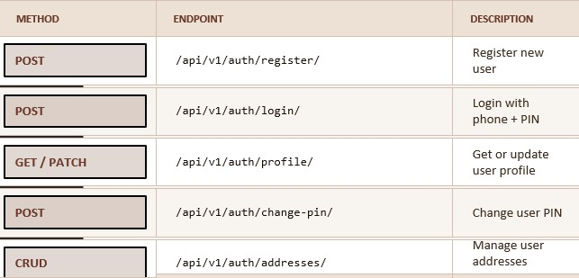
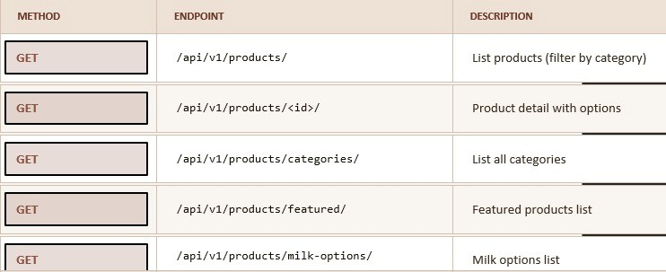
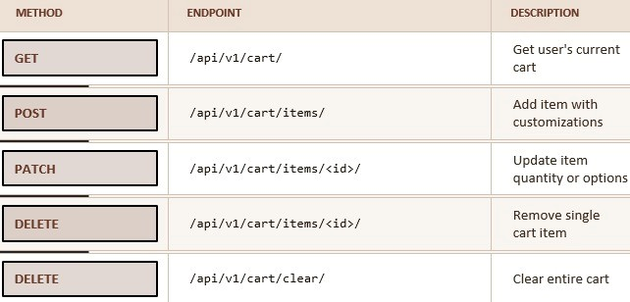
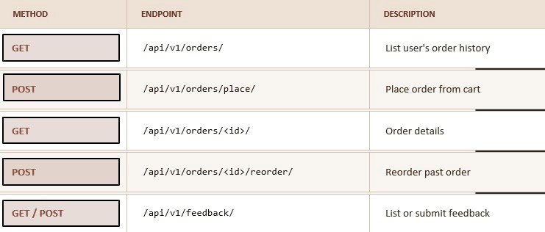
API ENDPOINT SUMMARY
Base URL: https://aura-brew.onrender.com | 22+ Endpoints
AUTH
PRODUCTS
CART
ORDERS & FEEDBACK

Slide 16
PERFORMANCE ANALYSIS
Measured Metrics vs. Targets
Metric
Target
Achieved
Optimization Applied
App Startup Time
< 3 seconds
~2 seconds
IndexedStack preserves tab state
API Response — Product List
< 500 ms
200–400 ms
select_related / prefetch_related
Image Loading
Progressive
Shimmer → fade
Cloudinary CDN edge delivery
Cart Operations
Instant UI
Optimistic UI
Provider selective notifyListeners()
APK Build Size (release)
< 30 MB
~22–25 MB
Flutter tree-shaking + minification
Database Queries
No N+1
Optimized
select_related on FK, prefetch M2M
PIN Hash Verification
< 200 ms
~100 ms
PBKDF2 hashing (Django make_password)
Static File Serving
Fast
Compressed
WhiteNoise with CompressedStaticFiles

Slide 17
GAP ANALYSIS
Aura Brew vs. Existing Coffee Ordering Applications
Feature
Existing Apps
Aura Brew
Full-Stack Open Source
Proprietary, closed-source
Fully open-source on GitHub with clean architecture
Authentication
Email/password — complex for users
Simple 4-digit PIN + phone — fast and secure
Drink Customization
Limited or basic options only
Granular: milk type, toppings, size, sugar level slider
Rewards System
Tied to paid memberships
Free Bronze / Silver / Gold tiers via bean accumulation
Cloud Deployment
Proprietary, tied infrastructure
Render + Neon.tech + Cloudinary — modern serverless stack
Cross-Platform
Often platform-specific (iOS or Android)
Flutter: single codebase for Android, iOS, Web, Desktop
Admin Dashboard
Separate external tools required
Built-in Django Jazzmin admin with custom branding

Slide 18
ETHICS, SUSTAINABILITY & SOCIETAL IMPACT
Environmental Impact
Societal Impact
• Digital menus eliminate paper waste from printed menus and receipts
• Bridges gap between local coffee businesses and digital consumers
• Remote ordering reduces unnecessary commutes and carbon emissions
• Open-source template empowers small/medium coffee shops to go digital
• Cloud-native deployment maximizes shared server resource utilization
• Reduces queue times; improves customer satisfaction and convenience
Ethical Principles
Sustainability Plan
• Data Privacy: PINs stored as PBKDF2 salted hashes — never in plaintext
• Technical: Actively maintained frameworks (Flutter, Django) ensure long-term compatibility
• Transparency: Fully open-source on GitHub for community inspection
• Operational: Cloud PaaS on Render + serverless DB eliminates hardware maintenance
• Fair Use: All technologies are open-source and freely available
• Economic: Entire stack operates within free tiers; scaling costs incremental and predictable
• No Dark Patterns: Pricing breakdown is fully transparent to users
• Notification settings are opt-in; promo notifications off by default
• Community: Open-source allows external contributions, security patching, and feature growth

Slide 19
CONCLUSION
Summary
Aura Brew successfully demonstrates the design, development, and cloud deployment of a production-grade full-stack mobile application — encompassing a Flutter mobile frontend with 15+ screens and a Django REST Framework backend with 7 modular apps and 22+ API endpoints.
Key Achievements
Secure Authentication
Drink Customization
Phone + 4-digit PIN with PBKDF2 hashing and token-based sessions
Milk, toppings, size, and sugar level with real-time price calculation
Full E-Commerce Flow
Gamified Rewards
Cart → order placement → auto pricing (tax + fee) → beans earned
Bronze → Silver → Gold tiers based on cumulative bean accumulation
Cloud Deployment
Full-Stack Delivery
Live API on Render with Neon.tech PostgreSQL and Cloudinary storage
15+ screens + 22+ endpoints + downloadable APK via GitHub Releases
CSE413: Mobile Application Design Lab | Daffodil International University, Dhaka | April 2026 | github.com/aaporosh/Aura-Brew

Slide 20
Thank You

