Slide 1

Academic Year 2025 - 26 S8 MINI PROJECT IV Final Review
PROJECT TITLE
E-CYCLE CONNECT
BIP PROJECT ID
2026EX146
CATERGORY
EXTERNAL
BATCH MEMBERS
SUMALESH K A (7376222IT266)
MADHUMETHA M (7376222IT187)
RAGUL V R (7376221CS274)
GUIDE
Dr. RAJESH KANNA P - CS10820
Assistant Professor
Department of CSE

Slide 2
ABSTRACT OF THE PROJECT
ELocate is an AI-powered e-waste management platform connecting citizens with certified recycling facilities across India. Using Faster R-CNN for device recognition, Next.js/Spring Boot architecture, and MapBox integration, it addresses India's 3.2M tonnes annual e-waste crisis where only 10% is properly recycled. The system features role-based dashboards, AI chatbot assistance, gamification, and QR-verified pickups to increase recycling rates by 15-20% while ensuring compliance with E-Waste Management Rules 2016.
AI-POWERED DEVICE RECOGNITION
Faster R-CNN model delivers real-time device identification within 2-3 seconds via camera scanning with automatic disposal recommendations.
MULTI-STAKEHOLDER ECOSYSTEM
Specialized dashboards for Citizens, NGOs, Recycling Facilities, and Administrators with facility verification and booking management.
INTELLIGENT FACILITY MAPPING
MapBox integration enables location-based discovery of certified e-waste centers with real-time navigation and proximity filtering.
GAMIFICATION & IMPACT TRACKING
Points-based rewards, leaderboards, and carbon footprint tracking (20kg CO2 saved per device) with digital certificates for sustained engagement.
SECURE & COMPLIANT ARCHITECTURE
Auth0 JWT authentication, RBAC, GDPR compliance, deployed on Vercel and Railway with PostgreSQL/MongoDB ensuring 99.9% uptime.

Slide 3
AIM OF THE PROJECT
The project aims to revolutionize e-waste management by creating a comprehensive platform that connects citizens with certified e-waste disposal facilities. By integrating advanced technologies including AI/ML, and real-time geolocation services, it provides users with an intelligent system to responsibly dispose of electronic waste, track their environmental impact, earn rewards, and contribute to reducing the global e-waste crisis while promoting environmental sustainability and regulatory compliance.

Slide 4
OBJECTIVES OF THE PROJECT
• Smart Facility Locator: Utilize AI-powered geolocation and MapBox/Leaflet APIs to identify nearest certified e-waste collection centers with real-time availability, capacity information, and accepted device types.
• Seamless Booking & Pickup System: Enable users to schedule doorstep pickups, track collection status in real-time, and receive instant confirmation with QR code verification for secure transactions. .
• Gamification & Rewards System: Develop an incentive mechanism where users earn points for each recycling transaction, redeem for vouchers or cashback, and compete on leaderboards to encourage consistent participation.
• Interactive Impact Dashboard: Visualize users' environmental contributions with metrics such as CO2 saved, materials recovered, and carbon footprint reduction, with social media sharing capabilities.
• ML-Powered Chatbot Assistant: Implement an intelligent conversational AI using NLP and machine learning to provide 24/7 support, answer e-waste queries, offer personalized recycling recommendations, and guide users through the disposal process.
• Educational Hub: Provide comprehensive resources including video tutorials, recycling guides, environmental impact calculators, and sustainability courses with certification to raise awareness.
• Corporate Dashboard: Enable businesses to manage bulk e-waste disposal, track compliance with environmental regulations, access detailed analytics, and generate automated CSR reports.
• Multi-Platform Accessibility: Develop responsive web application using Next.js and mobile applications for iOS and Android with offline mode, push notifications, and barcode scanning for device registration.

Slide 5
PROBLEM STATEMENT
E-waste Crisis: 53.6 million tons of e-waste generated globally in 2019, projected to reach 74 million tons by 2030, with exponential growth rates.
Poor Recycling Rates: Only 17.4% of e-waste is properly recycled, leaving 82.6% improperly disposed, causing severe soil, water, and air pollution.
Toxic Materials: E-waste contains hazardous substances (lead, mercury, cadmium, beryllium) causing serious health risks and long-term environmental damage.
Consumer Awareness Gap: Most people lack knowledge about where and how to dispose of electronic devices safely and responsibly.
Fragmented Infrastructure: No centralized platform connecting citizens with verified, certified recycling facilities in their local area.
Compliance Challenges: Organizations struggle to track proper disposal, obtain documentation for CSR requirements, and meet environmental regulations.
Lack of Incentives: No motivation system exists to encourage people to consistently recycle their e-waste instead of discarding it improperly.

Slide 6
LITERATURE SURVEY
Sl.No. | Journal Paper Title with Author | Works carried out ( with details of Methods/ Materials/ Software/ Algorithms / fabrication / techniques/ components used ) | Information gathered relevant to your project
1 | Kumar, A., et al. "Smart E-waste Management System using IoT and Cloud Computing." International Journal of Environmental Research and Public Health. 2021.. | The authors developed a location-based service using GPS and Google Maps API to identify nearest e-waste collection centers. Used MongoDB for facility data storage and RESTful APIs for real-time tracking. | This research informs our project's facility locator feature by demonstrating how geolocation services and map APIs can efficiently connect users with disposal centers, providing insights into real-time tracking implementation.
2 | Lee, H., & Park, S. "Hybrid Database Architecture for Scalable Environmental Applications." ACM Transactions on Database Systems. 2022. | Developed facility management system for e-waste collection centers with capacity tracking, certification verification, and real-time data synchronization. Used GIS mapping to optimize facility locations and coverage areas. Implemented REST APIs for facility registration and status updates. | This research informs our facility management features, showing how to maintain verified facility databases, track collection center capacities, and ensure proper certification. Provides insights into facility network optimization for maximum coverage and accessibility.
3 | Patel, K., & Desai, M. "Gamification Strategies to Promote Sustainable E-waste Disposal Behavior." Sustainability. 2021. | Created gamification framework with point-based rewards, leaderboards, and achievement badges. Used behavioral psychology principles to increase participation by 67%. | This study informs our rewards and incentive system, providing methodologies for user engagement through gamification, point systems, and social recognition to encourage recycling behavior.

Slide 7
LITERATURE SURVEY
Sl.No. | Journal Paper Title with Author | Works carried out ( with details of Methods/ Materials/ Software/ Algorithms / fabrication / techniques/ components used ) | Information gathered relevant to your project
4 | Silva, R., & Costa, M. "Circular Economy Ecosystem for Electronic Waste: Stakeholder Integration and Value Chain Analysis." Resources, Conservation & Recycling. 2023. | Analyzed e-waste circular economy ecosystem connecting consumers, NGOs, recyclers, and manufacturers. Developed multi-stakeholder platform with role-based workflows and value chain tracking. Demonstrated 35% increase in material recovery through ecosystem integration. | This study provides framework for our multi-stakeholder ecosystem approach, validating our role-based system (Citizens, NGOs, Admins). Shows how connecting different actors in the e-waste value chain creates sustainable circular economy and improves overall recycling rates.
5 | Chen, W., & Liu, Y. "Design and Implementation of Multi-platform Waste Management Application." International Journal of Computer Applications. 2022. | Developed React-based web portal and React Native mobile apps with Spring Boot backend. Implemented offline mode with local storage and push notification system. | This research validates our choice of Next.js for web and mobile app development, showing how responsive design and offline capabilities enhance user experience.
6 | Anderson, T., et al. "Visualizing Environmental Impact: Dashboard Design for Sustainable Behavior Tracking." Journal of Environmental Psychology. 2021. | Created environmental impact dashboard using D3.js and Chart.js to display CO2 savings, waste diverted, and resource recovery metrics. Users showed 45% increase in recycling frequency. | This study informs our impact dashboard feature, providing methods to visualize carbon footprint reduction, material recovery, and environmental metrics to motivate continued user participation.

Slide 8
SCOPE OF THE PROJECT
1. Smart Facility Locator & Booking System: Uses GPS and MapBox/Leaflet APIs to identify nearest certified e-waste collection centers with real-time availability, and enables doorstep pickup scheduling with QR verification.
2. AI/ML Integration: Implements machine learning for automated device recognition from photos and NLP-powered chatbot providing 24/7 support, personalized recommendations, and guided disposal assistance.
3. Gamification & Impact Dashboard: Provides point-based rewards system with leaderboards, and visualizes environmental impact including CO2 savings, materials recovered, and carbon footprint reduction.
4. Multi-Stakeholder Role System: Implements secure role-based platform for Citizens, NGOs, and Administrators with customized workflows, corporate compliance tracking, and automated CSR reporting.
5. Circular Economy Ecosystem: Connects all stakeholders in sustainable value chain with educational resources, certification programs, and analytics to maximize material recovery and promote environmental awareness.

Slide 9
NEED FOR THE CURRENT STUDY
With the exponential growth of electronic waste (53.6 million tons in 2019, projected to reach 74 million tons by 2030), there is an urgent need for technology-driven solutions to address the e-waste crisis. Current disposal methods are fragmented, with only 17.4% of e-waste being properly recycled. Citizens lack awareness about certified disposal facilities, and there is no centralized platform connecting users with verified recycling centers in their area.
This study addresses these critical limitations by developing a comprehensive e-waste management platform that integrates smart facility location services, real-time booking systems, and AI/ML technologies. By combining GPS-based geolocation with MapBox/Leaflet APIs, users can instantly locate nearest certified collection centers. The platform incorporates gamification and rewards to encourage participation, while impact dashboards visualize environmental contributions (CO2 savings, materials recovered) providing data-driven motivation for sustainable behavior.
The system creates a multi-stakeholder circular economy ecosystem connecting citizens, NGOs, and businesses through role-based workflows. This addresses the gap identified in literature regarding stakeholder integration and value chain optimization. By implementing secure authentication, facility network management, and corporate compliance tracking, the platform ensures proper documentation for CSR requirements and regulatory compliance, making e-waste disposal more accessible, transparent, and effective for users of all types

Slide 10
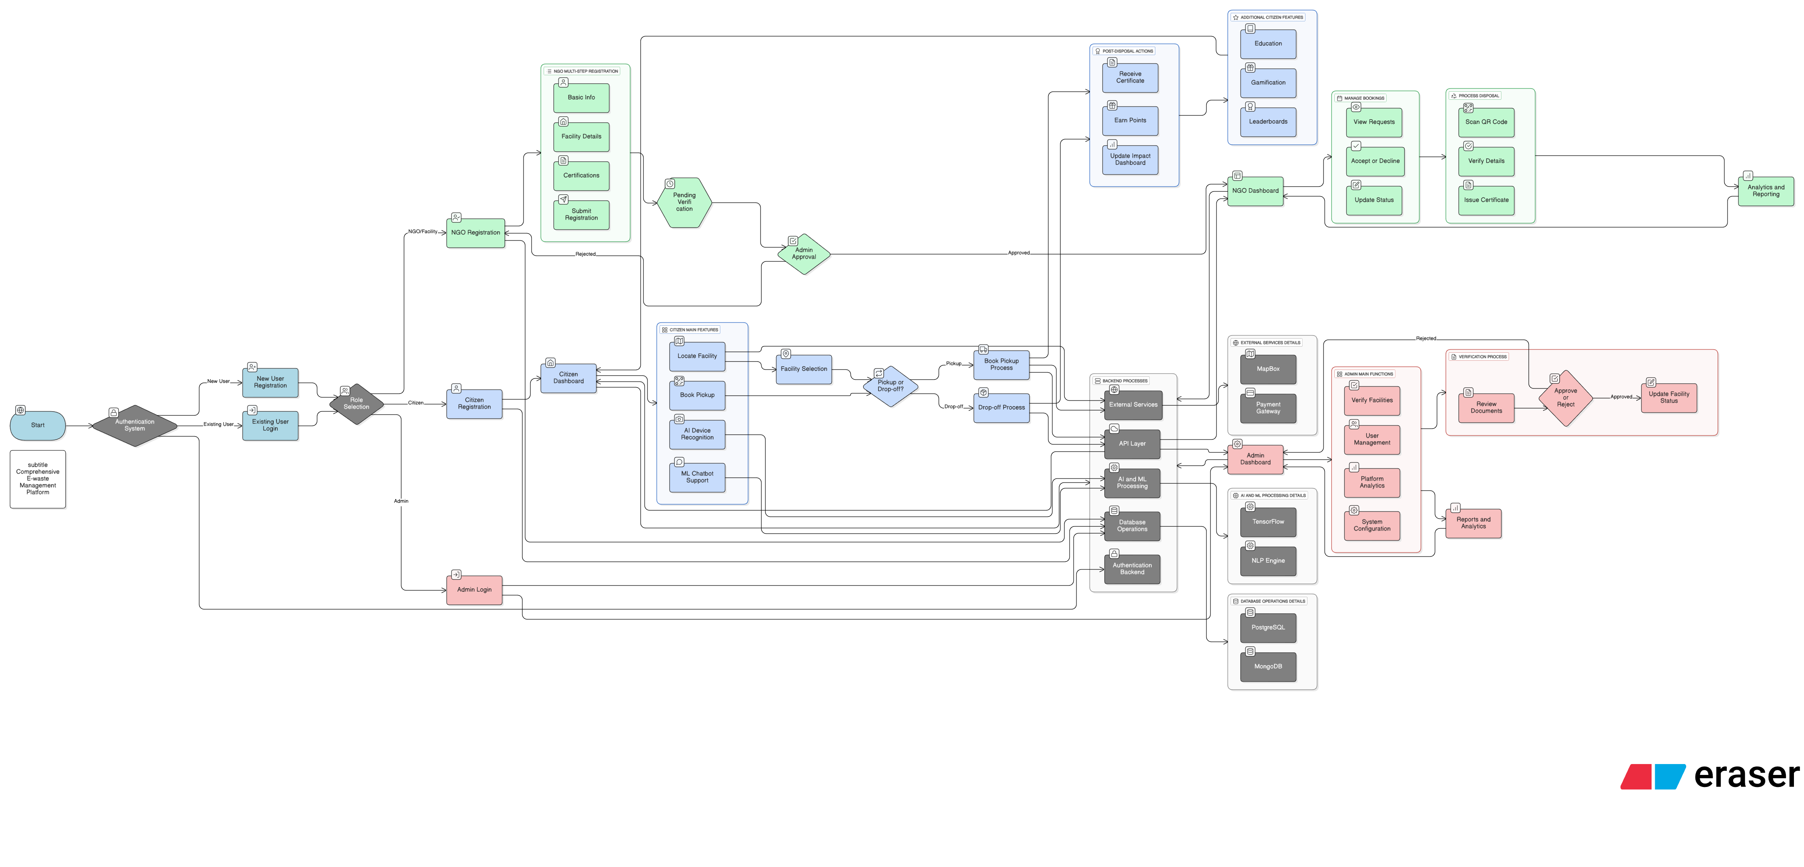
PROPOSED METHODOLOGY ( Flow Chart)
.

Slide 11
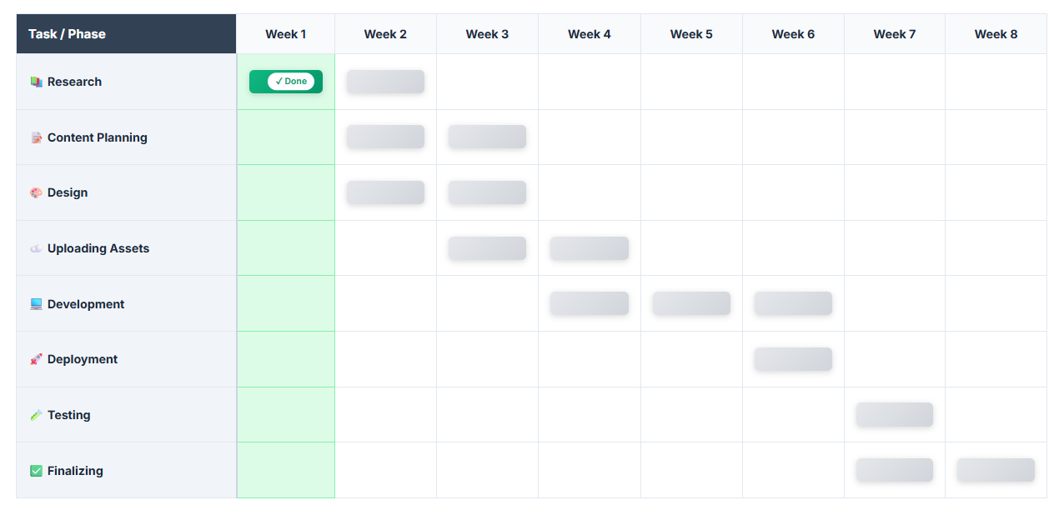
PROPOSED METHODOLOGY ( Overall Gantt Chart)
.

Slide 12
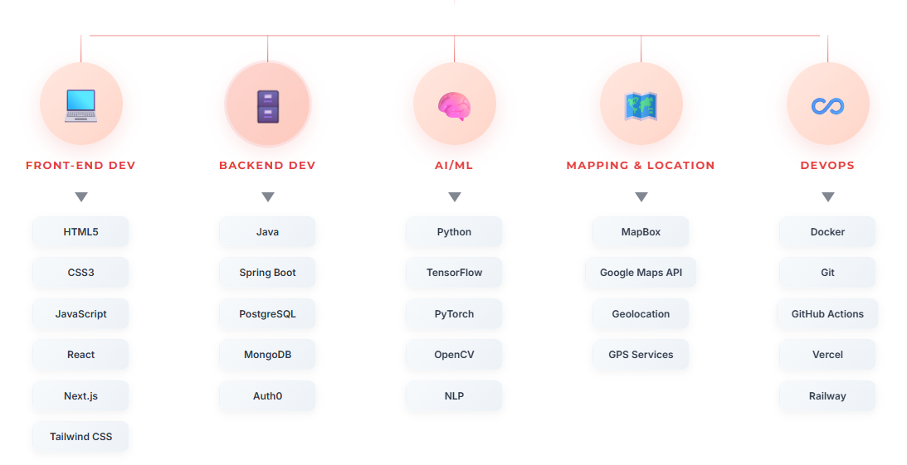
CHOICE OF COMPONENTS / MODULES / METHODS/TECHNIQUES EQUIPMENT USED FOR PROJECT DEVELOPMENT

Slide 13
CHOICE OF COMPONENTS / MODULES / METHODS/TECHNIQUES EQUIPMENT USED FOR PROJECT DEVELOPMENT
Front-End Development: HTML, CSS, and JavaScript are used to design and structure the user interface. React and Next.js frameworks provide dynamic, responsive components for seamless user experience. Tailwind CSS enables rapid, utility-first styling for modern aesthetics.
Back-End Development: Java with Spring Boot framework is implemented for handling server-side logic, RESTful API development, and robust business layer operations. PostgreSQL manages relational data for users, facilities, and bookings, while MongoDB handles unstructured data for AI model outputs and analytics.
Deep Learning: Utilizes TensorFlow and PyTorch for object detection algorithms to identify and classify e-waste devices through image recognition. Convolutional Neural Networks (CNN) are employed for visual pattern detection in device categorization.
AI & Text Detection: Employs Natural Language Processing (NLP) for ML-powered chatbot support and device information extraction. OpenCV is used for real-time QR code scanning and device recognition through camera integration.
Mapping & Location Services: MapBox API provides interactive mapping for e-waste facility visualization and real-time location tracking. Google Maps integration enables geolocation, route optimization, and distance calculation for pickup services.
Authentication & Security: Auth0 handles secure user authentication with JWT token-based authorization. Role-based access control (RBAC) ensures proper separation of Citizen, NGO, and Admin functionalities.
Testing: Comprehensive testing suite includes unit tests for backend services, integration tests for API endpoints, and end-to-end tests for user workflows. Automated testing validates system reliability and performance.
DevOps: Docker ensures smooth containerization and deployment across environments. Git and GitHub Actions provide version control and CI/CD pipelines. Vercel hosts the frontend application, while Railway manages backend infrastructure deployment.
Gamification & Analytics: Real-time impact dashboards visualize user contributions, CO2 savings, and e-waste statistics. Points system, leaderboards, and digital certificates drive user engagement through reward mechanisms.
Data Processing: Python scripts handle batch processing for analytics, report generation, and predictive modeling. Data pipelines aggregate facility performance metrics and environmental impact calculations.

Slide 14
INDIVIDUAL CONTRIBUTIONS TO THE WORK
Batch Member 1 : (7376222IT266 – SUMALESH K A)
1. Database Design & Setup
• Design PostgreSQL schema (users, facilities, bookings)
• Create MongoDB collections for AI outputs and analytics
2. Authentication APIs
• Implement Auth0 backend configuration
• Build login/signup endpoints with JWT token management
3. Citizen Service APIs
• Develop facility search, booking creation, and QR generation APIs
• Build certificate generation and points/rewards system
4. NGO & Admin Service APIs
• Create NGO registration, verification, and booking management endpoints
• Build admin facility approval and user management APIs
5. Third-Party Integrations
• Integrate MapBox API for geolocation
• Set up email/SMS notifications (SendGrid, Twilio)
6. DevOps & Deployment
• Set up Docker containerization and CI/CD with GitHub Actions
• Deploy frontend to Vercel and backend to Railway
7. Security & Testing
• Implement API rate limiting, validation, and security headers
• Conduct load testing and write comprehensive API tests

Slide 15
INDIVIDUAL CONTRIBUTIONS TO THE WORK
Batch Member 2 : (7376222IT187 – MADHUMETHA M)
1. UI/UX Design
• Create wireframes and mockups for all dashboards
• Develop design system (colors, typography, components)
2. User Authentication Interface
• Implement Auth0 login/signup pages
• Build multi-role registration forms (Citizen, NGO, Admin)
3. Citizen Module Development
• Build Citizen Dashboard with MapBox facility locator
• Create AI Device Recognition camera interface and ML Chatbot UI
4. Booking & Gamification Features
• Develop Book Pickup form with QR code generation
• Implement Impact Dashboard, points system, and leaderboards
5. NGO Module Development
• Build multi-step NGO registration and verification interface
• Create Booking Management and QR scanner components
6. Admin Module Development
• Build Admin Dashboard with facility verification interface
• Develop User Management and Platform Analytics visualization
7. Responsive Design & Testing
• Ensure mobile responsiveness for all pages
• Optimize performance and conduct UI/UX testing

Slide 16
INDIVIDUAL CONTRIBUTIONS TO THE WORK
Batch Member 3 : (7376221CS294 – RAGUL V R)
1. Project Conceptualization
• Define project scope, objectives, and key features
2. Research about Project
• Literature survey on e-waste management and AI-based classification systems
• Study existing solutions and document findings
3. Analysis of Algorithm
• Evaluate object detection algorithms (YOLO, FRCNN, SSD)
• Compare deep learning frameworks and select optimal approach
4. Deep Learning Model Development
• Design CNN architecture for e-waste device classification
• Prepare training dataset (10,000+ images) and label categories
5. Model Training & Optimization
• Train FRCNN model for device recognition
• Develop NLP model for chatbot functionality
6. AI Model Integration
• Integrate trained models with backend API
• Create REST endpoints for real-time predictions

Slide 17
FUTURE SCOPES
Blockchain Integration for Transparency - Immutable ledger for e-waste disposal tracking and NFT-based certificates
IoT-Enabled Smart Collection Bins - Real-time fill-level monitoring and automated pickup scheduling
AR-Based Device Disassembly Guide - Augmented Reality instructions for safe device disassembly and component removal
Marketplace for Refurbished Electronics - Integrated platform for selling refurbished devices to promote circular economy
AI-Powered Predictive Analytics - Machine learning models to forecast e-waste generation patterns and optimize resource allocation

Slide 18
REFERENCES ( Journal Papers/ Books / Website in IEEE Format )
Journal
[Kumar, Ashok, et al. "E-waste management: A review of recycling process, environmental and occupational health hazards, and potential solutions." Environmental Nanotechnology, Monitoring & Management 15 (2021): 100409.
Forti, Vanessa, et al. "The Global E-waste Monitor 2020: Quantities, flows, and the circular economy potential." United Nations University/United Nations Institute for Training and Research, International Telecommunication Union, and International Solid Waste Association (2020).
Conference Proceedings
Mittal, Gargi, et al. "SpotGarbage: smartphone app to detect garbage using deep learning." Proceedings of the ACM India Joint International Conference on Data Science and Management of Data (2016): 228-234.
Thung, Gary, and Mindy Yang. "Classification of trash for recyclability status." CS229 Project Report, Stanford University (2016).
Online Resources
World Health Organization. "Electronic waste (e-waste)." WHO Fact Sheet (2021). Available: https://www.who.int/news-room/fact-sheets/detail/electronic-waste-(e-waste)
United Nations Environment Programme. "Waste Management." UNEP Resources (2023). Available: https://www.unep.org/explore-topics/resource-efficiency/what-we-do/cities/waste-management
Books
Widmer, Rolf, et al. "Global perspectives on e-waste." Environmental Impact Assessment Review 25.5 (2005): 436-458.
Sthiannopkao, Suthipong, and Ming Hung Wong. "Handling e-waste in developed and developing countries: Initiatives, practices, and consequences." Science of the Total Environment 463 (2013): 1147-1153.

