Slide 1

.
Suma modugu
Joseph pavan Koushik reddy

Slide 2
CREATE YCREATE YOUR OWN EMOJI WITH create your own emoji with deep learning using CNN LEARNINGOUR OWN EMOJI WITH DEEP LEARNING

Slide 3
approach
Emojis or avatars are ways to indicate nonverbal cues. These cues have become an essential part of online chatting, product review, brand emotion, and many more. It also lead to increasing data science research dedicated to emoji-driven storytelling.
With advancements in computer vision and deep learning, it is now possible to detect human emotions from images. In this deep learning project, we will classify human facial expressions to filter and map corresponding emojis or avatars.

Slide 4
deliverables
The FER2013 dataset ( facial recognition) consists of 48*48 pixel grayscale face images.
The images are centered and occupy an equal amount of space. This dataset consist of facial emotions of following categories.
Algorithms developed for learning agent using python programming language.

Slide 5
Facial emotions categories:
1:Angry
2:Disgust
3:fear
4: sad
5: surprise
6: natural

Slide 6
Libraries used:
1. Pandas
2. NumPy
3. Matplotlib
4. Seaborn
5. os
6. datetime
7. tensorflow
8. CV2
9. Tkinter

Slide 7

CNN
CONVOLUTIONAL NEURAL NETWORKS
Convolutional Neural Networks (or convnets) are based on thefollowing principles:
Local receptive fields
Shared weights
Pooling (or down-sampling)

Slide 8
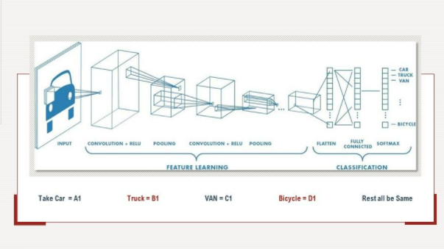
This special neural network architecture takes advantage of thespatial structure of data.
.

Slide 9
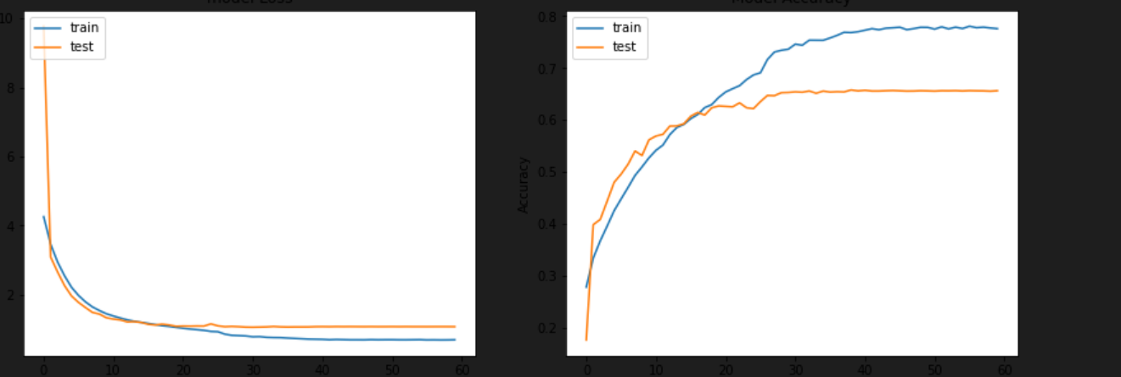
LOSS AND ACCURACY PLOT

Slide 10
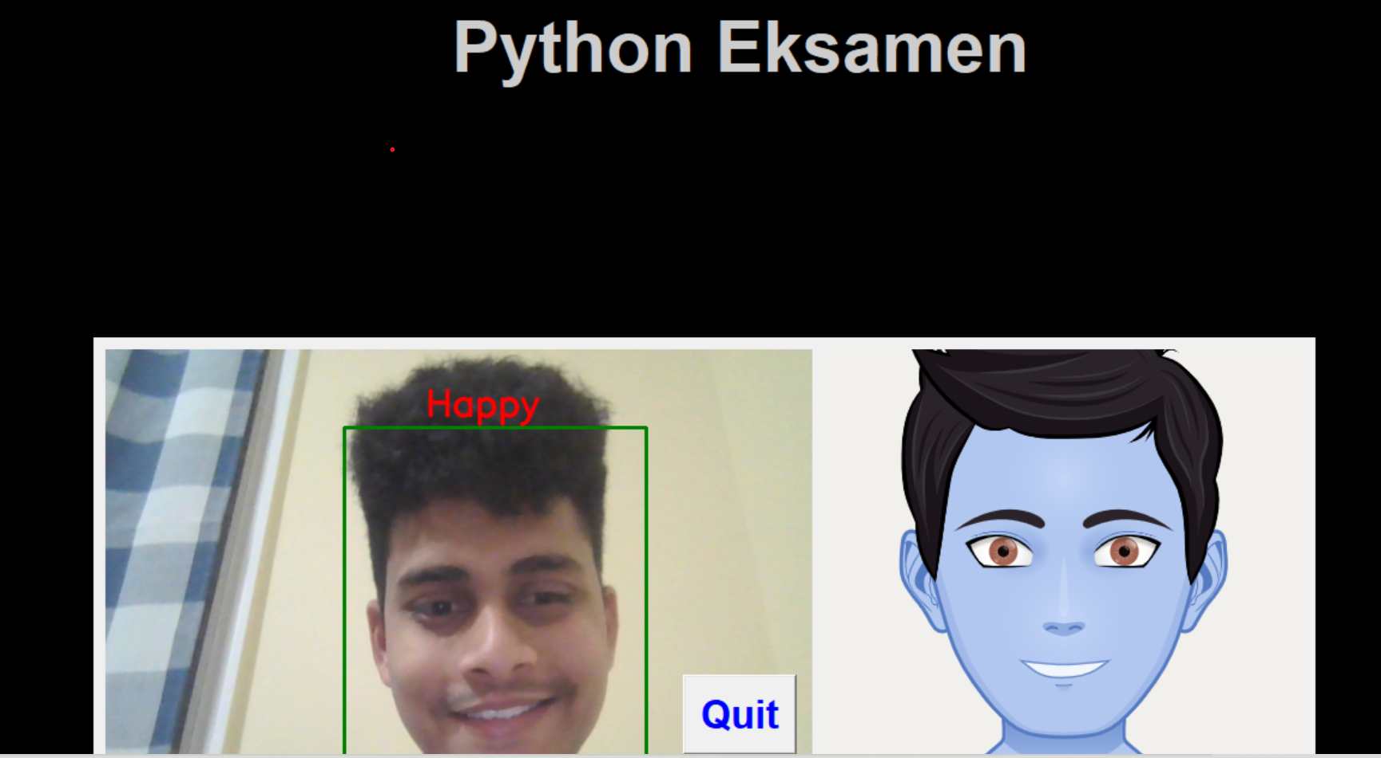
RESULTS

Slide 11
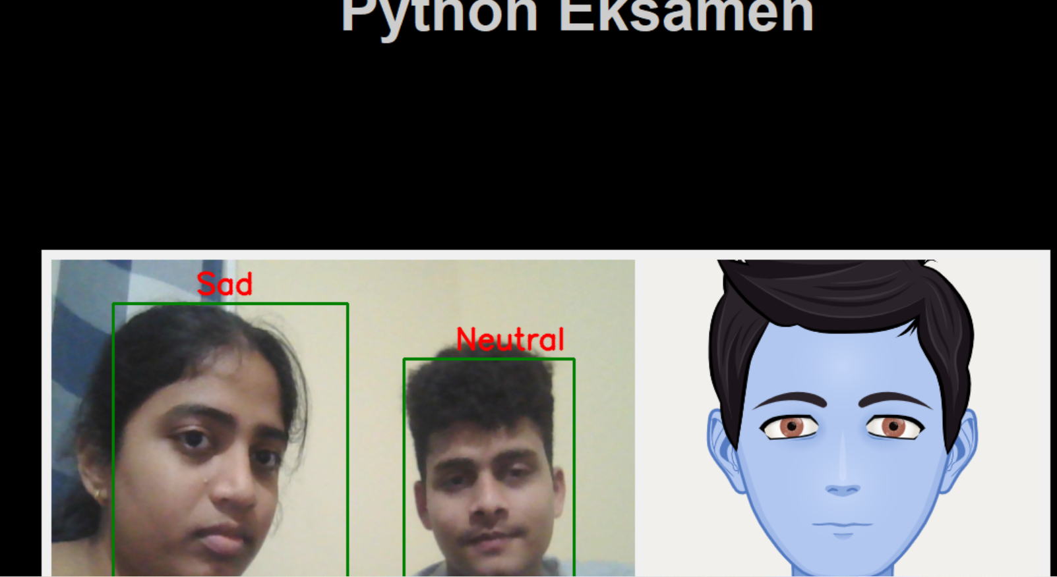
MULTIPLE FACES

Slide 12

THANKYOU

