Slide 1





Erasure Coding with Cloud Storage
#GHCI15
Suman Debnath
Member of Technical Staff
NetApp, Inc.
2015

Slide 2
Agenda
Why Erasure Coding
How Erasure Coding works
Implementation of Erasure Coding
Performance Analysis
Conclusion

Slide 3
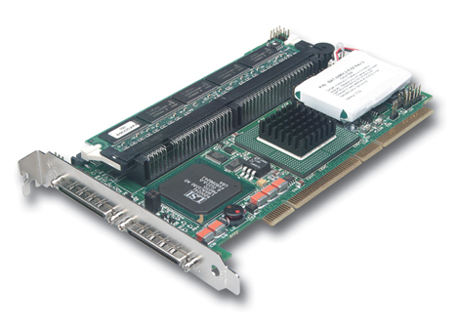

Why Erasure Coding
Want more protection from dual failure
Data protection should scale seamlessly
We want to build a volume that has a configurable degree of redundancy with a small space waste
Can be used simply on top of JBOD( Just bunch of disk)
RAID controllers are expensive

Slide 4

Why Erasure Coding
Replication is always expensive
(2-way, 3-way, n-way)
200 % + overhead ☹

Slide 5
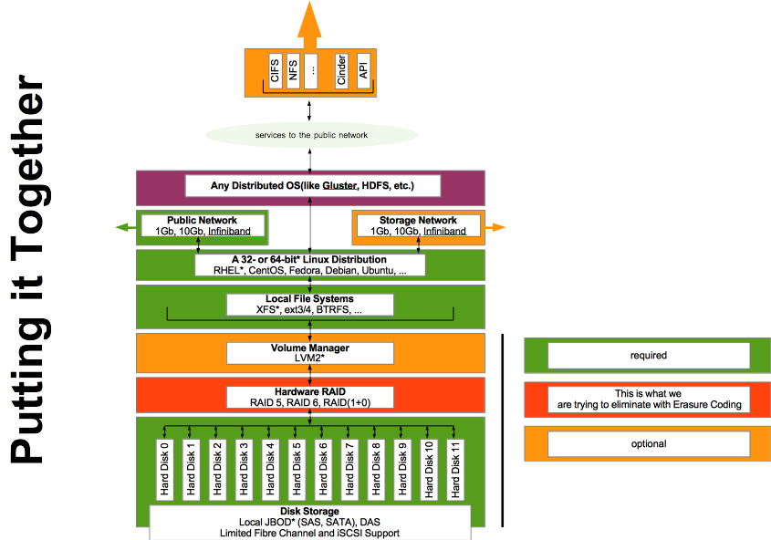
First Blush
Erasure Coded Volume

Slide 6
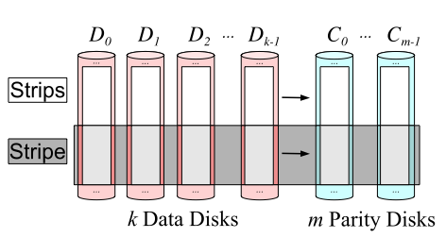
How it works
Erasure Code
Store “k” disk worth of data in “n” total required disk
(n > k)
“m” redundant disk
Pick “m” to choose the failure tolerance
(n = k + m)
A generalization of RAID6
Distributed across the nodes

Slide 7
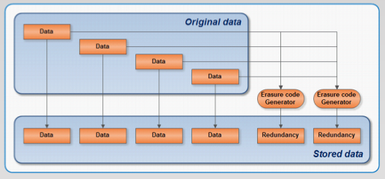
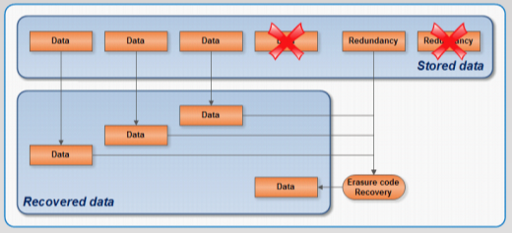
Erasure Code Algorithm
Based on erasure codes
Fast implementation of the Rabin IDA (Information Dispersal Algorithm)
m additional fragments are computed from a set of n– k data fragments
Any data fragment can be recovered from any subset of n – k fragments (data or redundancy)

Slide 8
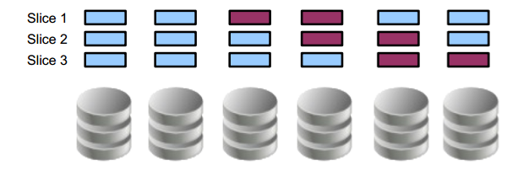
Systematic
“k” data chunks, “m” coding chunks
Can stripe parity and data on the same disk
Reads are simple, only decode in case of failure/repair

Slide 9
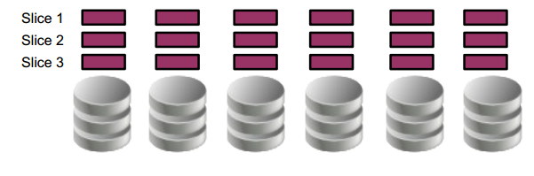
Non-Systematic
All “n” chunks in a stripe are coded
Encode/Decode for each read/write

Slide 10
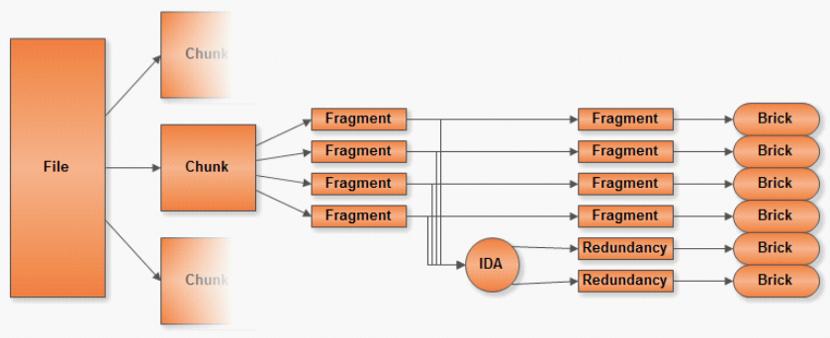
Write Operation

Slide 11
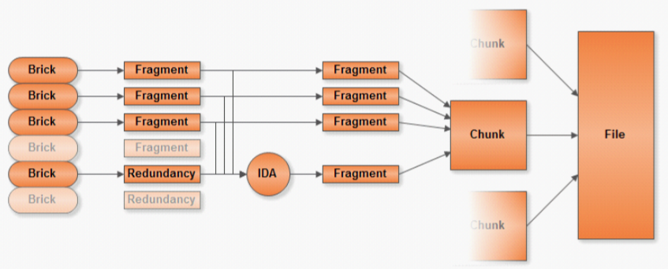
Read Operation

Slide 12
Implementation of Erasure Coding
Distributed Operating System
HDFS
Ceph
GlusterFS (Dispersed Volume)

Slide 13
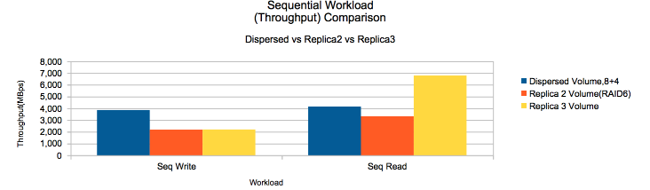
Performance Comparison

Slide 14
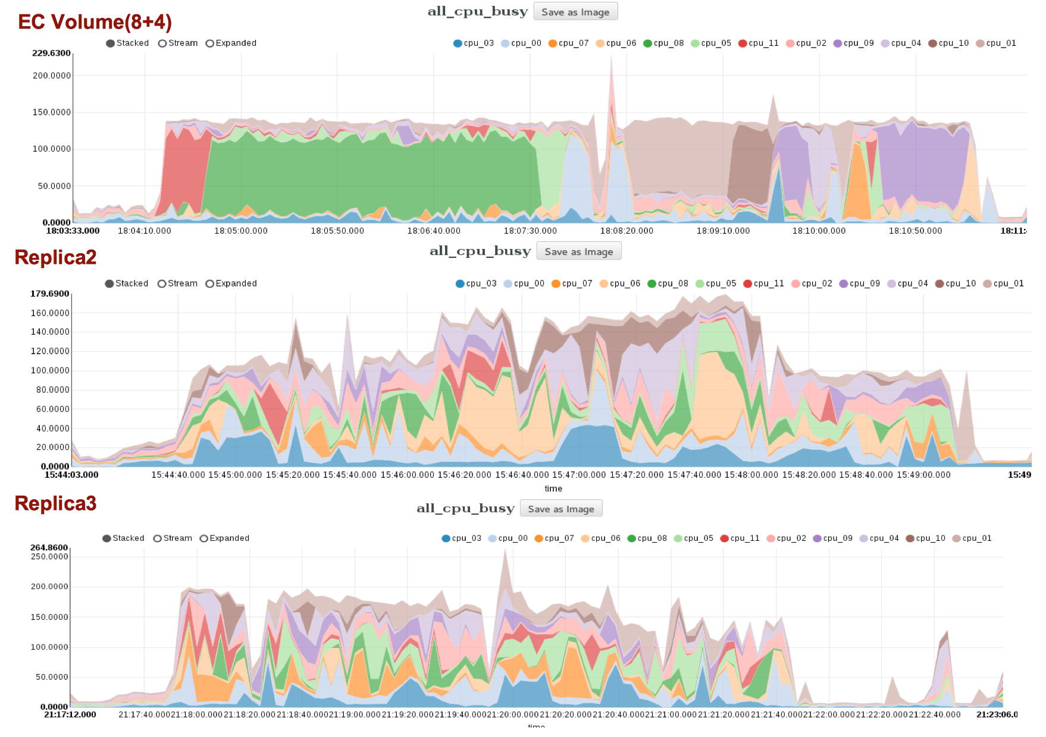
Performance Comparison

Slide 15
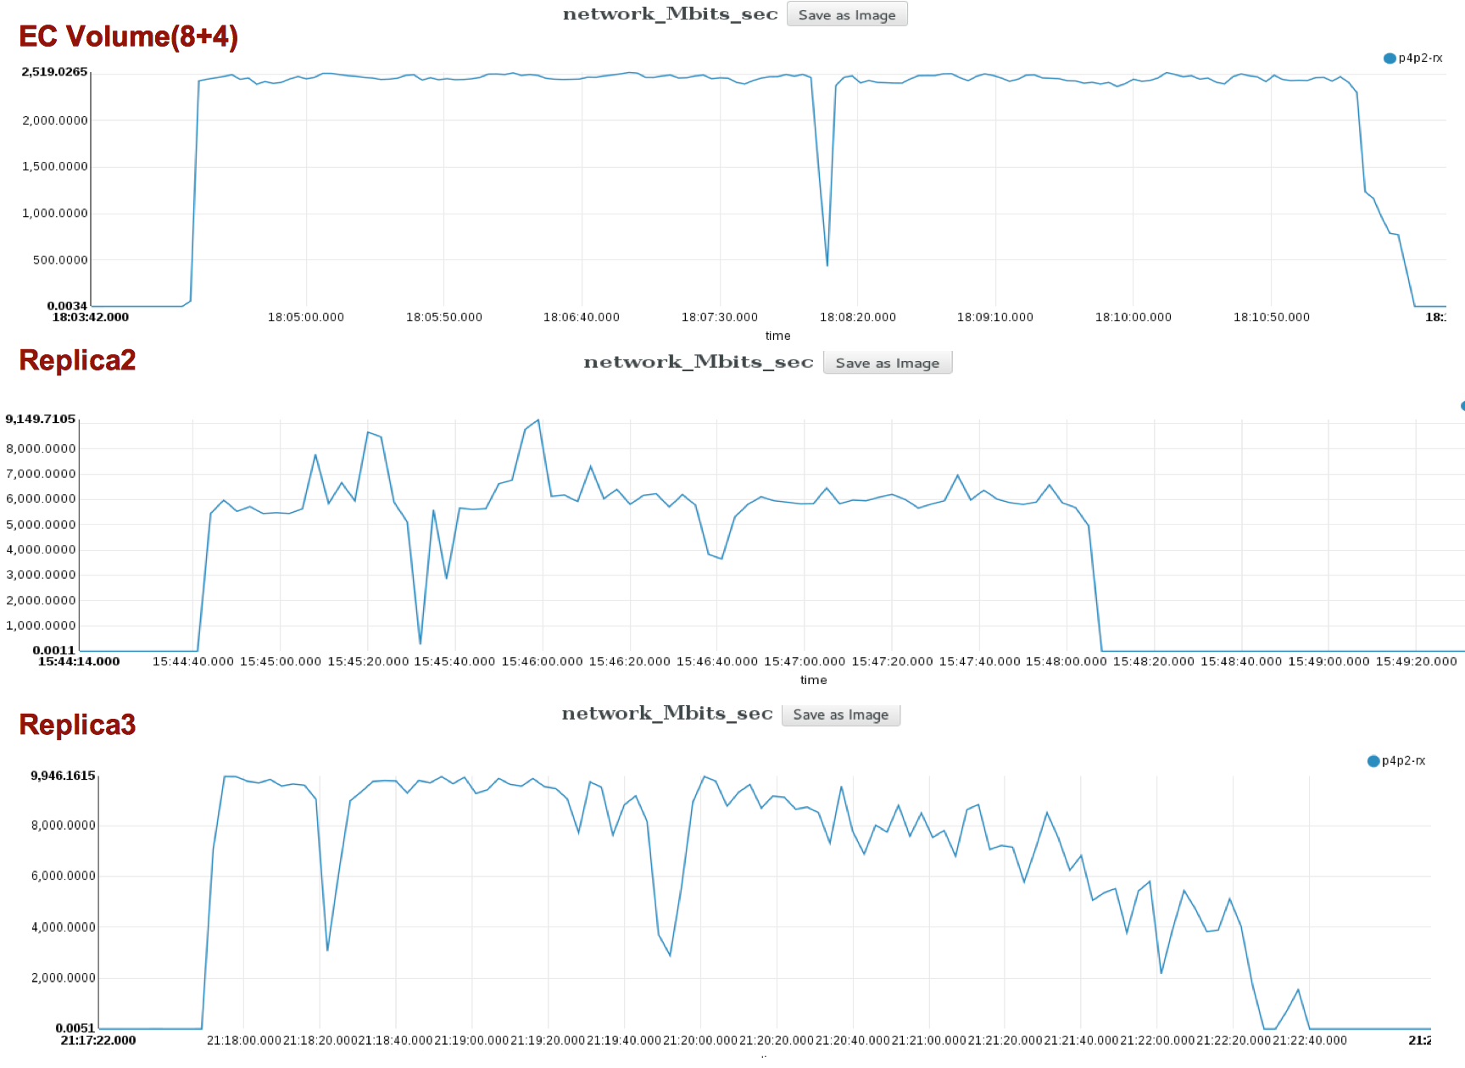
Performance Comparison

Slide 16
Conclusion
Pros:
Big Data workload
Sequential workload
Distributed Environment
Archiving and data backup
Cons:
Performance for random workload
Immature for production environment

Slide 17

Got Feedback?
Rate and review the session on our mobile app – Convene
For all details visit: http://ghcindia.anitaborg.org
Notes:
This is the last slide and must be included in the slide deck

Slide 18
Back up slides

Slide 19
GlusterFS Implementation
Install the package(in all the storage servers)
Start the GlusterD service
Peer probe the other storage server(creating the cluster)
Create and mount a file system to host a brick
Create a Dispersed Volume(Erasure Coded Volume)
Mount the volume

Slide 20
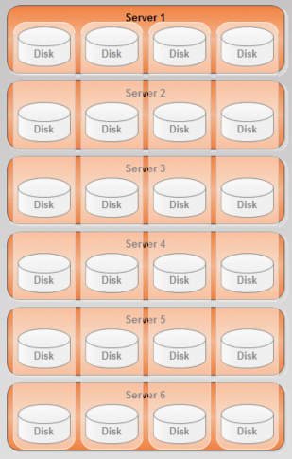
GlusterFS Implementation
Scenario
6 servers with 4 SATA drives 4TB each
Each drive is configured as 1 brick(disk)
Dispersed Volume(Erasure Coded)
Erasure Coded volume, 6.2(k = 4, m = 2)
Effective Capacity 64 TB([6*4*4] – [4*2*4])
Maximum failed bricks : 2
Maximum failed servers : 2

Slide 21
How it works in GlusterFS
Configurable level of fault tolerance
Volume can have any number of drives(bricks, “B”)
A level of redundancy must be defined(“R”)
Effective Space (B – R)
Redundancy is distributed evenly across all the drives(bricks)
Tradeoff between reliability and available space

Slide 22
How it works in GlusterFS
Minimum storage wastage
Each file is divided into chunks of size “S”
Each chunks is split into fragments
Additional redundancy fragments are generated
Each fragment is stored in each drive(brick)
The proportion of wastage of storage is R/B
Read
R disks do not need to be accessed
Some reads can be served in parallel
Write
All alive disks are accessed
No parallelism

Slide 23
Cli Command
$ gluster volume create EC_Vol_01 disperse 12 redundancy 4 \
Storage_Node{01,02,03,04,05,06}:/bricks/b0{1,2}/g \

Slide 24
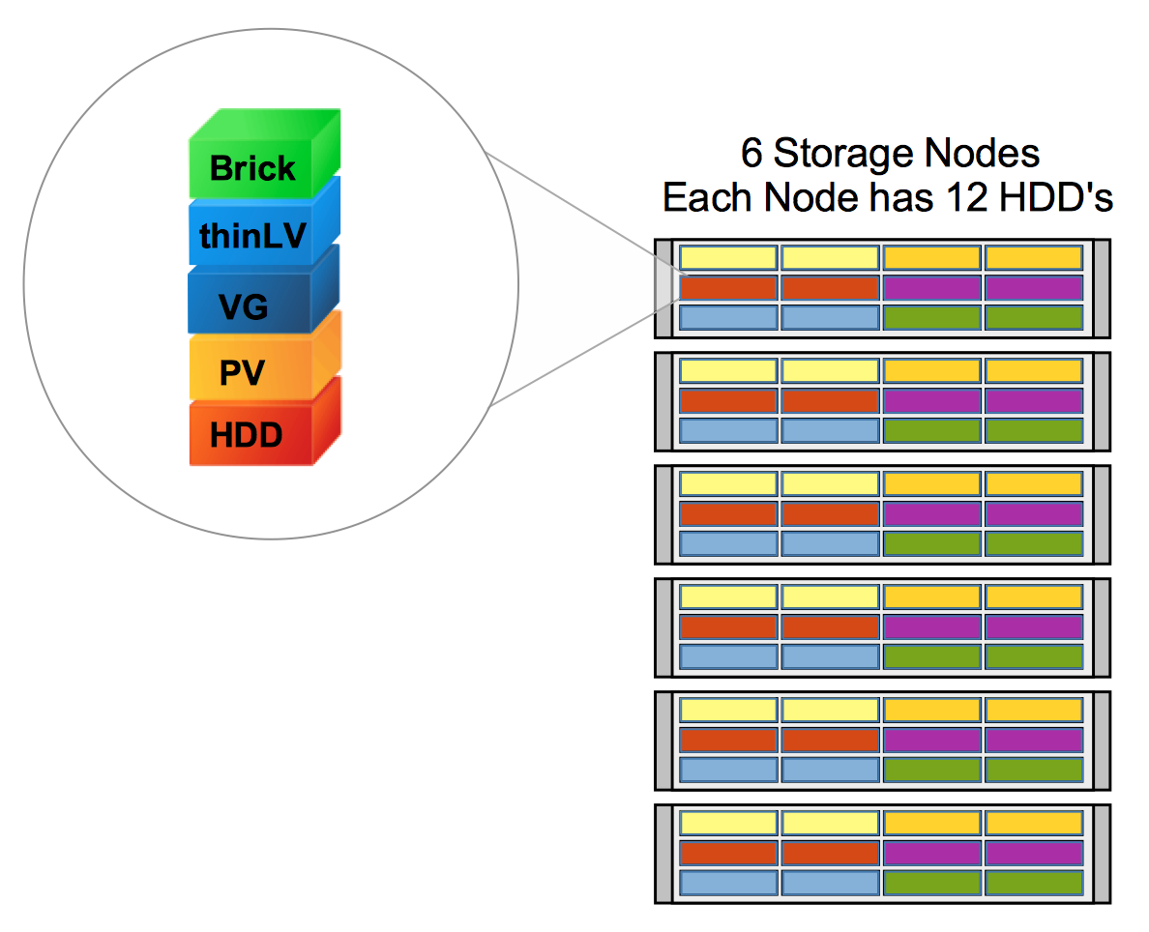
Backup

Slide 25
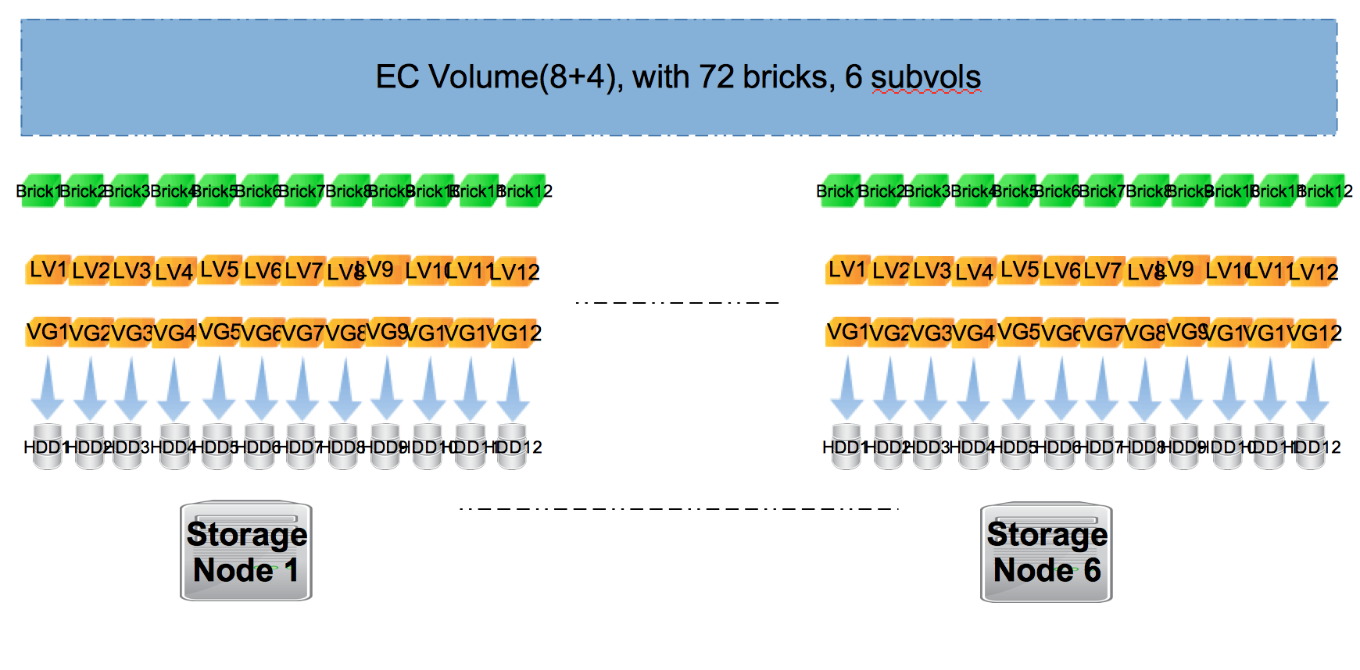
Backup

