Slide 1




Developing a Web Application using
and Scale with
Suman Debnath

Slide 2
Agenda
Introduction to Virtualization Technologies
Container based Virtualization
Docker Architecture
Docker based Flask Web-Application
Convert the application and “Microservice” ready application – using Radis
Scaling the application to Cloud on DigitalOcean

Slide 3
It’s all about Applications

Slide 4
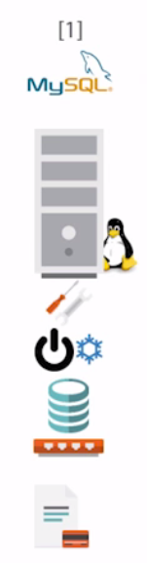
Server : Application 1 : 1

Slide 5
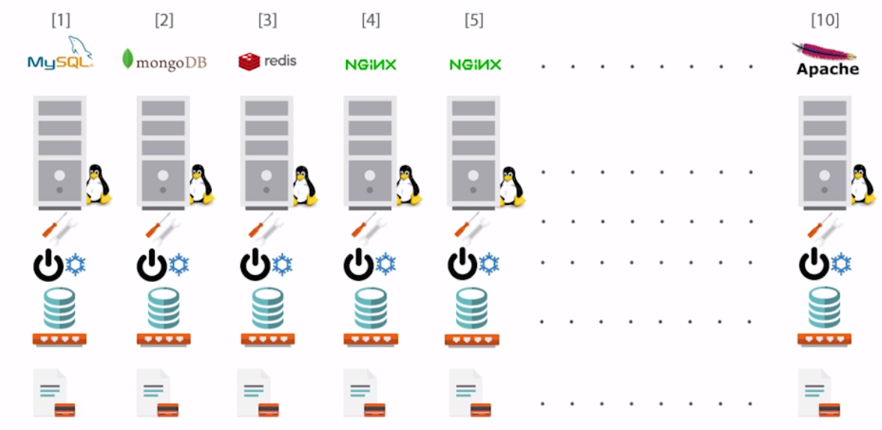
Server : Application 1 : 1

Slide 6
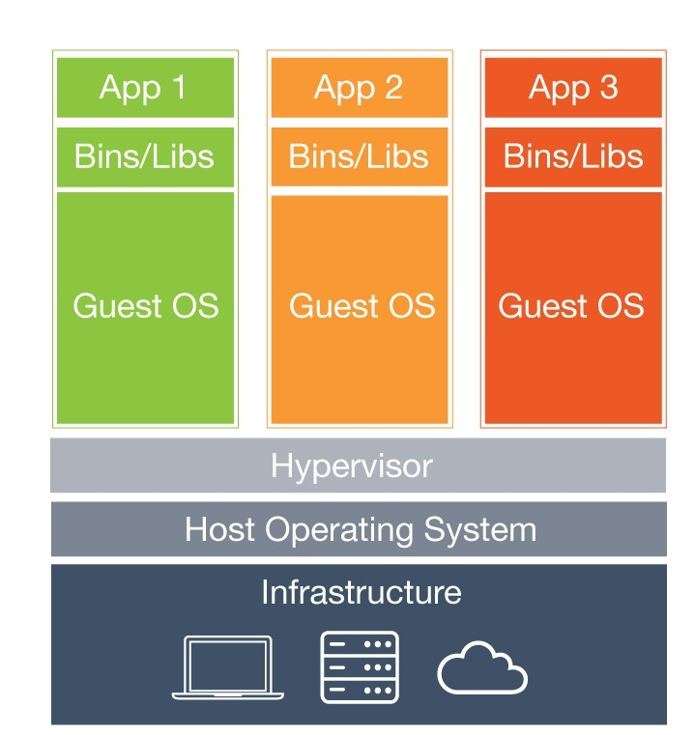
Hypervisor
Beneﬁts:
Cost-Eﬃcient
Easy to Scale
Limitations:
Separate Guest OS
Application Portability Issue

Slide 7
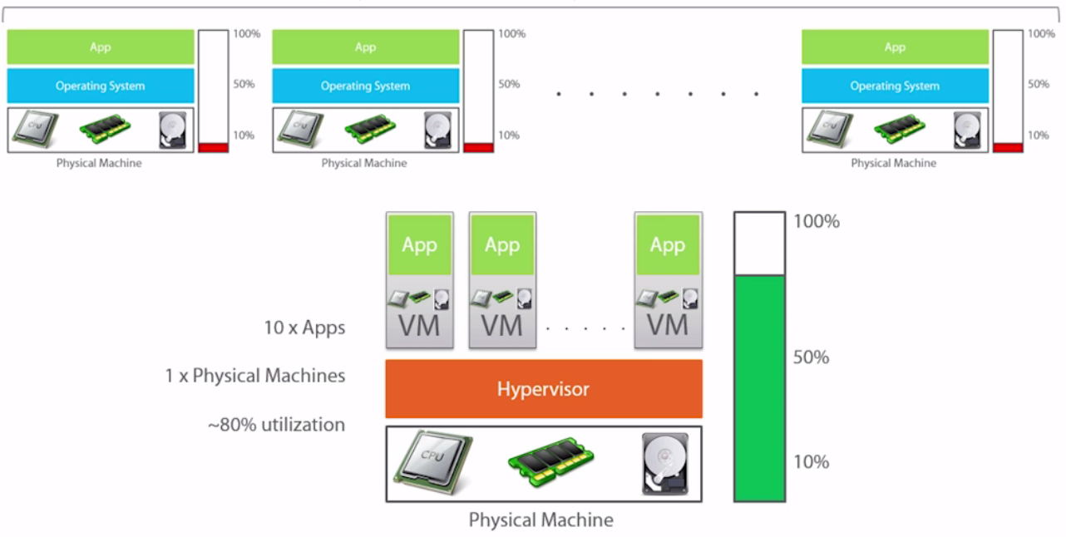
Server : Application 1 : 10
Previously
Now

Slide 8
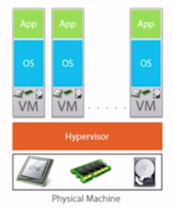
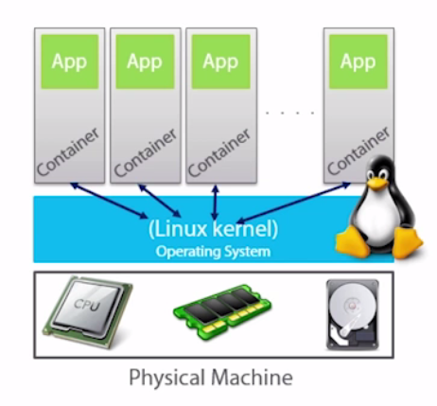
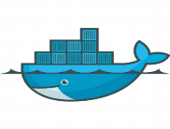
Containers
VM Model

Slide 9
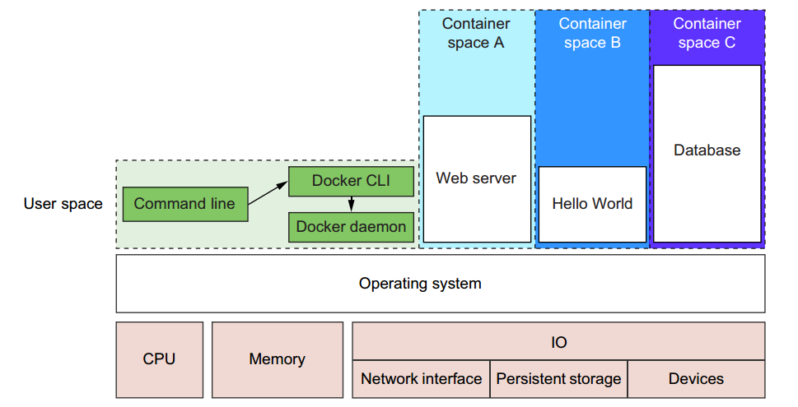
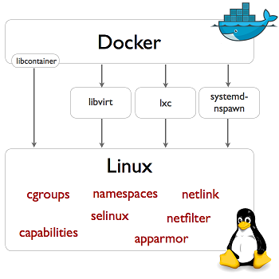
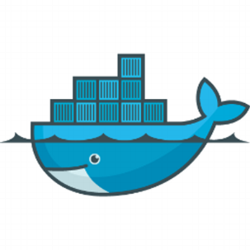
Docker (Underlying Technology)
Container1
Container2
Container3

Slide 10
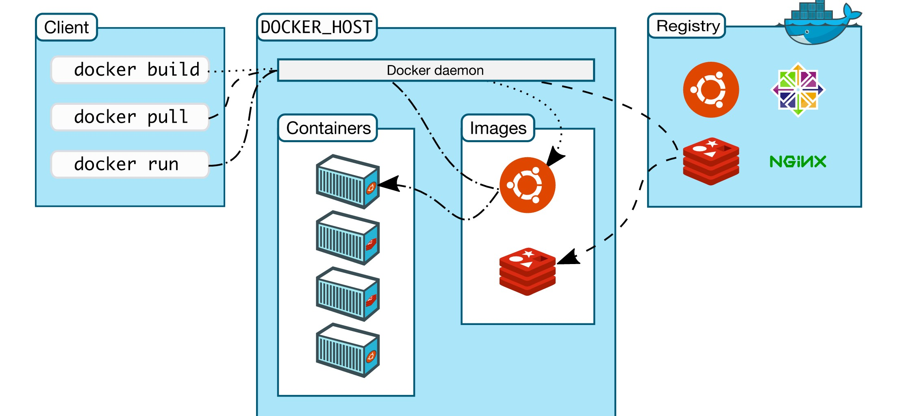
Docker Architecture
Same or different Server

Slide 11
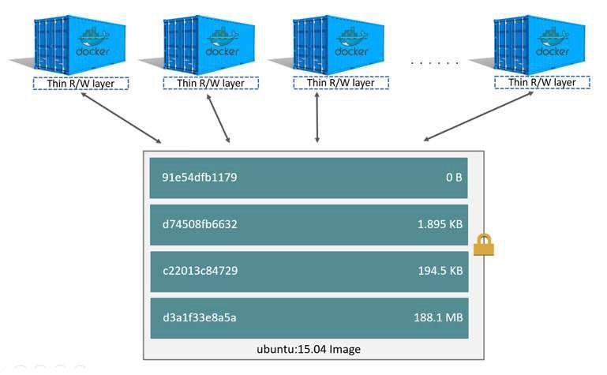
Image Layers

Slide 12
Installation

Slide 13
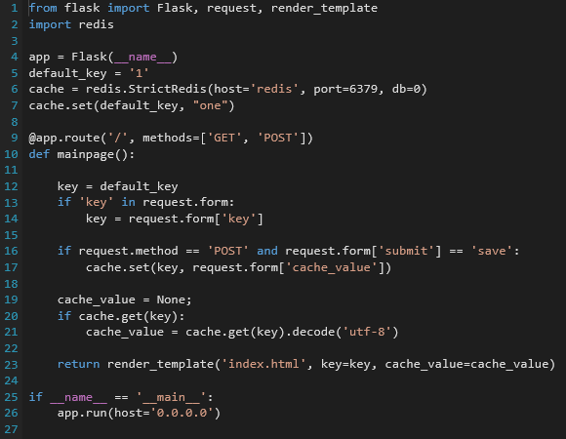
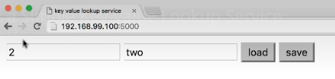
Web Application – Flask (Key-Value Store)

Slide 14
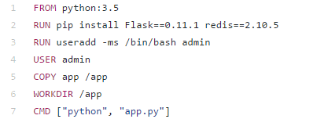
Dockerfile

Slide 15
Demo

Slide 16
Next ..
Lets make our app, a cool “Microservice” based app :
Will use Radis
Lets see in action

Slide 17
Scale our Application to Cloud
Lets now push our application to Cloud using DigitalOcean
Quick Intro to DigitalOcean
Lets see in action

Slide 18
What Next..
Docker
Docker Hub
The Docker Book
Tutorials
Cloud Computing for Developers
Deploying & Managing Scalable Web Applications in the Cloud
Best Practices for Running Production Applications in the Cloud

Slide 19





Let’s stay connected…
github.com/suman-d
suman.san14@yahoo.in
linkedin.com/in/suman-d
+91-9620102221

