Slide 1
Introduction to geocoding
Suman Debnath
Bangalore, IN

Slide 2
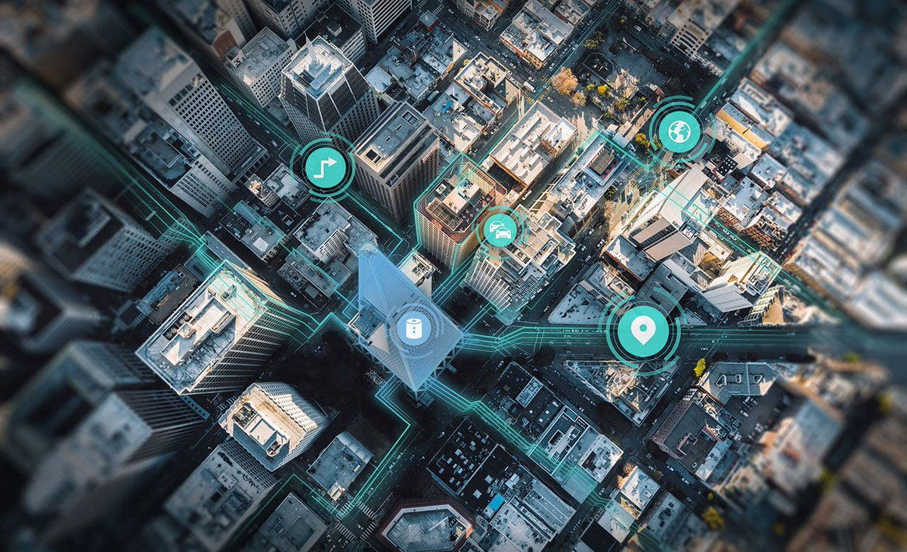






Who we are
Open Location Platform
  Maps
  Geocoding
  Routing
  Fleet Telematics
  Geospatial Data Management
Platforms

Slide 3

geocoding
Process of assigning latitude and longitude values to address information
The process of getting address data from location data is called backward geocoding
Geocoding is the conversion of human-readable location name into machine processable location.
Reverse Geocoding is the ability to find an associated textual location , like a street address or business name from latitude and longitude coordinates.

Slide 4
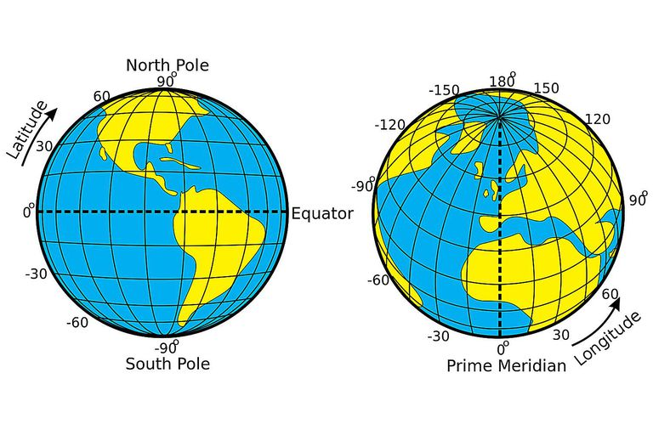
Latitude & Longitude

Slide 5
How it looks like..
SNN Raj Serenity Begur, Bangalore 560068
Latitude: 12.87207
Longitude: 77.62453

Slide 6

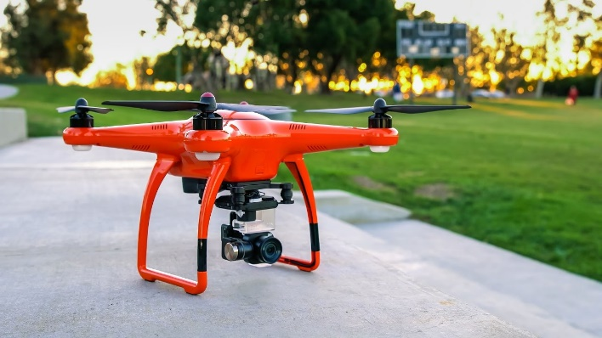

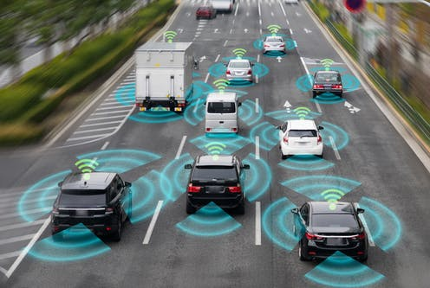
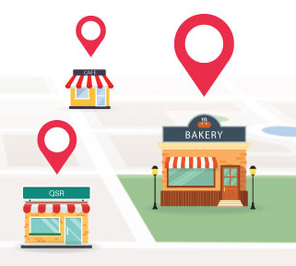

Location matters…
80% of data has a geospatial component

Slide 7
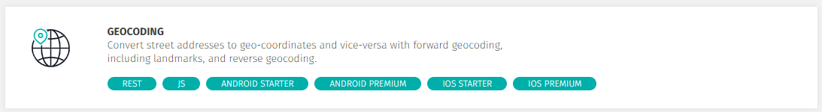
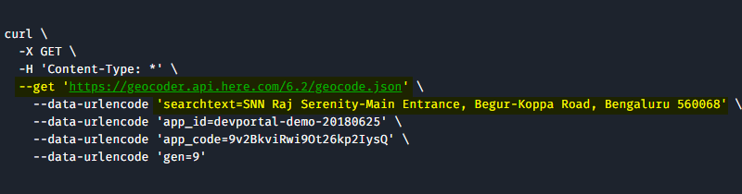
Here API

Slide 8
Demo TIME

Slide 9
Next point
https://developer.here.com
https://developer.here.com/documentation
https://github.com/heremaps
@heredev
https://stackoverflow.com/questions/tagged/here-api

Slide 10


