Slide 1

zzzz
WELCOME
TO UNIVERSITY OF BARISHAL

Slide 2
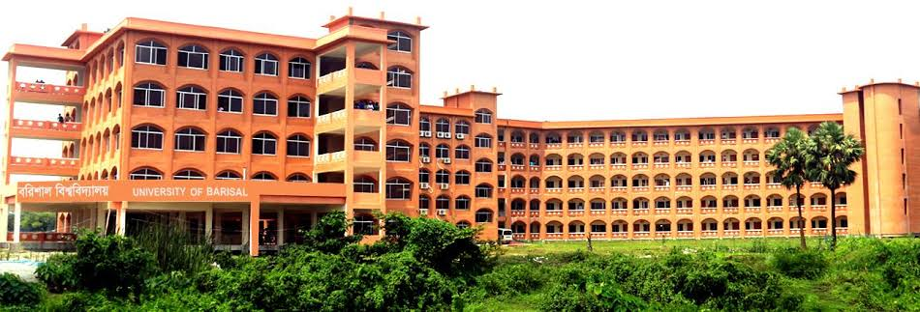
UNIVERSITY OF BARISHAL IS A PUBLIC UNIVERSITY LOCATED IN BARISHAL, A DIVISION CITY IN SOUTHERN BANGLADESH.

Slide 3
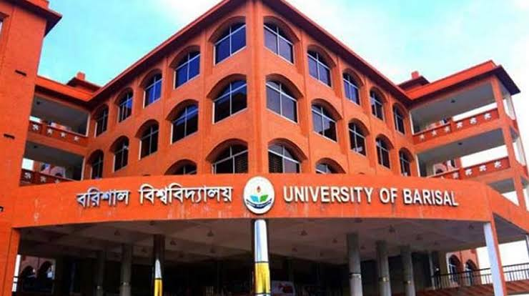
IT IS THE COUNTRY’S 33RD PUBLIC UNIVERSITY

Slide 4
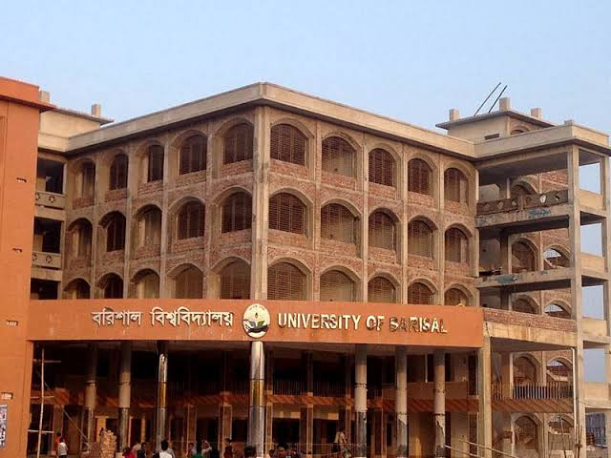
THE UNIVERSITY WAS ESTABLISHED IN 2011 .

Slide 5
THE UNIVERSITY HOUSES 25 ACADEMIC DEPARTMENT UNDER SIX FACULTIES , WHERE 24 DEPARTMENTS ARE CURRENTLY PROVIDING POSTGRADUATE DEGREES.

Slide 6
THE NAME OF FACULTYS:
1.FACULTY OF SCIENCE AND ENGINEERING
2.FACULTY OF BIO-SCIENCE
3.FACULTY OF BUSINESS STUDIES
4.FACULTY OF SOCIAL SCIENCE
5.FACULTY OF ARTS AND HUMANITIES
6.FACULTY OF LAW

Slide 7
FACULTY OF SCIENCE AND ENGINEERING
DEPARTMENT OF MATHEMATICS
DEPARTMENT OF COMPUTER SCIENCE & ENGINEERING
DEPARTMENT OF CHEMISTRY
DEPARTMENT OF PHYSICS
DEPARTMENT OF GEOLOGY AND MINING
DEPARTMENT OF STATISTICS
FACULTY OF BIO- SCIENCE
1.DEPARTMENT OF SOIL AND ENVIRONMENT SCIENCE
2.DEPARTMENT OF BOTANY
3.DEPARTMENT OF COASTAL STUDIES AND DISASTER MANAGEMENT
4.DEPARTMENT OF BIOCHEMISTRY AND BIOTECHNOLOGY

Slide 8
FACULTY OF BUSINESS STUDIES
DEPARTMENT OF MANAGEMENT STUDIES
DEPARTMENT OF ACCOUNTING AND INFORMATION SYSTEM
DEPARTMENT OF MARKETING
DEPARTMENT OF FINANCE AND BANKING
FACULTY SOCIAL SCIENCE
1.DEPARTMENT OF ECONOMICS
2.DEPARTMENT OF POLITICAL SCIENCE
3.DEPARTMENT OF SOCIOLOGY
4.DEPARTMENT OF PUBLIC ADMINISTRATION
5.DEPARTMENT OF MASS COMMUNICATION AND JOURNALISM
6.DEPARTMENT OF SOCIAL WORK

Slide 9
FACULTY OF ARTS AND HUMANITIES
DEPARTMENT OF BANGLA
DEPARTMENT OF ENGLISH
DEPARTMENT OF PHILOSOPHY
DEPARTMENT OF HISTORY
FACULTY SOCIAL LAW
1.DEPARTMENT OF LAW

Slide 10
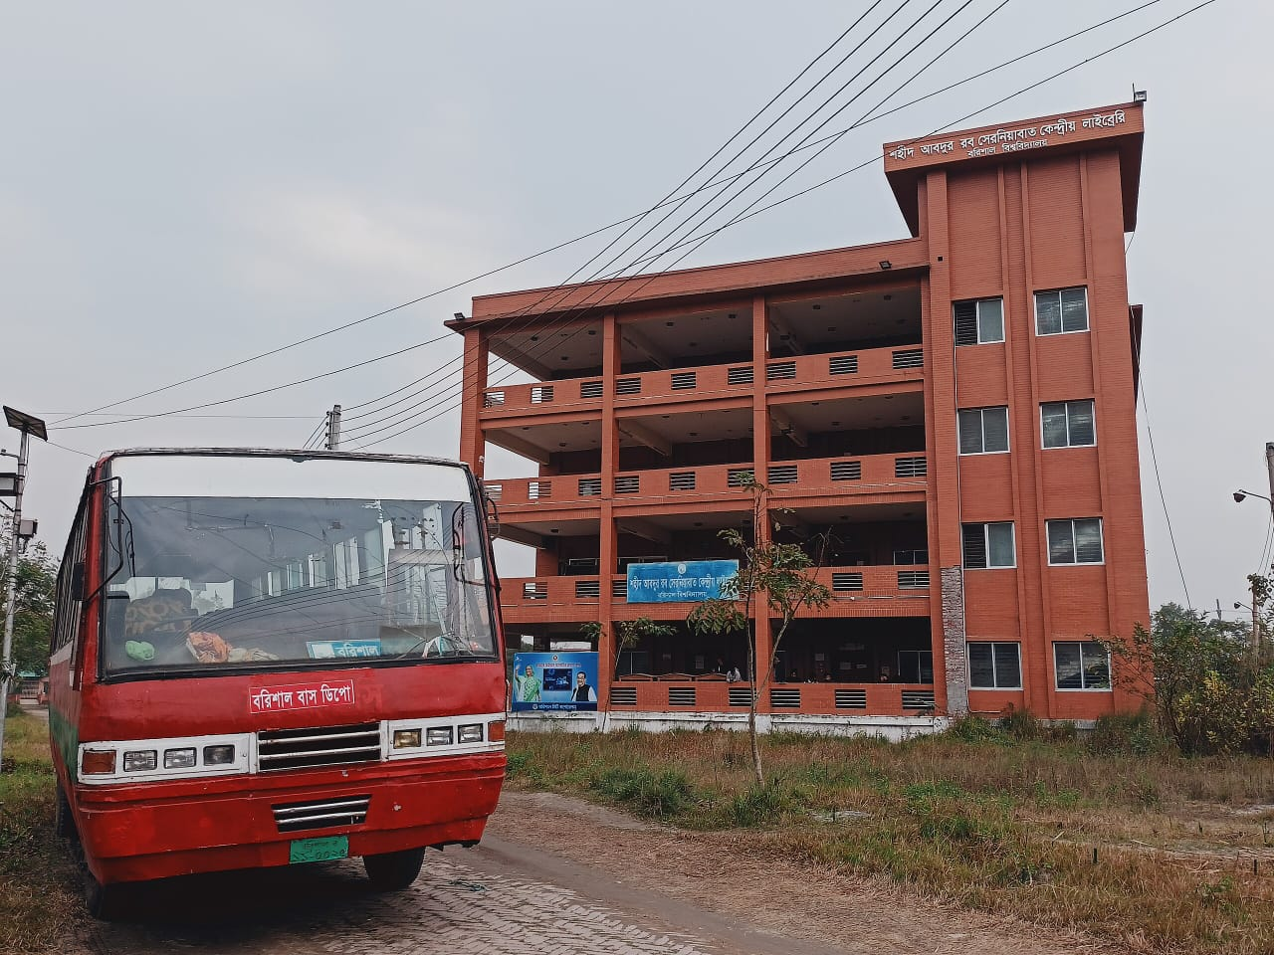
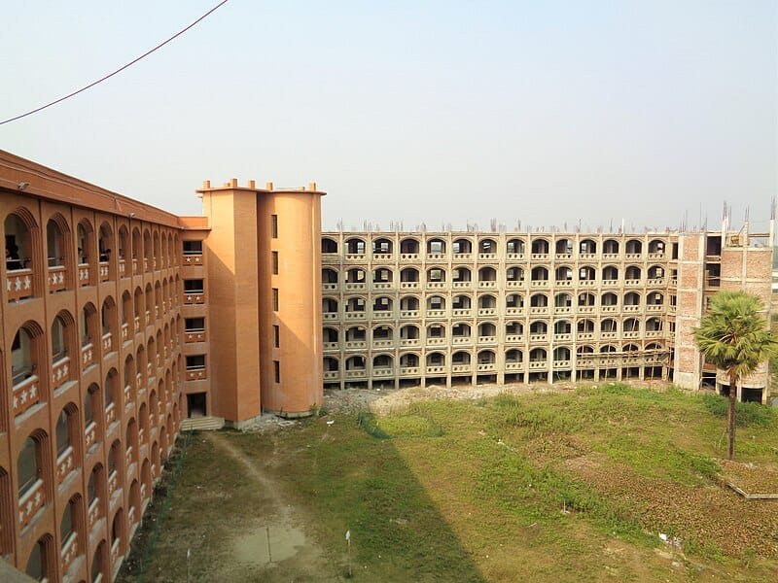

Slide 11
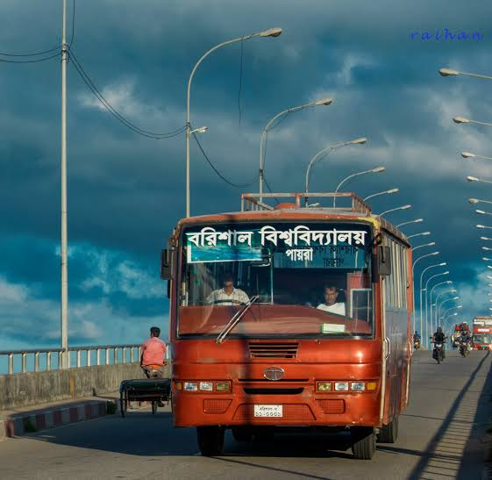

Slide 12

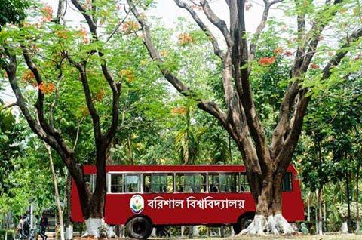

Slide 13
Job Information in Table:
Job Name | Opportunity
Govt. Job | 50%
Bank Job | 30%
Business | 10%
Non.Govt. Job | 10%

Slide 14
THANK YOU

