Slide 1
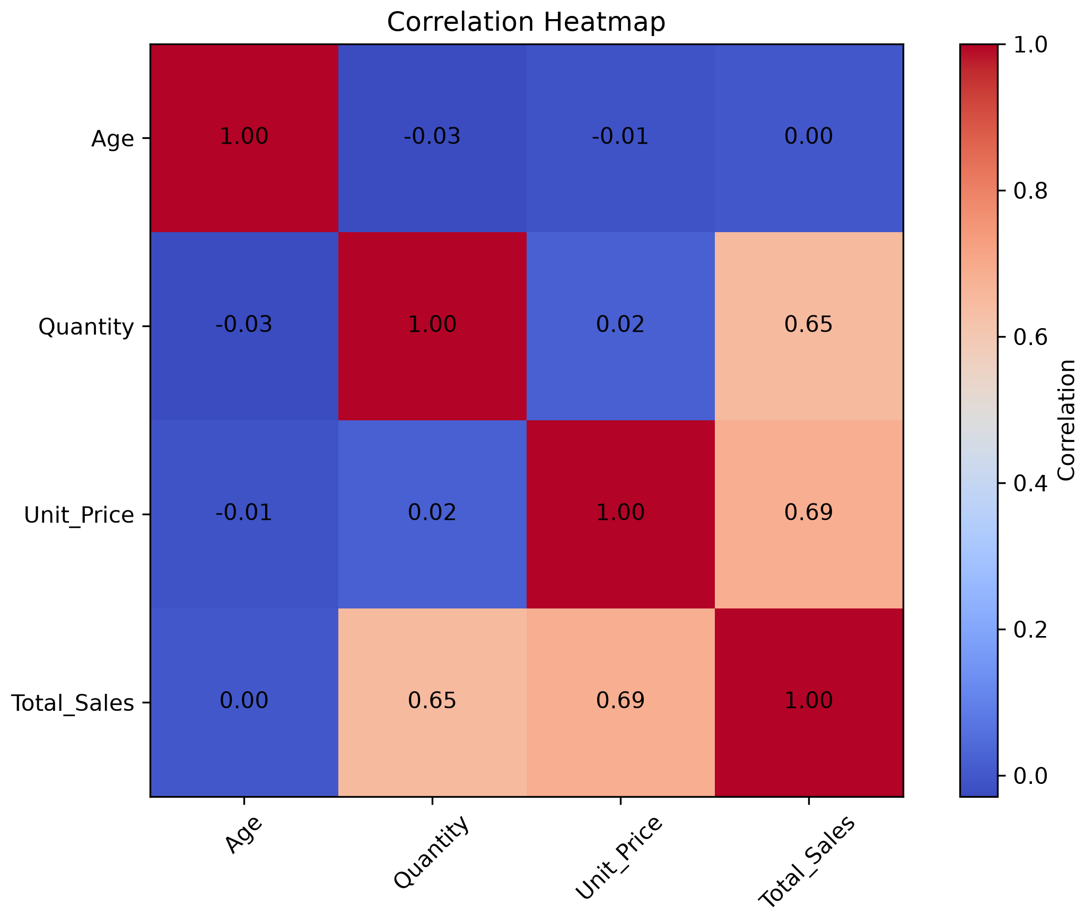
APEXPLANET TASK 2 — SALES ANALYTICS DASHBOARD
ApexPlanet 60-Day Data Analytics Internship
Cleaned sales dataset · 1,000 records
Exploratory Data Analysis & Business Intelligence
TOTAL SALES
TOTAL ORDERS
AVG SALES / ORDER
AVG QUANTITY / ORDER
₹139.40M
1,000
₹139.40K
5.43
₹139,399,439.65
Sales records in dataset
₹139,399.44
Units per order
Category-wise Total Sales (₹)
City-wise Order Count
Product-wise Order Count
Correlation Analysis
Key Business Insights
Quantity vs Total Sales
0.65
Mobile is the most frequently ordered product (184 orders).
Electronics is the largest category by order count (354 orders).
Patna has the highest number of orders (135 orders).
Gender split: Male 511 orders, Female 489 orders.
Averages: ₹139,399.44 sales and 5.43 units per order.
Quantity and Unit Price both show a positive relationship with Total Sales; Age shows almost no linear relationship.
Positive correlation
Unit Price vs Total Sales
0.69
Positive correlation
Age vs Total Sales
0.00
No linear correlation
Correlation describes association, not causation.
Source: ApexPlanet_Cleaned_Dataset.xlsx (1,000 records) and Task 2 EDA / SQL analysis outputs. “Unknown” city = records with no city value.

