Slide 1
STAKEHOLDER PRESENTATION
Sales Performance & Customer Intelligence
ApexPlanet Data Analytics Internship — Task 4
Data Storytelling
Business Intelligence
Statistical Validation
Notes:
Title slide. This deck tells one story: where sales value comes from, which customers drive it, and what the statistical test does and does not confirm.

Slide 2
Business Objective & Analytical Approach
Understand what drives sales and where revenue is concentrated
BUSINESS PROBLEM
THE ANALYSIS AIMS TO UNDERSTAND
How is the business performing, and which customers, categories, products, cities and periods drive its sales?
Sales performance
Customer contribution
Category & product performance
Geographic variation
Transaction-level behaviour
Statistical validation
Data Cleaning
›
Exploratory Analysis
›
Business Intelligence
›
Statistical Validation
›
Business Recommendations
1,000 records · 12 columns · January 2025 to January 2026 · 0 missing values · 0 duplicate rows
Notes:
The analysis moves from cleaning through exploration and BI to statistical validation, and ends in recommendations. Dataset: 1,000 records, 12 columns, no missing values, no complete duplicate rows.

Slide 3
Overall Sales Performance
Substantial sales volume across the analysed period
TOTAL SALES
TOTAL QUANTITY SOLD
UNIQUE CUSTOMERS
₹139.4M
5,435
947
approximate total
units
distinct customers
UNIQUE ORDERS
AVERAGE ORDER VALUE
EXECUTIVE INSIGHT
992
₹140,523.63
A broad base of 947 customers placed 992 orders, generating a substantial sales volume across 1,000 records.
distinct Order IDs
based on unique Order IDs
Notes:
Key KPIs from the verified findings: approximately ₹139.4 million in total sales, 5,435 units, 947 unique customers, 992 unique orders, and an average order value of ₹140,523.63 based on unique Order IDs.

Slide 4
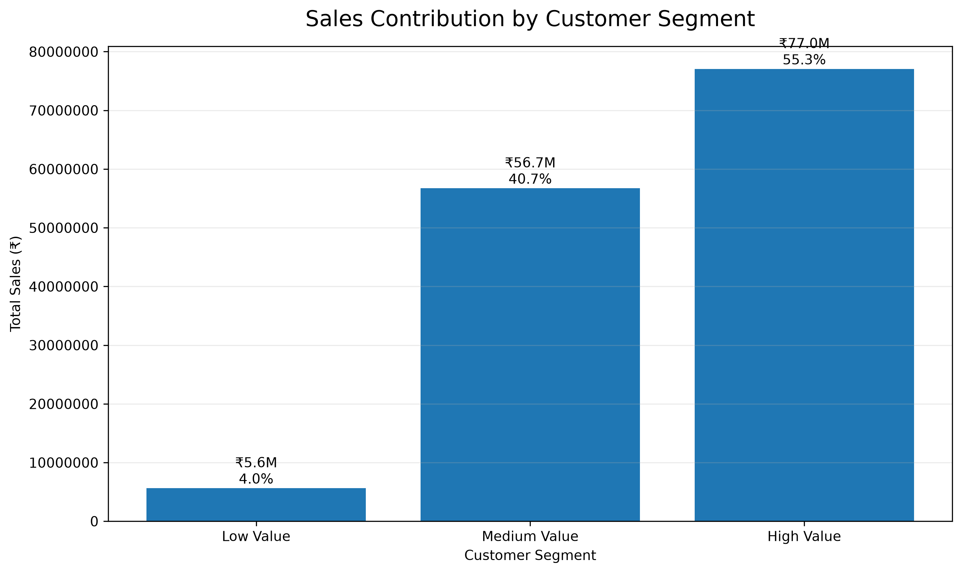
Customer Value Concentration
A small group of High Value customers generates a disproportionately large share of revenue
≈55%
High Value
of sales · ≈25% of customers
≈41%
Medium Value
of sales · ≈50% of customers
≈4%
Low Value
of sales · ≈25% of customers
Implication: prioritise retention and relationship management for High Value customers.
Notes:
High Value customers are about a quarter of customers (237 of 947) but contribute more than half of total sales (55.27%). Medium Value contribute 40.69% and Low Value 4.04%. The retention priority follows directly.

Slide 5
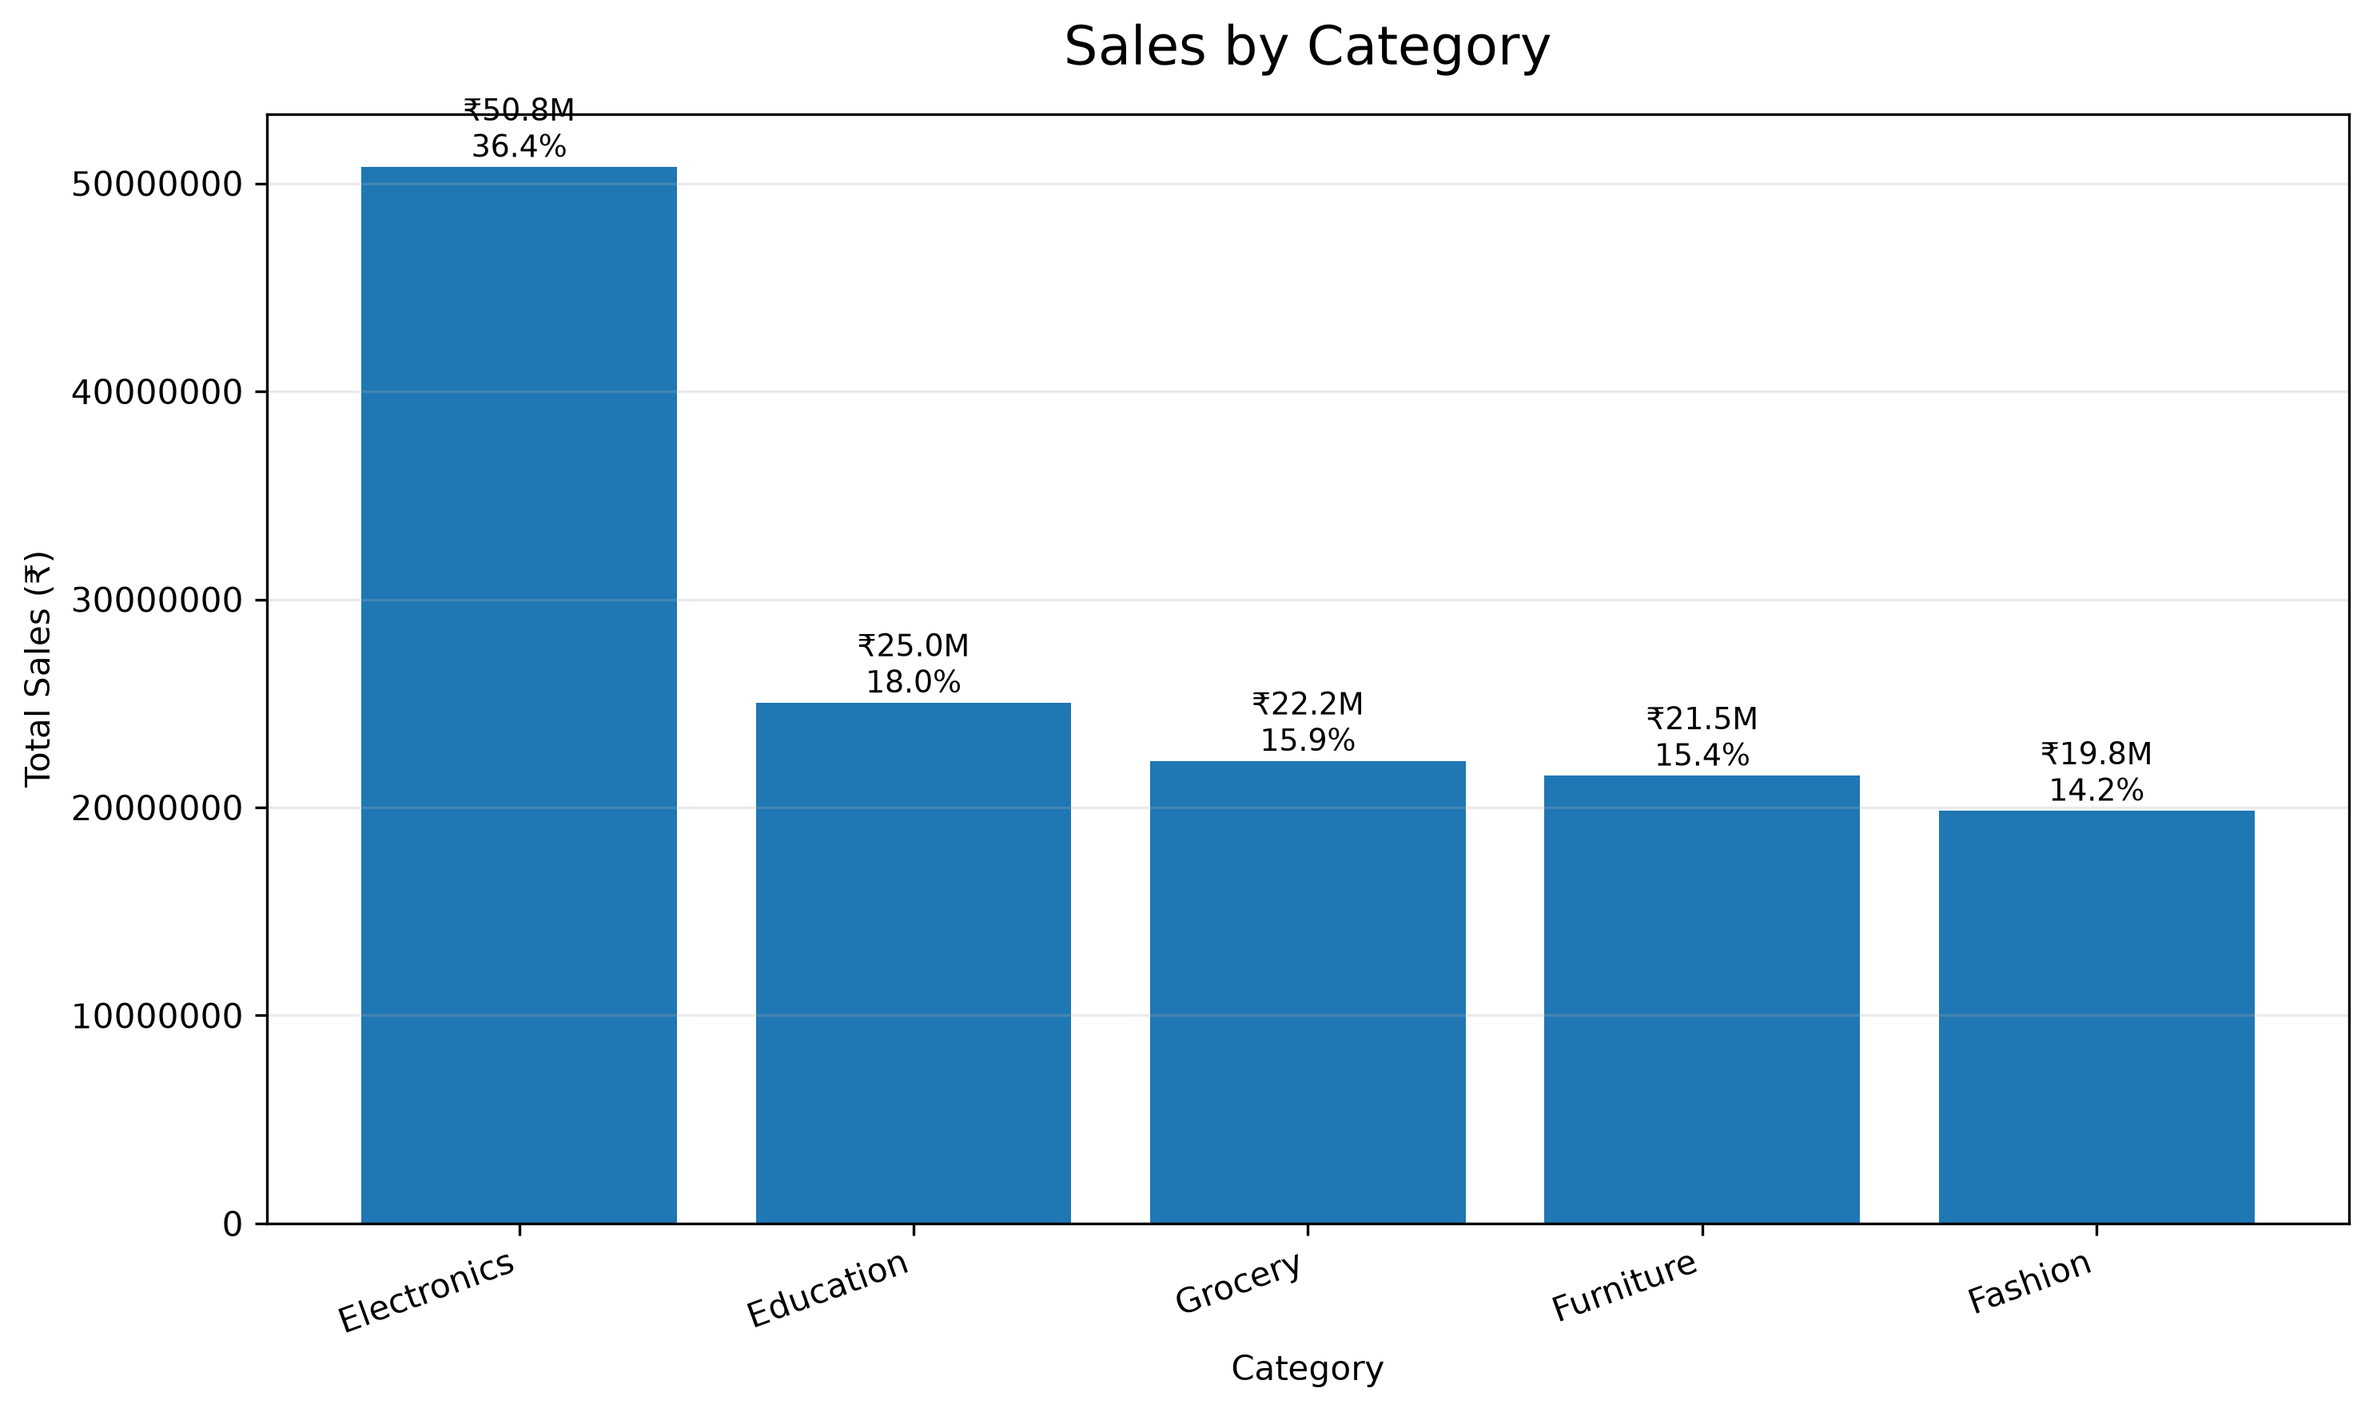
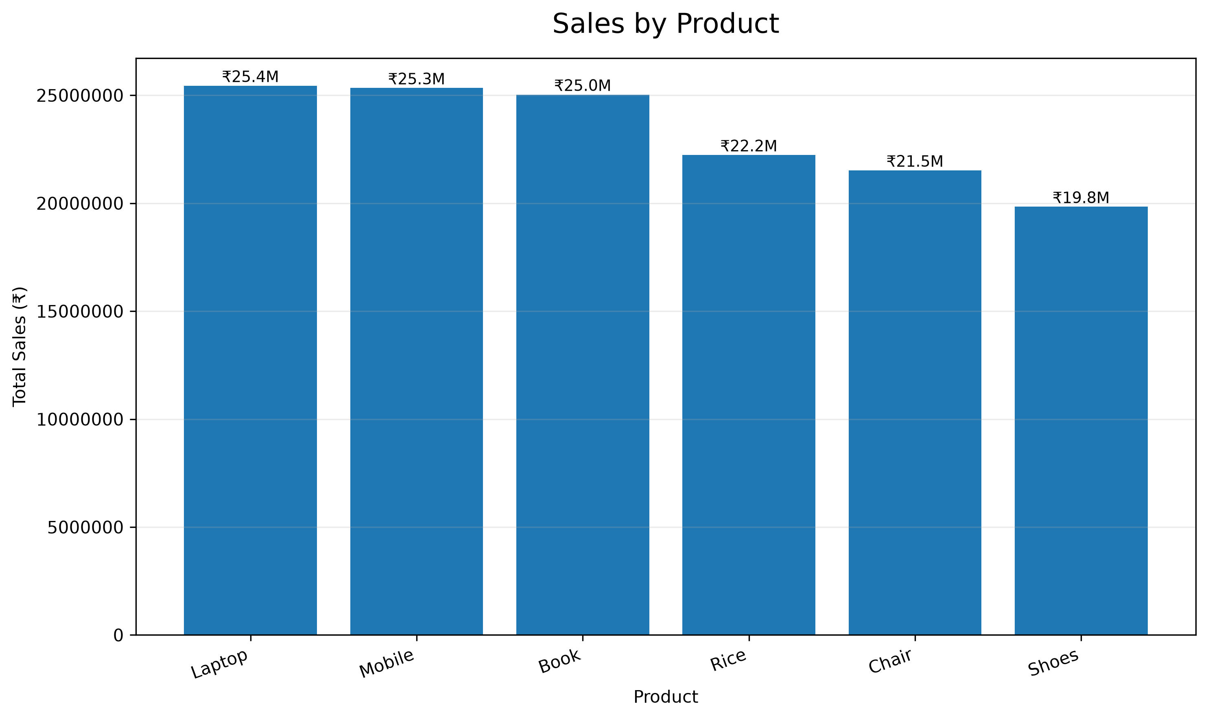
Category & Product Performance
Electronics leads on sales contribution; Laptop, Mobile and Book lead products
Electronics ≈₹50.78M · ≈36.43% of total sales
Laptop · Mobile · Book lead product sales
Note: category sales contribution is not the same as transaction-level value (see statistical validation).
Notes:
Electronics generated approximately ₹50.78 million, about 36.43% of total sales. Top products: Laptop ≈₹25.44M, Mobile ≈₹25.34M, Book ≈₹25.03M. Important: this is a total-sales contribution; it does not by itself mean individual Electronics transactions are higher in value. The next sections test that directly.

Slide 6
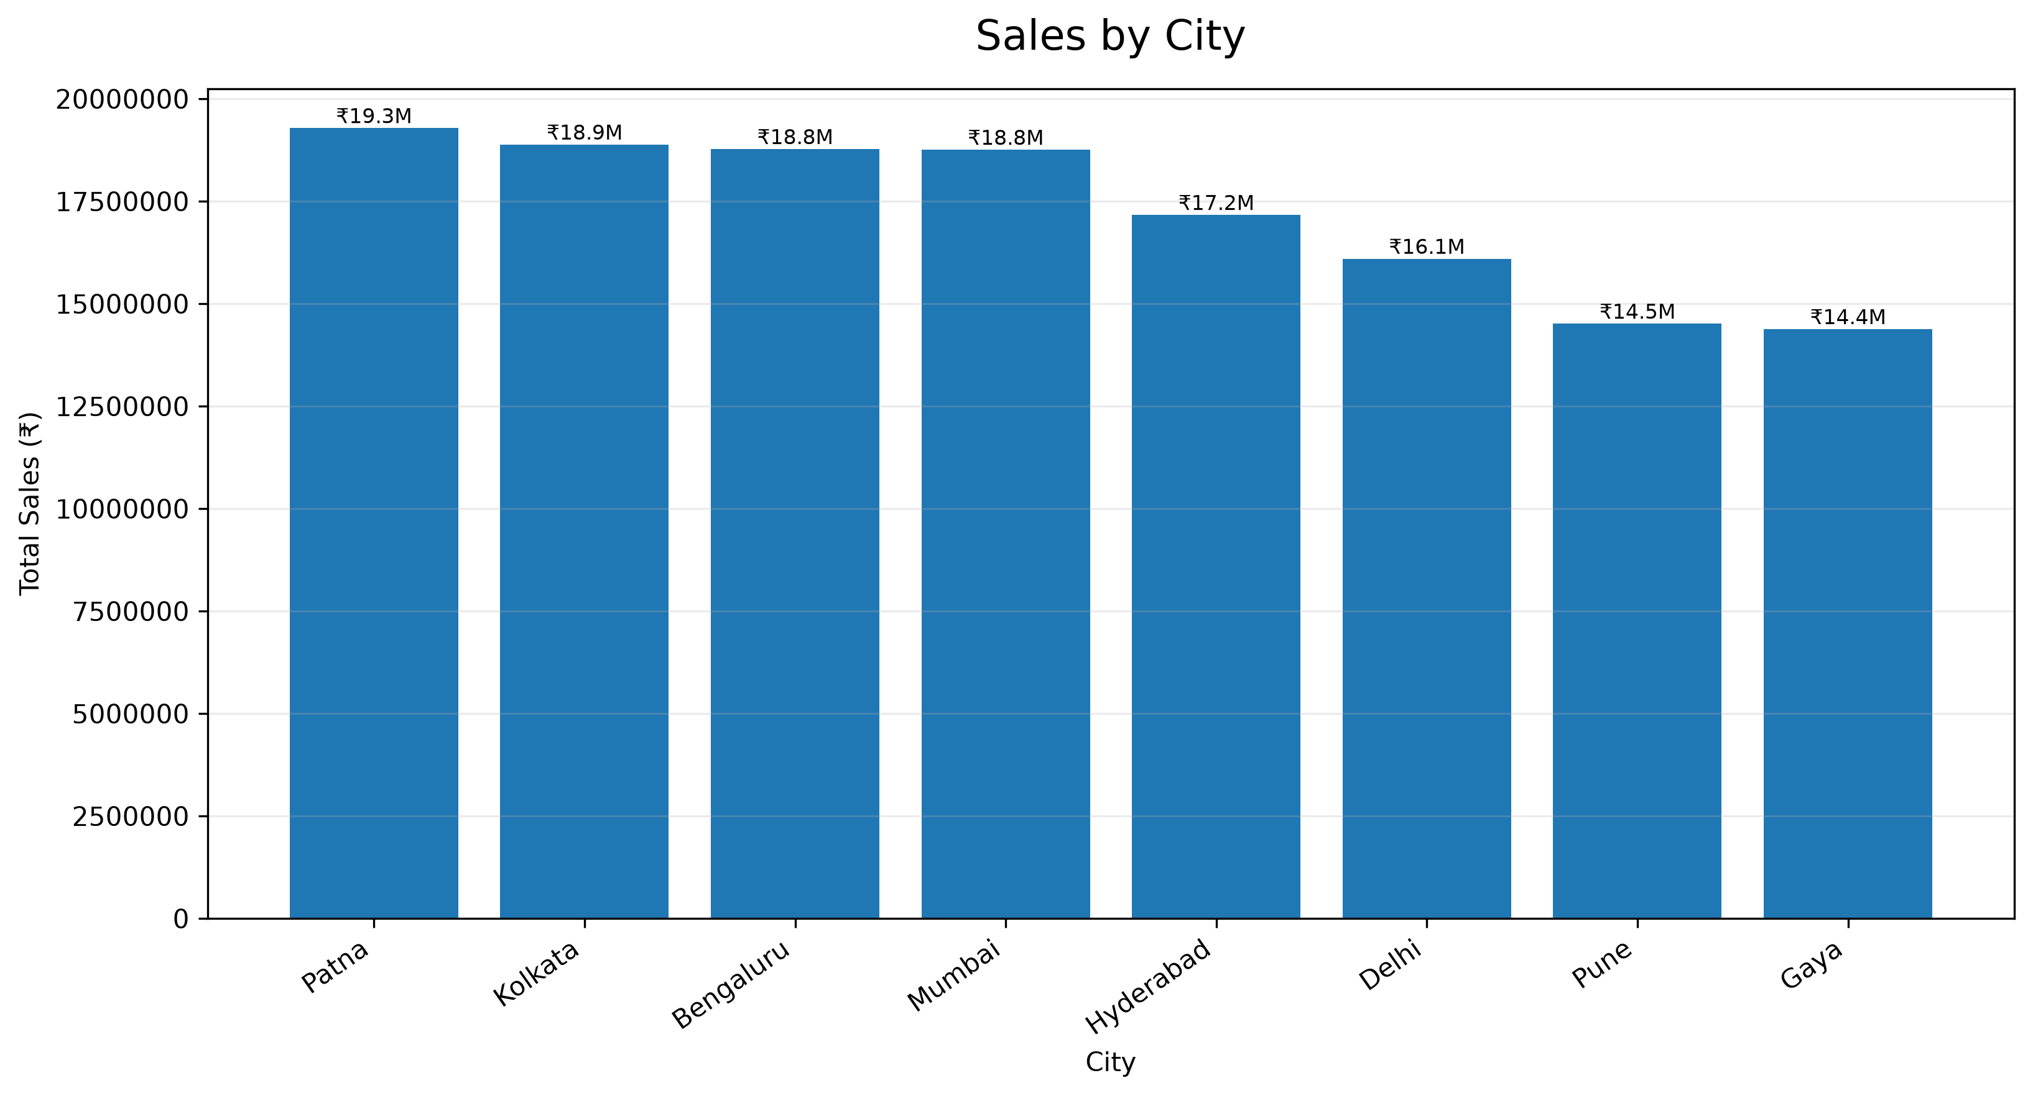
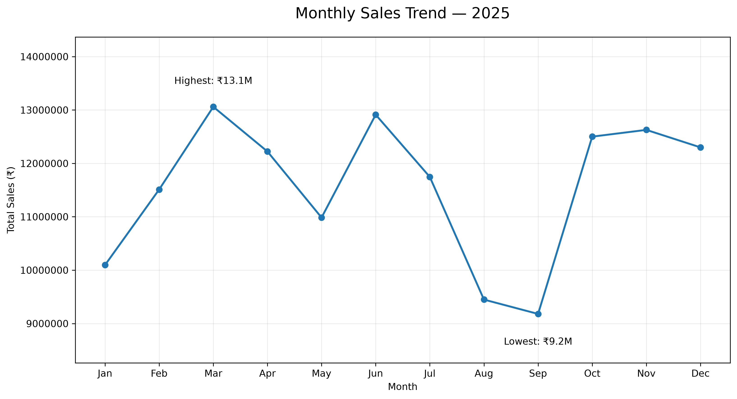
Geographic & Monthly Performance
Performance varies across cities and months
Patna: highest total sales, ≈₹19.29M
Bengaluru: highest sales per customer, ≈₹156,446
Kolkata and Bengaluru: also among the strongest cities
March 2025: highest complete month, ≈₹13.06M
September 2025: lowest complete month, ≈₹9.18M
January 2026: partial-period data, not compared with complete months
Notes:
Patna has the highest total sales (≈₹19.29M); Bengaluru has the highest sales per customer (≈₹156,446). Total sales and sales per customer give different views, so both matter when prioritising markets. March 2025 is the highest complete month and September 2025 the lowest. January 2026 holds only partial-period data and should not be compared directly with complete months.

Slide 7
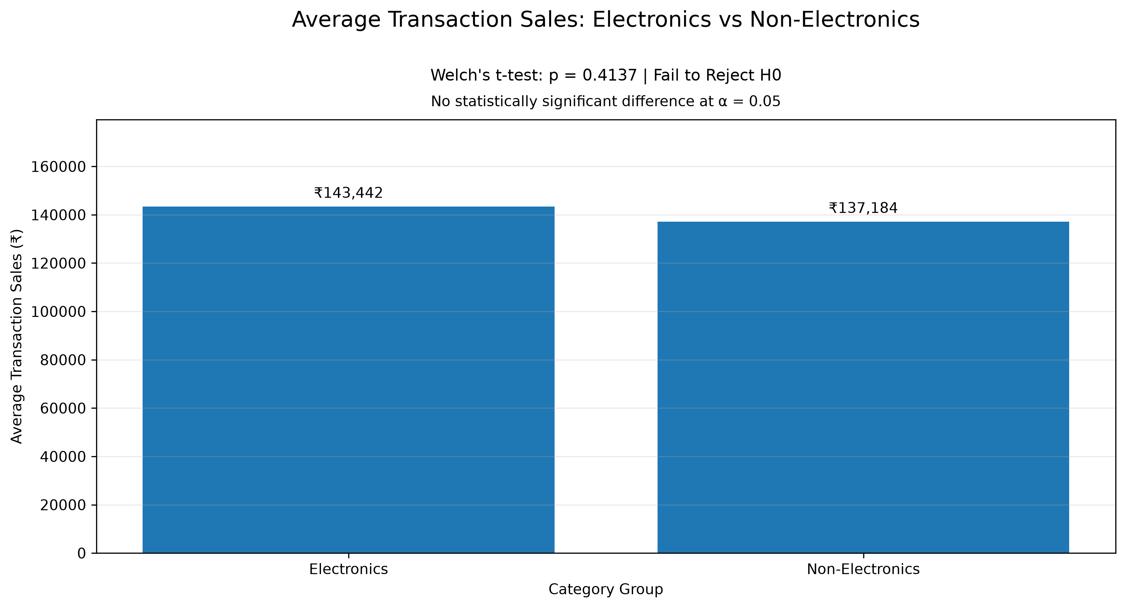
Statistical Validation
Higher observed average, but no statistically significant difference
H0: No significant difference in mean transaction sales between Electronics and Non-Electronics.
H1: A significant difference exists.
Welch's independent two-sample t-test · α = 0.05
Transactions (Elec. vs Non-Elec.) | 354 vs 646
Electronics mean | ₹143,442.32
Non-Electronics mean | ₹137,183.99
Mean difference | ₹6,258.33
T-statistic | 0.8179
P-value | 0.413674
95% confidence interval | ₹−8,764.16 to ₹21,280.82
Cohen's d | 0.0548 (Negligible)
Decision | Fail to Reject H0
Electronics transactions have a higher observed average sales value, but the difference is not statistically significant at the 5% significance level.
Notes:
Welch's t-test: Electronics mean ₹143,442.32 versus Non-Electronics ₹137,183.99, a difference of ₹6,258.33. T = 0.8179, p = 0.413674, which is above 0.05, so we fail to reject H0. The 95% confidence interval (₹−8,764.16 to ₹21,280.82) includes zero and Cohen's d of 0.0548 is negligible. We cannot conclude that average transaction values differ.

Slide 8
Key Business Insights
Five findings tie the descriptive and statistical evidence together
2
3
1
Electronics is the largest revenue category
Laptop and Mobile are top products
Revenue is strongly concentrated among High Value customers
≈36.43% of total sales
≈₹25.44M and ≈₹25.34M in sales
≈25% → ≈55%
4
5
Sales performance varies across cities and months
No significant transaction-value difference
of customers contribute this share of total sales
Patna leads total sales; Bengaluru leads sales per customer
Electronics vs Non-Electronics, p = 0.413674
Notes:
Synthesis: concentration of revenue in High Value customers, Electronics as the leading category, Laptop and Mobile as strong products, variation across cities and months, and no statistically significant transaction-value difference for Electronics.

Slide 9
Business Recommendations
Six practical actions that follow from the evidence
1
Prioritise High Value retention
2
Maintain Electronics strength
3
Monitor Laptop and Mobile
Build retention and relationship programmes for the segment driving ≈55% of sales.
Keep inventory, pricing and availability aligned with demand in the largest category.
Track the two leading products closely and watch the wider portfolio.
4
Use geographic insights
5
Monitor monthly trends
6
Pair metrics with statistics
Weigh total sales and sales per customer to spot growth opportunities across cities.
Use time-based patterns to guide sales planning and inventory decisions.
Use statistical validation alongside descriptive metrics for important decisions.
Notes:
Recommendations are practical and tied to the verified findings. The first, High Value retention, is the strongest opportunity.

Slide 10
Conclusion & Call to Action
Strong overall sales, with revenue concentrated among High Value customers and Electronics as the leading revenue-generating category.
However, statistical validation shows no significant difference in average transaction sales between Electronics and Non-Electronics.
Decisions should combine descriptive business intelligence with statistical evidence.
CALL TO ACTION
1
Strengthen High Value customer retention
2
Monitor Electronics and key products
3
Identify geographic growth opportunities
4
Track monthly sales trends
5
Use statistical validation for important business decisions
Notes:
Close on the core message: strong sales, concentrated in High Value customers, Electronics leads on revenue but not on a statistically significant transaction-value difference. Ask stakeholders to act on the five call-to-action items.

