Slide 1
ETL + Analytics for Brazilian E-Commerce
Using Streamlit, BigQuery, Plotly
Contents

Slide 2
Contents
CONTENTS
1 | Introduction
2 | Project Architecture
3 | Etl Process Flow
4 | Schema-Star Schema Design
5 | Data Analysis Capabilities
6 | Implementation Challenges
7 | Analysis-Visualizations
8 | Conclusion & Findings -> Next Steps

Slide 3
INTRODUCTION
A comprehensive data engineering solution for e-commerce data. This project automates data processing from multiple sources. It is streamlined for business intelligence and analytics. Built with Python, Streamlit, and Google BigQuery.
Additional functionality to send reports after Analysis.

Slide 4




Project Architecture
Data Sources
Processing Layer
Storage Layer
Presentation Layer
Kaggle datasets, MySQL databases, CSV files.
Python-based ETL pipeline.
Google BigQuery data warehouse.
Streamlit dashboard for ETL monitoring.
Report Transfer via Email

Slide 5




ETL Process Flow
Extract
Retrieve data from Kaggle, MySQL, and CSV files.
Transform
Clean, merge, and restructure data.
Load
Upload to BigQuery in star schema format.
Analyze
Create data marts, aggregation tables, and KPIs.

Slide 6
Star Schema Design
Fact Table
Dimension Tables
fact_orders (central transaction data)
dim_customers
dim_products
dim_sellers
dim_payment_types
dim_reviews

Slide 7
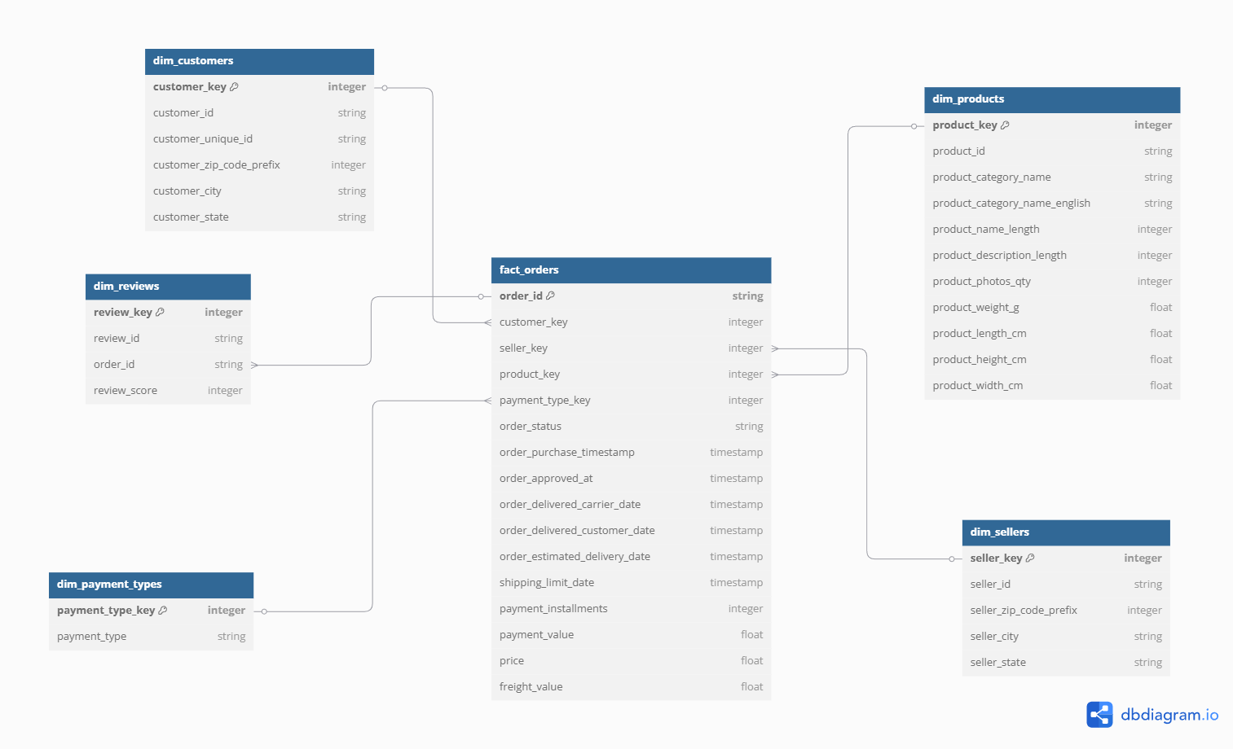
Star Schema Design
Contents | Previous | Next

Slide 8
Data Analysis Capabilities
Data Marts
Aggregation Tables
KPI Monitoring
Customer-centric view, product performance analysis, seller performance metrics.
Sales, customer satisfaction, order fulfillment, payment distribution.
Time-based, geographic, and product category performance.

Slide 9
Implementation Challenges
Data Quality Issues
Technical Challenges
Handling missing values
Integrating data sources
Data type inconsistencies
Optimizing transformations
Entity resolution
Managing BigQuery limitations

Slide 10
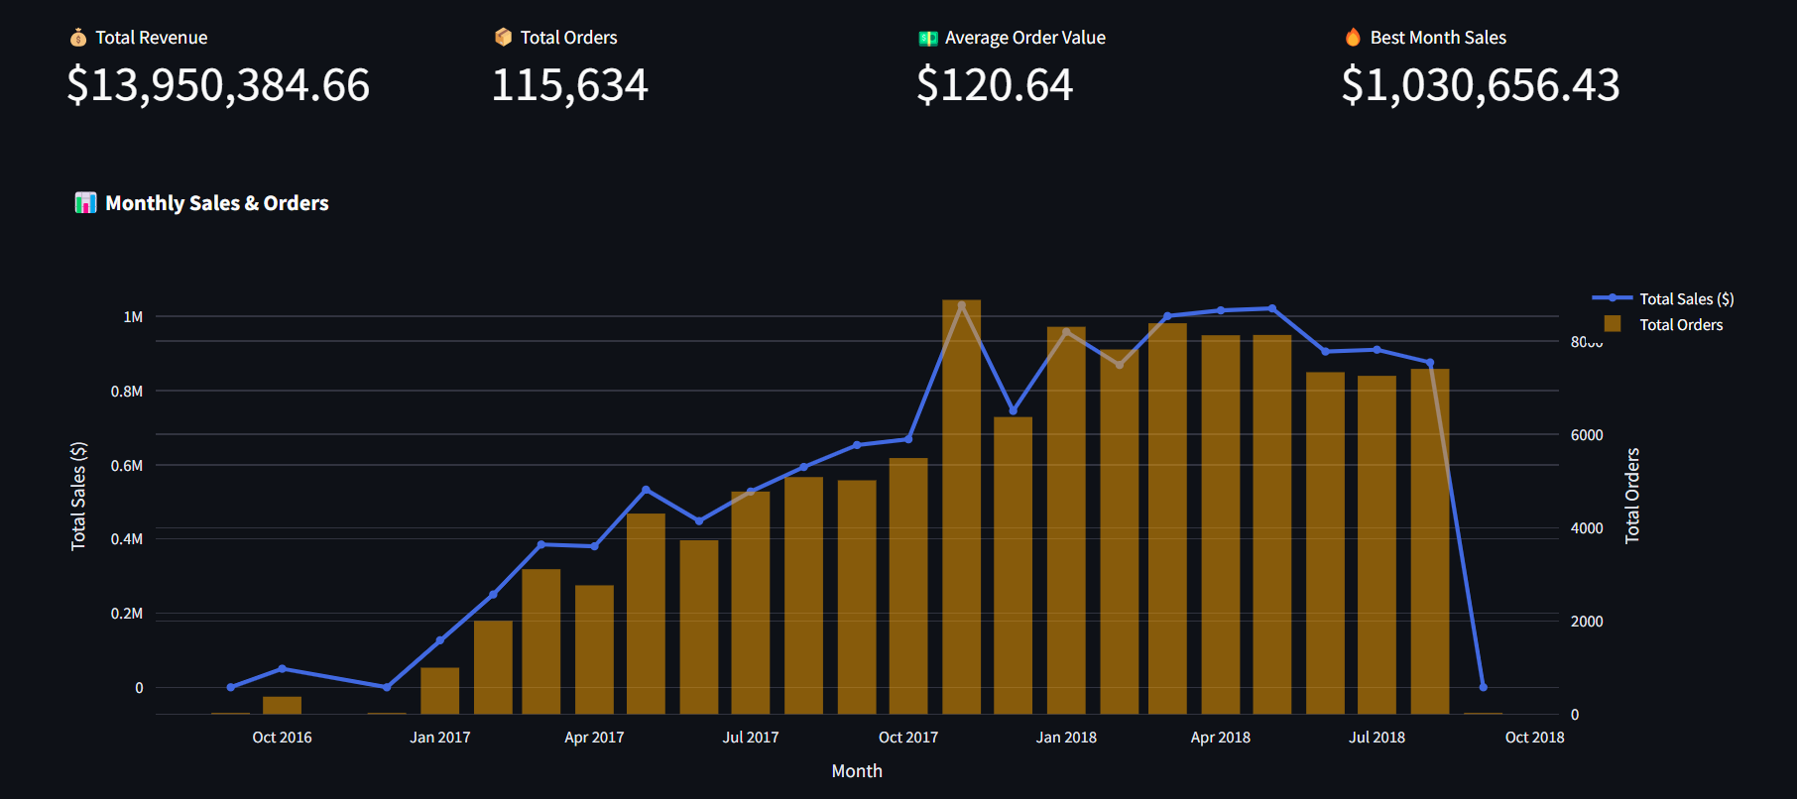

Slide 11
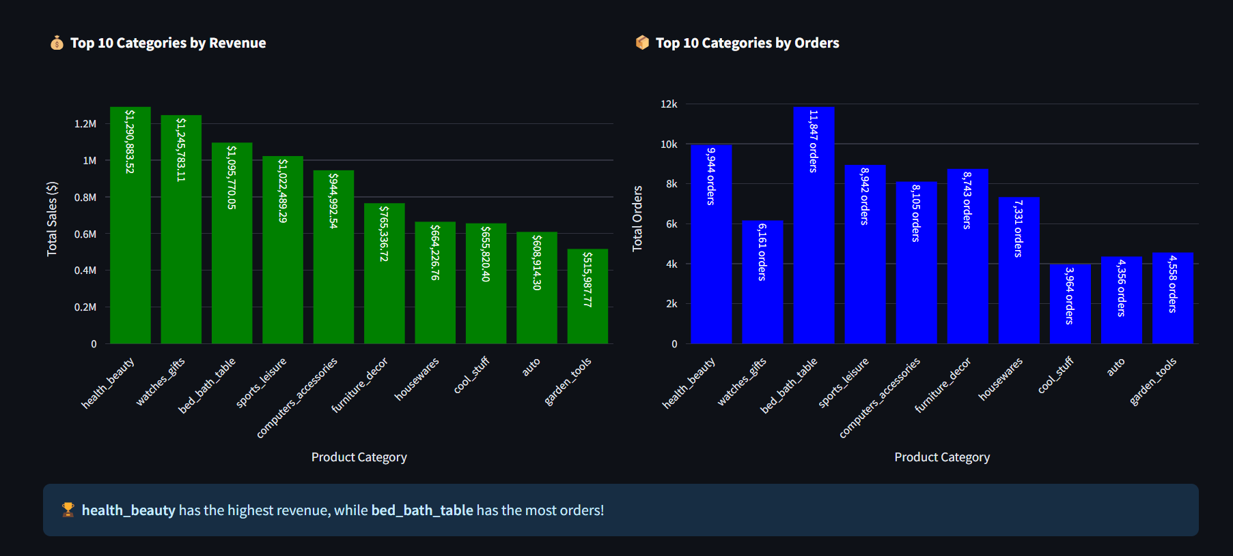

Slide 12
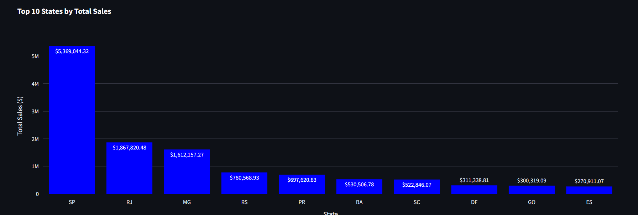
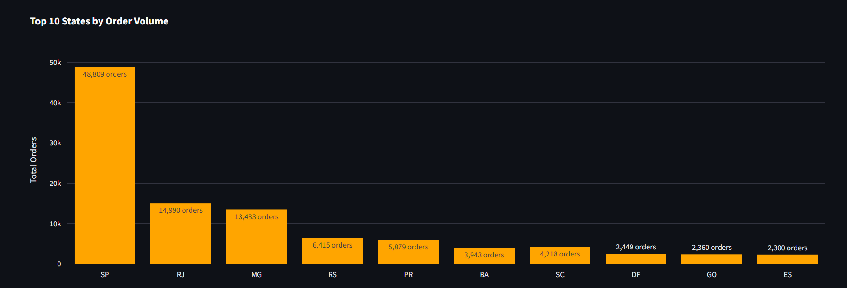

Slide 13
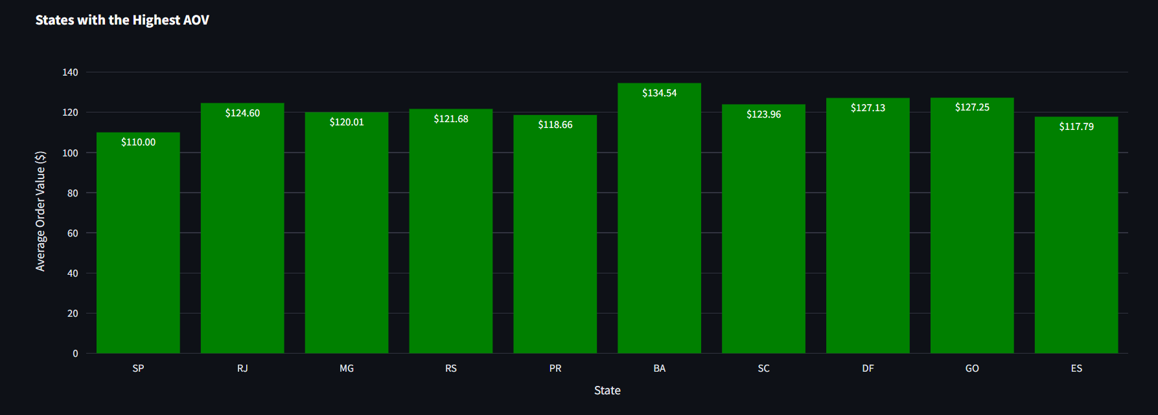
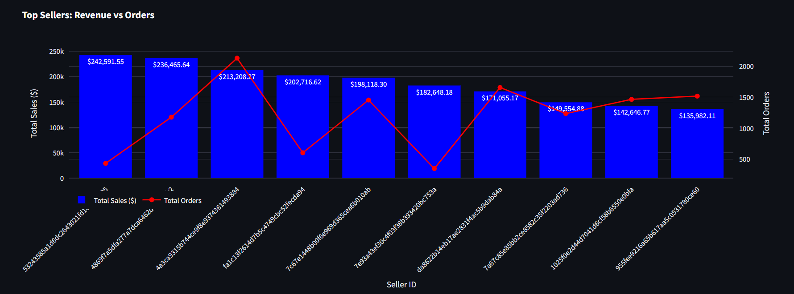

Slide 14
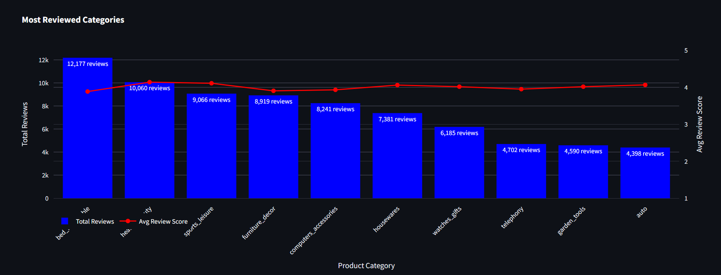
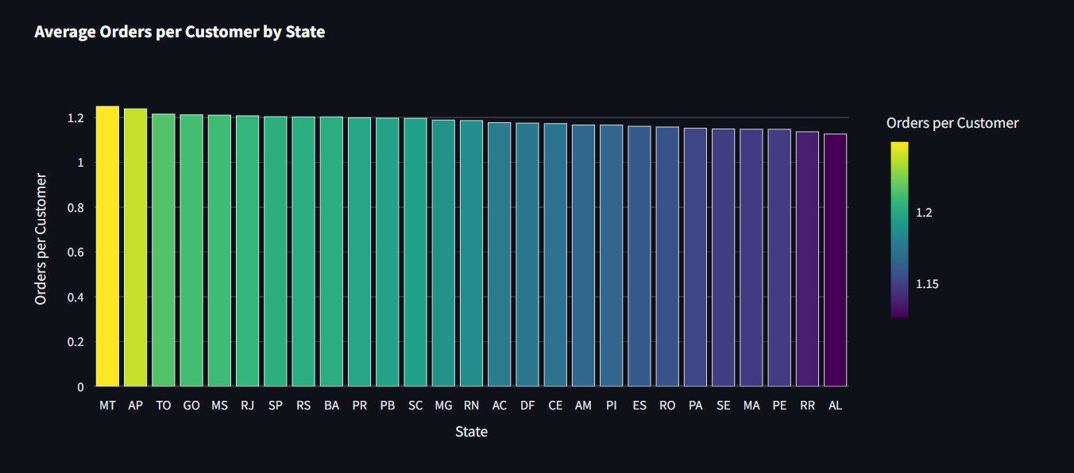

Slide 15

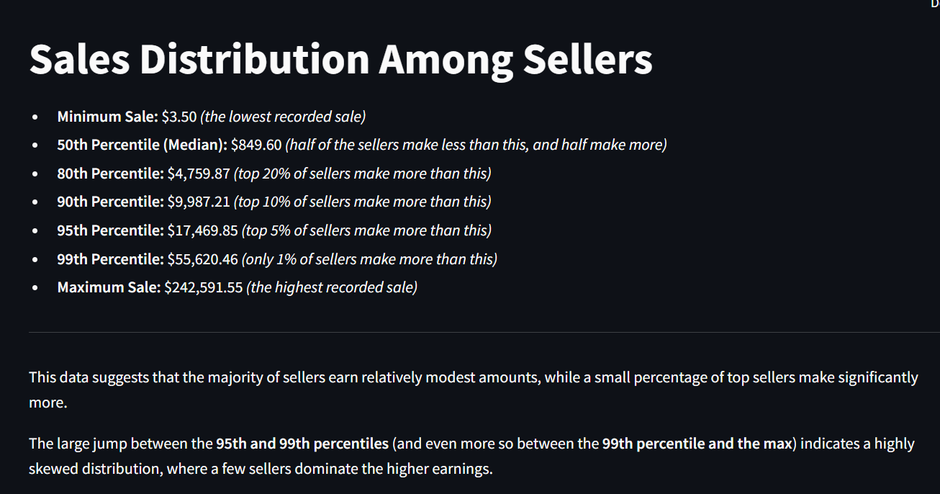

Slide 16
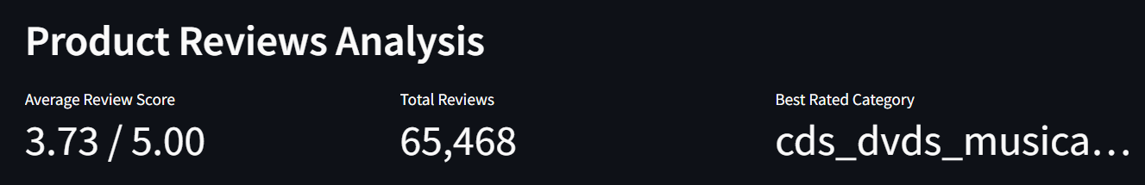
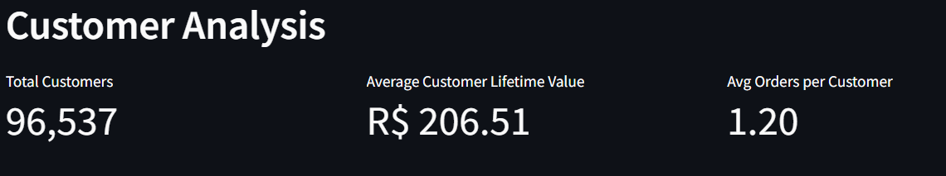
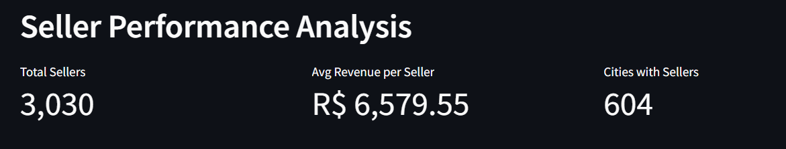

Slide 17
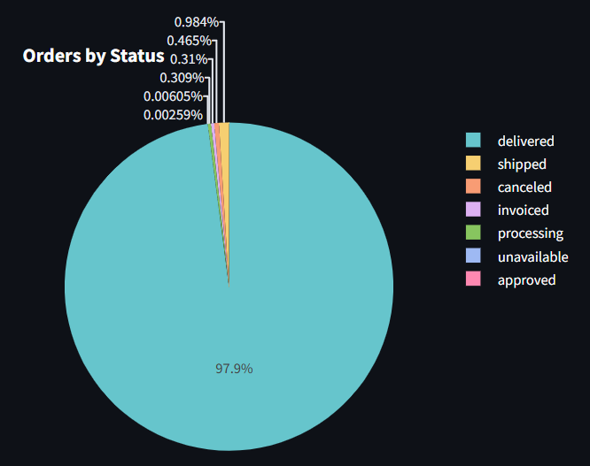
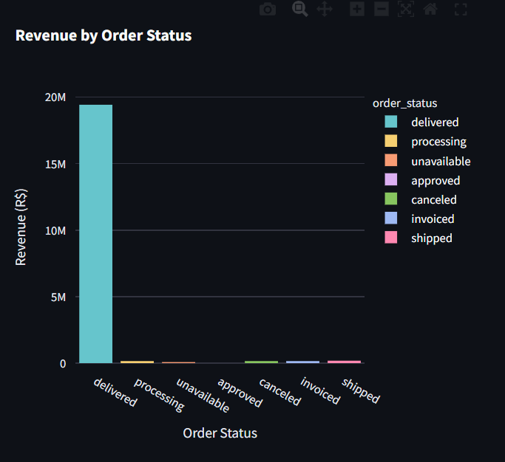
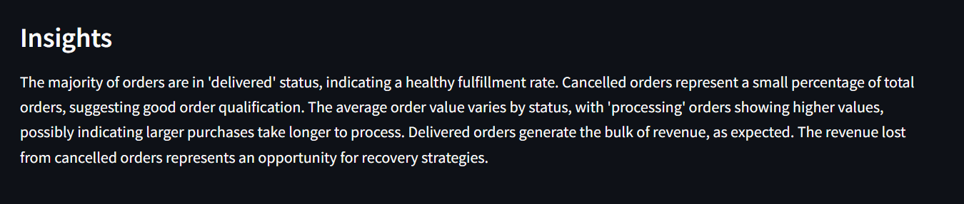

Slide 18
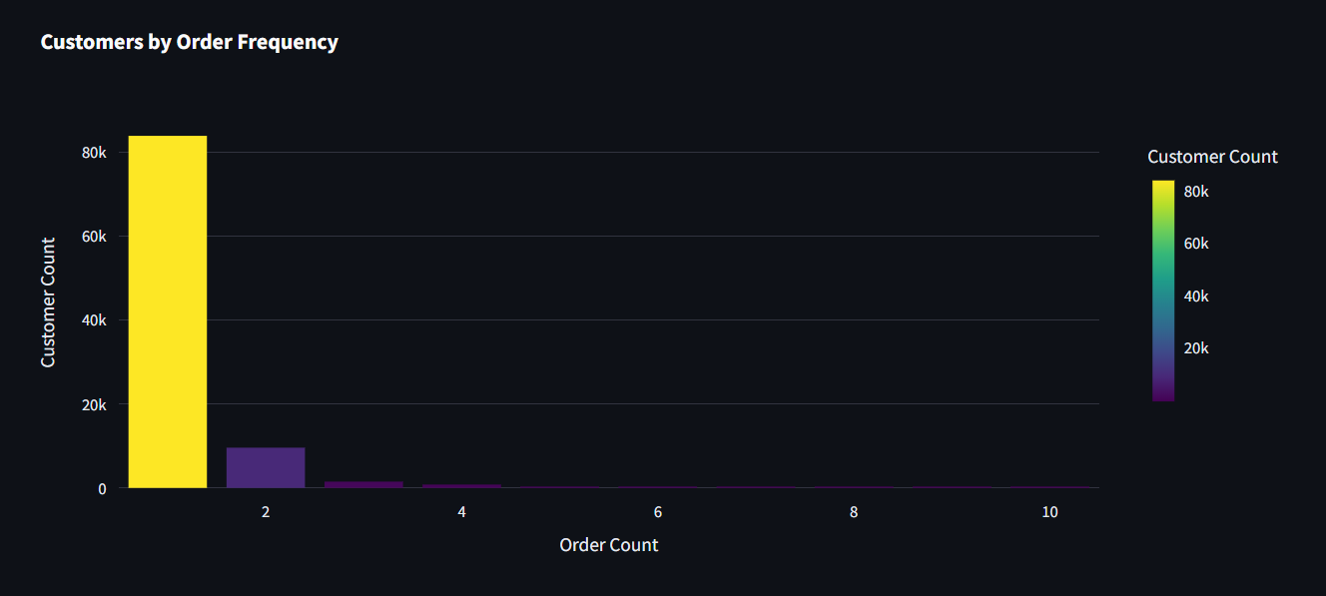
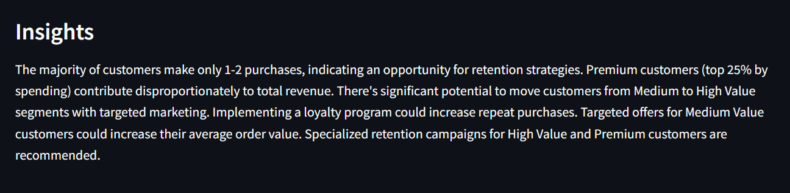

Slide 19
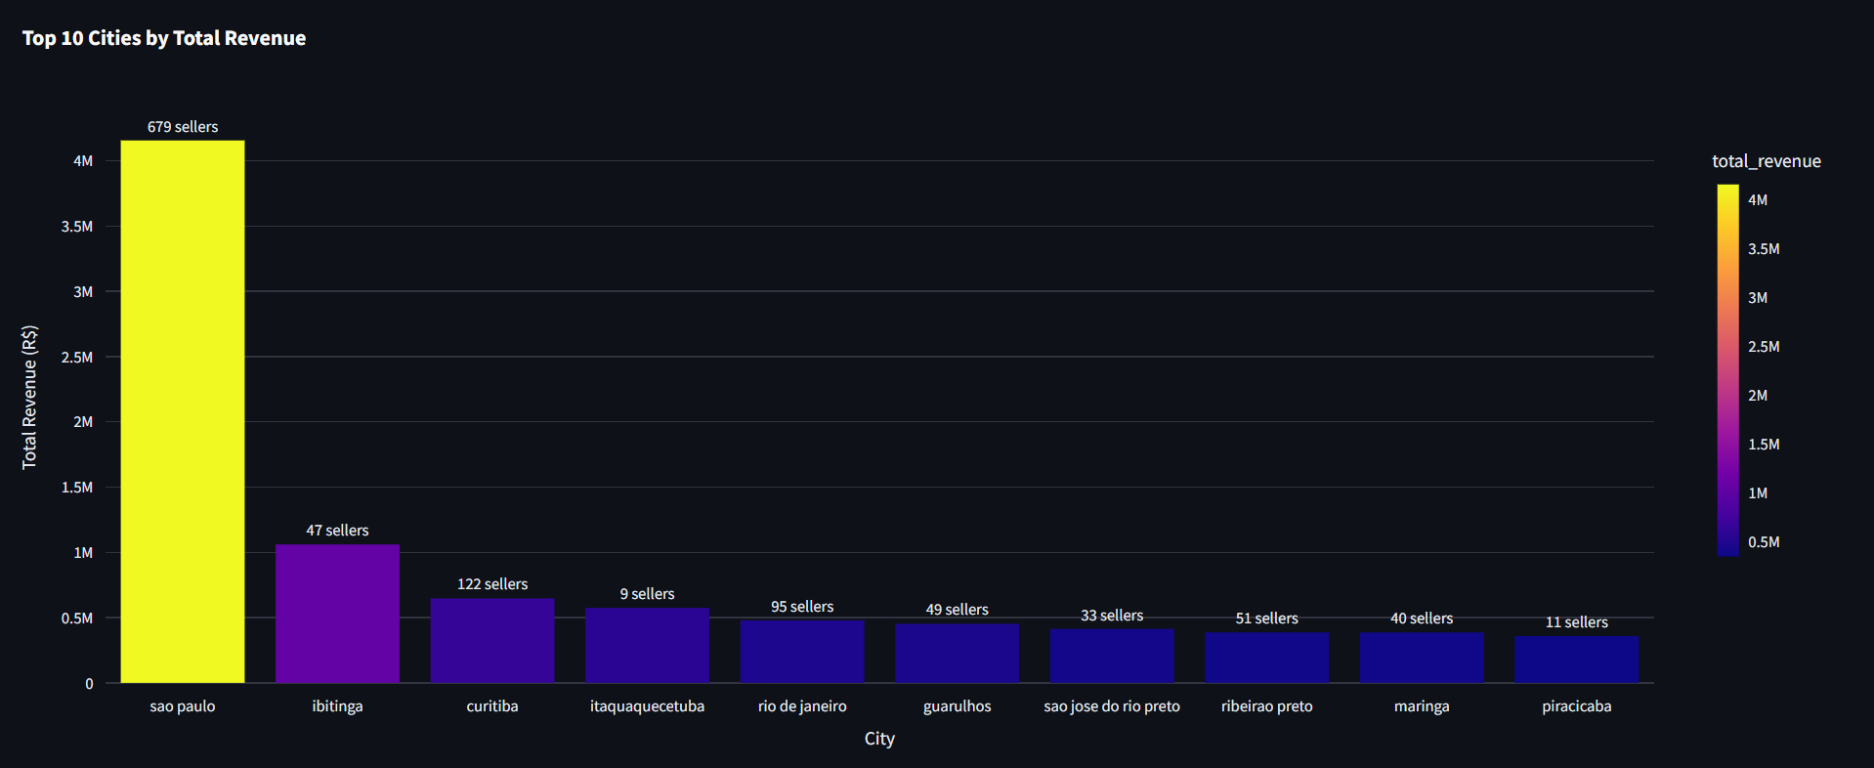
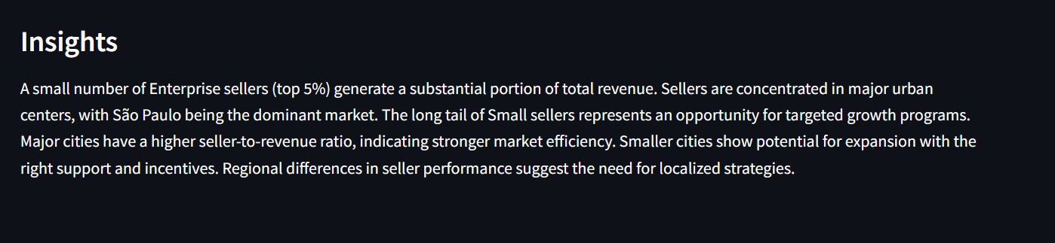

Slide 20
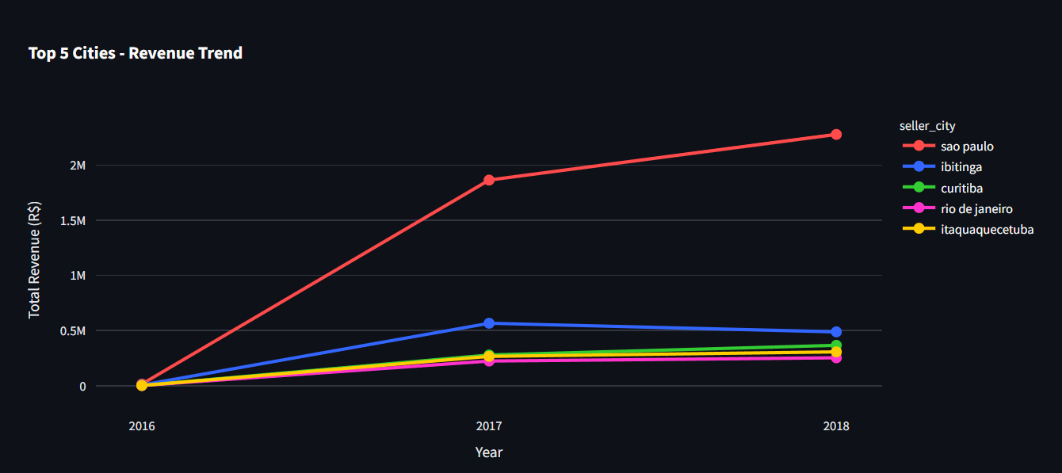
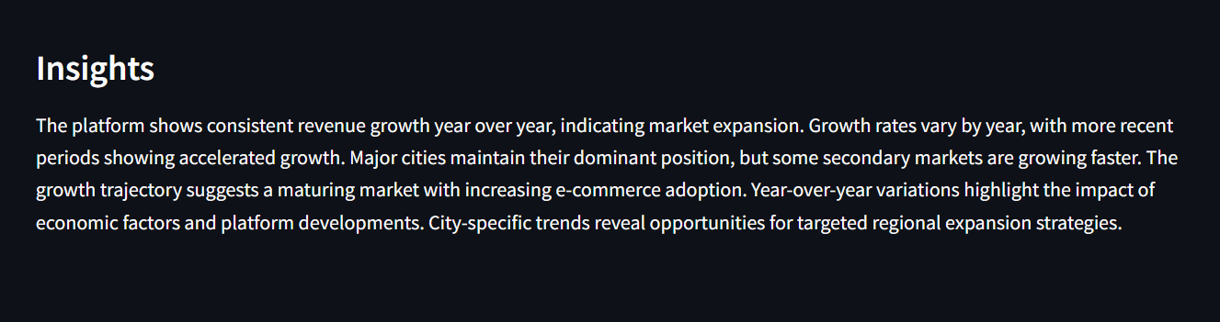

Slide 21
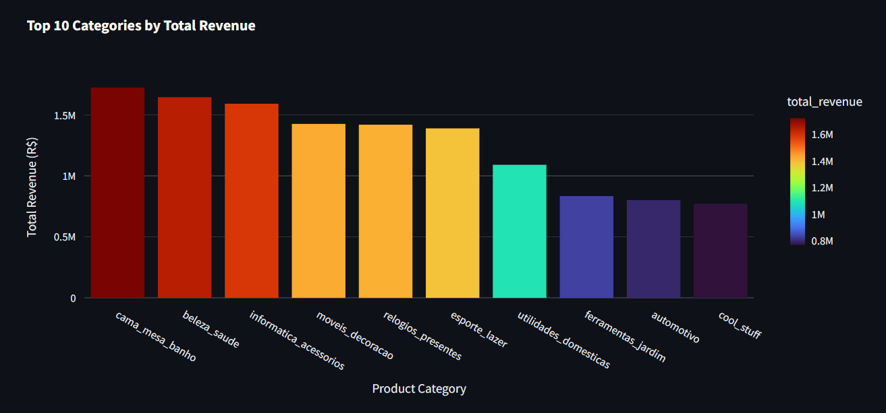
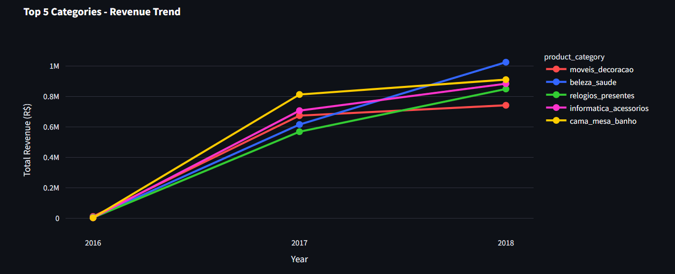
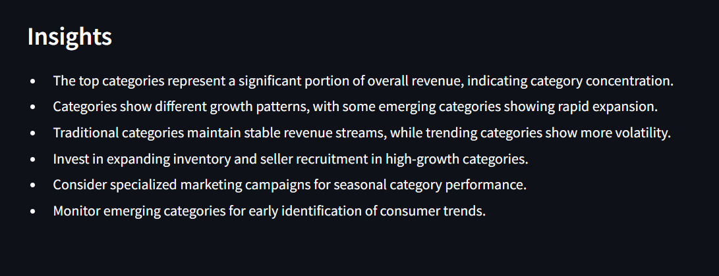

Slide 22
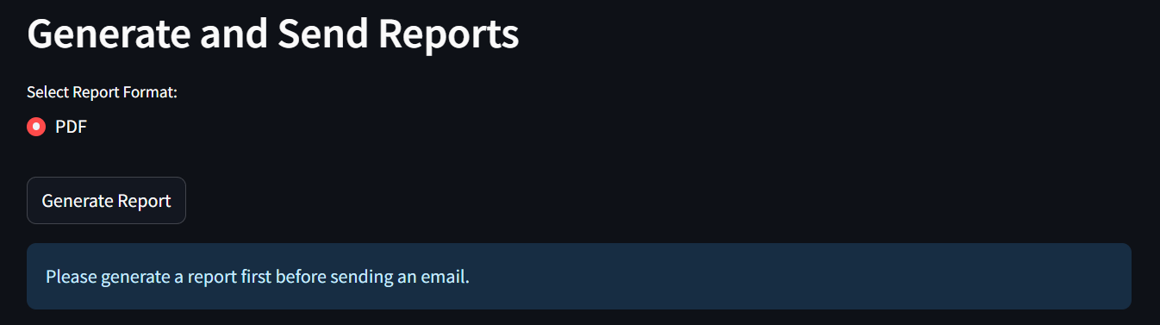
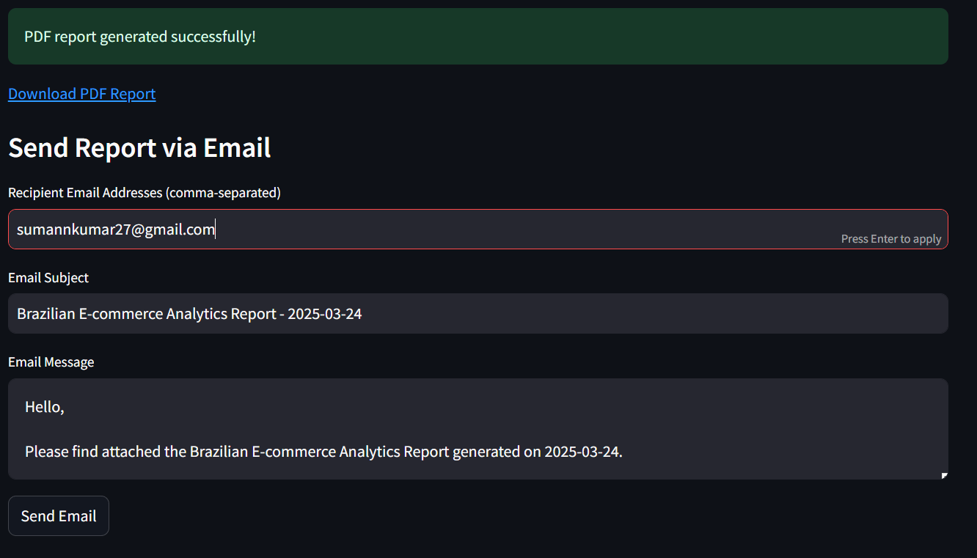

Slide 23
Conclusions & Findings
Technical Achievements
Business Value
Scalable Architecture
Enabled e-commerce analytics and data-driven decisions.
Integrated data sources and created optimized star schema.
Reduced time from data collection to insights.

Slide 24

Next Steps
Enhancements
Real-time data streaming integration.
Data Quality
Advanced data quality monitoring.
Future Applications
Predictive analytics for sales forecasting.

Slide 25
Thank You

