Slide 1

CONDITIONAL STATEMENTS
and CONTROL STATEMENTS

Slide 2
CONDITIONAL STATEMENTS (Decision Making)
The basic decision statements in computer is selection structure.
The decision is described to computer as a conditional statement that can be answered True or False.
Python language provide the following conditional (Decision making) statements.
  if statement
  if...else statement
  if...elif...else staement
  Nested if..else statement

Slide 3
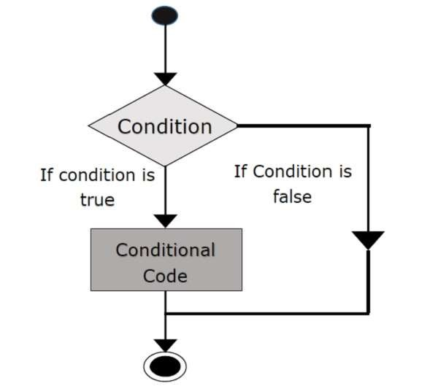
The if statement
The if statement is a decision making statement. It is used to control the flow of execution of the statements and also used to test logically whether the condition is true or false.
Syntax
if test expression: statement(s)
: → Indentation in Python is a strict syntactical requirement used to define code blocks, replacing the curly braces {} in C

Slide 4
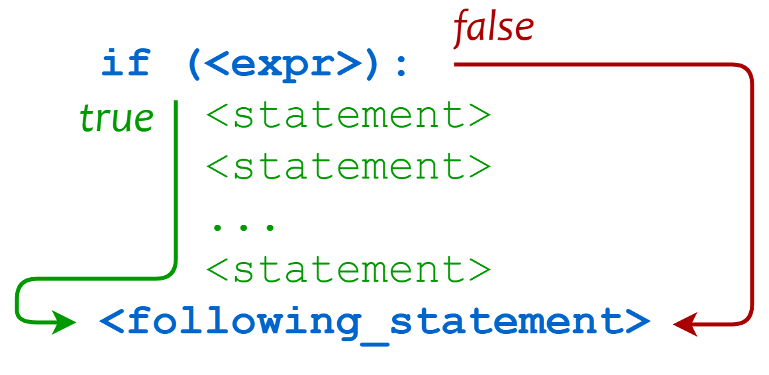
Compound if Statement
if <expr>:
statement
statement
statement
Outside statement
Here, all the statements at the matching indentation level are considered part of the same block.
The entire block is executed if <expr> is true, or skipped over if <expr> is false.
Either way, execution proceeds with <Outside_statement> afterward.

Slide 5
Example program
i=int(input(“Enter the number:”)) If (i<=10):
print(“ condition is true”)
OUTPUT
Enter the number: 9 Condition is true

Slide 6
nested-if
A nested if is an if statement that is the target of another if statement. Nested if statements means an if statement inside another if statement. Yes, Python allows us to nest if statements within if statements. i.e, we can place an if statement inside another if statement.
Syntax:
if (condition1):
# Executes when condition1 is true
if (condition2):
# Executes when condition2 is true
# if Block is end here
# if Block is end here

Slide 7
Example
i = 10
if (i == 10):
print ("i equal to 10")
if (i < 15):
print ("i is smaller than 15")
if (i < 12):
print ("i is smaller than 12 too")

Slide 8
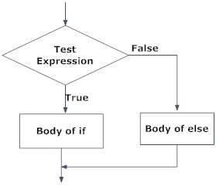
If … else statement
The if…else statement is called alternative execution, in which there are two possibilities and the condition determines wich one gets executed.
Syntax
if test expression:
Body of if
else:
Body of else

Slide 9
Write a program to check if a number is Odd or Even num = int(input(“Enter the number:”))
if (num % 2)== 0:
print (“Given number is Even”) else:
print(“ Given number is Odd”)
OUTPUT
Enter the number: 9 Given number is Odd

Slide 10
elif Statements
elif – is a keyword used in Python in replacement of else if to place another condition in the program. This is called chained conditional.
Chained conditions allows than two possibilities and need more than two branches.
SYNTAX
if expression:
Body of if elif expression:
Body of elif else:
Body of else

Slide 11
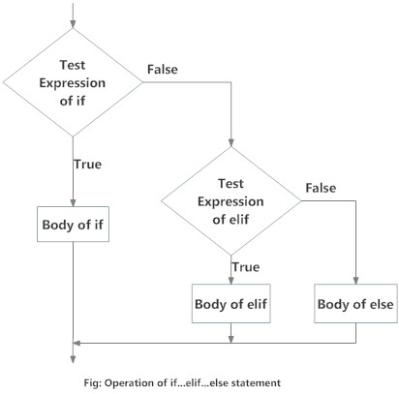
elif condition Flowchart

Slide 12
Example: largest among three numbers
a = int(input(“Enter 1st number:”)) b= int(input(“Enter 2nd number:”)) c= int(input(“Enter 3rd number:”))
if (a > b) and (a > c):
print("a is greater") elif (b >a) and (b > c):
print(“b is greater")
else:
print(“c is greater")
OUTPUT
Enter 1st number:10 Enter 2nd number:25
Enter 3rd number:15 B is greater

Slide 13
Nested if … else Statements
We can write an entire if… else statement in another if… else statement called nesting, and the statement is called nested if.
In a nested if construct, you can have an if … elif
… else construct inside an if … elif.. Else construct.

Slide 14
Syntax
if expression1:
statement(s) if expression2:
statement(s) elif expression3:
statement(s)
else:
statement(s)
.

Slide 15
Example program
n = int(input(“Enter number:”)) If (n<=15):
if (n == 10):
print(‘play cricket’) elif n > 10:
print(‘play kabadi’)
else:
print(‘Don’t play game’)
OUTPUT
Enter number : 10
Play cricket

Slide 16
Nested if, elif, else Conditions
price = 50
quantity = 5
amount = price*quantity
if amount > 100:
if amount > 500:
print("Amount is greater than 500")
else:
if amount < 500 and amount > 400:
print("Amount is")
elif amount < 500 and amount > 300:
print("Amount is between 300 and 500")
else:
print("Amount is between 200 and 500")
elif amount == 100:
print("Amount is 100")
else:
print("Amount is less than 100")

Slide 17
CONTROL STATEMENT (Looping Statement)
Program statement are executed sequentially one after another. In some situations, a block of code needs of times.
These are repetitive program codes, the computers have to perform to complete tasks. The following are the loop structures available in python.
  while statement
  for loop statement
  Nested loop staement

Slide 18
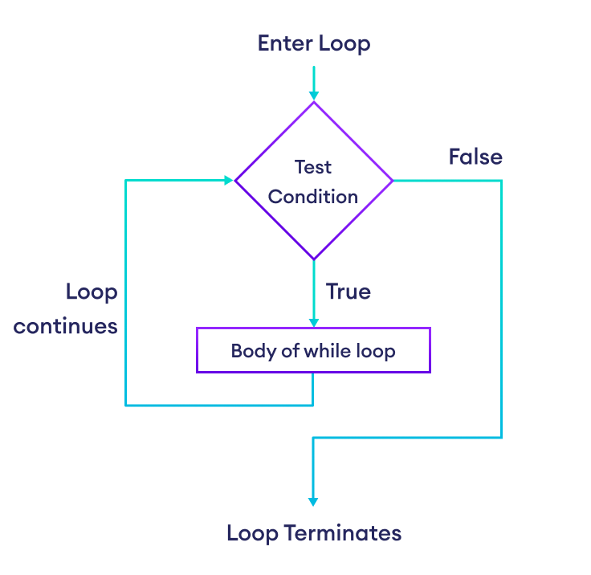
While loop statement
A while loop statement in Python programming language repeatedly executes a target statement as long as a given condition is true.
Syntax of while loop
while expression: statement(s)

Slide 19
# Program to add natural
n = int(input("Enter n: "))
sum = 0
i = 1
while i <= n:
sum = sum + i
i = i+1
print("The sum is", sum)

Slide 20
# Print numbers until the user enters 0
number = int(input('Enter a number: '))
# iterate until the user enters 0
while number != 0:
print("You entered {number}.", number)
number = int(input('Enter a number: '))
print('The end.')
age = 32
# The test condition is always True
while age > 18:
print('You can vote')

Slide 21
a = 1
while a < 10:
print(a, end=',')
a += 1
for a in range(10):
print(a, end=" ")
Write a Python program to print the square of all numbers from 0 to 10.
Write a Python program to find the sum of all even numbers from 0 to 10.

Slide 22
Using else statement with while loops
Python supports else statement associated with a loop statement.
If the else statement is used with a while loop, the else statement is executed when the condition false.
Program to illustrate the else in while loop
counter = 0
while counter < 3: print("Inside loop") counter = counter + 1
else:
print(“Outside loop")
OUTPUT
Inside loop Inside loop Inside loop Outside loop

Slide 23
For loop statement
The for loop is
another repetitive control
structure, and is used to execute a set of instructions repeatedly, until the condition becomes false.
The for loop in Python is used to iterate over a sequence (list, tuple, string) or other iterable objects. Iterating over a sequence is called
traversal.
Syntax
for val in sequence: Body of for loop

Slide 24
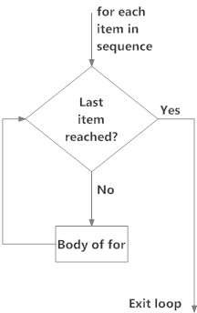
For loop flow chart
Addition of number using for loop
sum1 = 0
x= range(10)
for val in x :
sum1 = sum1+val
print("The sum is", sum1)
OUTPUT
range(stop)
range(start, stop,step)m is 55
Range function return a sequence of integers , which is an AP

Slide 25
for Loop and for Loop with else
OUTPUT
I like pop I like rock I like jazz
Numbers = range(2,101)
for num in numbers:
if num%2==0:
print ('the list contains an even number‘)
for letter in 'Python': # traversal of a string sequence
print ('Current Letter :', letter)
print()
print ("Good bye!")
OUTPUT
I like pop I like rock I like jazz
No items left.

Slide 26
For loop with else statement
x = range(2,10)
for i in x:
if i % 2 == 0:
print ("Even numbers:",i)
else:
print ("Odd numbers are:",i)

Slide 27
start = 25
end = 50
print("Prime numbers between", start, "and", end, "are:")
for num in range(start, end + 1):
# all prime numbers are greater than 1
# if number is less than or equal to 1, it is not prime
if num > 1:
for i in range(2, num):
# check for factors
if (num % i) == 0:
# not a prime number so break inner loop and
# look for next number
break
else:
print(num)

Slide 28
break, continue, and pass statements in Python
Break Statement
In Python, the break statement provides you with the opportunity to exit out of a loop when an external condition is triggered. You’ll put the break statement within the block of code under your loop statement, usually after a conditional if statement.

Slide 29
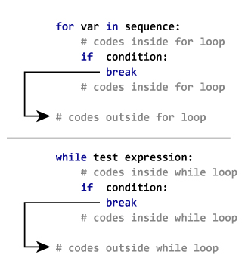

Slide 30
for ch in "python":
if ch == "h":
break
print(ch)
print("end")
for i in range(4):
for j in range(4):
if j==2:
break
print(i,j)

Slide 31
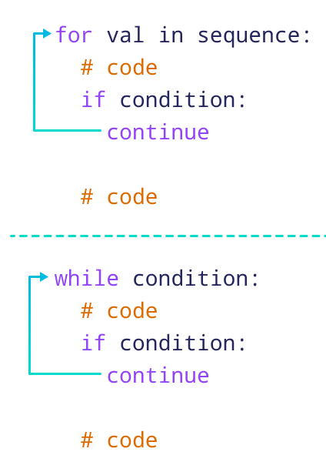
Continue Statement
The continue statement gives you the option to skip over the part of a loop where an external condition is triggered, but to go on to complete the rest of the loop. That is, the current iteration of the loop will be disrupted, but the program will return to the top of the loop.
for i in range(4):
if i==2:
continue
print(i)
number = 6
while number > 0:
number -= 1
if number == 2:
continue
print(number)
print("Loop ended")

Slide 32
# Initialize a counter
number = 0
# Loop as long as the number is less than 10
while number < 10:
# Increment the counter FIRST to avoid an infinite loop if the continue condition is met
number += 1
# Check if the number is a multiple of 3 (using the modulo operator %)
if number % 3 == 0:
# If it is, the 'continue' statement stops the current iteration
# and jumps back to the start of the while loop for the next iteration
continue
# This print statement is only reached if the 'continue' was NOT executed
print(number)
print("Loop finished.")

Slide 33
rows = 5
for i in range(1, rows + 1): # Outer loop for rows (1 to 5)
for j in range(i): # Inner loop for columns (0 to i-1)
print("*", end=" ") # Print star and stay on the same line
print() # Move to the next line after the row is complete

Slide 34
start = int(input("Enter start value: "))
end = int(input("Enter end value: "))
print("Prime numbers between", start, "and", end, "are:")
for num in range(start, end + 1):
if num <= 1:
continue # skip non-prime numbers
for i in range(2, num):
if num % i == 0:
break
else:
print(num)

Slide 35
start = int(input("Enter start value: "))
end = int(input("Enter end value: "))
print("Prime numbers are:")
for num in range(start, end + 1):
if num <= 1:
continue
is_prime = True
for i in range(2, num):
if num % i == 0:
is_prime = False
continue
if is_prime:
print(num)

Slide 36
Pass Statement
When an external condition is triggered, the pass statement allows you to handle the condition without the loop being impacted in any way; all of the code will continue to be read unless a break or other statement occurs.
for number in range(10):
if number %2 ==0:
pass
else:
print(number)
n = 10
# use pass inside if statement
if n > 10:
pass
print('Hello')

