Slide 1

Input and Output operations

Slide 2
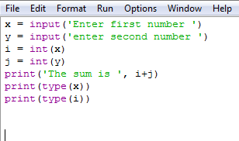
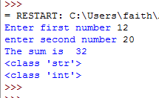
Input function in Python 3.x
Python offers two function int() and float() to convert the value in
integer and float type.
bool() can also be used to get data in true/false

Slide 3

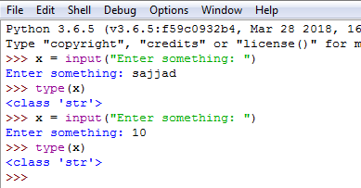
Input() function in Python 3.x should require type casting as it generate data in string type by default.

Slide 4

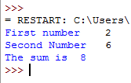

To take input from user we took two input function and two lines. What if we want this process in one single line?

Slide 5
Python split() Method
text = "geeks for geeks"
print(text.split())
text = "geeks,for,geeks"
print(text.split(","))
text = "geeks:for:geeks"
print(text.split(":"))
text = "CatBatSatFatOr"
print(text.split("t"))
#Output
['geeks', 'for', 'geeks']
['geeks', 'for', 'geeks']
['geeks', 'for', 'geeks']
['Ca', 'Ba', 'Sa', 'Fa', 'Or']

Slide 6




split() is a function/method used to split the input() function into multiple values.
The method split() returns a list of all the words in the string.
split() is opposite of concatenation which combines strings into one.

Slide 7

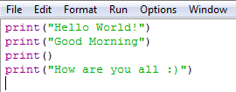

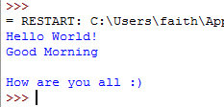
print() :- without argument print() function prints a blank line.
Line separator

Slide 8
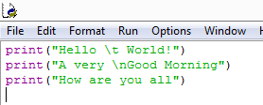
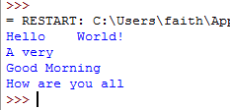
print(string) :- enclosed within quotes.
Allowed escape character

Slide 9

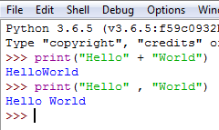
What is the difference between
print(“Hello”+ “World”) and print(“Hello” , “World”)
No Space
with Space
First argument
Second argument
print() function insert spaces between items automatically.

Slide 10



End with space not new line

