Slide 1


Network Induction Detection with KNN Algorithm
Network Induction Detection (NID) is an important field of machine learning and KNN is a widely used algorithm for classification problems. Let's explore NID and learn how to use KNN algorithm effectively.
SP
by Suman Patra

Slide 2
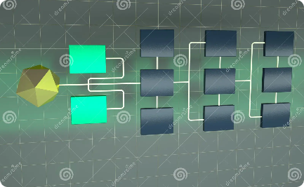


Introduction to Network Induction Detection
What is NID?
Why do we need NID?
How does NID work?
Network Induction Detection refers to the use of machine learning techniques to detect intrusions in a computer network.
Cyber attacks on computer networks are increasing and NID helps in preventing these intrusions and hackers from accessing sensitive information.
NID involves analyzing network traffic using various statistical models and algorithms to detect anomalies and potential threats.

Slide 3
Explanation of KNN Algorithm
What is KNN?
How does KNN work?
What are the advantages of KNN?
K-Nearest Neighbors (KNN) is a non-parametric algorithm used for classification and regression tasks. It makes predictions based on the K most similar training examples in the feature space.
KNN works by calculating the distance between the test sample and each training sample. It selects the K-nearest neighbors and takes the most common class label as the prediction.
KNN is simple, easy to implement, and gives good results on small datasets. It is also effective for multi-class problems and can handle data with complex patterns.

Slide 4
Benefits of Using KNN Algorithm
1
High Accuracy
KNN has a high accuracy rate, making it suitable for applications where accuracy is critical.
2
Simple and Intuitive
KNN is easy to understand and interpret, making it accessible to beginners in machine learning.
3
Non-parametric
KNN doesn't make any assumptions about the data distribution, making it suitable for diverse datasets.
4
Adaptable
KNN can be used for both classification and regression problems and can be adapted to handle missing data.

Slide 5
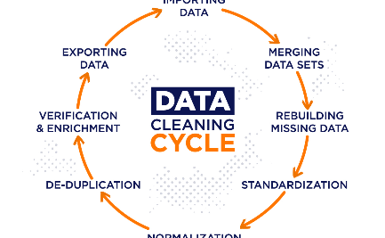

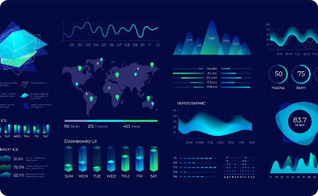
Data Preparation and Preprocessing
Data Cleansing
Feature Scaling
Data Visualization
Data cleansing involves removing noise and inconsistencies from the dataset to improve accuracy and reliability.
Feature scaling involves normalizing the data to bring all features to a similar scale, making it easier for KNN to classify the data.
Data visualization helps in understanding the patterns and relationships in the data, which can be helpful in selecting features and improving the model.

Slide 6
Model Training and Testing
Model Training
Model Testing
Model Optimization
KNN model is trained on the normalized dataset, using a suitable value of K and appropriate distance metric.
The trained model is tested on a separate test dataset, and evaluated using measures like accuracy, precision, recall, and f1-score.
The model can be optimized by tuning hyperparameters, selecting appropriate features, and trying different distance metrics.

Slide 7
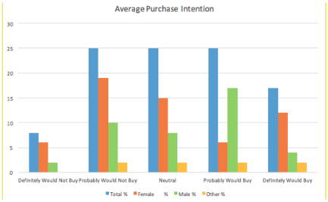
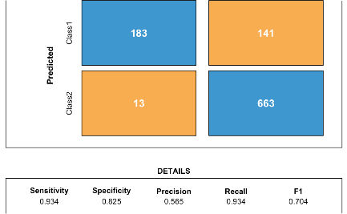
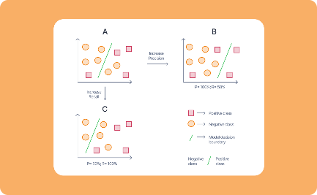
Results and Analysis
Results
Confusion Matrix
Precision-Recall Tradeoff
The KNN model achieved an accuracy of 92.32% on the test dataset, indicating its effectiveness in detecting network intrusions.
The confusion matrix shows the number of correctly and incorrectly classified instances, which can help in understanding the strengths and weaknesses of the model.
The precision-recall tradeoff curve helps in visualizing the tradeoff between precision and recall for different threshold values.

Slide 8
Conclusion and Future Work
1
Conclusion
KNN algorithm is an effective tool for Network Induction Detection, providing high accuracy and adaptability. It can be used for detecting multiple types of intrusions and can be optimized for better results.
Future Work
2
Further research can be done on using different distance metrics and feature selection techniques for improving the performance of KNN model. The model can also be integrated with other machine learning techniques for better results.

