Slide 1

FORENSIC TOOLKIT

Slide 2

FTK Imager
FTK Imager is an open-source software by AccessData.
It is used for creating accurate copies of the original evidence without actually making any changes to it.

Slide 3
The Image of the original evidence is remaining the same and allows us to copy data at a much faster rate, which can be soon be preserved and can be analyzed further.
The FTK imager also provides you with the inbuilt integrity checking function which generates a hash report which helps in matching the hash of the evidence before and after creating the image of the original Evidence.

Slide 4
Table of Contents
Creating a Forensic Image
Capturing Memory
Analyzing Image dump
Mounting Image to Drive
Custom Content Image using AD encryption
Decrypt AD Encryption
Obtain Protected Files
Detect EFS Encryption
Export Files

Slide 5
Creating a Forensic Image
Forensic Imaging is one of the most crucial steps involved in digital forensic investigation.
It is the process of making an archival or backup copy of the entire hard drive.

Slide 6
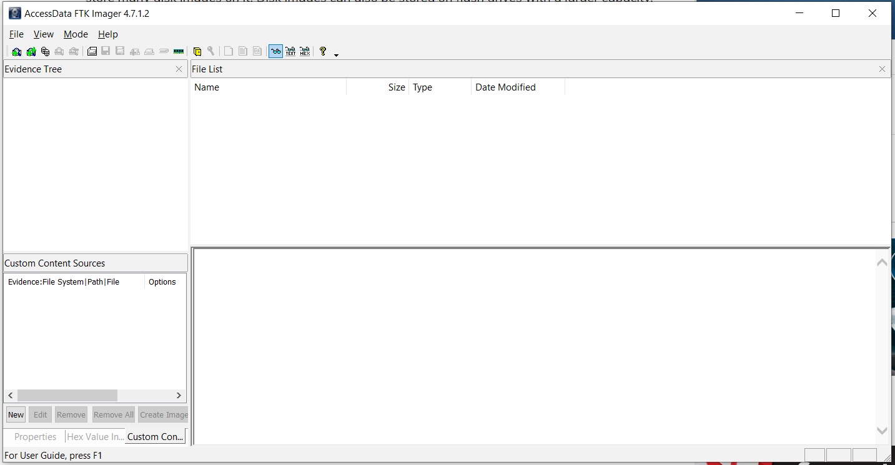
Open FTK Imager by AccessData after installing it, and you will see the window pop-up which is the first page to which this tool opens

Slide 7
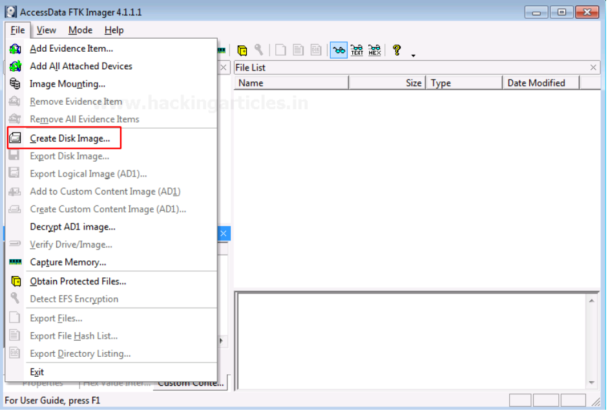
Now, to create a Disk Image. Click on File > Create Disk Image.

Slide 8
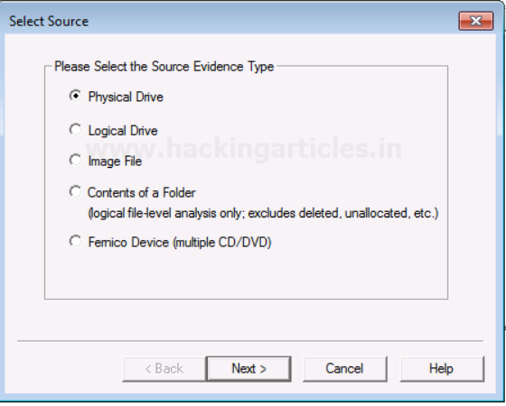
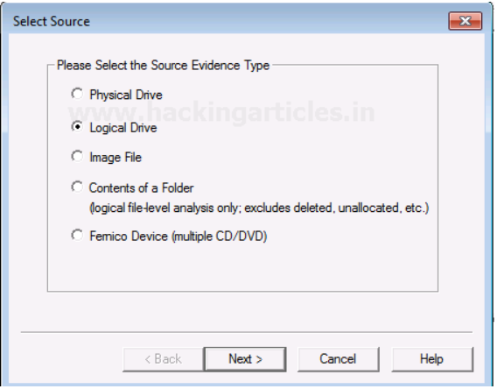
Now you can choose the source based on the drive you have. It can be a physical or a logical Drive depending on your evidence.
A Physical Drive is the primary storage hardware or the component within a device, which is used to store, retrieve, and organize data.
A Logical Drive is generally a drive space that is created over a physical hard disk. A logical drive has its parameters and functions because it operates independently.

Slide 9
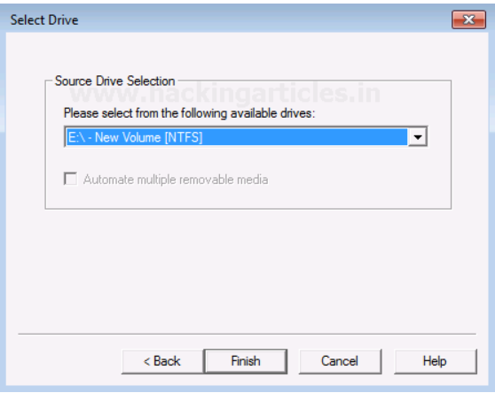
Now choose the source of your drive that you want to create an image copy of.

Slide 10
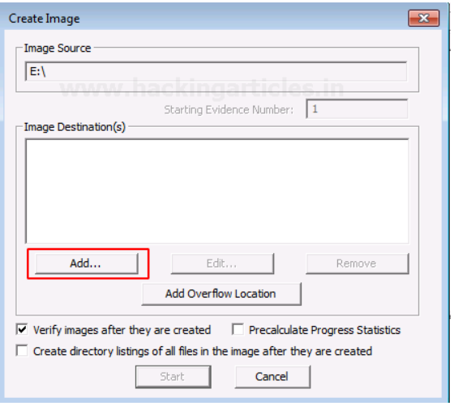
Add the Destination path of the image that is going to be created. From the forensic perspective, It should be copied in a separate hard drive and multiple copies of the original evidence should be created to prevent loss of evidence.

Slide 11
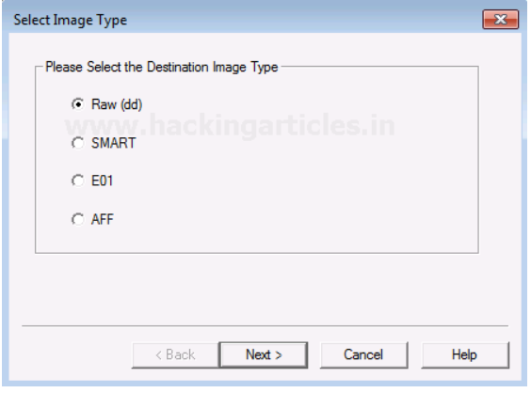
Select the format of the image that you want to create. The different formats for creating the image are:
Raw(dd): It is a bit-by-bit copy of the original evidence which is created without any additions and or deletions. They do not contain any metadata.
SMART: It is an image format that was used for Linux which is not popularly used anymore.
E01: It stands for EnCase Evidence File, which is a commonly used format for imaging and is similar to
AFF: It stands for Advanced Forensic Format that is an open-source format type.

Slide 12
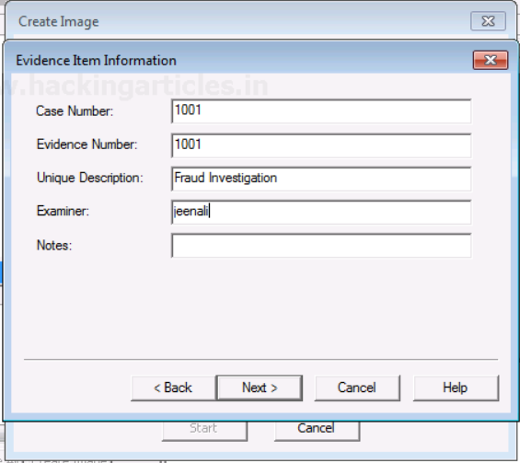
Now, add the details of the image to proceed.

Slide 13
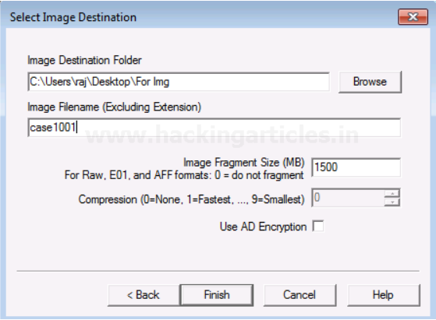
Now finally add the destination of the image file, name the image file and then click on Finish.

Slide 14
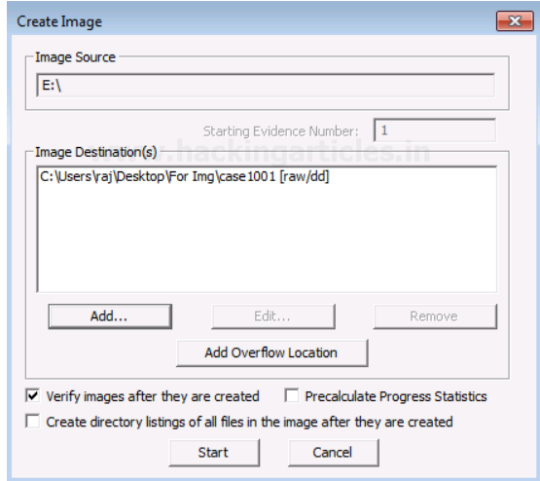
Once you have added the destination path, you can now start with the Imaging and also click on the verify option to generate a hash.

Slide 15
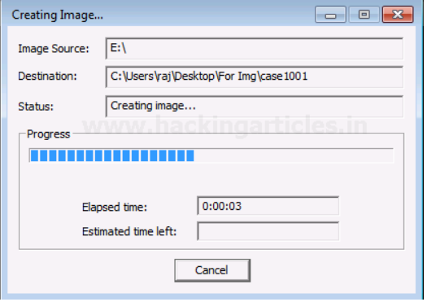
Now let us wait for a few minutes for the image to be created.

Slide 16
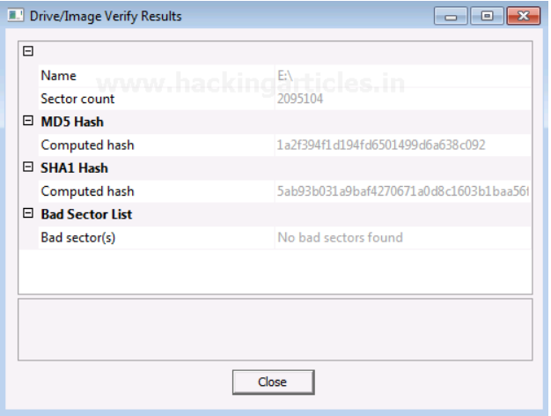
After the image is created, a Hash result is generated which verifies the MD5 Hash, SHA1 Hash, and the presence of any bad sector.

Slide 17
Capturing Memory
It is the method of capturing and dumping the contents of a volatile content into a non-volatile storage device to preserve it for further investigation.
A ram analysis can only be successfully conducted when the acquisition has been performed accurately without corrupting the image of the volatile memory.
In this phase, the investigator has to be careful about his decisions to collect the volatile data as it won’t exist after the system undergoes a reboot.

Slide 18
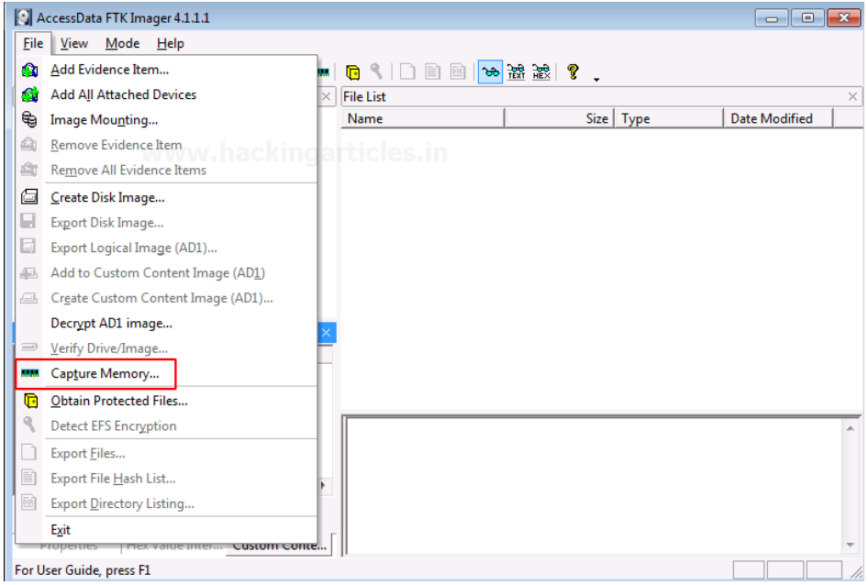
To capture the memory, click on File > Capture Memory.

Slide 19
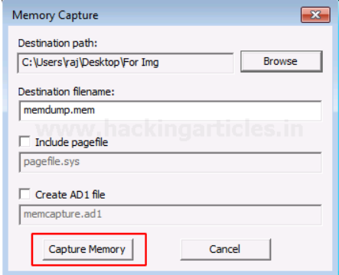
Choose the destination path and the destination file name, and click on capture memory.

Slide 20
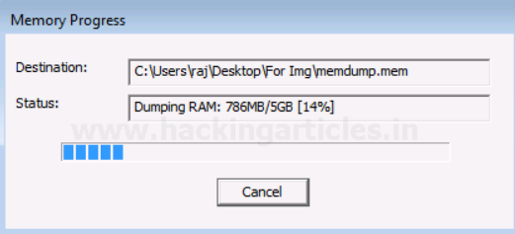
Now let us wait for a few minutes till the ram is being captured.

Slide 21
Analyzing Image Dump
Now let us analyze the Dump RAW Image once it has been acquired using FTK imager.

Slide 22
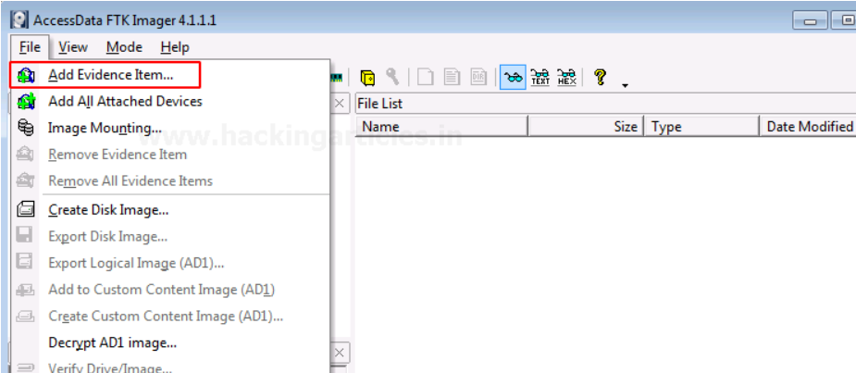
To start with analysis, click on File> Add Evidence Item.

Slide 23
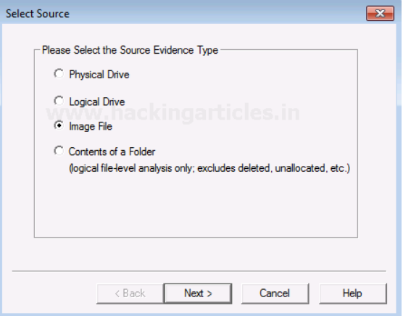
Now select the source of the dump file that you have already created, so here you have to select the image file option and click on Next.

Slide 24
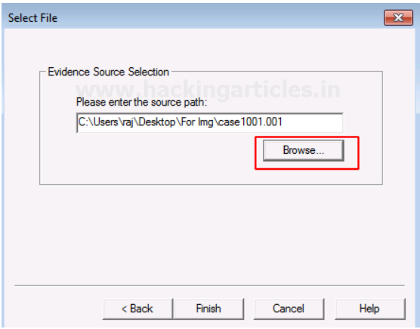
Choose the path of the image dump that you have captured by clicking on Browse.

Slide 25
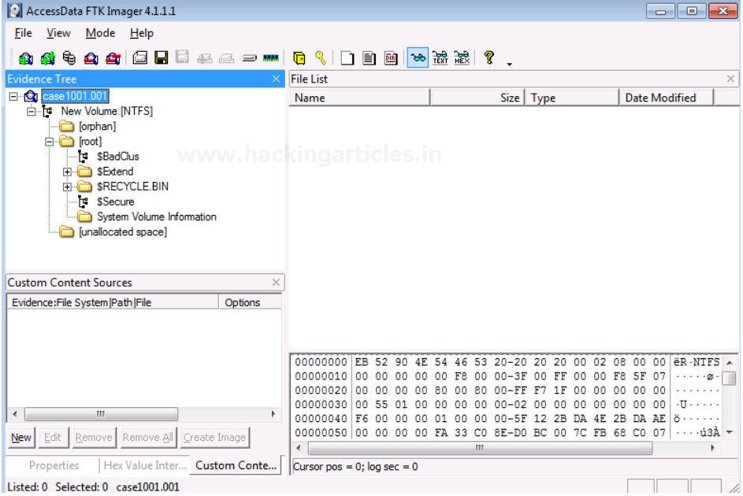
Once the image dump is attached to the analysis part, you will see an evidence tree which has the contents of the files of the image dump. This could have deleted as well as overwritten data.

Slide 26
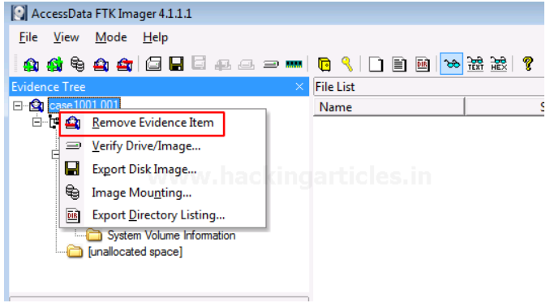
To analyze other things further, we will now remove this evidence item by right-clicking on the case and click on Remove Evidence Item

Slide 27
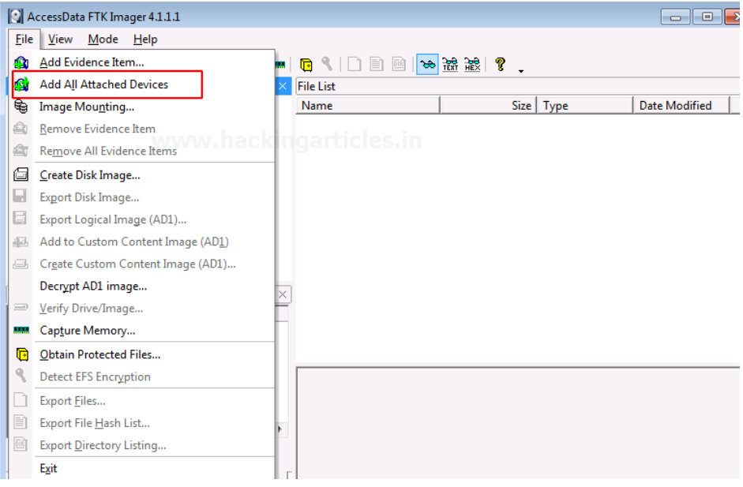
Mounting Image to Drive To mount the image as a drive in your system, click on File > Image Mounting

Slide 28
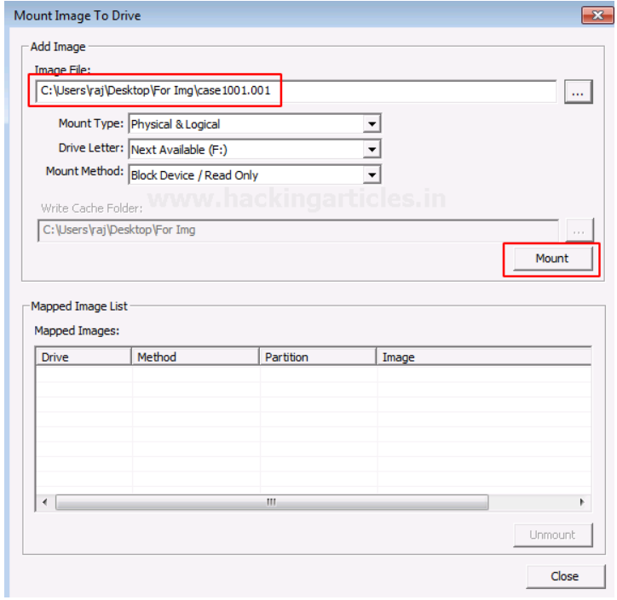
Once the Mount Image to Drive window appears, you can add the path to the image file that you want to mount and click on Mount.

Slide 29
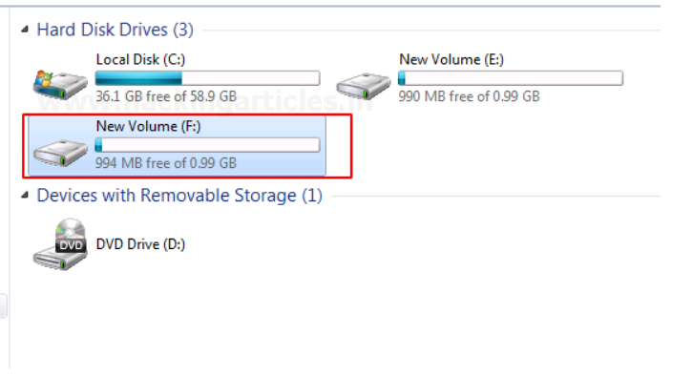
Now you can see that the image file has now been mounted as a drive.

