Slide 1
Introduction to open source

Slide 2

Founder- Eric Steven Raymond (ESR)
Year- 1998
Organization- Open Source Initiative
Logo of the Open Source Initiative, “combines the ‘O’ of open and a keyhole, for unlocking source code”

Slide 3
Is there any difference between Open source software , Freeware, Free software, Shareware?

Slide 4
FREEWARE (100% free of charge)
Freeware means there are no paid licenses required to use the application, no fees or donations necessary, no restrictions on how many times you can download or open the program, and no expiration date.
Examples:
Adobe Reader, Skype,Team Viewer,Yahoo Messenger.
“Source code is not available” as freeware is copyrighted and cannot be modified or distributed.

Slide 5
Free Software(copyright-free)
Free software is released under a license that allows users to change and distribute the software
Free software can be copied and distributed with or without any modifications.
This type of software is often called open-source software, or free and open-source software (FOSS).
Examples:
LibreOffice, Apache HTTP server, MySQL

Slide 6
The following are considered the required freedoms that a user must be granted for the software to be considered free software
Freedom 0: You're able to run the program for any purpose.
Freedom 1: You can study how the program works, and change it to make it do whatever you want.
Freedom 2: You're given the ability to share and make copies of the software so that you can help others.
Freedom 3: You can improve on the program, and release your improvements (and modified versions) to the public so that everyone benefits.

Slide 7
Shareware(Try before you buy)
Shareware software is a software that are freely distributed to users on trial basis.
( for example- free for 30 days or 2 months)
Computer users can download and use a limited version of software or full version of software for a limited period of time.
Examples:
Adobe acrobat 8 professional, PHP Debugger 2.1.3.3

Slide 8
Open source software
Open source software is software with source code that anyone can inspect, modify, and enhance.
Programmers who have access to source code can change a program by adding to it, changing it, or fixing parts of it that aren’t working properly.
Examples:
GNU/Linux, Mozilla Firefox,VLC media player.

Slide 9
Advantages of OSS
Lower Cost
Flexibility
Reliability and Quality
Conclusion
Open source software is the software in which users have the ability to run, copy, distribute, study, change, share and improve for any purpose.

Slide 10
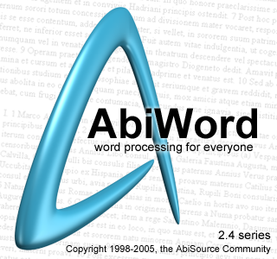




Examples
Office Automation: AbiWord, OpenOffice, KOffice
Web Design: Nvu, GIMPShop Bluefish
Communication: Pidgin Thunderbird, PhpBB
E-commerce: OsCommerce, VirtualMart, Zen Cart
Content-Management System: Drupal Joomla
Operating System: Fedora , Android
Web Browser: Lynx, Mozilla, Firefox
Programming Languages: Perl, PHP, Python, Ruby

