Slide 1
Linux
Linux is the best-known and most-used open source operating system. As an operating system, Linux is software that sits underneath all of the other software on a computer, receiving requests from those programs and relaying these requests to the computer’s hardware.
Reffer the below mentioned website
https://opensource.com/resources/linux

Slide 2
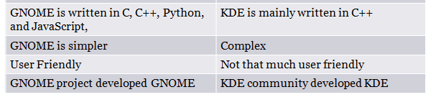
GNOME Vs KDE

Slide 3
Command line Structure
A command is a program that tells the Unix system to do something
syntax command [options] [arguments]
Commands are case sensitive.
DATE and date are not same .

Slide 4
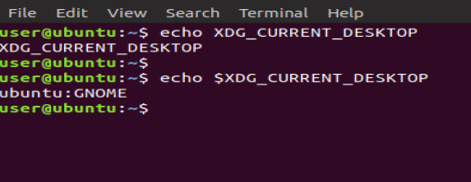
Checking Desktop

Slide 5
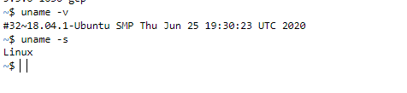
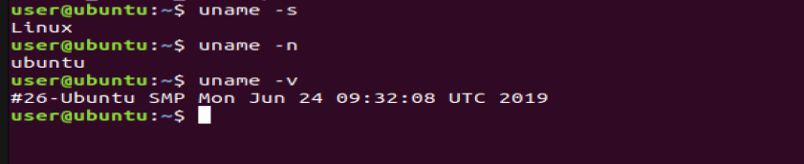
Checking version and release date

Slide 6
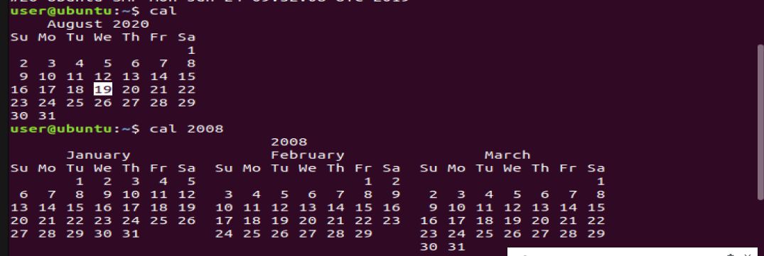
Cal Command
This command presents the quick view of a calander
Type cal for current calendar
for previous calendar like 2008 type cal 2008

Slide 7
date Command
Displays the system date and time
For current date type date
for 2 years ago here is the format

Slide 8
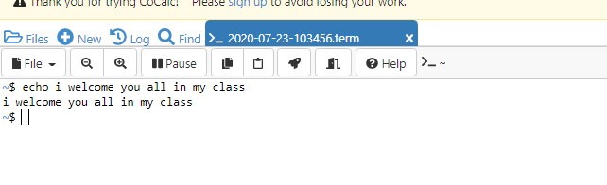
Echo Command
It is used to display the character / string or other values that are passed to it

Slide 9

Printing characters by different ways

Slide 10
mkdir
To create directories (also referred to as folders in some operating systems)
mkdir mydir creates a directory of my dir
mkdir mydir1 mydir2 mydir3 creates multiple directories

Slide 11
rmdir – remove empty directory
rmdir –p mydir1/mydir2/mydir3 (Each of the directory argument is treated as a pathname of which all components will be removed, if they are already empty, starting from the last component.)
rmdirmydir1/mydir2/mydir3 (Remove directory mydir3 if it’s empty)
rmdirmydir1 mydir2 mydir3 (Remove the directories mydir1, mydir2, and mydir3, if they are empty.)

Slide 12
ls – list contents of a directory
ls - -help (displays general syntax)
ls –t (sorts files by modification time)
ls –a lists all the files along with hidden files
pwd – present working directory

Slide 13
cat
cat - cat command allows us to create files, view contain of file, concatenate files and redirect output in terminal or files.
cat myfile (read content of myfile)
cat myfile1 myfile2 (read content of myfile1 and myfile2)
cat –n myfile1 myfile2 (display content with line number)
cat >myfile (create new file named myfile and write into it)

Slide 15
Printf
printf” command in Linux is used to display the given string, number or any other format specifier on the terminal window.
The most commonly used printf specifiers are %s, %b, %d, %x and %f.

Slide 16
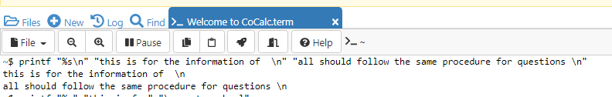
%s specifier
%s specifier: It is basically a string specifier for string output.$printf "%s\n" "Hello, World!"

Slide 17
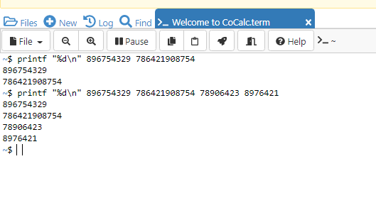
%d specifier
%d specifier: It is an integer specifier for showing the integral values.
Syntax $printf "%d\n" "213" "109"

Slide 18
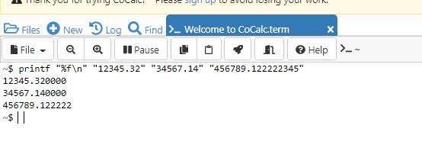
%f specifier

Slide 19
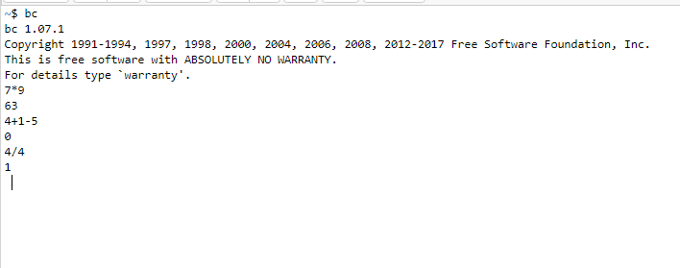
bc command
bc command is used for command line calculator. It is similar to basic calculator by using which we can do basic mathematical calculations

Slide 20
Who command
command is used to find out the following information : 1. Time of last system boot 2. Current run level of the system 3. List of logged in users and more.
Syntax who
Who –a for all users
Who -b time of last boot

Slide 21
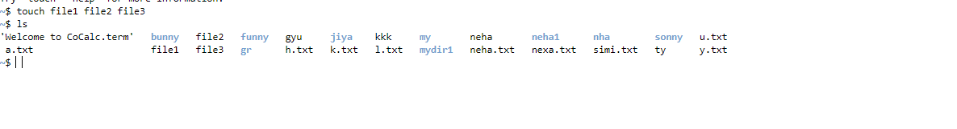
Touch command
It is used to create a file without any content
This command can be used when the user doesn’t have data to store at the time of file creation.
Syntax touch file1 file2 file3

Slide 22
Modifying timestamps
A timestamp is information associated with a file that identifies an important time in the files history

Slide 23
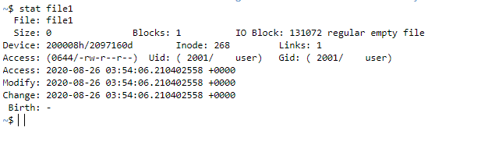
stat file1 that displays file status

Slide 24
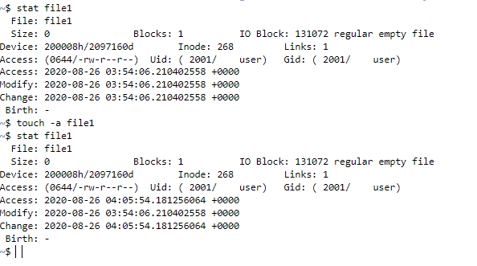
Changing timestamp access time
-m is used to change the change the modification time and –a option is used to change the access time

Slide 25
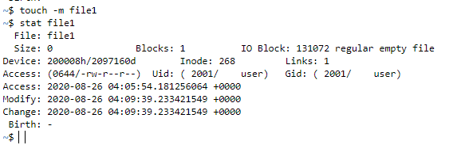
Changing the modification time

Slide 26
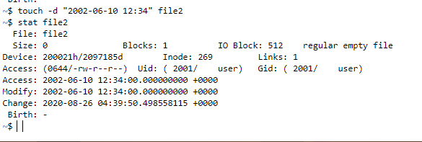
Changing date
touch –d “ 2002-09-7 13:24” name of file that you created
Type stat

Slide 27
Script command
command in Linux is used to make typescript or record all the terminal activities. After executing the script command it starts recording everything printed on the screen including the inputs and outputs until exit.
Syntax type script
Type exit to exit from script command

Slide 28
Script command
to start type script and to stop type exit
Default name of file is typescript
But we can change the name of typescript to any other name by typing the following command
mv typescript name of file(say abc)
Then to display type cat or more abc

Slide 30
Script command
command in Linux is used to make typescript or record all the terminal activities. After executing the script command it starts recording everything printed on the screen including the inputs and outputs until exit.
Syntax type script
Type exit to exit from script command

Slide 31
Script command
to start type script and to stop type exit
Default name of file is typescript
But we can change the name of typescript to any other name by typing the following command
mv typescript name of file(say abc)
Then to display type cat or more abc

Slide 32
grep
The grep filter searches a file for a particular pattern of characters, and displays all lines that contain that pattern
grep stands for globally search for regular expression and print out

Slide 33
Displaying the count of number of matches
We can find the number of lines that matches the given string/pattern
syntax grep -c “in" file1.txt
Note inside the quotes it can be any word that is present in your file followed by the filename

Slide 34
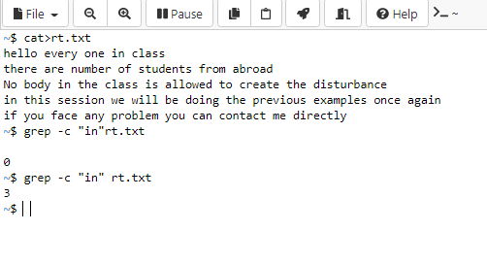
Finding “in”

Slide 35
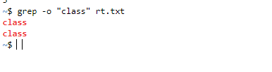
Displaying only the matched pattern
We can make the grep to display only the matched string by using the -o option.
syntax

Slide 36
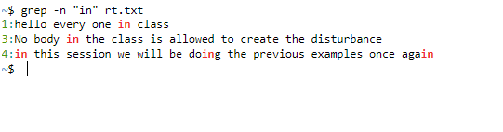
Show line number while displaying the output using grep -n
o show the line number of file with the line matched.

Slide 37
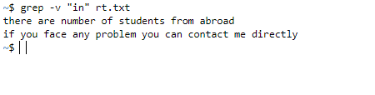
Inverting the pattern match
You can display the lines that are not matched with the specified search sting pattern using the -v option.
syntax

Slide 38
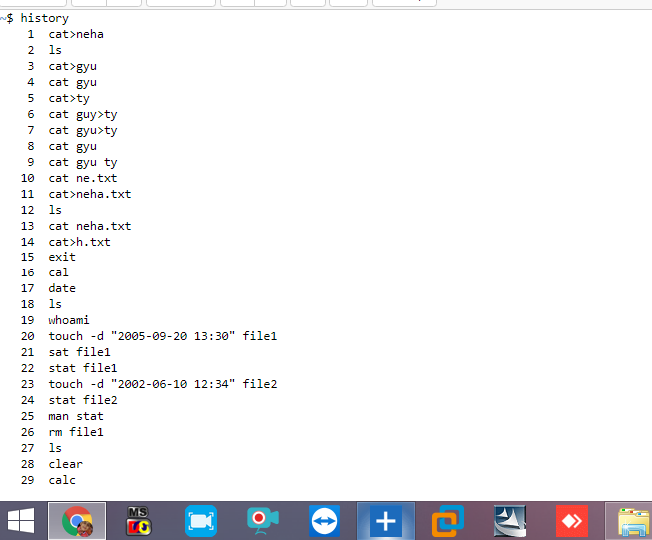
history command
The history command will show you the last five hundred commands you have entered.

Slide 39
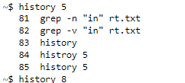
To check the limited no. of commands
To check last five executed commands
syntax history 5

Slide 40
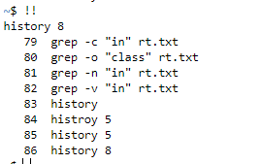
Most recently executed command

Slide 41

Clearing your history
history –c

Slide 43
cp command
This command is used to copy files or group of files or directory.
cp command require at least two filenames in its arguments.

Slide 44
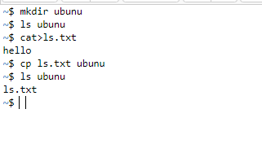
Copying file into directory

Slide 45
Overwriting the text of source file to destination file
cat> a1.txt
good to see you
cat>a2.txt
teacher
cp -i a1.txt a2.txt
cp: overwrite 'a2.txt'? y
cat a2.txt
good to see you
~$

Slide 46
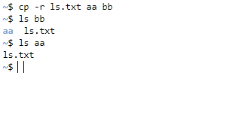
Copying a file in multiple directories
Syntax Cp –r followed by name of directories

Slide 47
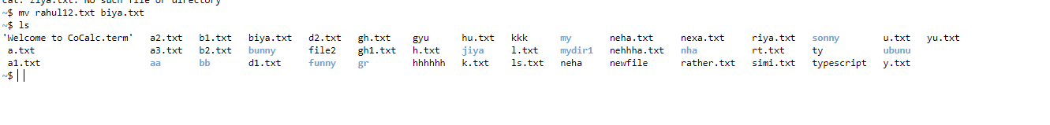
Renaming a file
mv file1.txt(name of file that you want to change ) followed by the name the name you want to keep it .
type ls to check the renamed file .

Slide 48
Shell scripting
If you are using any major operating system you are indirectly interacting to shell. If you are running Ubuntu, Linux Mint or any other Linux distribution, you are interacting to shell every time you use terminal

Slide 49
What is Kernel
The kernel is a computer program that is the core of a computer’s operating system, with complete control over everything in the system. It manages following resources of the Linux system –
File management
Process management
I/O management
Memory management
Device management etc.

Slide 50
What is Shell
A shell is special user program which provide an interface to user to use operating system services. Shell accept human readable commands from user and convert them into something which kernel can understand. It is a command language interpreter that execute commands read from input devices such as keyboards or from files. The shell gets started when the user logs in or start the terminal.

Slide 51
There are several shells are available for Linux systems like
BASH (Bourne Again SHell) – It is most widely used shell in Linux systems. It is used as default login shell in Linux systems and in macOS. It can also be installed on Windows OS.
CSH (C SHell) – The C shell’s syntax and usage are very similar to the C programming language.

Slide 52
Shell Scripting
Shell Scripting is an open-source computer program designed to be run by the Unix/Linux shell. Shell Scripting is a program to write a series of commands for the shell to execute. It can combine lengthy and repetitive sequences of commands into a single and simple script that can be stored and executed anytime which, reduces programming efforts.

Slide 53
How to Write Shell Script in Linux/Unix
Shell Scripts are written using text editors. On your Linux system, open a text editor program, open a new file to begin typing a shell script or shell programming, then give the shell permission to execute your shell script and put your script at the location from where the shell can find it.

Slide 54
Shebang
Shebang is a combination of bash # and bang ! followed the the bash shell path. This is the first line of the script. Shebang tells the shell to execute it via bash shell. Shebang is simply an absolute path to the bash interpreter.

Slide 55
Steps to create a program
Create a file using a vi editor(or any other editor). Name script file with extension .sh
Start the script with #! /bin/sh
Write some code.
Save the script file as filename.sh
For executing the script type bash filename.sh

Slide 56
“#!” is an operator called shebang which directs the script to the interpreter location. So, if we use”#! /bin/sh” the script gets directed to the bourne-shell.
Adding shell comments
Commenting is important in any program. In Shell programming, the syntax to add a comment is
#comment

Slide 57
1 CREATE A shell script program to print a message “I welcome you in my class”
Use proper command to display the content
2 Create a shell script program to display the date after 2 years and 2 years ago
3 Create a shell script program to rename a file abc into ab
4 create a shell program to perform the mathematical operation
“+,-,/,*”
Use bc and expr command

Slide 58
What are Shell Variables?
What are Shell Variables?
Variables store data in the form of characters and numbers. Similarly, Shell variables are used to store information and they can by the shell only.
For example, the following creates a shell variable and then prints it:
variable ="Hello"
echo $variable

Slide 59
Variable Names
The name of a variable can contain only letters (a to z or A to Z), numbers ( 0 to 9) or the underscore character ( _).
By convention, Unix shell variables will have their names in UPPERCASE
The following examples are valid variable names:
ALI
TOKEN_A
VAR_1
VAR_2

Slide 60
Following are the examples of invalid variable names
2_VAR
-VARIABLE
VAR1-VAR2
VAR_A!

Slide 61
The reason you cannot use other characters such as !, *, or - is that these characters have a special meaning for the shell.

Slide 62
#!/bin/sh
echo "what is your name?"
read name
echo "How do you do, $name?"
read remark
echo "I am $remark too!"

Slide 63
Variable Types
Local Variables − A local variable is a variable that is present within the current instance of the shell. It is not available to programs that are started by the shell. They are set at the command prompt.
Environment Variables − An environment variable is available to any child process of the shell. Some programs need environment variables in order to function correctly. Usually, a shell script defines only those environment variables that are needed by the programs that it runs.
Shell Variables − A shell variable is a special variable that is set by the shell and is required by the shell in order to function correctly. Some of these variables are environment variables whereas others are local variables.

Slide 64
Example
#!/bin/bash
Var=“hello”
Echo $Var

Slide 65
Read-only Variables
Shell provides a way to mark variables as read-only by using the read-only command. After a variable is marked read-only, its value cannot be changed.
For example, the following script generates an error while trying to change the value of NAME
#!/bin/sh
NAME="Zara Ali"
readonly NAME
NAME="Qadiri"

Slide 66
Unsetting Variables
Unsetting or deleting a variable directs the shell to remove the variable from the list of variables that it tracks. Once you unset a variable, you cannot access the stored value in the variable.
Following is the syntax to unset a defined variable using the unset command −
unset variable_name
#!/bin/sh
NAME="Zara Ali"
unset NAME
echo $NAME

Slide 67
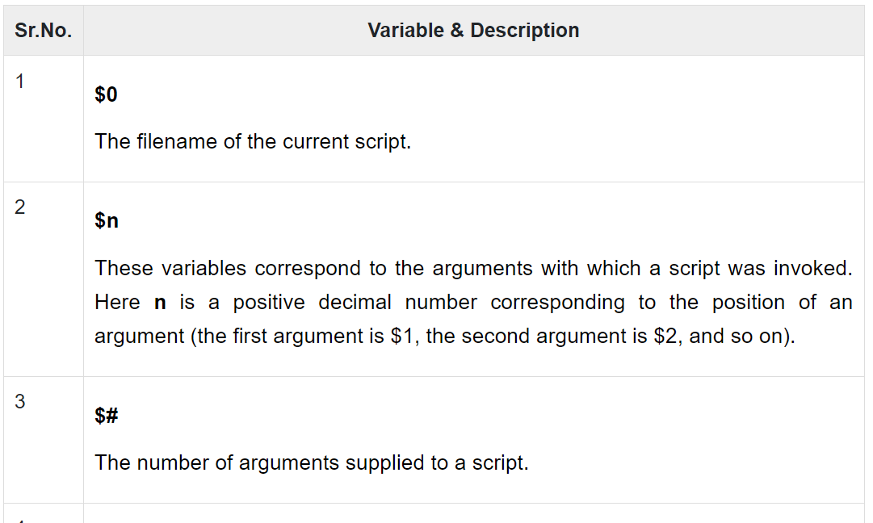
Special Variables
These variables are reserved for specific functions.

Slide 68
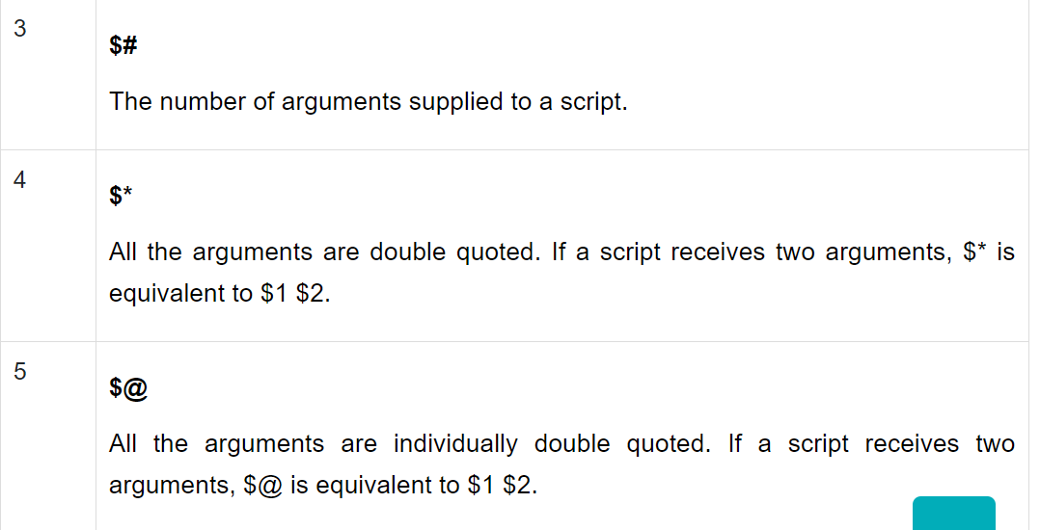

Slide 69
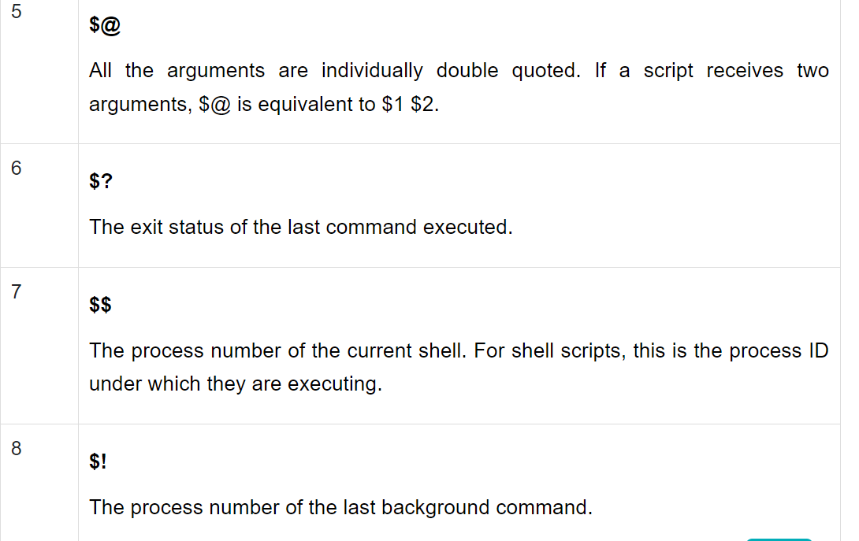

Slide 70
Positional Parameters
Arguments passed to a script are processed in the same order in which they’re sent. The indexing of the arguments starts at one, and the first argument can be accessed inside the script using $1. Similarly, the second argument can be accessed using $2, and so on. The positional parameter refers to this representation of the arguments using their position.

Slide 71
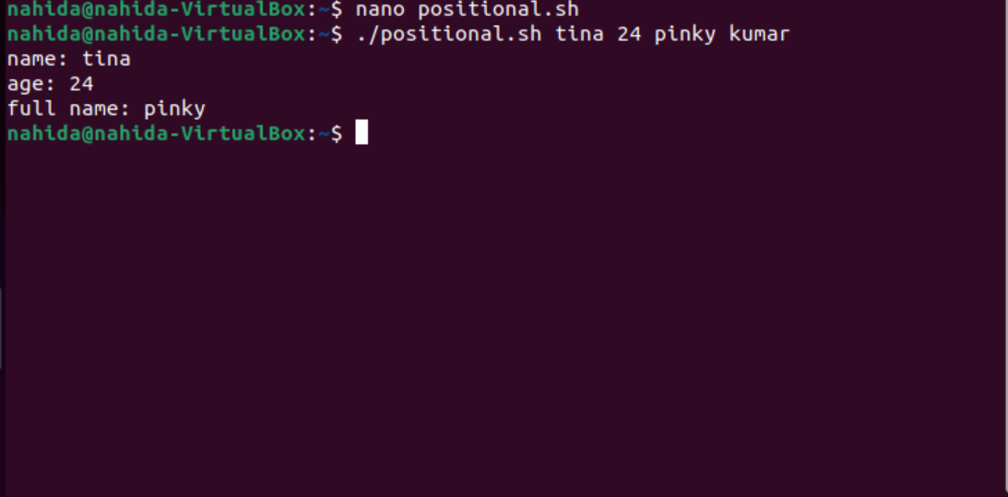
Command-Line Arguments

Slide 72
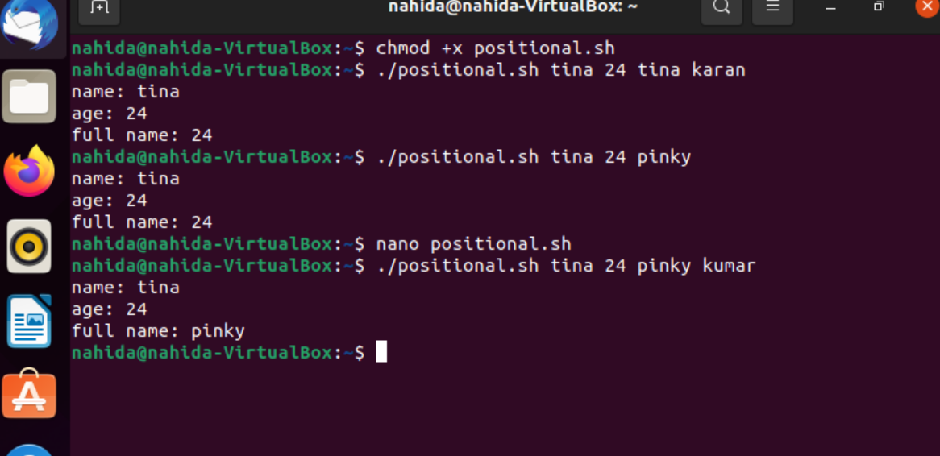

Slide 74
Conditional statements
conditional statements which are used to perform different actions based on different conditions. We will now understand two decision-making statements here −
The if...else statement
The case...esac statement

Slide 75
The if...else statements
If else statements are useful decision-making statements which can be used to select an option from a given set of options.
Unix Shell supports following forms of if…else statement −
if...fi statement
if...else...fi statement
if...elif...else...fi statement

Slide 76
The case...esac Statement
You can use multiple if...elif statements to perform a multiway branch. However, this is not always the best solution, especially when all of the branches depend on the value of a single variable.
Unix Shell supports case...esac statement which handles exactly this situation, and it does so more efficiently than repeated if...elif statements.
There is only one form of case...esac statement which has been described in detail here −
case...esac statement
The case...esac statement in the Unix shell is very similar to the switch...case statement we have in other programming languages like C or C++ and PERL, etc.

Slide 77
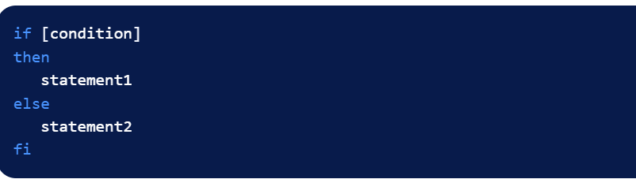
If sytnax

Slide 78
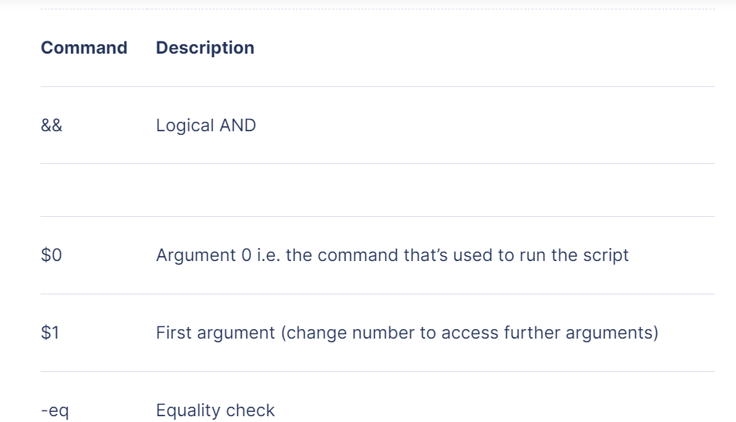

Slide 79


Slide 80
Arithmetic Operators
Relational Operators
Boolean Operators
String Operators
File Test Operators

Slide 81
Control structures in shell scripting

Slide 82
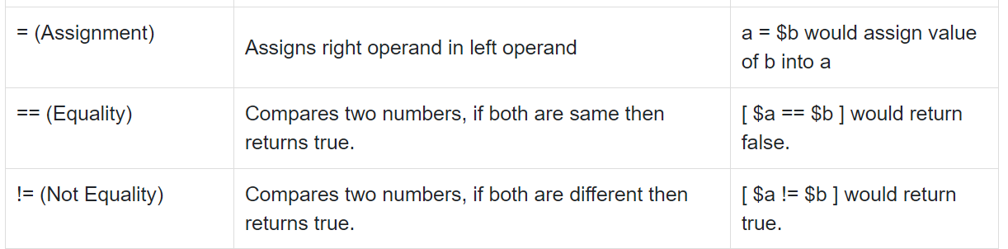

Slide 83
It is very important to understand that all the conditional expressions should be inside square braces with spaces around them, for example [ $a == $b ] is correct whereas, [$a==$b] is incorrect.

Slide 84
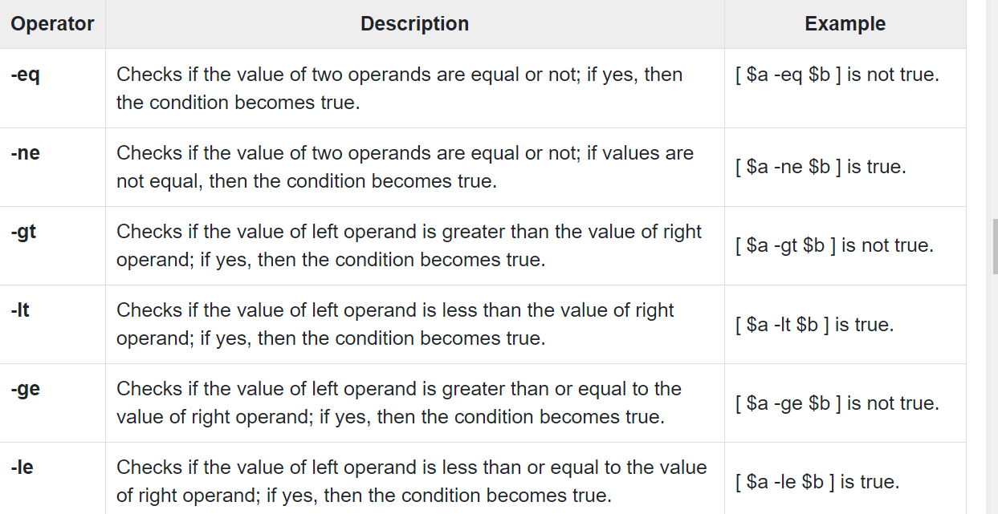

Slide 85
It is very important to understand that all the conditional expressions should be placed inside square braces with spaces around them. For example, [ $a <= $b ] is correct whereas, [$a <= $b] is incorrect

Slide 86
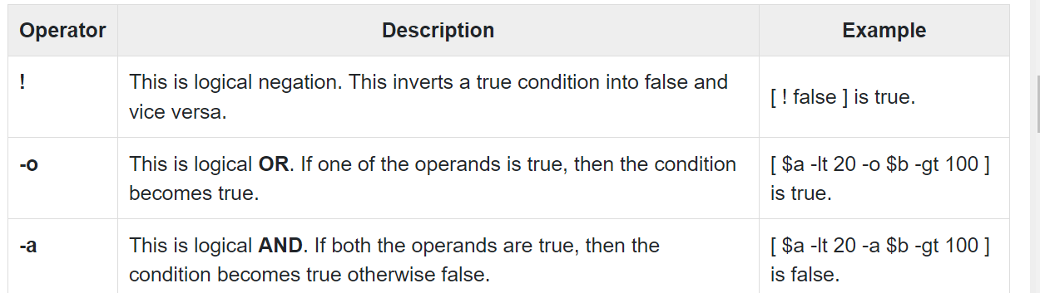
The following Boolean operators are supported by the Bourne Shell. Assume variable a holds 10 and variable b holds 20 then

