Slide 1
STM32F401CCU6
ARM Cortex M4 Series MCU

Slide 2
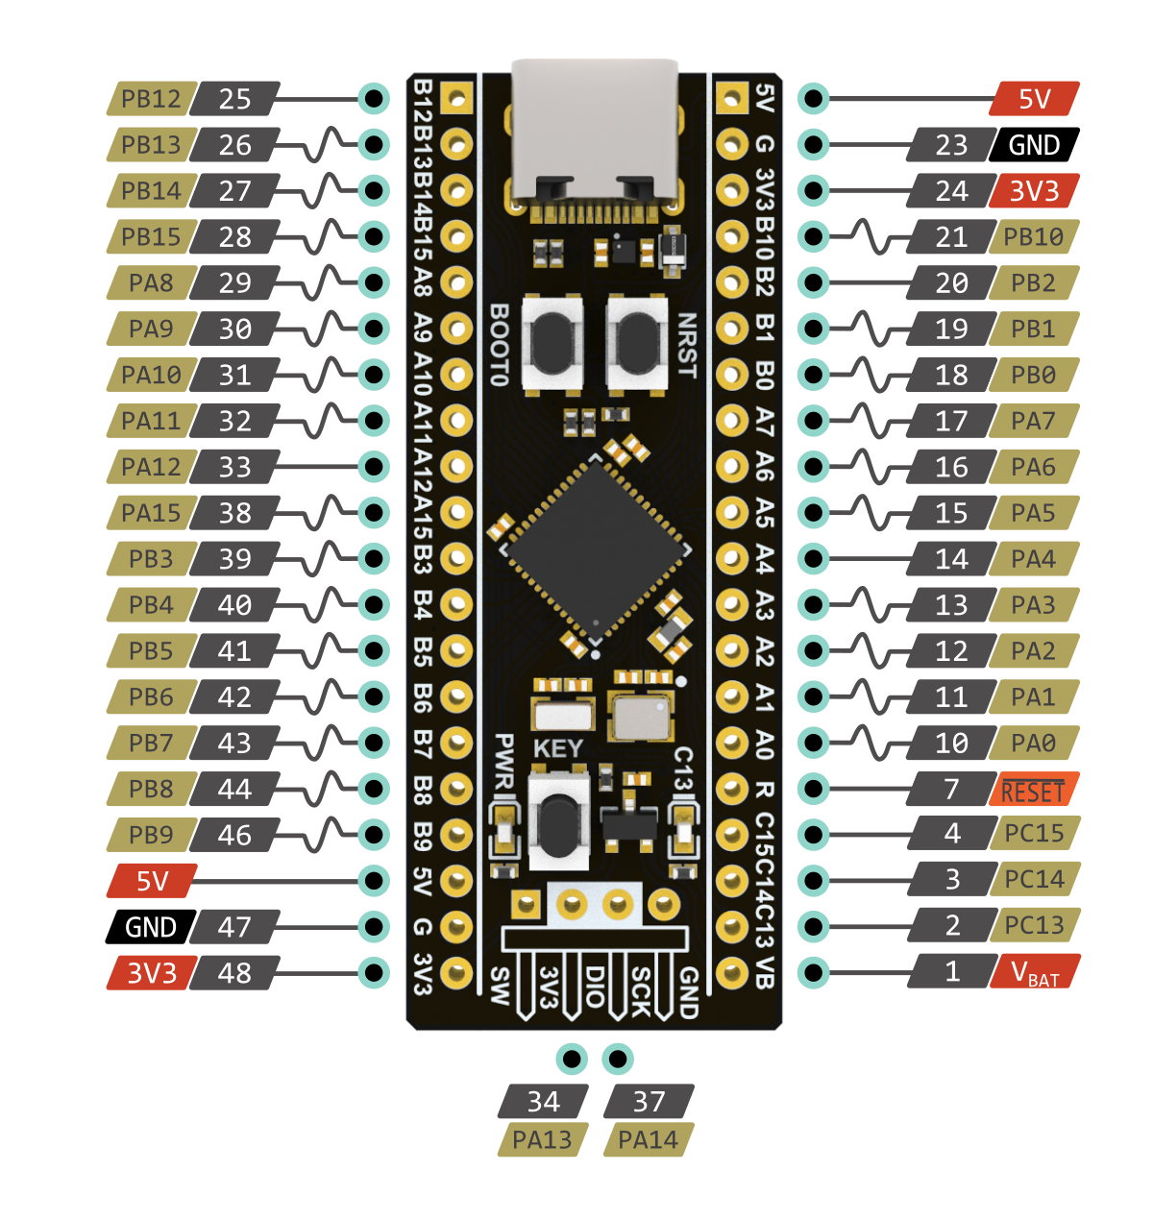
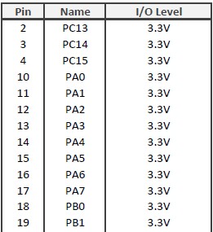
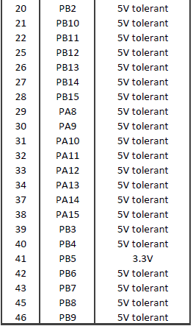

Slide 3
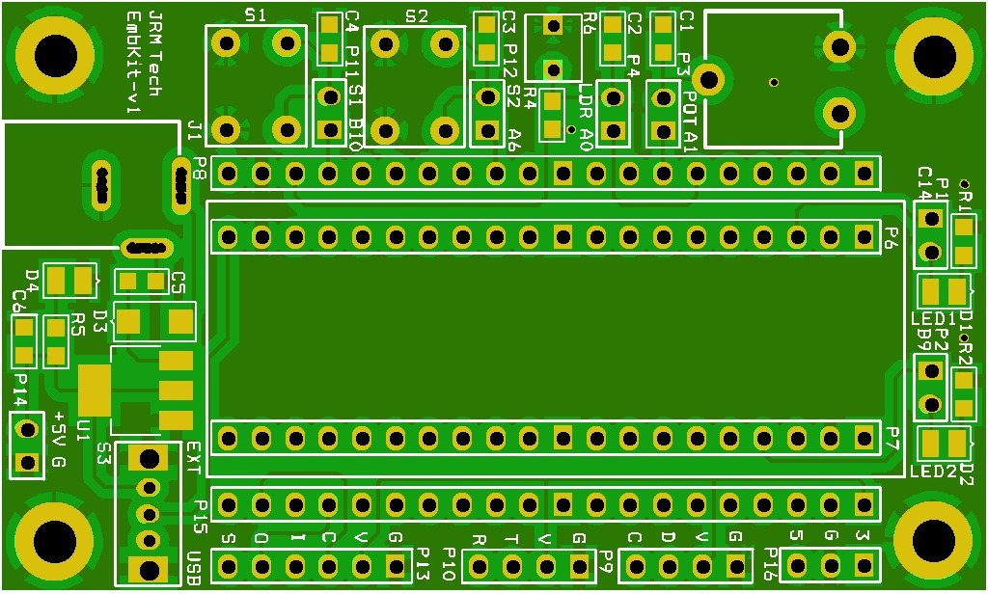

Slide 4
STM32F401-Refmanual.pdf
Refer Section 8 – GPIO 8.4
STM32F411 Black Pill Pinout, Schematic, Datasheet (Dev. Board) (deepbluembedded.com)

Slide 5
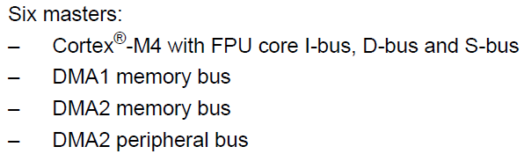
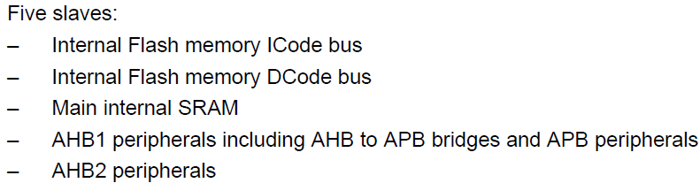
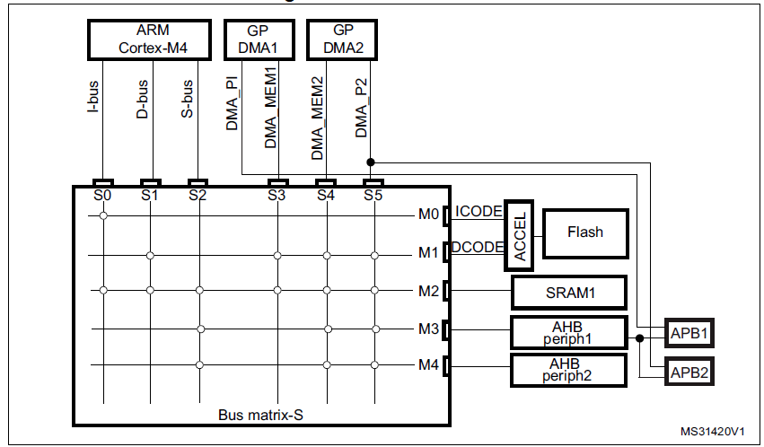
Multi-AHB bus matrix
The 32-bit multi-AHB bus matrix interconnects all the masters (CPU, DMAs) and the slavesv (Flash memory, RAM, AHB and APB peripherals) and ensures a seamless and efficient operation even when several high-speed peripherals work simultaneously.

Slide 6
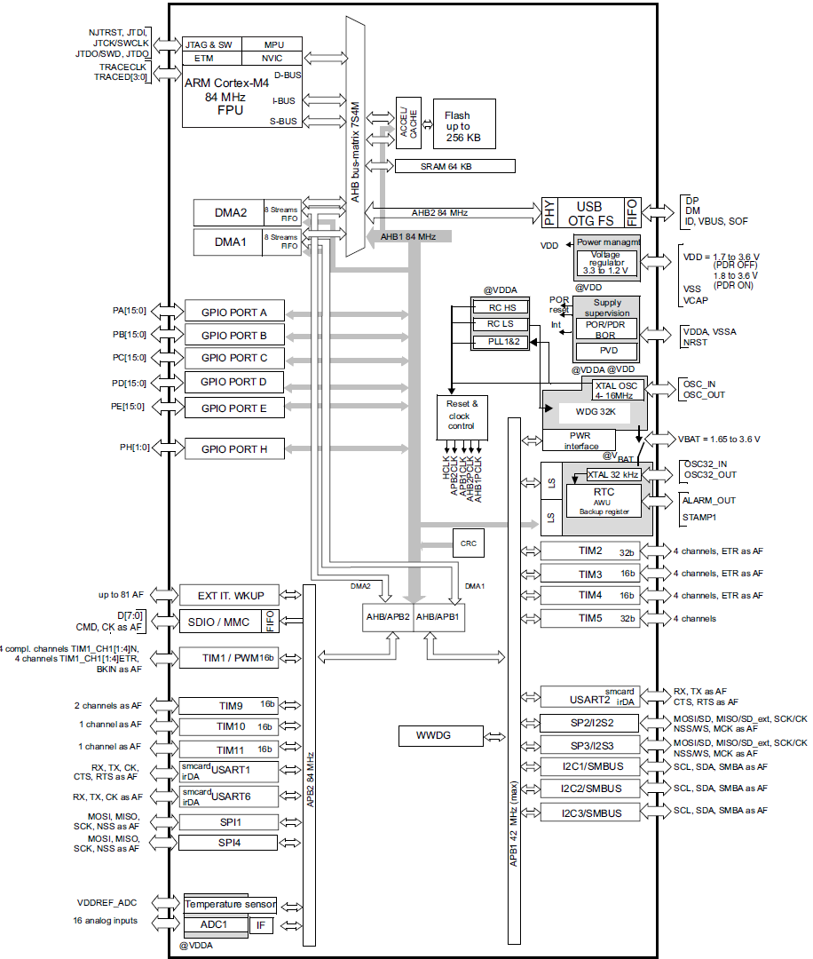
Arm® Cortex®-M4 with FPU core with embedded Flash and SRAM
Memory protection unit
Embedded Flash memory
CRC (cyclic redundancy check) calculation unit
Embedded SRAM
Multi-AHB bus matrix
DMA controller (DMA)
Nested vectored interrupt controller (NVIC)
External interrupt/event controller (EXTI)
Clocks and startup
General-purpose input/outputs (GPIOs)
Analog-to-digital converter (ADC)
Temperature sensor
Serial wire JTAG debug port (SWJ-DP)
Embedded Trace Macrocell

Slide 7
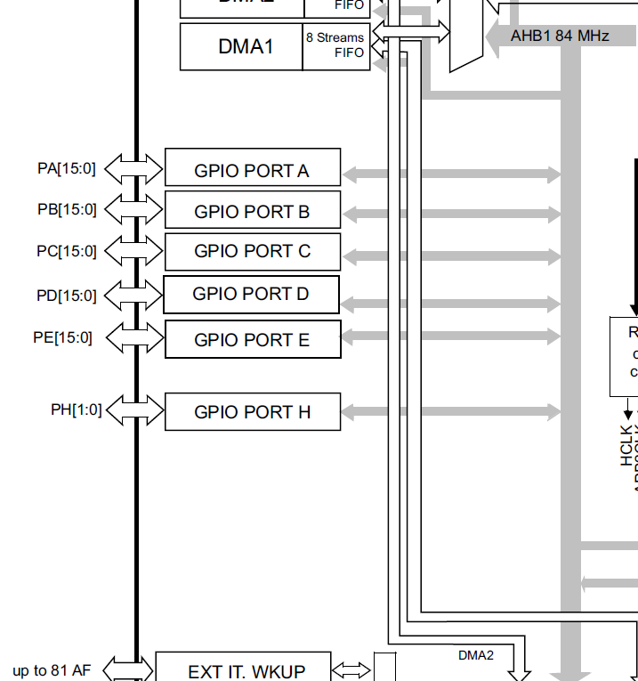
General-purpose I/Os (GPIO)
GPIO F/G/H/I/J/K (except GPIOH0 and GPIOH1) are not available in STM32F401

Slide 8
General-purpose I/Os (GPIO)
Each general-purpose I/O port has four 32-bit configuration registers:
GPIOx_MODER
GPIOx_OTYPER
GPIOx_OSPEEDR
GPIOx_PUPDR
Two 32-bit data registers
GPIOx_IDR and GPIOx_ODR)
A 32-bit set/reset register : GPIOx_BSRR
A 32-bit locking register : GPIOx_LCKR
GPIO F/G/H/I/J/K (except GPIOH0 and GPIOH1) are not available in STM32F401xB/C and STM32F401xD/E.

Slide 9
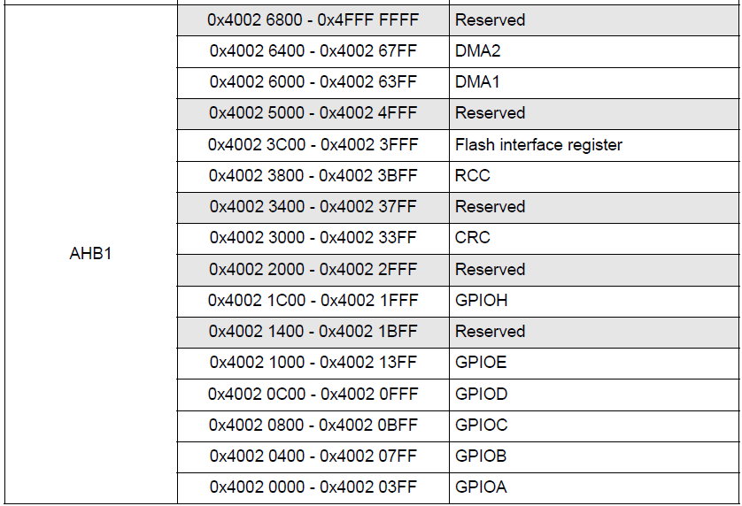
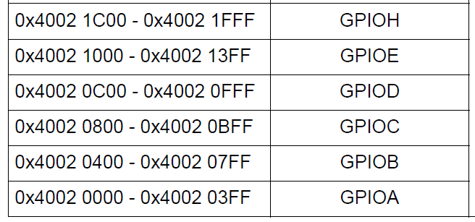
GPIO Registers Address

Slide 10
WRITE A DRIVER TO TOGGLE GPIOA PIN5

Slide 11
Registers need to be configured:-

Slide 12
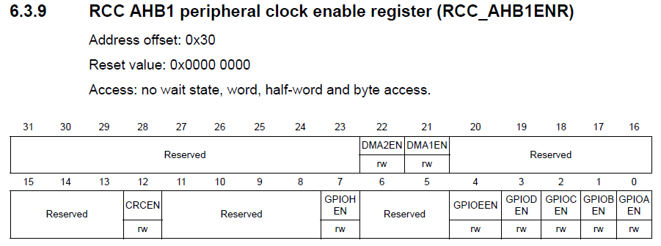
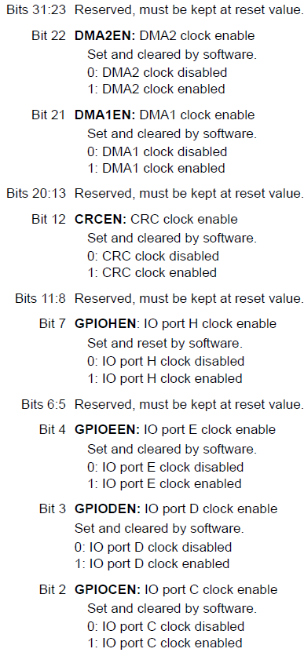
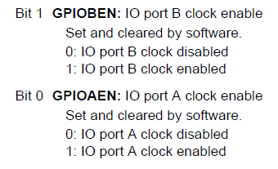
/*1. Enable GPIOA clock by Writing 1 to bit0 of AHB1ENR*/
RCC->AHB1ENR |=(1U<<0);

Slide 13
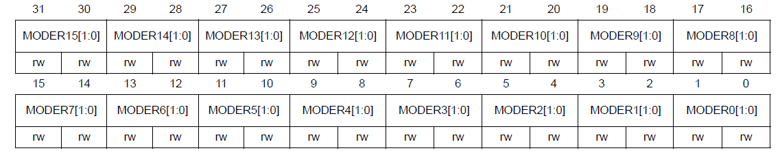
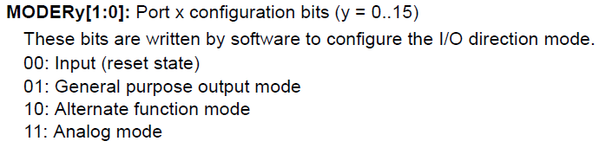
/*2. Set PA5 to output mode by writing 1 to bit10 of MODER*/
GPIOA->MODER |=(1U<<10);

Slide 14
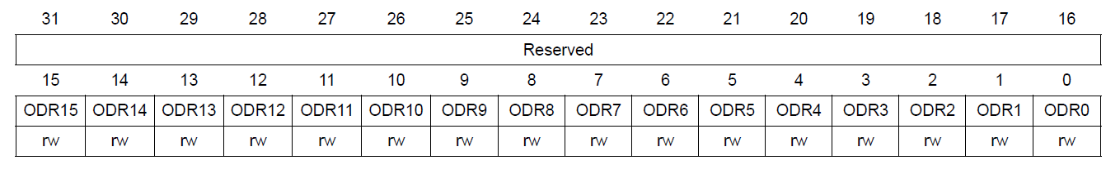
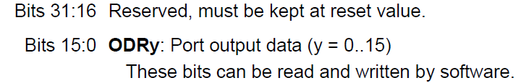
/*3. Turn on PA5 by writing 1 to bit5 of ODR*/
GPIOA->ODR |=(1U<<5);
/*5. Turn off PA5 by writing 0 to bit5 of ODR*/
GPIOA->ODR &=~(1U<<5);

Slide 15
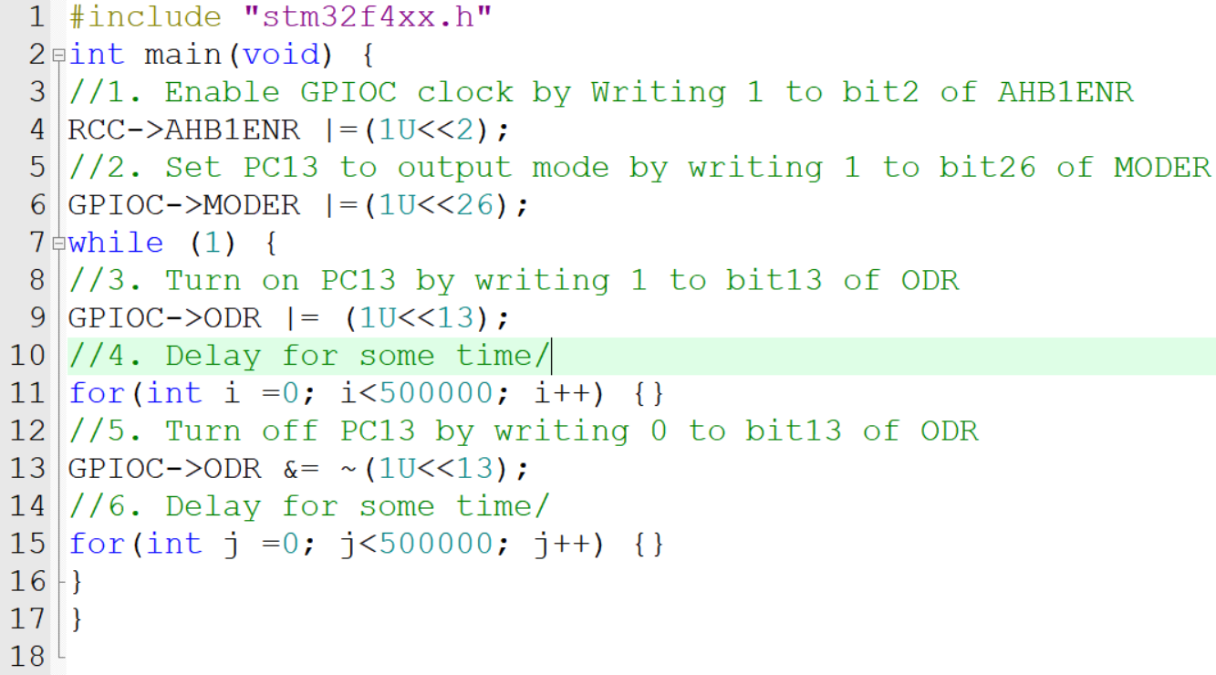
Code for blinking LED

Slide 16
WRITE A DRIVER TO READ FROM GPIOA PIN0 AND TOGGLE OUTPUT AT GPIOC PIN13

Slide 17
/*1. Enable GPIOA clock by Writing 1 to bit0 of AHB1ENR*/
RCC->AHB1ENR |=(1U<<0);
/*2. Enable GPIOC clock by writing 1 to bit2 of AHB1ENR*/
RCC->AHB1ENR |=(1U<<2);

Slide 18
/*3. Set PA0 to input mode by writing 0 to bit0 and bit 1 of MODER*/
GPIOA->MODER |=(0U<<0);
GPIOA->MODER |=(0U<<1);
/*4. Set PC13 to output mode by writing 1 to bit26 of MODER*/
GPIOC->MODER |=(1U<<26);

Slide 19
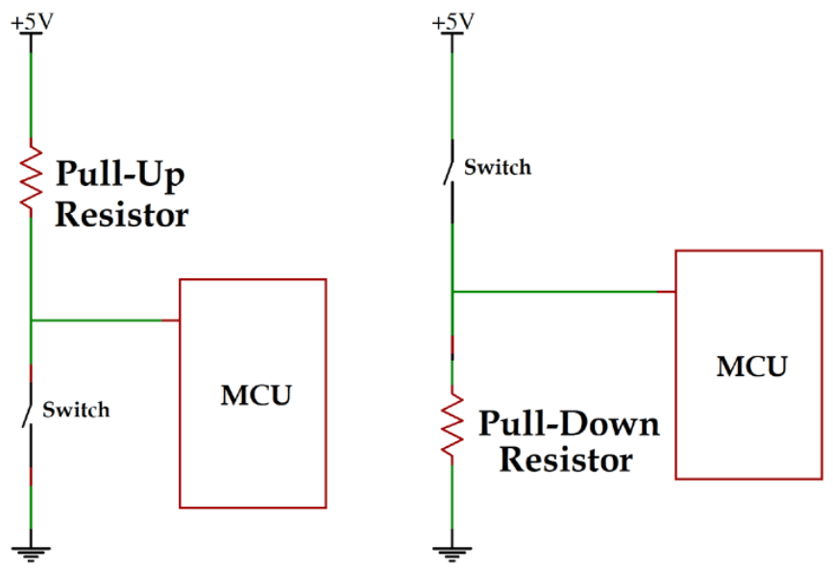

Slide 20
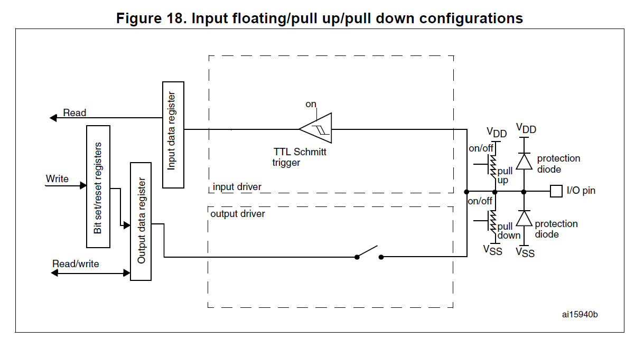
The pull-up and pull-down resistors are activated depending on the value in the GPIOx_PUPDR register

Slide 21
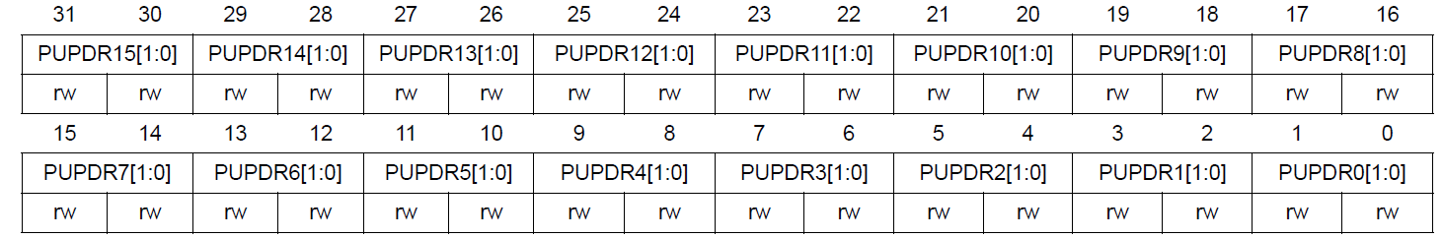
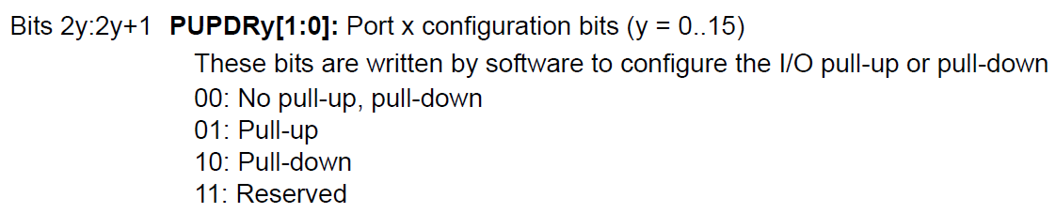
/*5. set pull-up for PA0*/
GPIOA->PUPDR |= 0x00000001;

Slide 22
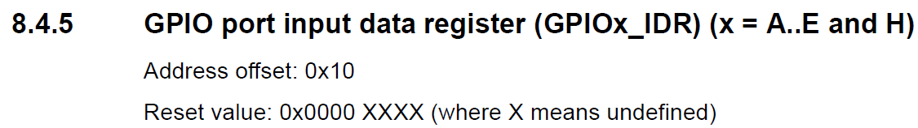
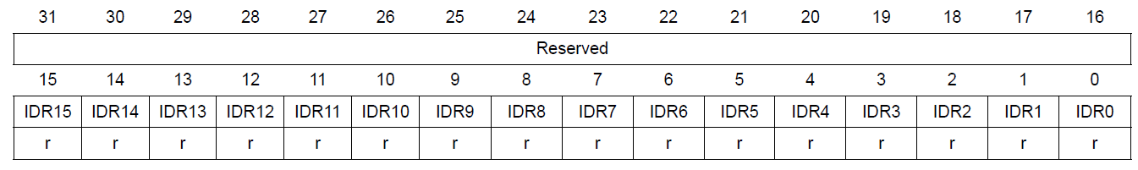
/*5. Check if input is high by checking if bit0 is 1*/
if(GPIOA->IDR & (1U<<0))

Slide 23
/*5. Check if input is high by checking if bit0 is 1*/
if(GPIOA->IDR & (1U<<0))
/*6. Turn on PC13 (LED-active low) by writing 0 to bit13 of ODR*/
/*7. Turn off PC13 (LED-active low) by writing 1 to bit13 of ODR*/
else
GPIOC->ODR &=~(1U<<13);
GPIOC->ODR |= (1U<<13);

Slide 24
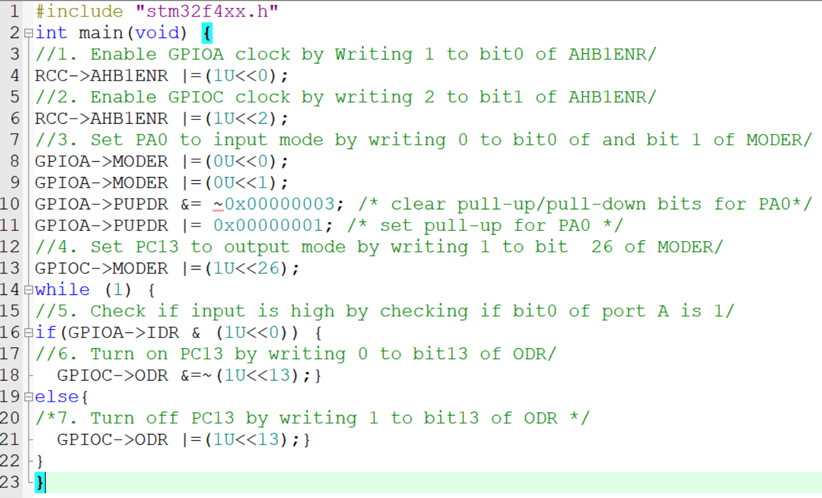
Code for button controlled LED

