Slide 1


Coin Dash Game

Slide 2
Project setup
Launch Godot and create a new project, making sure to use the Create Folder button to ensure that this project's files will be kept separate from other projects.
In this project, you will make three independent scenes: Player, Coin, and HUD, which will all be combined into the game's Main scene
All resources in your project will be located relative to the res://
For example, the images for the coin would be located in res://assets/coin/.
Copy the assets folder from the projects downloaded.

Slide 3
UI – Project Setting
Click on the Project menu and select Project Settings
Look for the Display/Window section and set Width to 480 and Height to 720.
set the Stretch/Mode to 2D and the Aspect to keep. – This will ensure that user resize the game window, everything will scale appropriately
you can also uncheck the box for Resizable

Slide 4
Vectors and 2D coordinate systems
Vector math is an essential tool in game development
Cartesian coordinates to identify locations in space
2D space is written as a pair of values, such as (4,3) x and y axes
Y axis is downwards and this orientation is very common in computer graphics applications.
This arrow is a vector
location, (4, 3), its length, m, and its angle from the x-axis, θ.

Slide 5
Pixel Rendering
Project | Project Settings and find the Rendering/Quality section in the sidebar and enable Use Pixel Snap , Since objects can't be drawn at half pixels

Slide 6
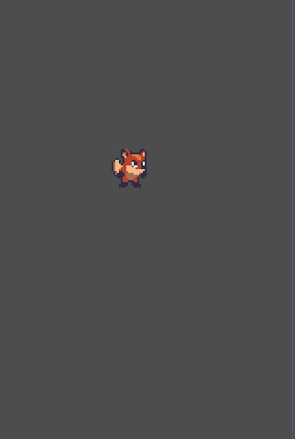
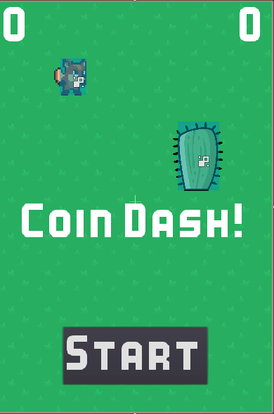
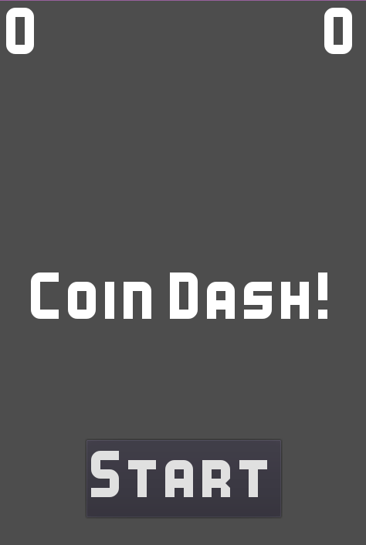
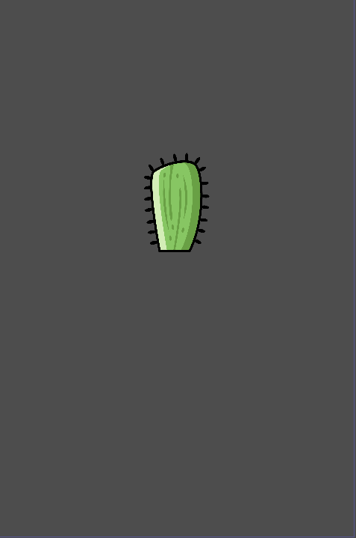

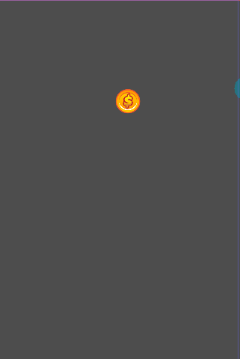
Player Scene
6) Main Scene
4) Head up display Scene
Scene
Coin Dash game has various scenes.
Player
Coin
HUD
Main
Obstacles
Poweups
Separate scenes can be tested independently
Easier to troubleshoot, modify, and even replace entirely without affecting other parts of the game.
5) Obstacle
2) Coin Scene
3) Power up Scene

Slide 7

Coin Dash Game Part 1 – Player Scene

Slide 8

Player Scene
Create Player
Add Animation to Player
Prepare Player for Collision
Detect Player movement and direction
Pick up coins when player enter coin area

Slide 9
Player Scene
Click Add/Create a New Node button and selecting an Area2D
Rename it o player
Click Scene | Save Scene to save the scene
Click the icon next to the lock
click on the Player node and add an AnimatedSprite as a child
Frames property in the Inspector and click <null> |New SpriteFrames
In the same location, click <SpriteFrames> to open the SpriteFrames panel

Slide 10
Player Scene Animation
Click the default one and rename it to run. Then, click the Add button and create a second animation named idle and a third named hurt.
FileSystem dock on the left, find the run, idle, and hurt player images and drag them into the corresponding animations:
Speed (FPS) setting to 8.
Playing property
Choose Animation to see the animations in action
Set Loop -> On

Slide 11
Player Scene Collision
Area2D need to have shape, so it can detect the collision
Add a CollisionShape2D as a child of player
In the Inspector, next to Shape, click <null> and choose New RectangleShape2D
Offset property in the Inspector , Set it to (0, -5).

Slide 12
Player Scene Scripting
Scripts allow you to add additional functionality that
isn't provided by the built-in nodes
Click the Player node and click the Add Script button
Click Create and you'll be taken to the script window.
Click on the Player node and set the Speed property to 350
extends Area2D
export (int) var speed # export keyword on the speed variable allows you to set its value in the Inspector
var velocity = Vector2() # velocity will contain the character's current movement speed and direction
var screensize = Vector2(480, 720) #screensize will be used to set the limits of the player's movement.

Slide 13
Player Moving
You need the player to do three things:
Check for keyboard input
Move in the given direction
Play the appropriate animation
check all type of inputs in Project Settings ->Input Map
20. Add following code to player script
func get_input():
velocity = Vector2()
if Input.is_action_pressed("ui_left"): # returns true if the key is held down and false if it is not.
velocity.x -= 1
if Input.is_action_pressed("ui_right"):
velocity.x += 1
if Input.is_action_pressed("ui_up"):
velocity.y -= 1
if Input.is_action_pressed("ui_down"):
velocity.y += 1
if velocity.length() > 0:
velocity = velocity.normalized() * speed # if you hold right and down at the same time, the resulting velocity vector will be (1, 1). # In this case, since we’re adding a horizontal and a vertical movement together, the
# player would move faster than if they just moved horizontally. You can prevent that by
normalizing the velocity, which means setting its length to 1, then mult it by the desired speed:

Slide 14
Player Moving
21. Next, you'll use the _process() function to define what the player will do. The _process() function is called on every frame
About delta
Mostly 60 frames per second. Elapse (delta) time between frames is 0.016 s. But his totally depends on computer speed.
So we then take your desired speed (600 px/s) and multiply by delta, you will get a movement of exactly 10. If, however, the delta increased to 0.3, then the object will be moved 18 pixels. Overall, the movement speed remains consistent and independent of the frame rate.
func _process(delta):
get_input() # call the get_input function
position += velocity * delta # change the player's position by the resulting velocity.
position.x = clamp(position.x, 0, screensize.x)
position.y = clamp(position.y, 0, screensize.y) # To prevent the player from leaving the screen, you can use the clamp() #function to limit the position to a minimum and maximum value:
if velocity.length() > 0: # for choosing animation, if there is some value in velocity then the animation is running
$AnimatedSprite.animation = "run"
$AnimatedSprite.flip_h = velocity.x < 0 # this will flip the animation horizontally
else:
$AnimatedSprite.animation = "idle"

Slide 15
Player collisions with Coin & Signals
Player should also
detect when it hits a coin or an obstacle
Godot's signal functionality - are a way for nodes to send out
messages that other nodes can detect and react to.
Custom Signals
Build in Signals
Signals are used by connecting them to the node(s) that you want to listen
and respond to.
22. Add the following to the top of the script (after extends Area2D):
signal pickup
signal hurt
These signals will be send out when they touch a coin or an obstacle.

Slide 16
Player Signals
23. Select area_entered() signal -> click Connect
Godot will automatically create a new function called _on_Player_area_entered() in your script.
24. Add the following code to this new function:
func _on_Player_area_entered( area ):
if area.is_in_group("coins"): # if another area is detected
area.pickup() # pickup function will be created in coin scene, and it will define the behavriour
emit_signal("pickup")
if area.is_in_group("obstacles"):
emit_signal("hurt")
die()
Press f6 to play the player scene

Slide 17

Coin Dash Game Part 2 – Coin Scene

Slide 18
Coin Scene
Player Scene
6) Main Scene
4) Head up display Scene
properties and behavior of a single coin
The main scene will load the coin scene and create multiple instances (that is, copies) of it
5) Obstacle
2) Coin Scene
3) Power up Scene

Slide 19
Coin Scene
Click Scene | New Scene and add the following nodes.
Area2D (named Coin)
AnimatedSprite
CollisionShape2D
Save the scene
This time, you only have one animation: a shine/sparkle effect that makes the coin look less flat and boring.
Add all the frames and set the Speed (FPS) to 12.
The images are a little too large, so set the Scale of AnimatedSprite to (0.5, 0.5).
In the CollisionShape2D, use a CircleShape2D and size it to cover the coin image. Don't forget: never use the scale handles when sizing a collision shape.
The circle shape has a single handle that adjusts the circle's radius.

Slide 20
Coin Scene – groups & Script
Groups provide a tagging system for nodes, allowing you to identify similar nodes.
8. Select coin -> Node -> Groups
Type coins in the box and click Add
add a script to the Coin node.
extends Area2D
func pickup(): # this function is called when plyaer_area_entered
queue_free() # this will put the coin object to the removal method

Slide 21
Coin Dash Game Part 3 – Main Scene

Slide 22
Main Scene
Player Scene
6) Main Scene
4) Head up display Scene
Main scene is what ties all the pieces of the game together
manage the player, the coins, the timer, and the other pieces of the game.
5) Obstacle
2) Coin Scene
3) Power up Scene

Slide 23
Main Scene – Node Setup
Click Scene | New Scene and add node named Main
Add player to the scene, click instance button and select Player.tscn
Add following nodes to the main.
TextureRect (named Background)—for the background image
Node (named CoinContainer)—to hold all the coins
Position2D (named PlayerStart)—to mark the starting position of
the Player
Timer (named GameTimer)—to track the time limit
Drag the grass.png image from the assets folder into the Texture property
Change the Stretch Mode to Tile and then click Layout | Full Rect
Set the Position of the PlayerStart node to (240, 350).
Your scene layout should look like this:

Slide 24
Main Scene – Script
Add a script to the Main node (use the Empty template) and add the following variables:
extends Node
export (PackedScene) var Coin
export (int) var playtime # Coin and Playtime properties will now appear in the Inspector when you click on Main.
var level
var score
var time_left
var screensize
var playing = false
Drag Coin.tscn from the FileSystem panel and drop it in the Coin property
Set Playtime to 30 (this is the amount of time the game will last).
Next, add the _ready() function
func _ready():
randomize()
screensize = get_viewport().get_visible_rect().size
$Player.screensize = screensize # $ to refer to a particular node by name.
$Player.hide()

Slide 25
Main Scene – Script
the new_game() function will initialize everything for a new game:
func new_game(): # this function will be called when player click the start button.
playing = true
level = 1
score = 0
time_left = playtime # set all the variables to its starting point
$Player.start($PlayerStart.position) # ensure it moves to the proper starting location.
$Player.show()
$GameTimer.start() # game timer is started, which will count down the remaining time in the game. We set it to 30 sec by the fault
spawn_coins()
Add the function that will create a number of coins.
func spawn_coins():
for i in range(4 + level): # depending on the level of the game, number of coins should increase.
var c = Coin.instance() # create a number of instances of the Coin object
$CoinContainer.add_child(c) # add it as a child of the CoinContainer.
c.screensize = screensize
c.position = Vector2(rand_range(0, screensize.x),
rand_range(0, screensize.y)) # change the coin position to random location
Play the Project (F5). At this point, you should see your player and five coins appear on the screen. When the player touches a coin, it disappears.

Slide 26
Main Scene – Script
Main script needs to detect whether the player has picked up all the coins.
func _process(delta): # Put this in the _process() function so that it will be checked every frame. Usual frame rate is 0.016 sec
if playing and $CoinContainer.get_child_count() == 0: # find out how many coins remain.
level += 1 # If no more coins remain, then the player advances to the next level
time_left += 5 # also for every advance level add some extra time to the total time_left
spawn_coins()

Slide 27
Coin Dash Game Part 4 – User Interface

Slide 28
HUD (Head Up Display)
Player Scene
6) Main Scene
4) Head up display Scene
Heads-Up Display (HUD), information appears as an overlay on top of the game view.
The HUD will display the following information:
Score
Time remaining
A message, such as Game Over
A start button
HUD will have all the control nodes. They usually have
Position
Size
Anchors –define origin
Margin – distance from control node
Fonts
Godot Editor itself is made using these elements
5) Obstacle
2) Coin Scene
3) Power up Scene

Slide 29
HUD – Node Setup
Create a new scene and add a CanvasLayer node named HUD.
Add a Label node to the scene and change its name to MessasgeLabel.
View->Show Helpers, click on Layout menu and select HCenter Wide
The Text property in the Inspector, set it to Coin Dash !
Aligh and Vlign to Center
Assign font, Scroll down to Custom Fonts and select New DynamicFonts
From file system drag Kenney Bold.ttf and drop it to the Font Data property.
Set Size to 48
Add a Timer node change its name to MessageTimer
Wait Time to 2
One Shot to On

Slide 30
HUD – Score and time display
Score and Time both are Label nodes, arranged at opposite sides of the game screen
Use Container node to mange their position . Container nodes are used to mange padding, margines, rows and columns.
add a MarginContainer node to the HUD
Layout menu, set the anchors to Top Wide
In Custom Constants section, set Margin Right, Margin Top and Margin Left to 10
Click on MessageLabel, and press Ctrl +D and create two duplicate labels.
Drag them to MarginContainer to make them its children.
Name one ScoreLabel, and other TimeLabel.
Set its Text property to 0 for both
Set Align to Left for ScoreLabel and Right for TimeLabel.

Slide 31
HUD – Updating UI via GDScript
Add a script to the HUD node. This script will update the UI elements when their properties
need to change, updating the score text whenever a coin is collected
extends CanvasLayer
signal start_game
func update_score(value): # main scene will call these functions to update the display whenever they collect a coin.
$MarginContainer/ScoreLabel.text = str(value)
func update_timer(value):
$MarginContainer/TimeLabel.txt = str(value)
For the MessageLabel, you also need a timer to make it disappear after a brief period.
Add a timer node, and change its name to MessgaeTimer. We had set its Wait Time to 2.
set One Shot to On. – this means the timer will run only once.
Add the following code
func show_message(text): # this function will show the Coin Dash game msg and start the timer once, which will run for 2 sec.
$MessageLabel.text = text
$MessageLabel.show()
$MessageTimer.start() # message and start the timer
To hide the message, connect the timeout() signal of MessageTimer and add this
func _on_MessageTimer_timeout():
$MessageLabel.hide()

Slide 32
HUD – Adding Start Button
Start button will be displayed before the game starts, and when clicked, it will hide itself and send a signal to the Main scene to start the game.
Add a Button node and change its name to StartButton.
Set the Text property to Start
Change the custom font
Aligh and Vlign to Center
Assign font, Scroll down to Custom Fonts and select New DynamicFonts
From file system drag Kenney Bold.ttf and drop it to the Font Data property.
Set Size to 48
In the Layout menu, choose Center Bottom
Top to -150 and Bottom to -50.
Connect the pressed() signal in the Node tab.
func _on_StartButton_pressed():
$StartButton.hide()
$MessageLabel.hide()
emit_signal("start_game") # HUD emits start_game signal to notify Main that its time to start a new game

Slide 33
HUD – Game Over
The final task for UI is to react to the game ending.
func show_game_over():
show_message("Game Over") # Game Over message to be displayed for two seconds, show_message() function does that
yield($MessageTimer, "timeout") # Once the message has disappeared, you want to show star button. Yield function helps in that.
# The yield() function pauses execution of the function until the given node (MessageTimer) emits a # given signal (timeout).
$StartButton.show()
$MessageLabel.text = "Coin Dash!"
$MessageLabel.show()

Slide 34
Adding HUD to Main
Set up the communication between Main scene and HUD.
Add an instance of HUD to the Main scene.
In Main scene connect the timeout() signal of GameTimer and add the following code
func _on_GameTimer_timeout(): # Every time the GameTimer times out (every second), the remaining time is reduced
time_left -= 1
$HUD.update_timer(time_left)
if time_left <= 0:
game_over()
Next connect pickup() and hurt() signals of Player.
func _on_Player_pickup():
score += 1
$HUD.update_score(score)
func _on_Player_hurt():
game_over()
Several things need to happen when the game ends, so add the following function:
func game_over(): # This function halts the game, and also loops through the coins and removes any that are remaining
playing = false
$GameTimer.stop()
for coin in $CoinContainer.get_children():
coin.queue_free()
$HUD.show_game_over() # calls the show_game_over function which shows the game over msg and starts new game
$Player.die()

Slide 35
Adding HUD to Main
Finally, the StartButton needs to activate the new_game() function.
Click on the HUD instance and select its new_game() signal.
In the signal connection dialog, click Make Function to Off and in the Method In Node field, type new_game
Remove new_game() from the _ready()
add these two lines to the new_game()
function:
$HUD.update_score(score)
$HUD.update_timer(time_left)
Play the Project (F5). At this point
Check scores updating
Time updating
Game Ending
Game Starting

Slide 36
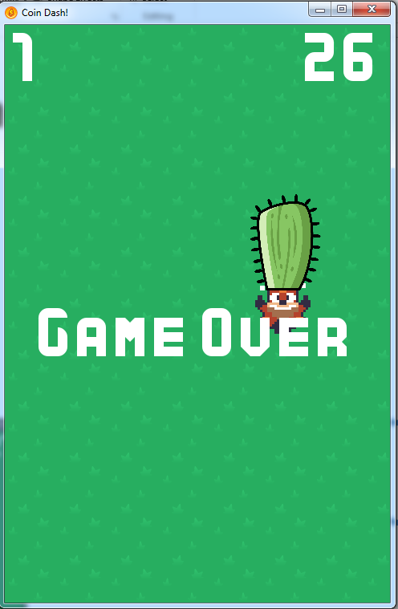
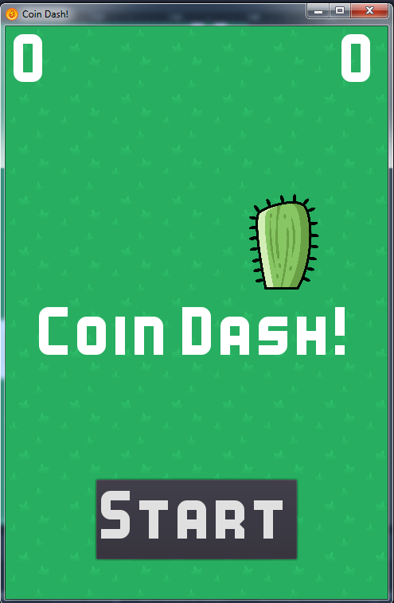
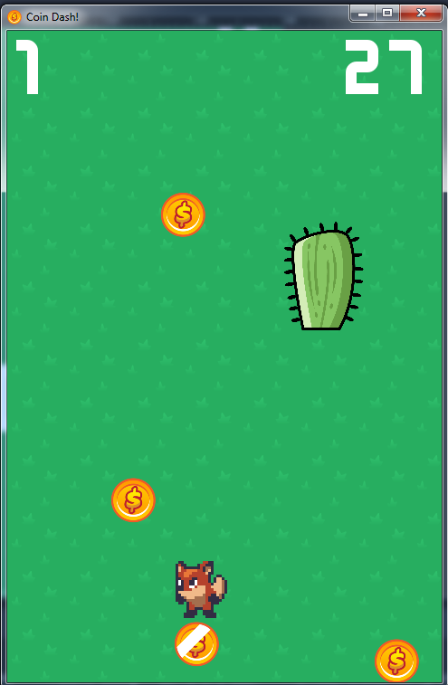
Reviewing Game Loop

Slide 37
Signaling works in parallel
HUD
signals timeout start_game _on_StartButton_pressed() will emit_signal("start_game")
Player
signals
Pickup
Hurt
Area_enterd
_on_Player_area_entered() will emit_signal (“pickup”) emit_signal(“hurt”)
new_game() is called
_on_Player_pickup() on_Player_hurt() is called
_on_StartButton_pressed() is called
_on_GameTimer_timeout() is called
Button
signals pressed
GameTimer
signals timeout GameTimer timeout every second.
1. Game engine is always waiting for signals to be triggered
2. Every frame it executes _process function

Slide 38
Coin Dash Game Part 5 – Finishing up Juice Visual Effect Sound Effect Animation Effect

Slide 39
Visual Effect ( Tween )
Tween – Interpolate the change gradually ( change the value from start to end gradually)
add these line to _ready() function of coin
$Tween.interpolate_property($AnimatedSprite, 'scale', $AnimatedSprite.scale, $AnimatedSprite.scale * 3, 0.3, Tween.TRANS_QUAD, Tween.EASE_IN_OUT) # Coin growing larfer when they are picked up
$Tween.interpolate_property($AnimatedSprite, 'modulate', Color(1, 1, 1, 1), Color(1, 1, 1, 0), 0.3, Tween.TRANS_QUAD,
Tween.EASE_IN_OUT) # coin change color from 1(opaque) to 0 (transparent)
The node to affect
The property to alter
The property's starting value
The property's ending value
The duration (in seconds)
The function to use – This can be quadratic, liner, exponential etc.
The direction
Replace queue_free() in the pickup() function:
func pickup():
monitoring = false # to ensure that area_enter() signal won't be emitted if the player touches the coin during the tween animation.
$Tween.start()
Connect Tween nodes tween_completed signal
func _on_Tween_tween_completed(object, key):
queue_free()

Slide 40
Sound Effect
Sound is most important but often neglected piece of game. It can add a huge amount of Juice.
For this game we will add Three sound effects
In the main scene add three AudioStreamPlayer nodes and name them CoinSound, LevelSound, and EndSound.
Drag each sound from the audio folder (you can find it under assets in the FileSystem dock) into the corresponding Stream property of each node.
To Play a sound, you can call play() function on it.
Add $CoinSound.play() to the _on_Player_pickup()
$EndSound.play() to the game_over()
$LevelSound.play() to the spawn_coins() function

Slide 41
Coin animation
When you created the Coin scene, you added an AnimatedSprite, but it isn't playing yet. The coin animation displays a shimmer effect traveling across the face of the coin. If all the coins display this at the same time, it will look too regular, so each coin needs a small random delay in its animation.
click on the AnimatedSprite and then on the Frames resource. Make sure Loop is set to Off and that Speed is set to 12.
Add a Timer node to the Coin scene
add this code to _ready():
$Timer.wait_time = rand_range(3, 8)
$Timer.start()
Now, connect the timeout() signal from the Timer and add this:
func _on_Timer_timeout():
$AnimatedSprite.frame = 0
$AnimatedSprite.play()
Play the Project (F5). At this point
Tween effect in disappearing in coin
Check the coin animation

Slide 42

Powerups
Powerup gives player a small advantage,
1) Time bonus
2) Appears occasionally for short time and then disappear
Create a new scene similar to coin -> go to coin scene, Scene | Save Scene As and save it as Powerup.tscn.
Change the name to Powerup.
Remove the script disconnect area_entered signal.
In Groups tab, remove the coins group and add powerups instead.
In the AnimatedSprite, change the images from the coin to the powerup
Click to add a new script and copy the code from the Coin.gd script.
change _on_Coin_area_entered to _on_Powerup_area_entered and connect area_entered signal to it again.
Next, add a Timer node named Lifetime.
Set its Wait Time to 2 and both One Shot and Autostart to On.
Connect its timeout signal
func _on_Lifetime_timeout():
queue_free()

Slide 43
Powerups to Main
In Main Scene
Add another Timer node called PowerupTimer.
Set its One Shot property to On.
Powerup.wav sound in the audio folder you can add with another AudioStreamPlayer.
Connect the timeout signal to spawn Powerup
func _on_PowerupTimer_timeout():
var p = Powerup.instance() # creating instance of powerup
add_child(p)
p.screensize = screensize
p.position = Vector2(rand_range(0, screensize.x), rand_range(0, screensize.y))
The Powerup scene needs to be linked by adding a variable, then dragging the scene into the property in the Inspector
export (PackedScene) var Powerup
Add this to the _process() function after the new coins are spawned with spawn_coins():
$PowerupTimer.wait_time = rand_range(5, 10) # The powerups should appear unpredictably
$PowerupTimer.start() # so the wait time of the PowerupTimer needs to be set whenever you begin a new level.

Slide 44
Powerups to Player
In Player Scene
Change the code in Player.gd to check for what kind of object has been hit:
func _on_Player_area_entered( area ):
if area.is_in_group("coins"):
area.pickup()
emit_signal("pickup", "coin") # now you're emitting the pickup signal with an additional argument if area.is_in_group("powerups"):
area.pickup()
emit_signal("pickup", "powerup") # now you're emitting the pickup signal with an additional argument if area.is_in_group("obstacles"):
emit_signal("hurt")
die()
In Main Scene
The corresponding function in Main.gd can now be changed to accept that argument and use the match statement to decide what action to take:
func _on_Player_pickup(type):
match type:
"coin":
score += 1
$CoinSound.play()
$HUD.update_score(score)
"powerup":
time_left += 5
$PowerupSound.play()
$HUD.update_timer(time_left)
Play the Project (F5). At this point
Sounds play
Time increases by five

Slide 45
Understanding the flow
When player_area_enters( )
Emits pickup signal
_on_Player_pickup(type):
This function updates HUD
HUD time and score updated
When player_area_enters( )
Emits pickup signal

Slide 46

Obstacles
Create a new scene for the cactus and add the following nodes:
Area2D (named Cactus)
Sprite
CollisionShape2D
Drag the cactus texture from the FileSystem dock to the Texture property of the Sprite.
Add a RectangleShape2D to the collision shape and size it so that it covers the image.
Add the Cactus body to the obstacles group using the Node tab (next to Inspector).
Add a Cactus instance to the Main scene and move it to a location in the upper half
In Coin Scene
6. Connect the coin's area_entered() signal and add the
func _on_Coin_area_entered( area ):
if area.is_in_group("obstacles"): # We need this, so coins don’t spown behind cactus
position = Vector2(rand_range(0, screensize.x), rand_range(0, screensize.y))
Play the Project (F5).

