Slide 1


Installation & UI overview

Slide 2
Download and Install
https:/ / godotengine. org/ - Click Download
Choose 64 bit version
Double click on
Double click
Also Download Sample codes from https://github.com/PacktPublishing/Godot-Game-Engine-Projects/releases and unzip it.
Launch Project Manager

Slide 3
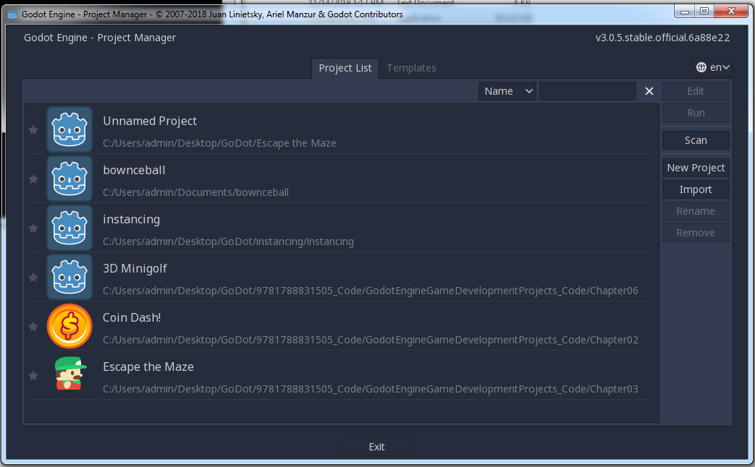
UI – Project Manager
A list of your existing Godot projects.
You can choose an existing project and click Run to play the game or click Edit to work on it in the Godot
Editor (refer to the following screenshot). You can also create a new project by clicking New
Project:
Choose import to import a project from one of the godot games you downloaded from github

Slide 4
Create New Project
give the project a name and create a folder to store it in.
lowercase and use underscores

Slide 5
Editor Window
switch between 2D and 3D mode, as well Script
The icons in the toolbar will change based on what kind of object you are editing.
launching the game and interacting
with it when it's running:
Viewport. This is where you'll see parts of your game as you're working on them
The Scene tab shows the current scene you
are working on in the Viewport. In the Inspector tab below it, you can see and adjust the
properties of any object you select

Slide 6
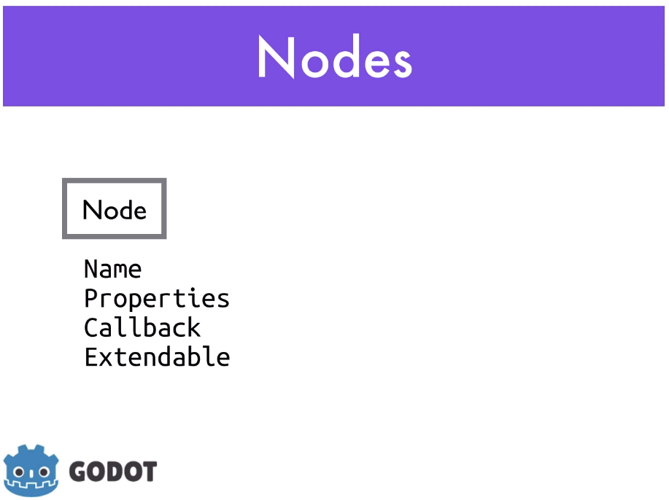
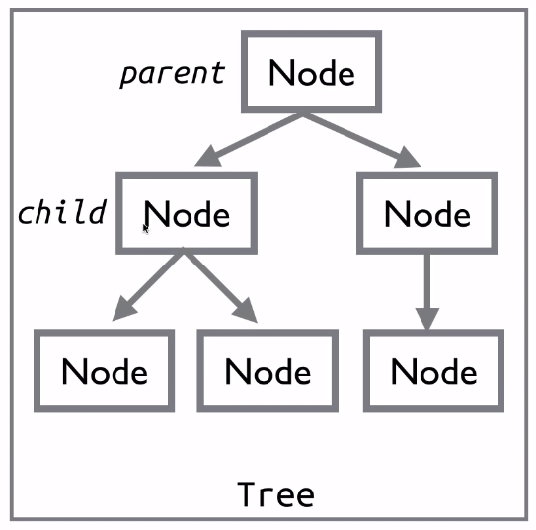
Every thing in Godot is a node.
It can be animation, a sprit, a sound
Node will be have
name, all king of properties, Callback- means make the node react to things. This is done through scripting
Any tree of node is grouped together to make a scene

Slide 7
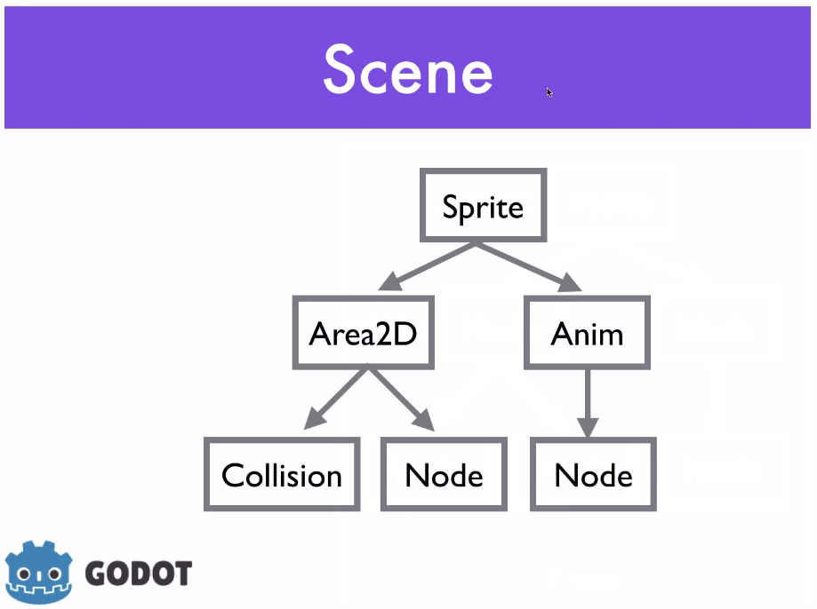
Nodes and Scene are fundamental to GoDot
Any tree of node group together to make scene
Ex: player scene that contains all the nodes and scripts that make the
player's character work

Slide 8
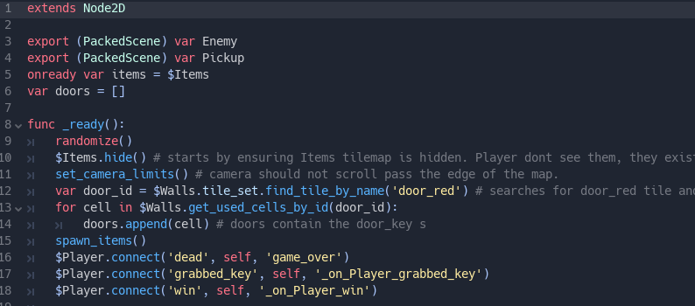
Scripting
You can write code in GDScript, VisualScript, and C#
We will use GDScript
GDScript is like Python. Looks something like this

Slide 9
Scripting
Get the feel of the “coin dash” game

