Slide 1
Online Inter College Event Management System
By Darshan Tank (CE 135 ) &
Suman Vadhel (CE 138)

Slide 2
Definition
The Online Event Management System will provide the platform for all the colleges to promote their events and help students to participate in the particular event.This system will help to manage the events ,participants, easy to get e-certification.
The main objective is to efficiently evaluate the candidate thoroughly through a fully automated system that not only saves a lot of time but also gives fast results. Candidates can Register Own self in different events and evaluate their own self and make a good career in Good organizations.

Slide 3
Requirements overview
→ Login Module: The admin/Organizer and the normal users can login to their profiles , by giving the authenticated credentials on the login page. After the login is successful , the users (admin and normal users)will be redirected to their respective homepage.
→ Registration Module: When the users use the software for the first time (the normal user) , they will have to provide their details like Username, email, password, etc.
→ Profile Module: Personal Details like Username, Password, email, etc.(user can update)
→ Event Module: Organizer can perform all the CRUD operation for Event like adding, updating, deleting.After the completion of event Organizer can declare the winners for the particular event and add the E-certificate to the winner's profile.
→ Booking Module: User can book the particular event by pressing “Book Now” button and providing other detail via registration link.

Slide 4
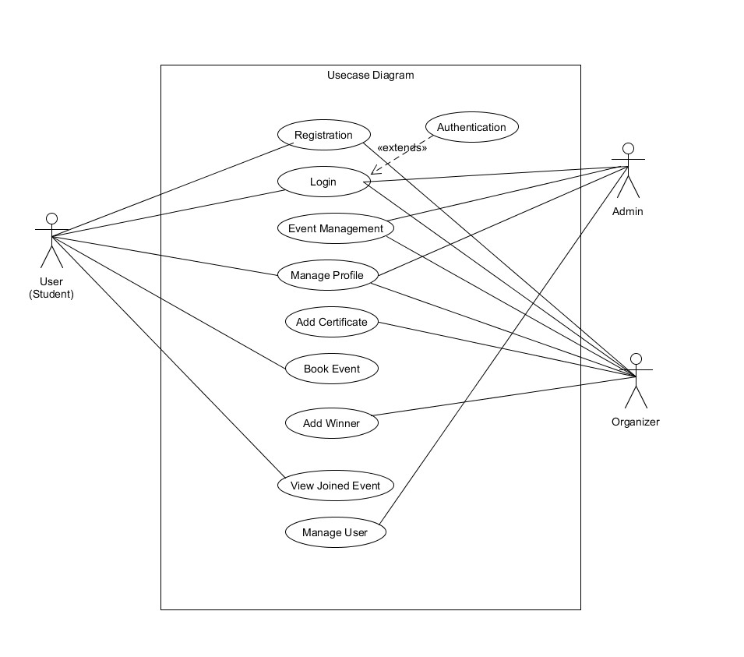
Diagrams
Use case Diagram

Slide 5
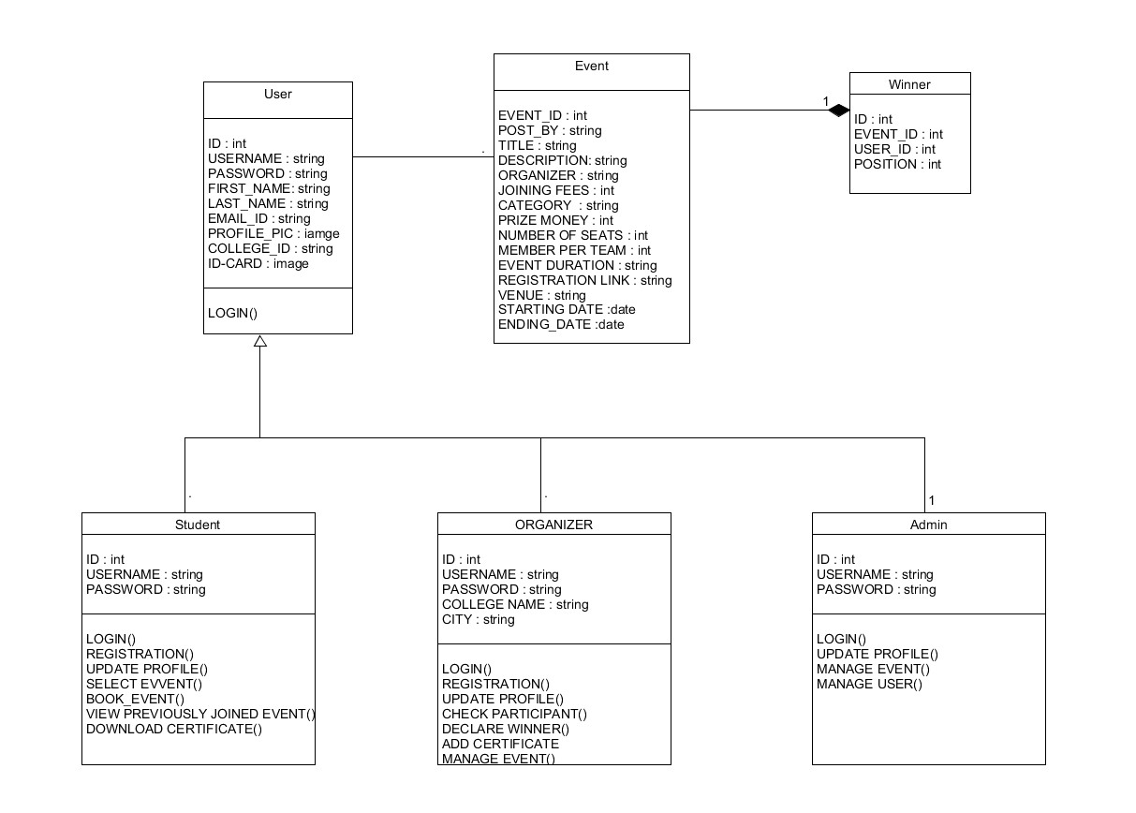
2) Class Diagram

Slide 6
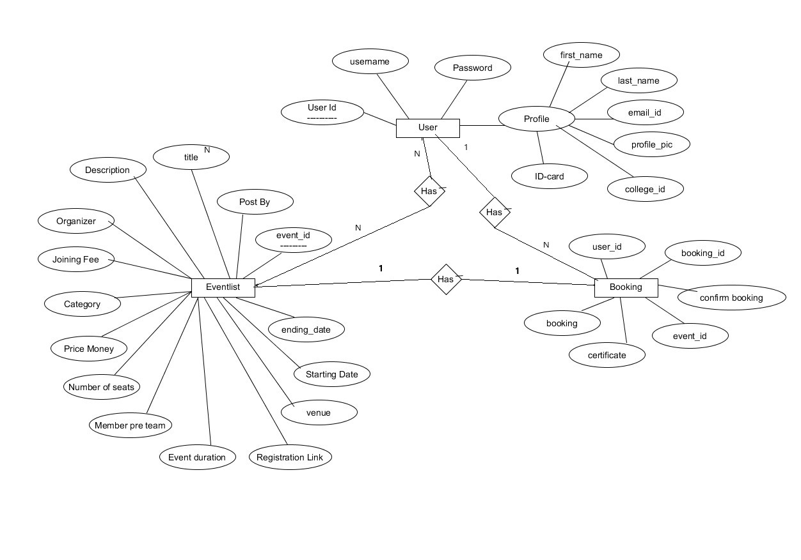
3) ER Diagram

Slide 7
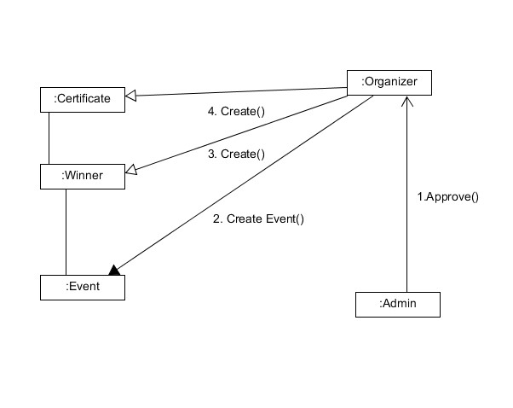
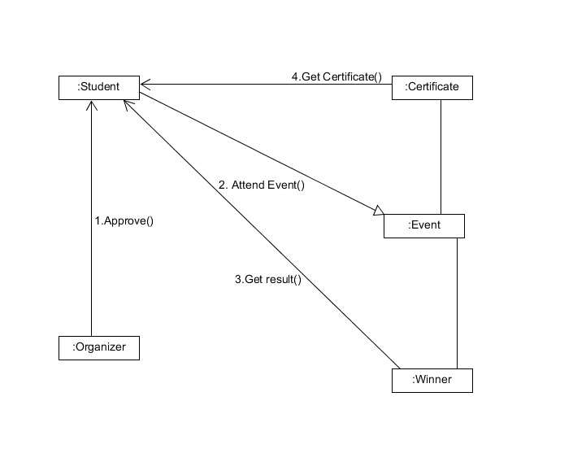
4) Collaboration Diagram

Slide 8
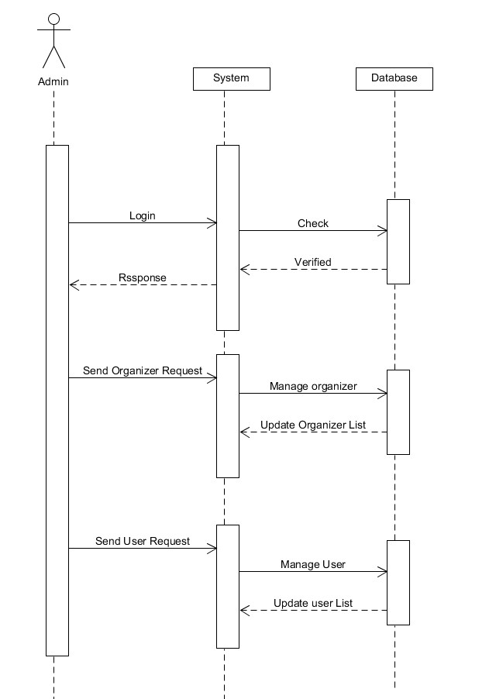
5) Sequence Diagram (For Admin)

Slide 9
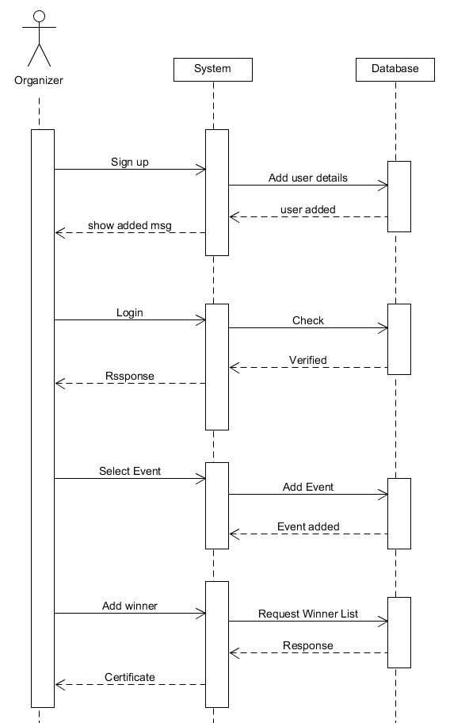
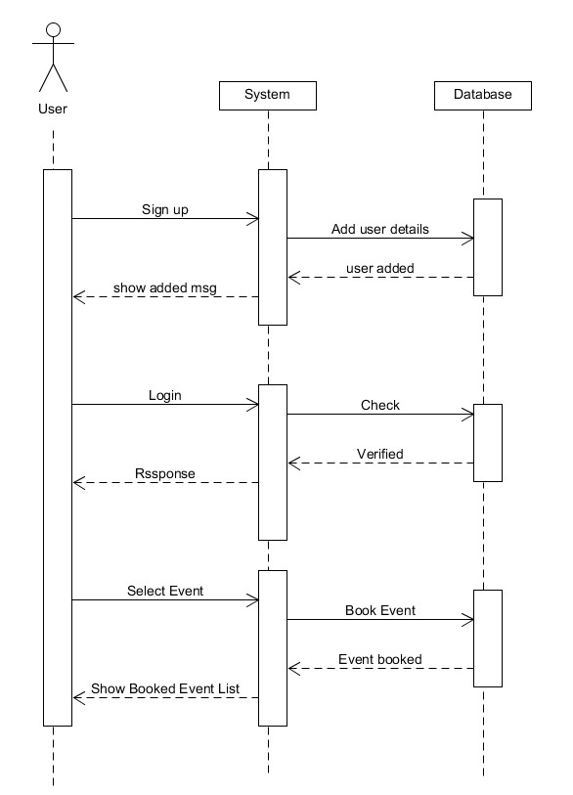
For Organizer For Student

Slide 10
Database Design (For User)
Sr. No | Field name | Datatype | Size | Required | PK/F
1 | Username | CharField | 20 | Yes | Yes
2 | Email | EmailField | 20 | Yes | No
3 | First Name | CharField | 20 | Yes | No
4 | Last Name | CharField | 20 | Yes | No
5 | Password | Password | 20 | Yes | No
6 | Profile | ImageField | - | Yes | No
7 | Idcard | ImageField | - | Yes | No
8 | Id Number | CharField | 20 | Yes | No
9 | About | TextField | 100 | Yes | No

Slide 11
For Event Booking
Sr. No | Field name | Datatype | Size | Required | PK/F
1 | userid | CharField | 100 | Yes | Yes
2 | eventid | CharField | 100 | Yes | Yes
3 | booking | BooleanField | - | Yes | No
4 | booking_ confirmed | BooleanField | - | Yes | No
5 | attended | BooleanField | - | Yes | No
6 | certificate | BooleanField | - | Yes | No

Slide 12
For EventList
Sr. No | Field name | Datatype | Size | Required | PK/F
1 | postby | CharField | 20 | Yes | Yes
2 | thumbnail | ImageField | - | Yes | No
3 | title | CharField | 100 | Yes | No
4 | description | TextField | 5000 | Yes | No
5 | organizer | CharField | 20 | Yes | No
6 | joining fees | CharField | 10 | Yes | No
7 | pricemoney | CharField | 10 | Yes | No
8 | members | CharField | 5 | Yes | No

Slide 13
Sr. No | Field name | Datatype | Size | Required | PK/F
9 | link | CharField | 100 | Yes | No
10 | Eventtime | CharField | 10 | Yes | No
11 | venue | TextField | 1000 | Yes | No
12 | Starting Date | DateTimeField | - | Yes | No
13 | Ending Date | DateTimeField | - | Yes | No
14 | Category | CharField | 100 | Yes | No
15 | number of seats | CharField | 10 | Yes | No

Slide 14
Overview of Implementation details
Our project is developed in Django which works on MVT- Model, View, Template
→ Model: Models define the structure of stored data, including the field types and possibly also their maximum size, default values, selection list options, help text for documentation, label text for forms, etc.
→ View: A view is a callable that takes a request and returns a response.
→ Template: A template consists of static parts of the desired HTML output as well as some special syntax describing how dynamic content will be inserted.
In this Django project, we have created 2 apps
1.)User
2.)Event

Slide 15
1.)User
This app basically contains details about users.
→ In this app, we have a profile section, Registration section, login section as well as logout section
profile section contains user details like college icard, id number. a profile is in a one-to-one relationship with the user. so, When a new user is created his profile section will also be created and once the user gets remove, the profile section will automatically get removed.
→ For user registration, we have created a function in views.py of the user app.
→ For login and logout we have used Django's default authentication system.
2.)Event
→ In this app all the remain functionality of the system is implemented like CRUD on Event, Booking of Event, Keep track of booked and attended events, certifications.
→ This app has two model class: Eventlist-contains details of event and EventBook-user's event booking details

Slide 16
Testing (BlackBox)
Module name | Field Input | Expected output | Actual output
Login | Username & Password (true input) | Redirect to Home page | Redirect to Home page
User Registration | User Details | Warning message & SuccessFully Registered | Warning message & SuccessFully Registered
Add Event Module | Details of Event | Event Created is appear on screen | Event Created is appear on screen
Event Booking Module | Event Selection | Registration Link | Registration Link
Profile Module | Tabular fields in which all details are present | Details Updated & Warning Message | Details Updated & Warning Message
User Confirmation Module | User Selection | Tabular fields in which all details are present | Tabular fields in which all details are present

Slide 17
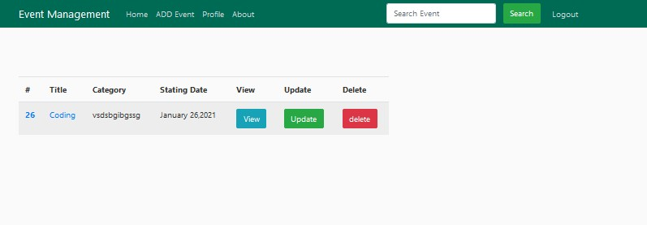
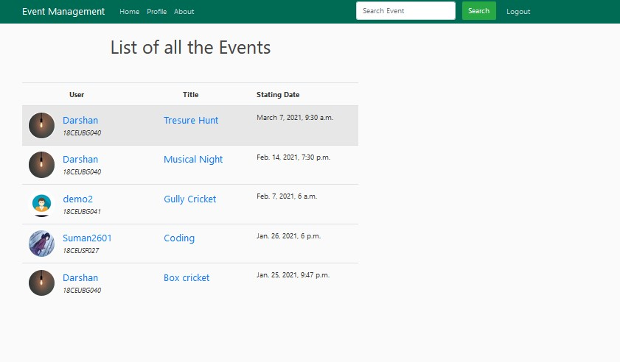
Screenshots

Slide 18
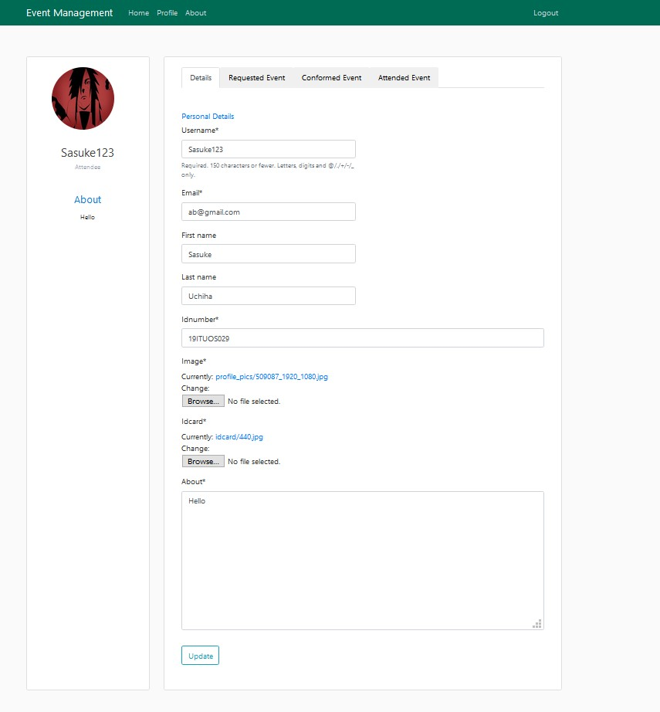
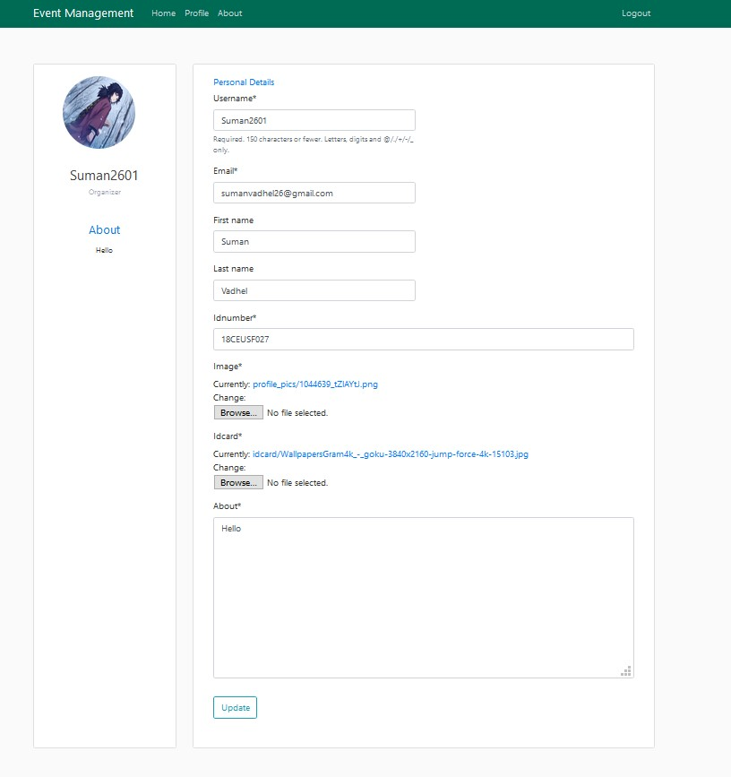

Slide 19
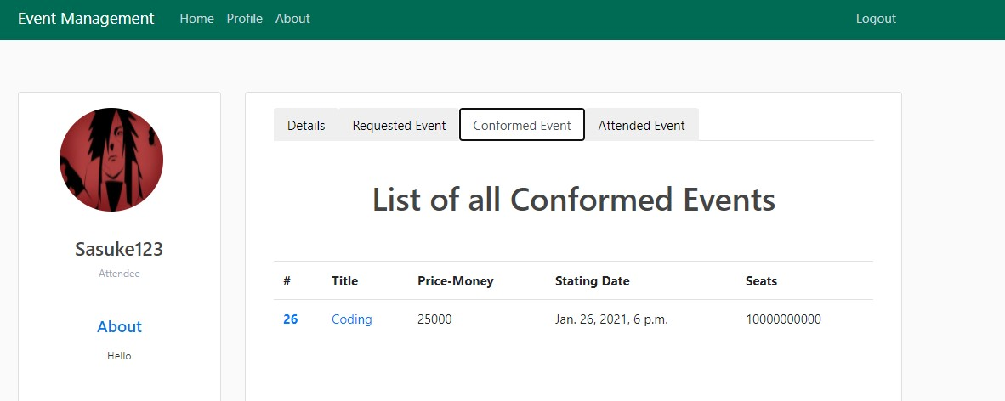
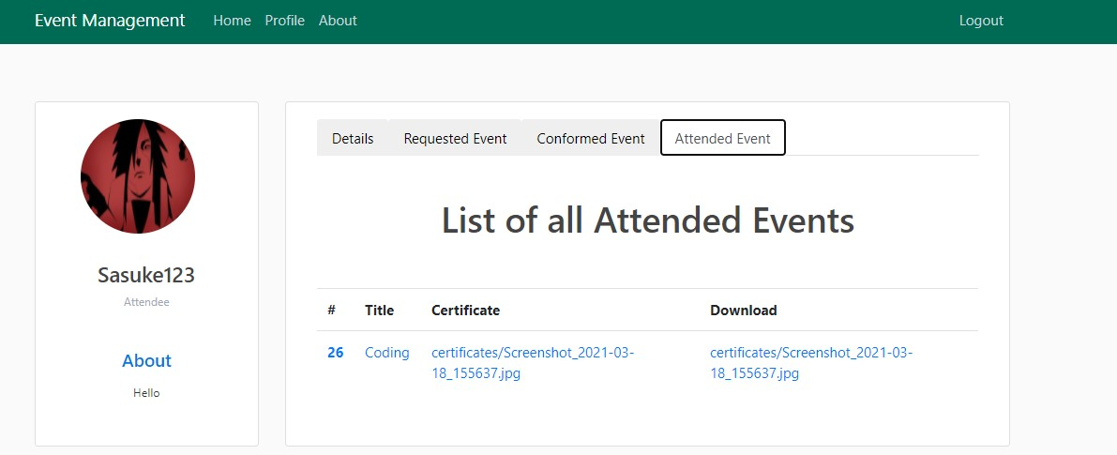

Slide 20
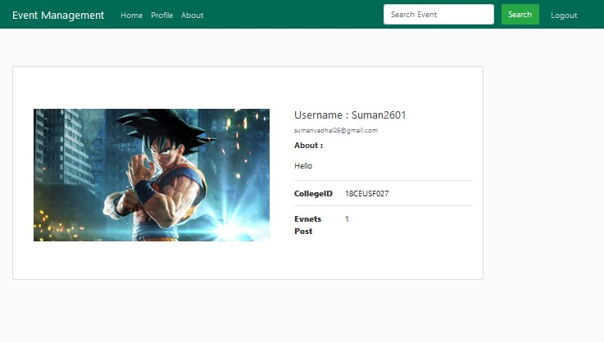
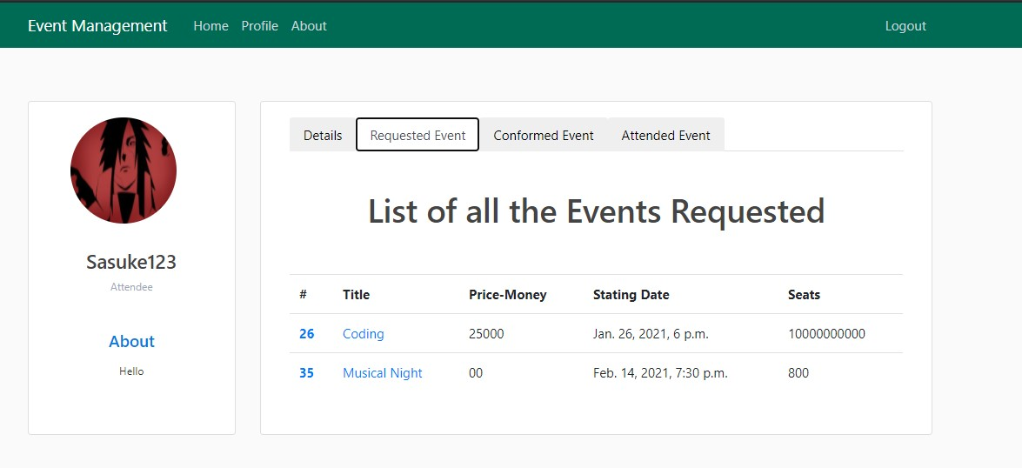

Slide 21
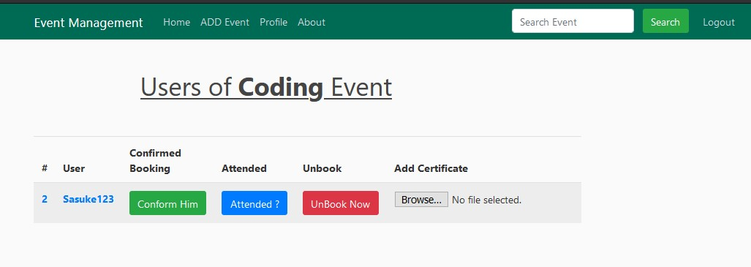

Slide 22
conclusion
The functionalities implemented in the system after understanding all the system modules according to the requirements.
Functionalities That are successfully implemented in the system are :
→ User registration containing all the necessary validation on field
→ Login
→ User authentication
→ Logout
→ Event Can be successfully Created With Valid Event Details that are Uploaded By Organizer.
→ Students can successfully Book the event and can download the certificate of that event at any time.
→ Admin side management
After the implementation and coding of system comprehensive testing was performed on the system to determine the errors and possible flaws in the system.

