Slide 1
Bank Management System
Supervised by
Smt. Swagata Saha
(Assistant Professor)
(Head of the Department)
Project by
Suman Debnath
Roll No. 183513-21-0026
Reg. No. 513-1111-0077-18

Slide 2
What is a Bank Management System?
Provides financial services using electronic communication and computation
Automation of various activities and functions of any bank through Internet
Digitization of money
Effortless account handling
Time saving

Slide 3
Domain
Web applications use a combination of server-side scripts (PHP) to handle the storage and retrieval of the information, and client-side scripts (JavaScript and HTML) to present information to users.
A database is an organized collection of structured information, or data, typically stored electronically in a computer system. A database is usually controlled by a database management system (DBMS). Together, the data and the DBMS, along with the applications that are associated with them, are referred to as a database system, often shortened to just database.

Slide 4
Scope of Work
Fund Transfer
View Transaction History
View Account details
Manipulate Client Account
Manipulate Employee Account
Withdrawal and deposit of funds

Slide 5
Methodology
Problem Statement
Recording and maintaining all the client record
User friendly connection between client, employee & manager

Slide 6
Design
Admin
User
Login
New Account
Account Statement
Deposit
Cash Deposit
Withdraw
Cash Withdraw
All Transaction
Logout
Transaction
Balance Enquiry
Balance Enquiry
Delete Account

Slide 7
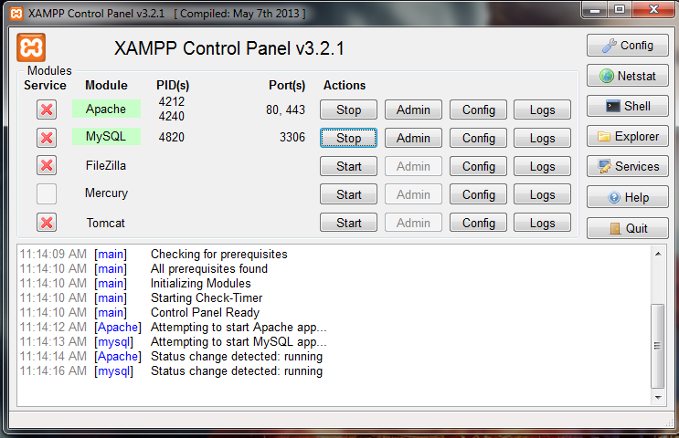
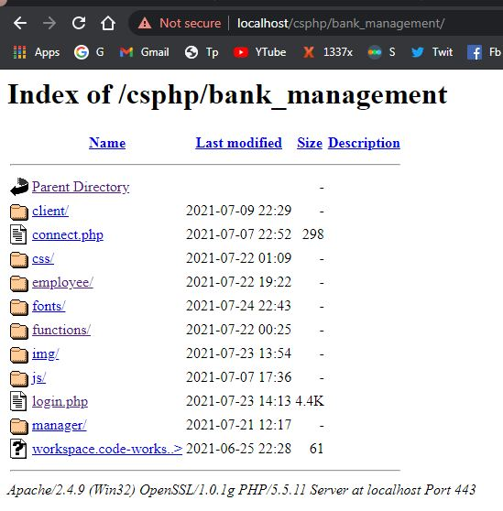
Implementation
Server Side

Slide 8

Client Side

Slide 9
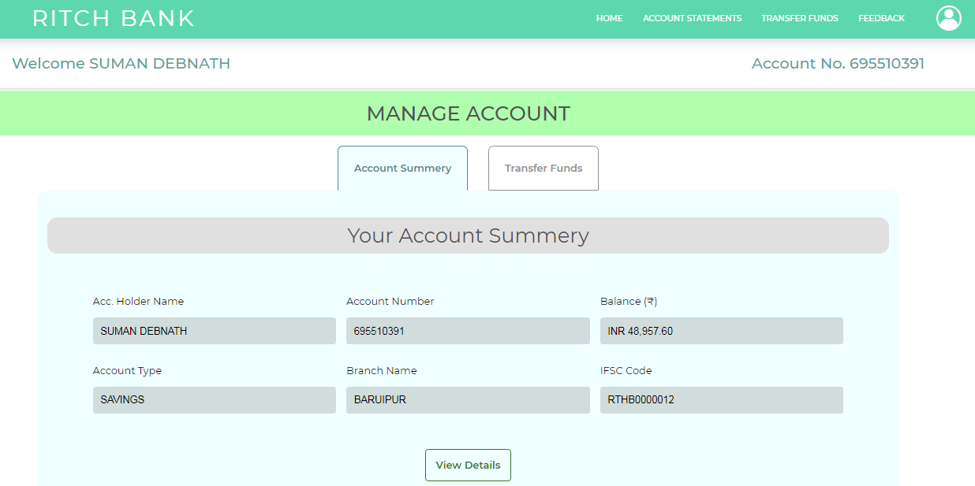
Client Dashboard

Slide 10
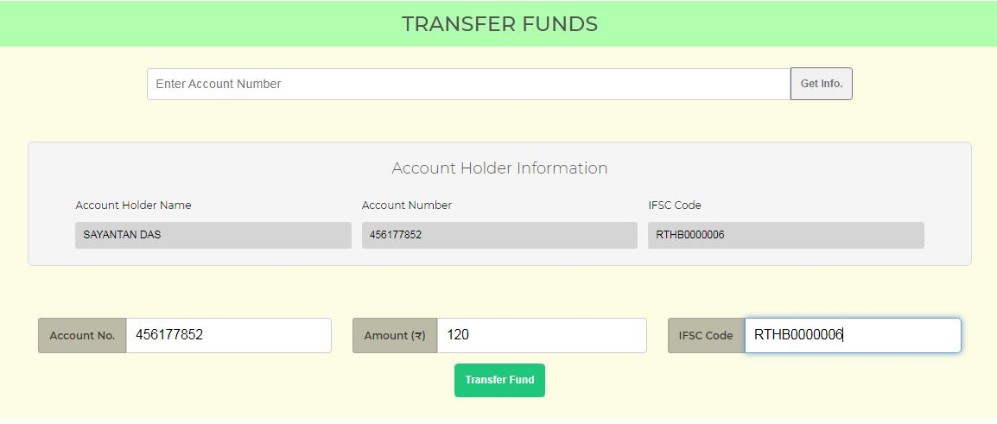
Transfer Fund

Slide 11
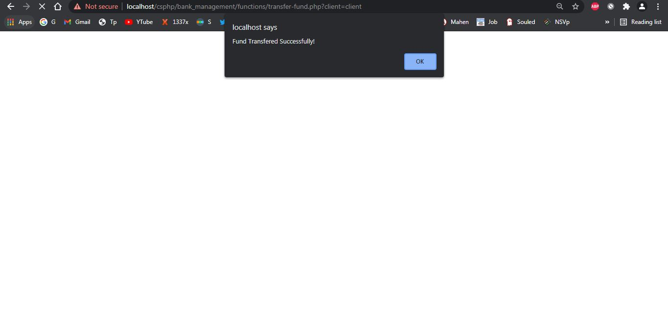
Fund Transfer Successful

Slide 12
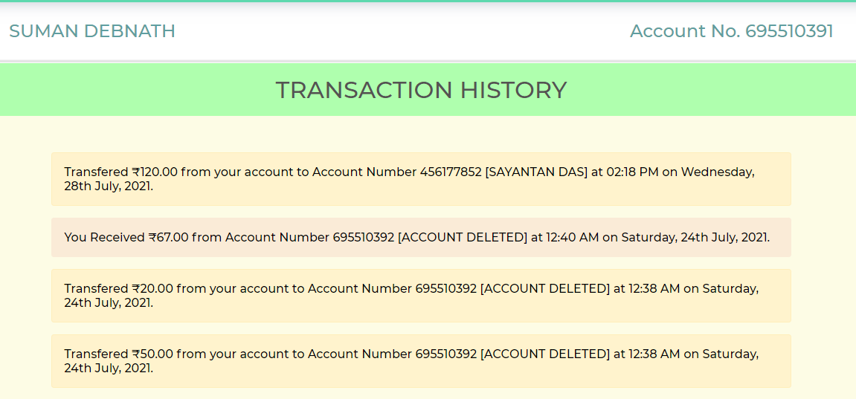
Transaction History

Slide 13
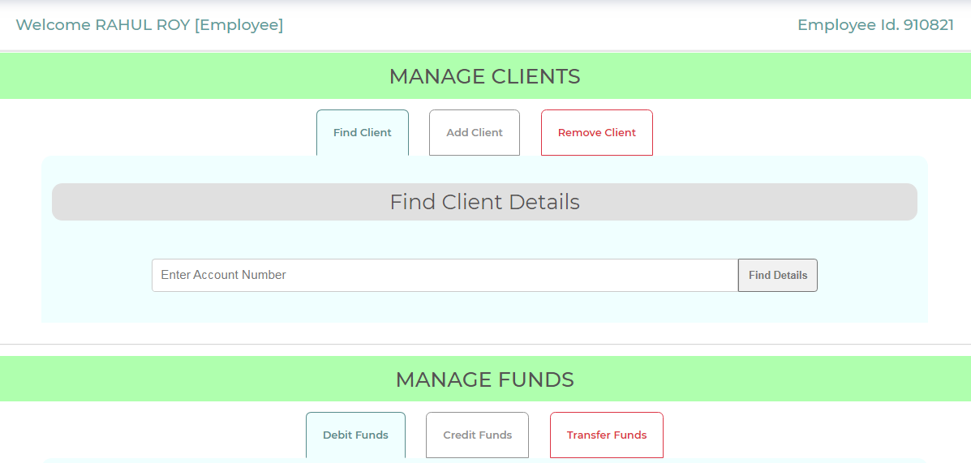
Employee Dashboard

Slide 14
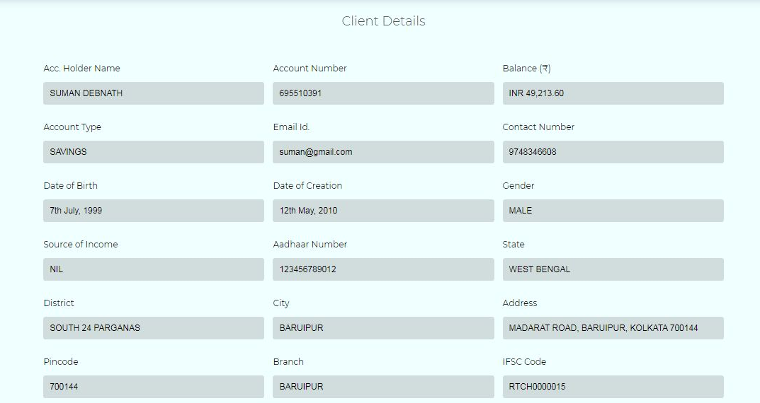
Find Client Details

Slide 15
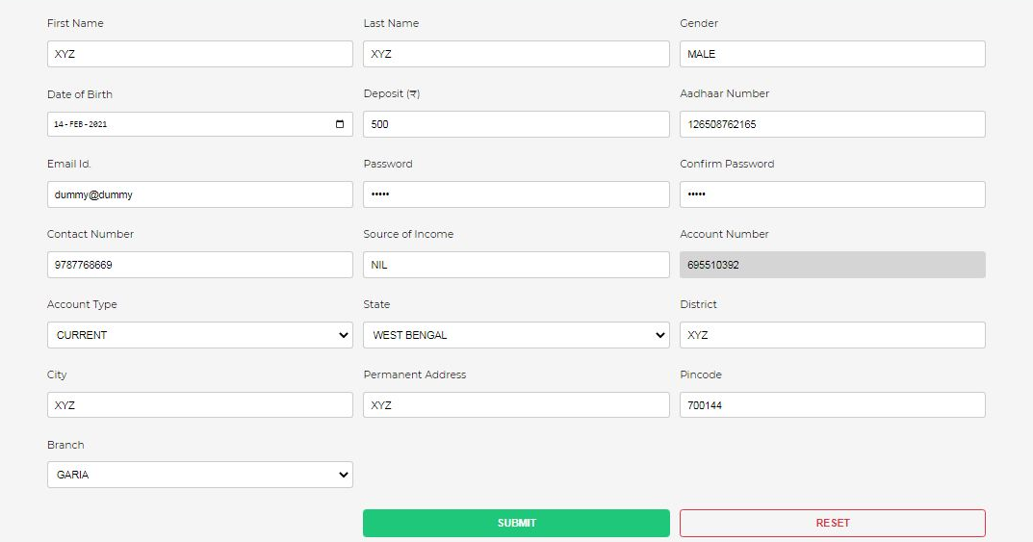
Add Client

Slide 16
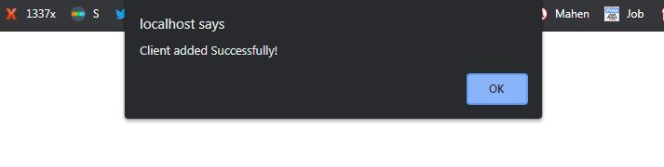
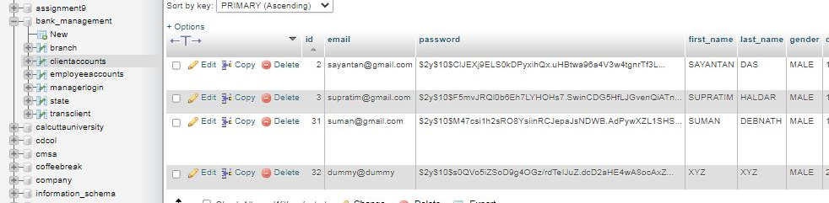
Client Added Successfully

Slide 17
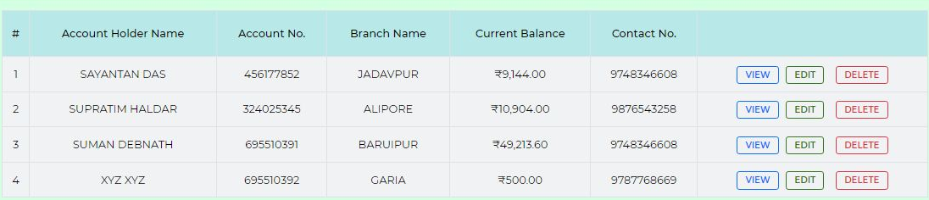
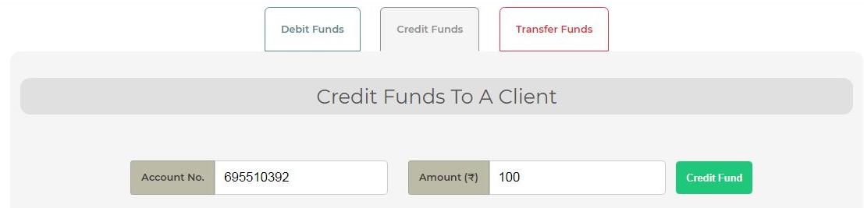
Credit Funds

Slide 18
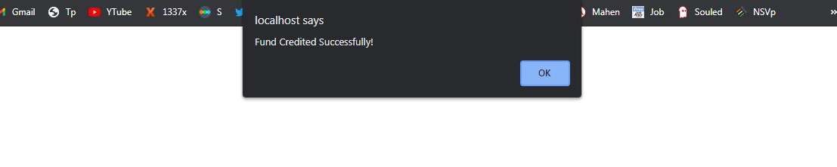
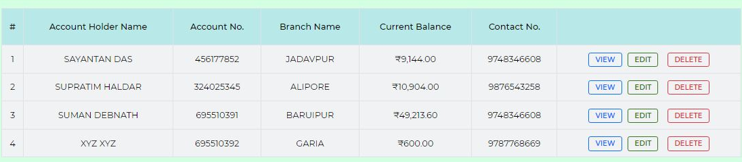
Fund Credit Successful

Slide 19
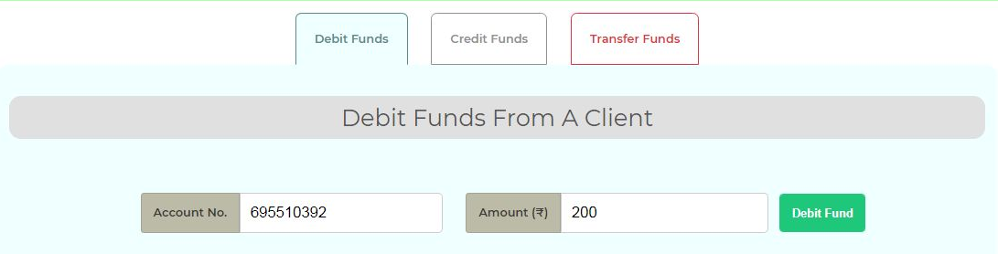
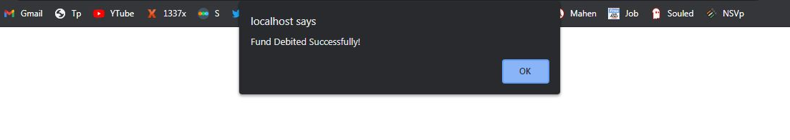
Debit Funds

Slide 20
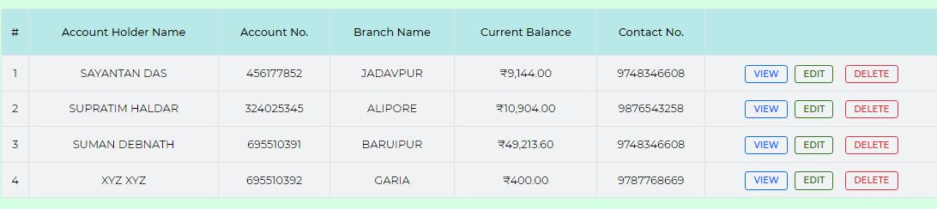
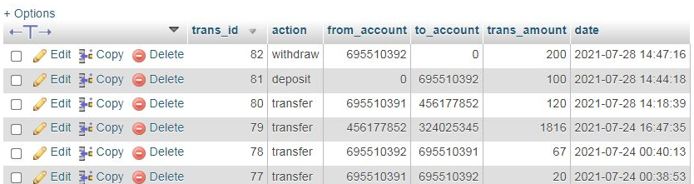
Fund Debit Successful

Slide 21
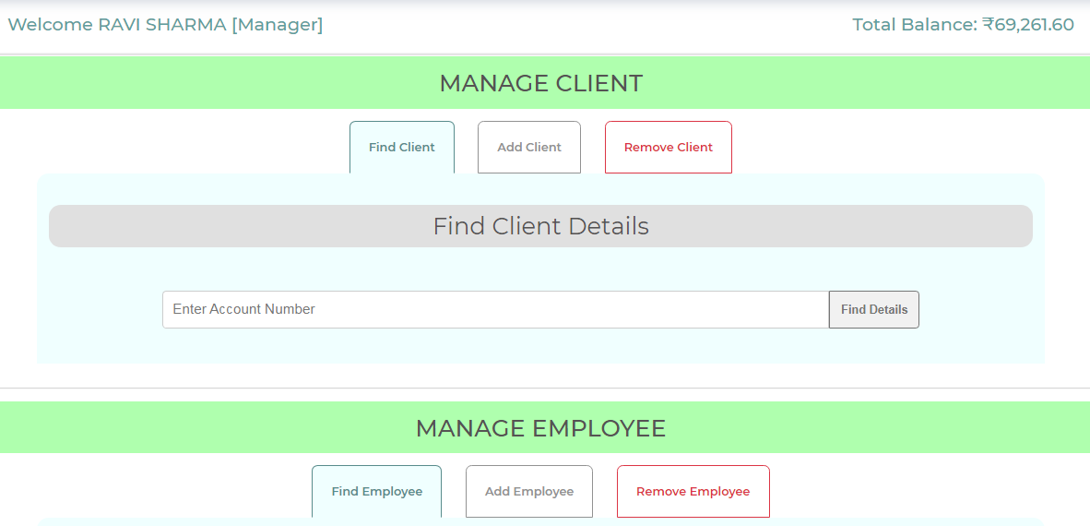
Manager Dashboard

Slide 22
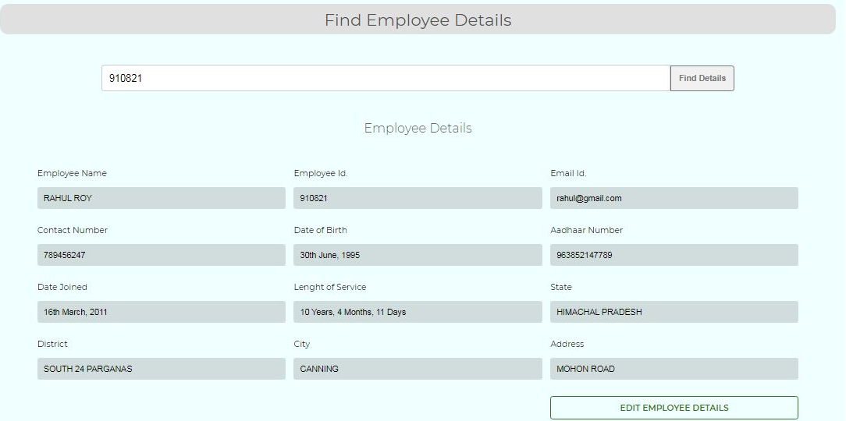
Find Employee

Slide 23
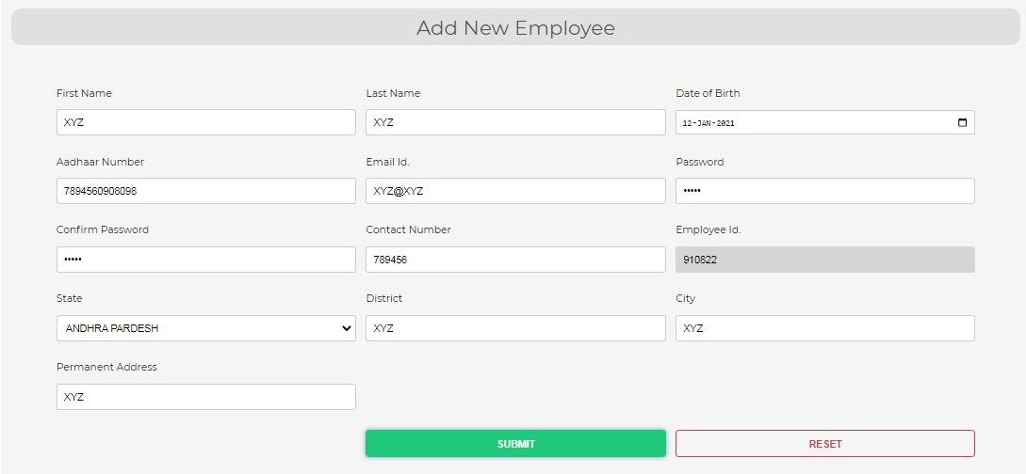
Add Employee

Slide 24
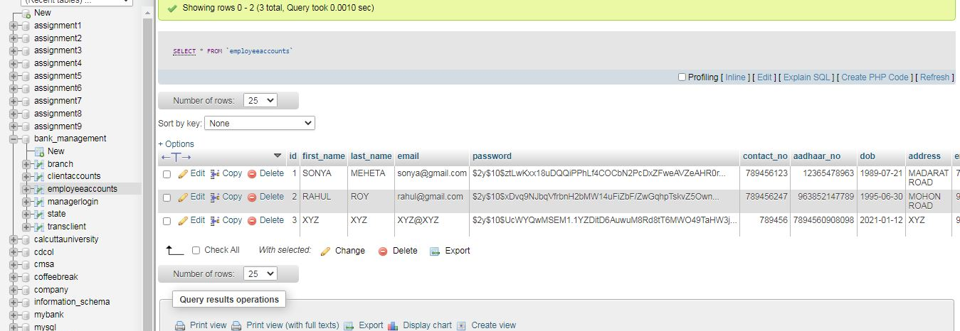
Employee Added to Database

Slide 25
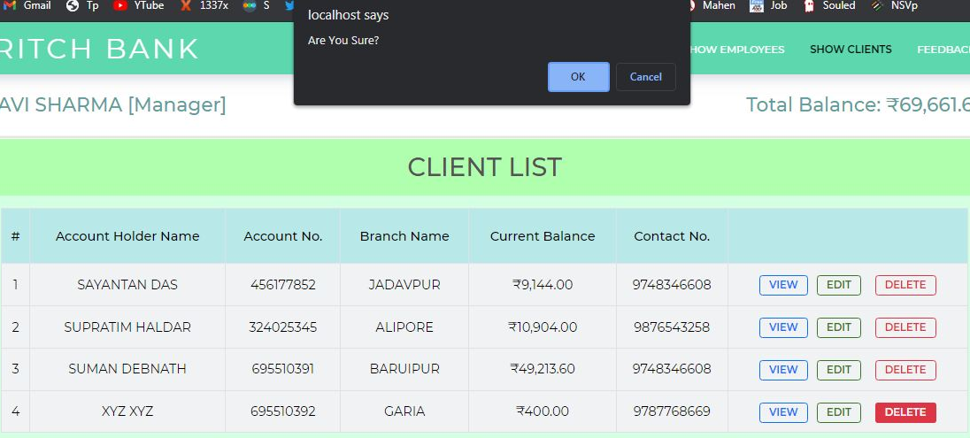
Delete Client

Slide 26
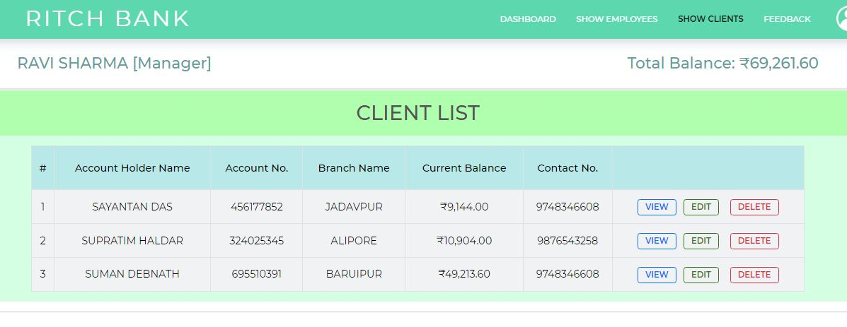
Client Deleted from Database

Slide 27
Result & Discussion
Working features are
Fund transfer
Debit / Credit funds
Add / Edit / Delete client accounts
Add / Edit / Delete employee accounts
View transaction
Limitation
International banking is not supported
Live hosting is not supported

Slide 28
Thank You

