Slide 1
Don Bosco Institue Of Technology
Electronics And Telecommunication Department
MINI PRJOECT – II
T.E 2015-2016
Mid Semester Project Report
IOT BASED RASPBEERY-PI SURVEILLANCE BOT
NAME | Roll no.
Justine Ayroor | 6
Suman Deb | 16
Sohan Naik | 48

Slide 2

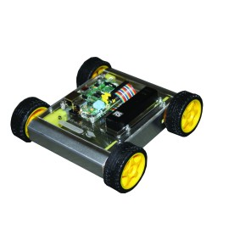
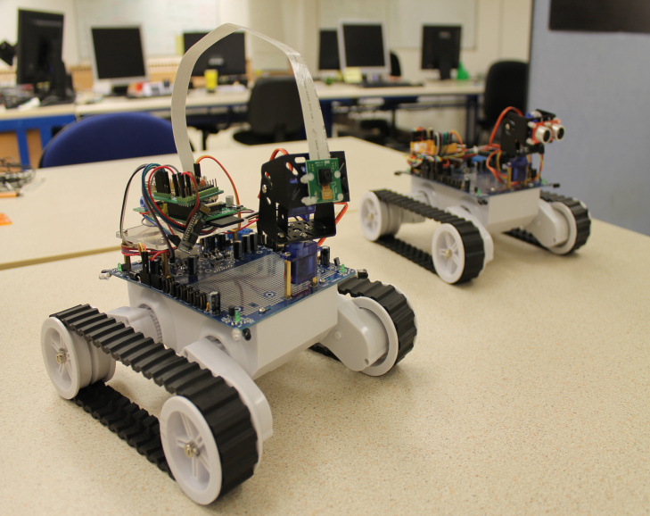
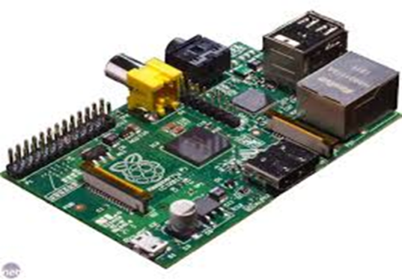
RASPBERRY PI
Surveillance bot

Slide 3
*AIM:
To design a SURVEILLANCE BOT using raspberry-pi controlled through IOT
*Equipments Used:
->Raspberry -PI
->RC CAR chassis
->Motors(DC & servo)
->Motor driver IC(L293D)
->WI-FI adapter
->Sensors(HC-SR04 DHT-11)
*Software Used:
->Python
->Putty
->NGIN-X
->VIM
->Flask
->Uwsgi
→Skeleton css
*Papers/Websites/Other literature utilized:
->http://www.youtube.com
->http://www.raspberrypi.org
->www.udemy.com

Slide 4
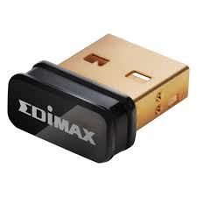
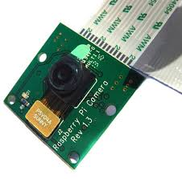
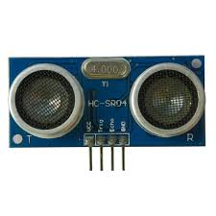
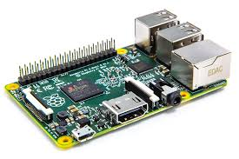
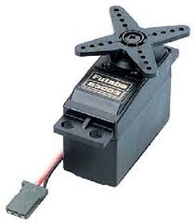
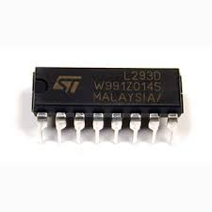
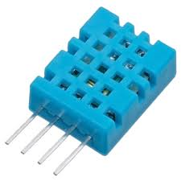
H/W REQIREMENTS:
RASPBERRY PI
WIFI ADAPTER
PICAM
HCSR04
SERVO MOTOR
L293D IC
DHT11

Slide 5



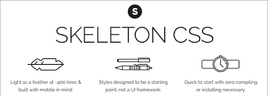




S/W REQIREMENTS:

Slide 6
BLOCK DIAGRAM:
AUV
PYTHON-FLASK APPLICATION
COMP/LAPTOP/MOBILE
(UWSGI)
APPLICATION SERVER
RPI
(NGINX)
WEB SERVER
ROUTER
WEB BROWSER
EDIMAX WIFI ADAPTER

Slide 7



CAR SETUP:
SERVO MOTOR
RASP PI
DHT11
POWER SUPPLY
PICAM
EDIMAX
L293D

Slide 8
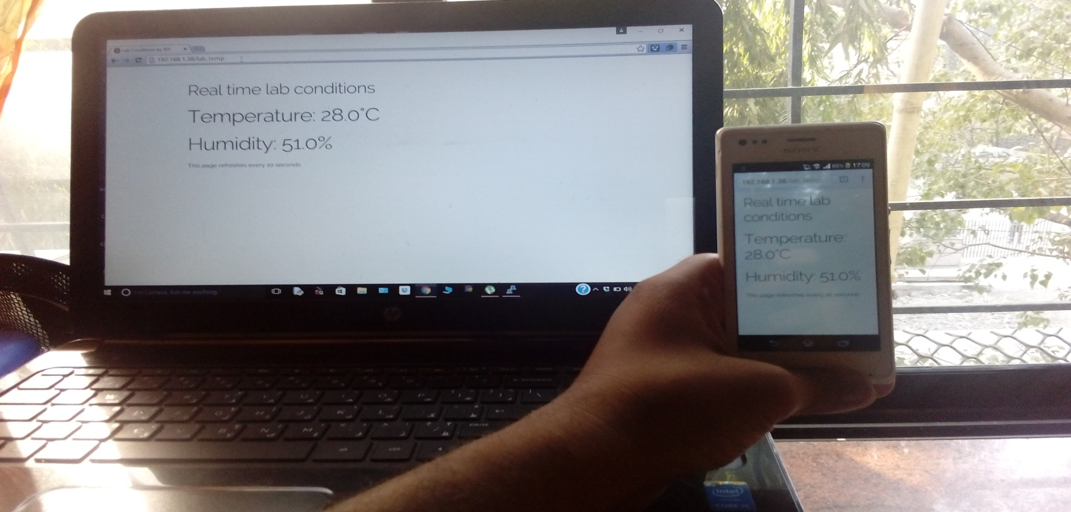
OUTCOMES:

Slide 9

PICAM:

Slide 10
THANK YOU!!!!!

