Slide 1
AquaSentinel: A Cloud-Integrated AloT System for Water Quality and Level Monitoring
Submitted in the partial fulfillment for the award of the degree of
BACHELOR OF ENGINEERING
IN
COMPUTER SCIENCE ENGINEERING
specialization in Internet Of Things
Submitted by:
Pranchal (22BIT70002)
Ayush (22BIT70024)
Suman (22BIT70027)
Aryan (22BIT70067)
Under the Supervision of:
Er. Abhishek Tiwari (E15792)
Department of AIT-CSE
DISCOVER . LEARN . EMPOWER

Slide 2
Outline
Introduction to Project
Problem Formulation
Objectives of the work
Hardware requirement
Methodology to be used
Literature Review
Conclusion
Future Scope
References

Slide 3
Introduction to Aquasentinel
AquaSentinel is an Artificial Intelligence of Things (AIoT) cloud-controlled system designed for continuous monitoring of water quality and water levels.​
Global Water Crisis:
  Over 2 billion people worldwide lack access to safe water​
  Water contamination from industrial and agricultural activities is worsening​
  Floods, scarcity, and pollution endanger ecology, human health, and development​
Why AquaSentinel?
  Traditional manual sampling and laboratory testing are time-consuming and inefficient​
  Cannot provide 24/7 intelligent surveillance needed for timely responses​
  Real-time monitoring is essential for proactive water resource management

Slide 4
Problem Formulation
Challenges in Traditional Water Monitoring:​
  Manual Sampling Limitations: Labor-intensive, cumbersome processes that cannot deliver real-time data​
  Delayed Response: Laboratory-based detection methods fail to provide timely alerts for contamination events​
  Scalability Issues: Existing IoT systems suffer from latency, poor connectivity, and limited deployment capabilities​
  Lack of Intelligence: Most systems only focus on data storage and visualization without predictive analytics​
  Fragmented Solutions: IoT, cloud computing, and AI technologies exist separately rather than as integrated solutions

Slide 5
Objectives of the Work
Real-time Monitoring: Monitor critical water parameters (pH, turbidity, temperature, dissolved oxygen, water levels) continuously​
Cloud Integration: Enable secure data storage, large-scale analytics, and remote accessibility​
AI-Driven Intelligence: Implement machine learning algorithms for anomaly detection and predictive maintenance​
Scalable Architecture: Create an AIoT-ready system that can be deployed across different water bodies​
Interactive Dashboard: Develop visualization tools with real-time notifications for stakeholders​
Proactive Solution: Predict contamination events and enable timely interventions

Slide 6
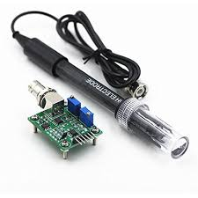
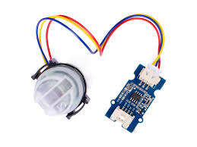
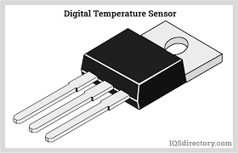
Hardware requirement
Sensors:​
pH Sensor: Measures water acidity/alkalinity
Turbidity Sensor: Detects suspended particles and water clarity
Temperature Sensor (DS18B20/LM35): Monitors thermal fluctuations
pH Sensor
Turbidity Sensor

Slide 7
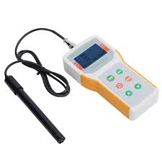
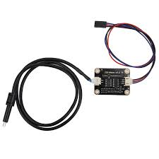
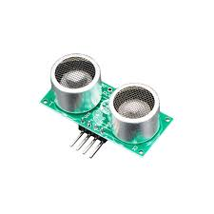
Hardware requirement
Dissolved Oxygen Sensor: Measures oxygen concentration for aquatic life
Conductivity Sensor: Examines salinity and dissolved solids
Ultrasonic/Pressure Sensors: Accurate water level monitoring
Dissolved Oxygen sensor
Conductivity Sensor
Ultrasonic Sensor

Slide 8
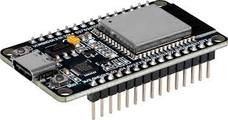
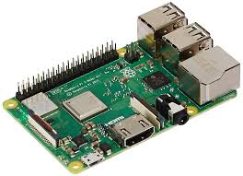
Hardware requirement
Edge Devices:​
    ESP32/Arduino: Low-power, cost-effective microcontrollers
    Raspberry Pi: For applications requiring enhanced processing power and edge analytics
Communication Modules:​
    Wi-Fi: Short-range, high-bandwidth (urban water tanks)
    LoRaWAN: Long-range, low-power (rural applications)
    NB-IoT: Cellular-based wide-area monitoring
ESP32
Raspberry Pi

Slide 9
Methodology to be used
Data Collection Setup:​
  Deployed across overhead tanks, lakes, and small reservoirs for heterogeneous datasets​
  Multi-parameter sensors connected to microcontroller with wireless communication modules​
Experimental Protocol:​
  Duration: 30-day continuous monitoring period​
  Sampling Rate: Data collected every 5 minutes​
  Validation: Laboratory sampling for ground-truth verification at regular intervals

Slide 10
Methodology to be used
AI/ML Techniques:​
  Decision Trees & SVM: Classification of water quality (normal vs. abnormal)​
  CNN & LSTM Networks: Time-series analysis for detecting minute anomalies and temporal dependencies​
  Cloud-hosted Training: Hyperparameter optimization for enhanced accuracy and efficiency​
Performance Metrics:​
  Accuracy, Latency, Power Consumption, Scalability

Slide 11
Literature Review
Evolution of Water Monitoring Systems:​
Early IoT Systems:
  Low-cost sensor networks for pH, turbidity, temperature monitoring​
  Limitations: Latency issues, poor connectivity, small-scale deployments​
Cloud-Integrated Systems:
  Centralized data aggregation with remote viewing capabilities​
  Gap: Focused only on storage/visualization, lacked advanced analytics​
AI/ML Applications:
  High accuracy in detecting anomalies and predicting contamination​
  Challenge: Offered separately, not integrated into IoT-cloud ecosystems​

Slide 12
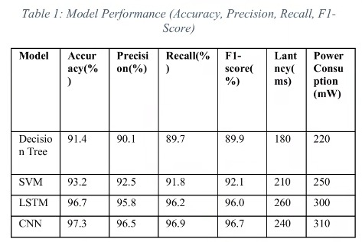
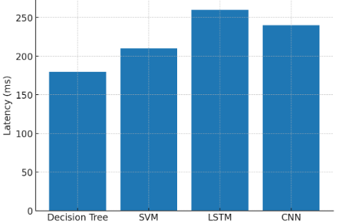
Literature Review
AquaSentinel's Contribution:​
  First fully integrated solution combining AIoT sensing, cloud storage/analytics, and AI-driven anomaly detection
  Provides end-to-end intelligence from data collection to predictive management insights
Figure: Latency vs Model Type

Slide 13
Conclusion
AquaSentinel is a cloud-enabled AIoT system that monitors real-time water quality and water levels to address critical challenges of water pollution, scarcity, and floods. By integrating AI models with IoT sensors and cloud infrastructure, the system delivers high-precision water quality classification, anomaly detection, and predictive alerts. Experimental results demonstrate improved efficiency, accuracy, and scalability compared to conventional methods, with significant reductions in latency and enhanced anomaly detection capabilities. The cloud integration provides superior data storage, visibility, and accessibility, while the user-friendly dashboard and automated alert system enable effective decision-making for policymakers and communities. AquaSentinel's modular and scalable architecture positions it as a viable solution for both urban smart cities and rural water resource management, offering a sustainable foundation for intelligent water management by bridging IoT, AI, and cloud computing technologies.

Slide 14
Future Scope
Blockchain Integration: Secure, tamper-proof, transparent water quality data management for regulatory compliance​
Advanced Deep Learning: Implement recurrent neural networks and attention-based models for enhanced anomaly detection​
Smart City Integration: Interoperability with flood management, wastewater treatment, and emergency response systems​
Low-Power Edge AI: Deploy in remote/resource-limited regions for continuous surveillance without heavy cloud dependence​
Industrial Expansion: Scale to industrial wastewater monitoring with stricter environmental compliance requirements​
Enhanced Predictive Analytics: Further optimize forecasting models for seasonal patterns and contamination events

Slide 15
References
Key Research Citations:​
  Leigh C. et al., "A framework of automated anomaly detection in high frequency water-quality data using in situ sensors," arXiv preprint, October 2018
  Singh N. et al., "Detection of Water Quality through Machine Learning and IoT," IJERT, vol. 10, no. 11, 2021
  Moursi M. et al., "Smart Environmental Monitoring of Marine Pollution using Edge AI," arXiv, Apr. 2025
  Kathen M. J. et al., "AquaFeL-PSO: Monitoring system of water resources through autonomous surface vessels," arXiv, Nov. 2022
  "Anomaly Detection of Water Quality Sensor Monitoring Using Multivariate Deep Learning," Sensors, vol. 23, no. 20, Oct. 2023
  "AI-Based Anomaly Detection of Smart Water Metering Systems through Ensemble Learning," Water, vol. 17, no. 13, Jun. 2025

