Slide 1
Email Security

Slide 2
Threats
Threats to the security of e-mail itself
  Loss of confidentiality
    E-mails are sent in clear over open networks
    E-mails stored on potentially insecure clients and mail servers
  Loss of integrity
    No integrity protection on e-mails; body can be altered in transit or on mail server
  Lack of data origin authentication
  Lack of non-repudiation
  Lack of notification of receipt

Slide 3
Threats Enabled by E-mail
Disclosure of sensitive information
Exposure of systems to malicious code
Denial-of-Service (DoS)
Unauthorized accesses etc.
Notes:
Story: mailing of patent list to academic mailing list.

Slide 4
What are the Options
Secure the server to client connections (easy thing first)
  POP, IMAP over ssh, SSL
  https access to webmail
  Very easy to configure
  Protection against insecure wireless access
Secure the end-to-end email delivery
  The PGPs of the world
  Still need to get the other party to be PGP aware
  Practical in an enterprise intra-network environment

Slide 5
Email based Attacks
Active content attack
  Clean up at the server (AV, Defang)
Buffer over-flow attack
  Fix the code
Shell script attack
  Scan before send to the shell
Trojan Horse Attack
  Use “do not automatically use the macro” option
Web bugs (for tracking)
  Mangle the image at the mail server

Slide 6
Email SPAM
Cost to exceed $10 billion
SPAM filtering
  Content based – required hits
  White list
  Black list
  Defang MIME

Slide 7
PGP
PGP=“Pretty Good Privacy”
First released in 1991, developed by Phil Zimmerman
Freeware: OpenPGP and variants:
OpenPGP specified in RFC 2440 and defined by IETF OpenPGP working group.
  www.ietf.org/html.charters/openpgp-charter.html
Available as plug-in for popular e-mail clients, can also be used as stand-alone software.

Slide 8
PGP
Functionality
  Encryption for confidentiality.
  Signature for non-repudiation/authenticity.
Sign before encrypt, so signatures on unencrypted data - can be detached and stored separately.
PGP-processed data is base64 encoded
Notes:
In fact PGP-processed data can be used with any transport protocol. PGP-processed message is simply placed
Into e-mail client edit window.

Slide 9
PGP Algorithms
Broad range of algorithms supported:
Symmetric encryption:
  DES, 3DES, AES and others.
Public key encryption of session keys:
  RSA or ElGamal.
Hashing:
  SHA-1, MD-5 and others.
Signature:
  RSA, DSS, ECDSA and others.

Slide 10
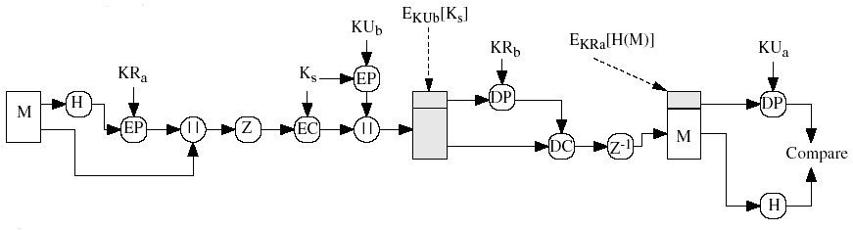
PGP Services

Slide 11
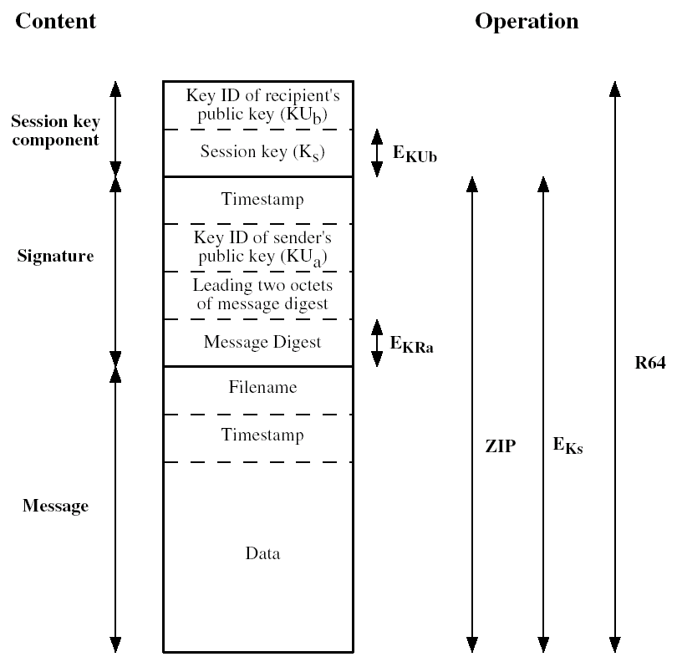
PGP Message

Slide 12
PGP Key Rings
PGP supports multiple public/private keys pairs per sender/recipient.
Keys stored locally in a PGP Key Ring – essentially a database of keys.
Private keys stored in encrypted form; decryption key determined by user-entered pass-phrase.

Slide 13
Key Management for PGP
Public keys for encrypting session keys / verifying signatures.
Private keys for decrypting session keys / creating signatures.
Where do these keys come from and on what basis can they be trusted?
Notes:
S/MIME and PGP address these questions in quite different ways.
What goes wrong if you use the wrong public key to encrypt or verify?

Slide 14
PGP Key Management
PGP adopts a trust model called the web of trust.
No centralised authority
Individuals sign one another’s public keys, these “certificates” are stored along with keys in key rings.
PGP computes a trust level for each public key in key ring.
Users interpret trust level for themselves.

Slide 15
PGP Trust Levels
Trust levels for public keys dependent on:
  Number of signatures on the key;
  Trust level assigned to each of those signatures.
Trust levels recomputed from time to time.

Slide 16
PGP Key Mgmt Issues
Original intention was that all e-mail users would contribute to web of trust.
Reality is that this web is sparsely populated.
How should security-unaware users assign and interpret trust levels?
Later versions of PGP support X.509 certs.
Notes:
Another HP story here: academic and HP employee using PGP as guerrilla secure e-mail solution.

Slide 17
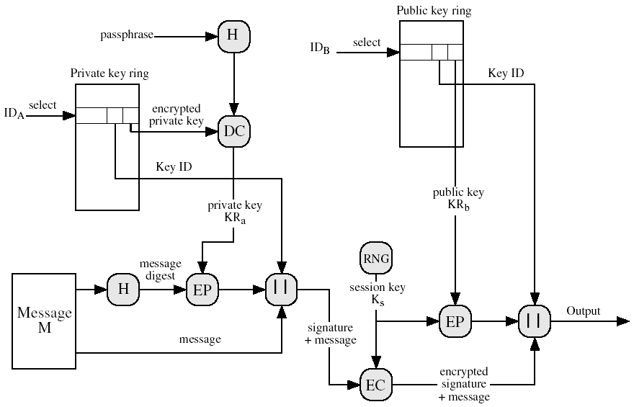
PGP Message Generation

Slide 18
PGP Message Generation (cont’d)
The sending PGP entity performs the following steps:
  Signs the message:
    PGP gets sender’s private key from key ring using its user id as an index.
    PGP prompts user for passphrase to decrypt private key.
    PGP constructs the signature component of the message.
  Encrypts the message:
    PGP generates a session key and encrypts the message.
    PGP retrieves the receiver public key from the key ring using its user id as an index.
    PGP constructs session component of message

Slide 19
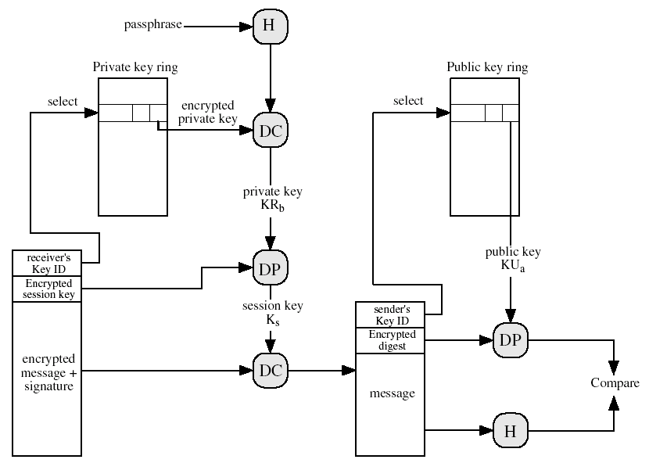
PGP Message Reception

Slide 20
PGP Message Reception
The receiving PGP entity performs the following steps:
  Decrypting the message:
    PGP get private key from private-key ring using Key ID field in session key component of message as an index.
    PGP prompts user for passphrase to decrypt private key.
    PGP recovers the session key and decrypts the message.
  Authenticating the message:
    PGP retrieves the sender’s public key from the public-key ring using the Key ID field in the signature key component as index.
    PGP recovers the transmitted message digest.
    PGP computes the message for the received message and compares it to the transmitted version for authentication.

