Slide 1


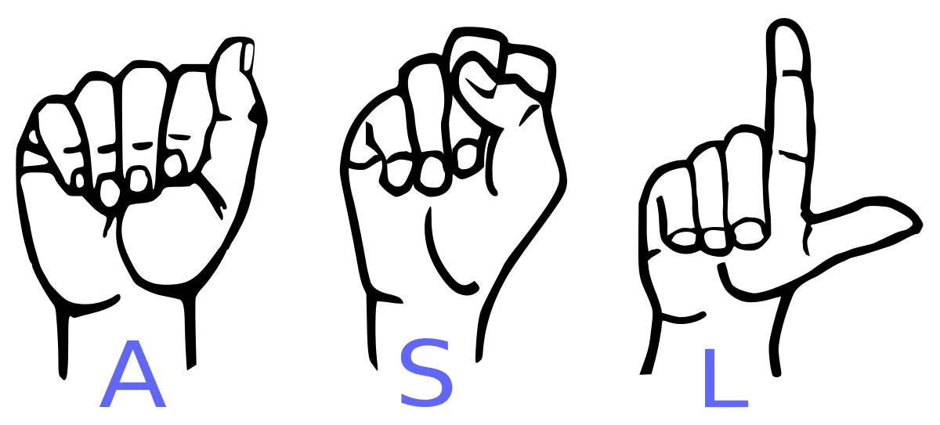
REAL-TIME SIGN LANGUAGE RECOGNITION SYSTEM USING DEEP LEARNING AND COMPUTER VISION
Prof.Manjot Kaur Gill
Assistant Professor
Department of CSE
Submitted by
Name: Sumanpreet kaur
(U.R.No.:2461612)

Slide 2

Abstract
Our project aims to create a REAL-TIME SIGN LANGUAGE RECOGNITION SYSTEM and train a model which when shown a real time video of hand gestures of American Sign Language shows the output for that particular sign in text format on the screen.

Slide 3
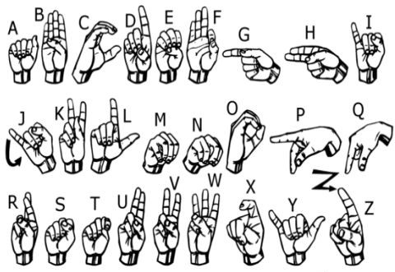
We implemented 27 symbols(A-Z, blank) of ASL in our project.

Slide 4
Literature Review

Slide 5
Title | Authors | Year | Journal/Conference | Publisher
A real-time platform for Spanish Sign Language interpretation | Morillas-Espejo, F., & Martinez-Martin, E. | 2024 | Neural Computing and Applications | Springer
Combining state-of-the-art pre-trained deep learning models: A novel approach for Bangla Sign Language recognition using Max Voting Ensemble | Kabir, M. H., Miah, A. S. M., Hadiuzzaman, M., & Shin, J. | 2025 | Systems and Soft Computing | Elsevier
Two stream GRU model with ELU activation function for sign language recognition | Myagila, K., Nyambo, D. G., & Dida, M. A. | 2025 | Intelligent Systems with Applications | Elsevier
MSKA: Multi-stream keypoint attention network for sign language recognition and translation | Guan, M., Wang, Y., Ma, G., Liu, J., & Sun, M. | 2025 | Pattern Recognition | Elsevier
Hear Sign Language: A Real-Time End-to-End Sign Language Recognition System | Wang, Z., Zhao, T., Ma, J., Chen, H., Liu, K., Shao, H., Wang, Q., & Ren, J. | 2022 | IEEE Transactions on Mobile Computing | IEEE
Title | Authors | Year | Journal/Conference | Publisher
A real-time platform for Spanish Sign Language interpretation | Morillas-Espejo, F., & Martinez-Martin, E. | 2024 | Neural Computing and Applications | Springer
Combining state-of-the-art pre-trained deep learning models: A novel approach for Bangla Sign Language recognition using Max Voting Ensemble | Kabir, M. H., Miah, A. S. M., Hadiuzzaman, M., & Shin, J. | 2025 | Systems and Soft Computing | Elsevier
Two stream GRU model with ELU activation function for sign language recognition | Myagila, K., Nyambo, D. G., & Dida, M. A. | 2025 | Intelligent Systems with Applications | Elsevier
MSKA: Multi-stream keypoint attention network for sign language recognition and translation | Guan, M., Wang, Y., Ma, G., Liu, J., & Sun, M. | 2025 | Pattern Recognition | Elsevier
Hear Sign Language: A Real-Time End-to-End Sign Language Recognition System | Wang, Z., Zhao, T., Ma, J., Chen, H., Liu, K., Shao, H., Wang, Q., & Ren, J. | 2022 | IEEE Transactions on Mobile Computing | IEEE
Title | Authors | Year | Journal/Conference | Publisher
A real-time platform for Spanish Sign Language interpretation | Morillas-Espejo, F., & Martinez-Martin, E. | 2024 | Neural Computing and Applications | Springer
Combining state-of-the-art pre-trained deep learning models: A novel approach for Bangla Sign Language recognition using Max Voting Ensemble | Kabir, M. H., Miah, A. S. M., Hadiuzzaman, M., & Shin, J. | 2025 | Systems and Soft Computing | Elsevier
Two stream GRU model with ELU activation function for sign language recognition | Myagila, K., Nyambo, D. G., & Dida, M. A. | 2025 | Intelligent Systems with Applications | Elsevier
MSKA: Multi-stream keypoint attention network for sign language recognition and translation | Guan, M., Wang, Y., Ma, G., Liu, J., & Sun, M. | 2025 | Pattern Recognition | Elsevier
Hear Sign Language: A Real-Time End-to-End Sign Language Recognition System | Wang, Z., Zhao, T., Ma, J., Chen, H., Liu, K., Shao, H., Wang, Q., & Ren, J. | 2022 | IEEE Transactions on Mobile Computing | IEEE
Title | Authors | Year | Journal/Conference | Publisher
A real-time platform for Spanish Sign Language interpretation | Morillas-Espejo, F., & Martinez-Martin, E. | 2024 | Neural Computing and Applications | Springer
Combining state-of-the-art pre-trained deep learning models: A novel approach for Bangla Sign Language recognition using Max Voting Ensemble | Kabir, M. H., Miah, A. S. M., Hadiuzzaman, M., & Shin, J. | 2025 | Systems and Soft Computing | Elsevier
Two stream GRU model with ELU activation function for sign language recognition | Myagila, K., Nyambo, D. G., & Dida, M. A. | 2025 | Intelligent Systems with Applications | Elsevier

Slide 6
Title | Authors | Year | Journal/Conference | Publisher | DOI
Real-Time Sign Language Recognition using Machine Learning and CNN-based EfficientNetB3 for Accessible Communication | Mizan, Z. I., Aidelkhani, F., Reza, K. T., Bhuiyan, T. H., Alom, M., & Tuhin, S. I. | 2024 | International Conference on Advanced Computing and Renewable Systems (ICACRS) | IEEE | DOI
Real-Time Marathi Sign Language Recognition using Deep Learning Techniques | Deshmukh, R., Lahamge, T., Phadatare, I., Shinde, D., & Manhas, R. | 2024 | ICACRS 2024 | IEEE | DOI
Sign to Text: Automated Sign Language Interpretation using LSTM and Computer Vision | Sakthivel, S. M., Kumar, N. S., Harika, C., Harika, C., Reddy, C., & Kalyan, D. | 2024 | ICACRS 2024 | IEEE | DOI
Multimodal Real-Time Translation System for Hearing Impaired Accessibility Using Deep Learning | Balachandra, M., & Manjula, A. | 2024 | Indian Scientific Journal Of Research In Engineering And Management | IJSREM | DOI
Real-time Sign Language to Text Conversion using Deep Learning Models | Shekhar, R. | 2024 | International Conference on Advances in Nanotechnology (ICONAT) | IEEE | DOI

Slide 7
Objectives.
1. To integrate two labeled sign language datasets for training deep learning models.
2. To design and implement a real-time system that captures and processes hand gestures for accurate sign language recognition.
3. To evaluate the performance of the proposed system using evaluation metrics such as precision, recall, F1-score, and the confusion matrix.

Slide 8
Methodology

Slide 9
1.Data Collection 1. Two datasets from Kaggle ( Alphabets) 2 .Converted all images to JPG format 3. Combined into a single labeled dataset 4. Included variations in hand shape, background, and lighting 5. Images labeled as ‘0’, ‘1’, ‘A’, ‘B’, etc. 6. Organized into class-wise directories for training

Slide 10
2.Preprocessing Steps
Grayscale Conversion: Simplifies input data by focusing on shape and gesture recognition, reducing model complexity.
Gamma Correction: Adjusts brightness and contrast to improve visibility under various lighting conditions.
Gaussian Blur: Reduces noise and smooths images, allowing the model to focus on essential features.
Resizing: Standardizes image size to 224x224 pixels for model compatibility while preserving gesture structure.

Slide 11
3.Model Selection
MobileNetV2
Lightweight CNN optimized for mobile and embedded devices.
Uses depthwise separable convolutions for reduced computation.
Incorporates inverted residual blocks with linear bottlenecks.
Offers fast and efficient performance with fewer parameters.
Ideal for real-time applications on low-power hardware.

Slide 12
ResNet50
Deep CNN with 50 layers based on residual learning.
Uses skip connections to prevent vanishing gradient problems.
Achieves high accuracy on complex image recognition tasks.
Requires more computational power (GPU/CPU).
Well-suited for large-scale datasets.

Slide 13
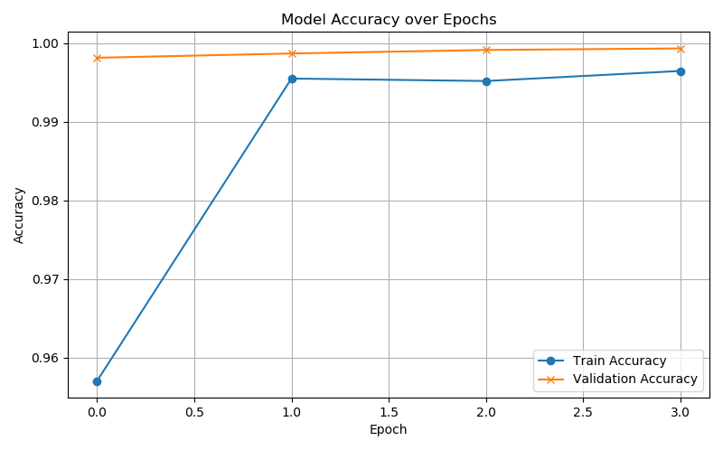
4.Training the Model
MobileNetV2

Slide 14
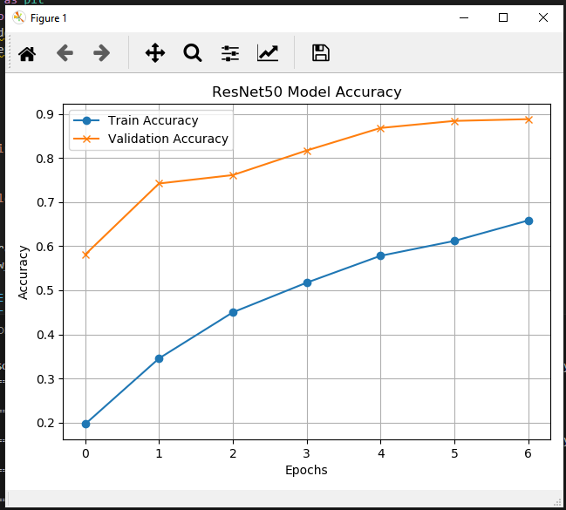
ResNet50

Slide 15
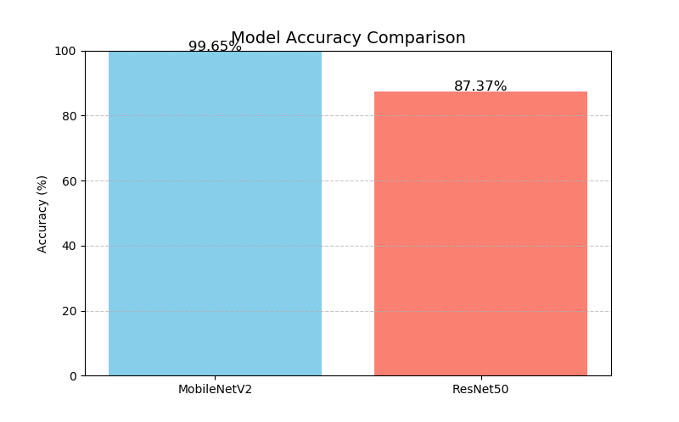
Result and Conclusions

Slide 16
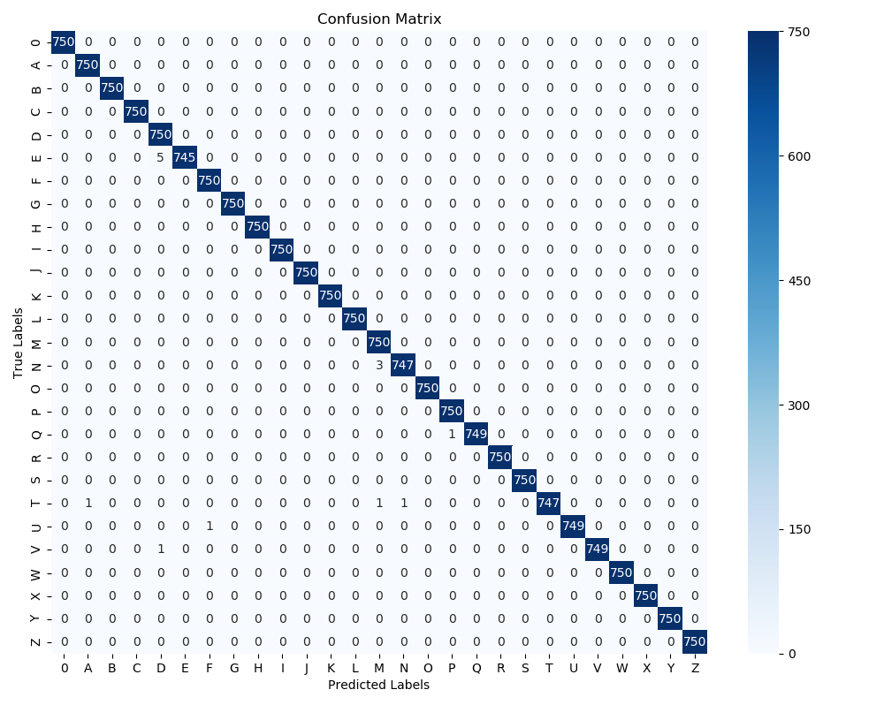
MobileNetV2

Slide 17
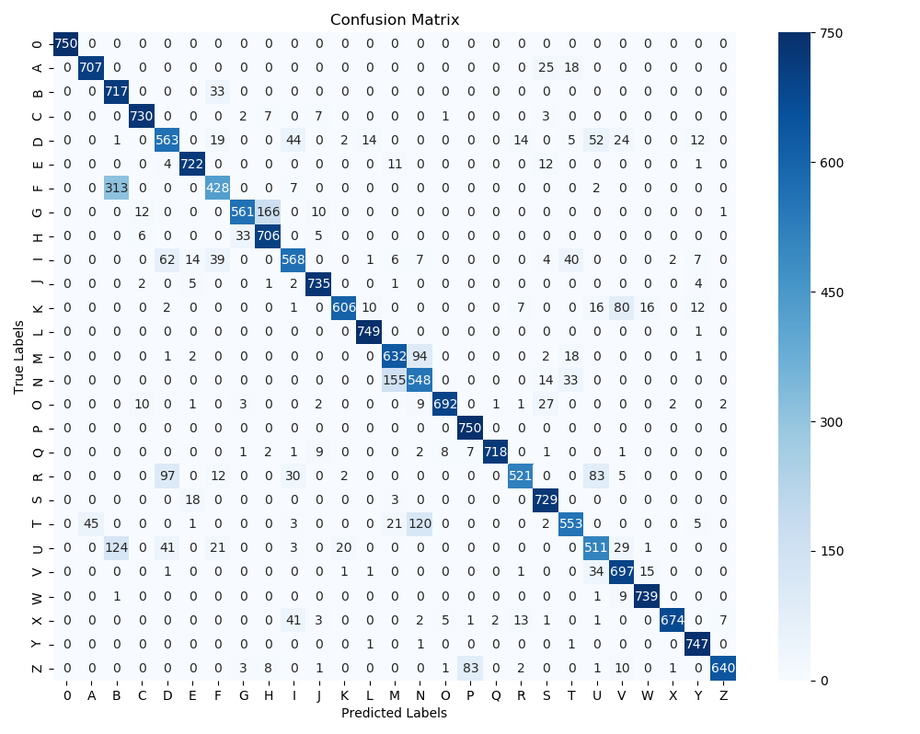
ResNet-50

Slide 18
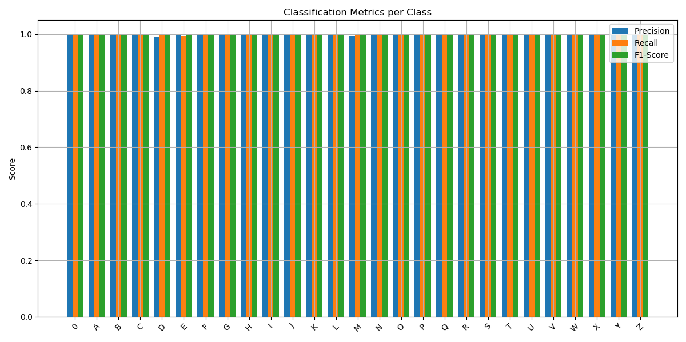
MobileNetV2

Slide 19
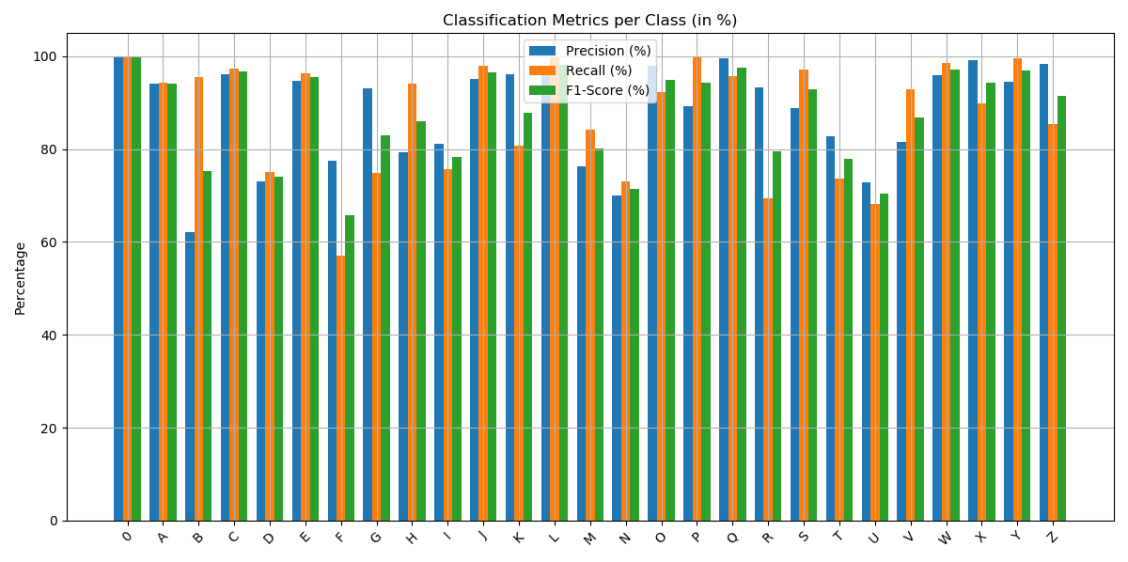
ResNet50

Slide 20
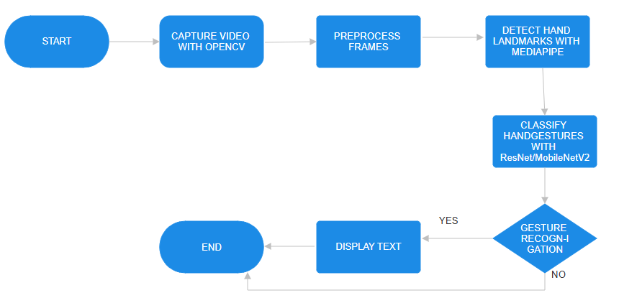

Slide 21
Software Requirements
Python 3.6.6
Tensorflow 1.11.0
OpenCV 3.4.3.18
NumPy 1.15.3
Matplotlib 3.0.0
VS code
Keras 2.2.1
PIL 5.3.0

Slide 22
Limitations of our model
The model works well only in good lighting conditions.
Plain background is needed for the model to detect with accuracy.

Slide 23
Conclusion
In conclusion, this project successfully developed a real-time sign language recognition system that accurately translates hand gestures into text and speech. Among the models tested, MobileNetV2 proved to be the most efficient, achieving 99.7% accuracy with fast inference and low computational cost, making it ideal for real-world applications on resource-constrained devices.

Slide 24
Future Scope
We are planning to achieve higher accuracy even in case of complex backgrounds by trying out various background subtraction algorithms.
We are also thinking of improving the preprocessing to predict gestures in low light conditions with a higher accuracy.

Slide 25
Thank You !

