Slide 1
Credit Card Fraud Detection
( CSE 506 )
Group 12
Team Members:
Dilip Kumar Gangwar (MT17012)
Suman Kumar (MT17060)
V.N.Dwaraka Mai (MT17067)

Slide 2
Why this project
Aim is to detect the 100% fraud transaction rather than having 99% accuracy and 0% fraud catch.
Simple Machine learning classifier work well on Balanced dataset, But what to do when classes are highly unbalanced.
Sensitive data comes in form of hidden form, so how to proceed with that.
In general, it is important to correctly classify all samples(high precision)
But problem like Credit Card Fraud detection, want to get all fraud case(high recall) rather than predicting correctly them

Slide 3
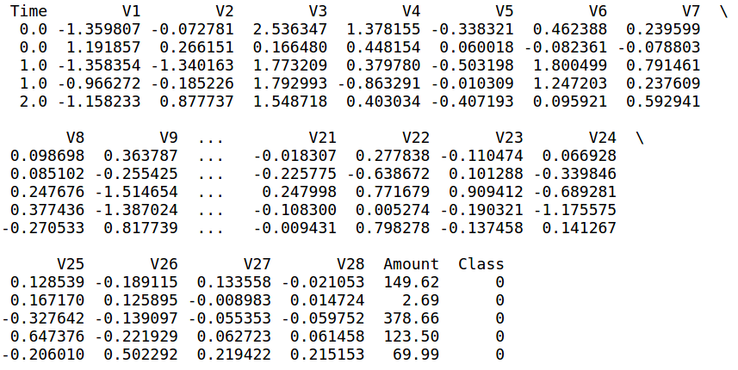
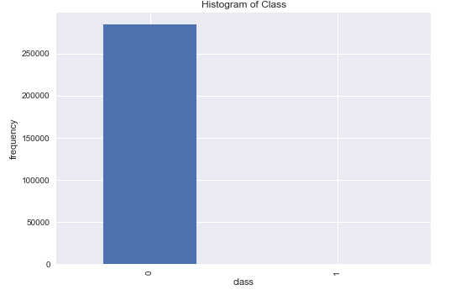
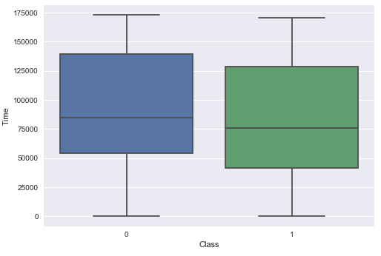
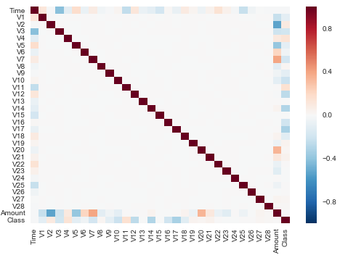
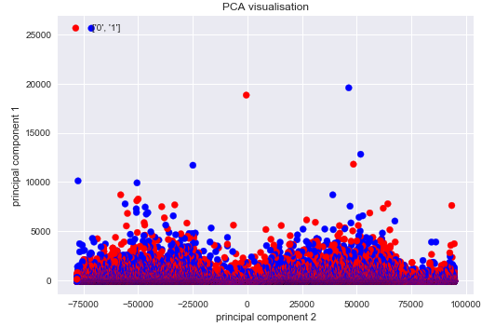
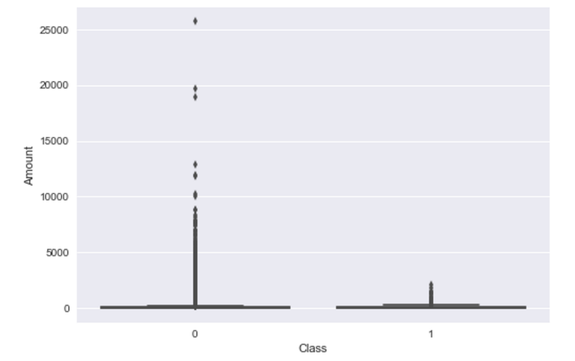
Exploratory Data Analysis

Slide 4
Methodology
Handling unbalanced dataset
Logistic Regression
Standard Scaler
Decision Tree
Random Forest
SMOTE(Over-sampling)
SVM
Logistic Regression
Logistic Regression
Decision Tree
Decision Tree
Random Forest
Random Forest
SVM
SVM

Slide 5
Result - 1
Data Type | Classifiers | Accuracy | Recall | Precision | F1-Score | ROC - AUC
Unbalanced Data | Logistic Regression | 99.8 | 56.4 | 74 | 64 | 78.2
 | Decision Tree | 99.9 | 80.1 | 74.3 | 77.1 | 90
 | Random Forest | 99.9 | 74.2 | 92.5 | 82.4 | 87.1
 | SVM | 99.8 | 36.6 | 75.5 | 49.3 | 68.3
After Standard Scaling | Logistic Regression | 99.9 | 63.3 | 87.6 | 73.5 | 81.6
 | Decision Tree | 99.9 | 80.1 | 74.3 | 77.1 | 90
 | Random Forest | 99.9 | 74.2 | 92.5 | 82.4 | 87.1
 | SVM | 99.8 | 36.6 | 75.5 | 49.3 | 68.3
After SMOTE | Logistic Regression | 97.5 | 94 | 6.3 | 11.8 | 95.7
 | Decision Tree | 99.7 | 82.1 | 45.3 | 58.4 | 91
 | Random Forest | 99.9 | 82.1 | 85.5 | 83.8 | 91.0
 | SVM | 99.8 | 46.6 | 65.5 | 54.4 | 69.3

Slide 6
Result - 2
Before applying SMOTE technique, Recall is low in all techniques.
After applying SMOTE technique, Recall is high which means model able to identify the true positive.
Also as the recall increases, accuracy is getting slightly lower. So we want to increase the true positive along with acceptable number of false positive.
We want to get more fraud transaction rather than higher accuracy, so Recall should be more and its there in result
Here precision is not important, but highly desirable.
F1 score is also not useful here as F1 score remain close to the minimum of recall and precision and as our aim is to find high recall.

Slide 7
Conclusion
Unbalanced dataset is very difficult to handle.
SMOTE technique able to increase the recall and perform better on crucial unbalanced dataset like fraud detection, insurance and banking
Accuracy and F1 score is not reliable in case of Unbalanced dataset
SMOTE and logistic regression gives the best result
Standard Scaling also help in higher recall

