Slide 1



Fault-Tolerant ADAS Sensor Fusion
State Level Hackathon
Sync · Thanjavur
IR + ultrasonic fusion on QNX SDP 8 and Raspberry Pi 4 that degrades gracefully when a sensor fails.

Slide 2



Problem Synthesis & Scenario
Design and Execution
The Scenario
Two sensors, two different blind spots
Low-cost ADAS prototypes trust a few cheap sensors. When one fails silently, the vehicle can report a clear road while an obstacle is right ahead.
Ultrasonic (HC-SR04)
Measures distance, 2 to 400 cm
echo timeout, soft or angled surfaces
Why determinism matters
A late or stale reading looks the same as ROAD CLEAR. Faults must be detected within a bounded time, so scheduling jitter becomes a safety risk.
Digital IR obstacle sensor
Obstacle yes / no, LOW means obstacle
sunlight, dark surfaces, stuck output
Success metric
Example conflict: IR = OBSTACLE but ultrasonic = 45 cm. Which one is right?
Any sensor fault or disagreement puts the system in DEGRADED mode, with a warning LED and no false ROAD CLEAR.
Fault or disagreement: DEGRADED mode, never a false ROAD CLEAR

Slide 3






QNX Architectural Approach
Design and Execution
Microkernel, isolated services
POSIX threads
Mutex-protected shared state
Drivers (i2c, spi, io-sock, wdtkick) run as separate user-space processes. Our qnx_adas_sf is one more protected process.
Main plus 6 worker threads: ultrasonic, IR, fusion, watchdog, logger and LED. Each has its own period and one job.
One data_mutex guards SensorData. Fusion copies a snapshot, then unlocks before any print or log: short critical sections.
Condvar producer-consumer
Deterministic time
Direct hardware access
log_event() writes to a 32-slot ring buffer and signals a condition variable. Only the logger touches the file; drops are counted, never blocked on.
CLOCK_MONOTONIC nanosecond stamps, EINTR-safe nanosleep periods, and deadline checks for stale data and missed heartbeats.
ThreadCtl(_NTO_TCTL_IO) and mmap(MAP_PHYS, PROT_NOCACHE) map the BCM2711 GPIO registers at 0xFE200000 for user-space I/O.
Priority setup
Today: all threads run at the default 10r (round-robin), as seen in Momentics. Hardening plan: SCHED_FIFO with Watchdog > Fusion > IR > Ultrasonic > LED/Logger, priority-inheritance mutexes, CPU affinity on the RPi 4 cores.

Slide 4
Technical Execution (Hardware & Logic)
Design and Execution
Ultrasonic HC-SR04
TRIG GPIO23, ECHO GPIO24
Ultrasonic thread
every 60 ms, 5-sample average
Shared SensorData
guarded by data_mutex
distance, IR state, validity, error counts, heartbeats, mode
Fusion thread, 200 ms
cross-check, then NORMAL or DEGRADED
Digital IR sensor
GPIO25, LOW = obstacle
IR thread
every 5 ms, 4-sample majority vote
Watchdog thread, 100 ms
heartbeat limits 0.5 s and 1 s
LED thread: GPIO18 blinks every 250 ms in DEGRADED
Logger: log_event() → 32-slot queue + condvar → logger thread → /tmp/adas_fault.log
Distance
Fusion rule
Disagreement check
d = echo time × 0.00001715 cm/ns (speed of sound ÷ 2). Valid range 2 to 400 cm; 3 bad reads in a row = fault.
NORMAL: obstacle = IR hit OR distance ≤ 10 cm, else ROAD CLEAR. Printed only when the result changes.
IR says obstacle but distance > 30 cm, or IR clear but distance < 10 cm: switch to DEGRADED.

Slide 5



Resilience & Degraded-Mode Response
Design and Execution
NORMAL
Both sensors valid and agree
OBSTACLE or ROAD CLEAR
LED off
DEGRADED
Fault reported and logged
LED blinks every 250 ms
ROAD CLEAR suppressed
What the monitors watch
any fault
Ultrasonic
3 bad reads in a row (30 ms echo timeout, outside 2 to 400 cm)
Stale data
no good sample for 1 s
all clear
Task stall
watchdog heartbeat missed: 0.5 s sensors, 1 s fusion
Disagreement
IR and distance conflict (10 cm and 30 cm limits)
Edge-triggered logging: each fault and recovery is logged once per change, so the event queue never floods.
Stuck check
unchanged for 10 s or 30 s: logged only, static scenes are normal
The stress
Mitigation
Recovery
The jury unplugs or blocks one sensor, or a thread stalls.
Validity checks, watchdog and cross-check flip to DEGRADED in about 0.5 s; the logger records it without blocking.
Automatic. First good reading plus the next 200 ms fusion cycle returns to NORMAL (about 0.3 s by design).

Slide 6
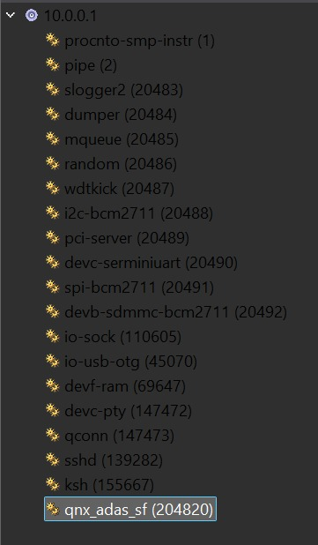
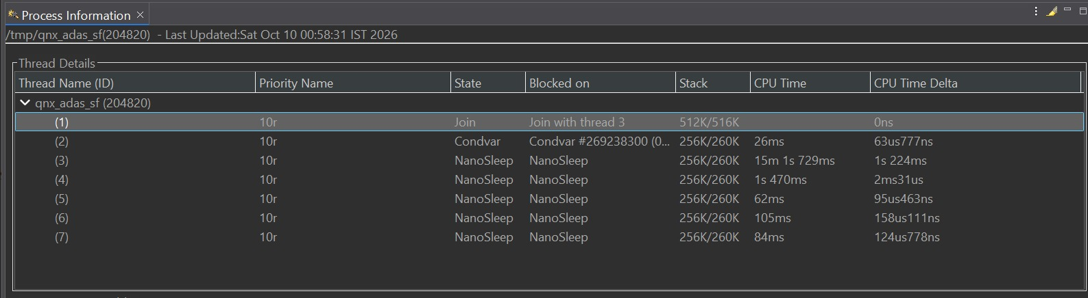
Performance Proof (The Profiler Slide)
Demonstration
7 threads
5 + 1
99.8%
Main in Join plus 6 workers, matching the design.
Five periodic threads sleep in NanoSleep; the logger blocks on a condvar.
of CPU time is in the ultrasonic thread (15 m 1 s): busy-wait echo timing.
Analysis: threads sleep between periods instead of spinning, so only echo timing is CPU-bound. Next step: a GPIO edge interrupt.
Target 10.0.0.1: qnx_adas_sf runs beside QNX services

Slide 7
Future Scalability & Conclusion
Demonstration
NOW
Working prototype
NEXT
RTOS hardening
LATER
Automotive grade
IR + ultrasonic fusion on RPi 4
6 pthreads, mutex, condvar logger
Watchdog, DEGRADED mode, warning LED
SCHED_FIFO priorities, priority-inheritance mutexes
CPU affinity on RPi 4 cores
GPIO edge interrupts replace busy-wait
HAM restarts a failed sensor service
Sensors as separate processes with QNX message passing
Camera + radar with confidence-weighted fusion
ISO 26262 path with QNX OS for Safety
Learning outcome
CLOSING STATEMENT
Static scene or stuck sensor? Constant readings can be valid, so we log a suspicion and degrade only on hard faults.
Slow file I/O must never block a time-critical thread: condvar queue plus a dedicated logger.
The profiler exposed busy-wait echo timing as the CPU hot spot.
A vehicle that knows when it cannot trust its sensors.
Deterministic detection. Graceful degradation. Built on QNX.

