Slide 1
Clue Keeper
Group – 08 (Section – 03)

Slide 2
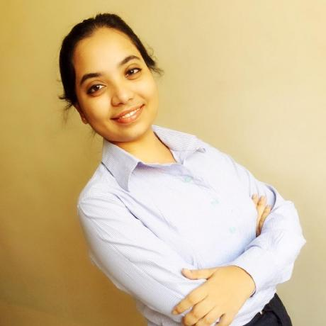

Sri Sudheera Sumana Reddy
About Team

Slide 3

Objective and Stack
PostgreSQL
Express
Sequelize
Node.js

Slide 4
Repo Link & Heroku Link
Repo: https://github.com/sumana-reddy/FSA-group8
Heroku: https://fsa-group8.herokuapp.com/

Slide 5
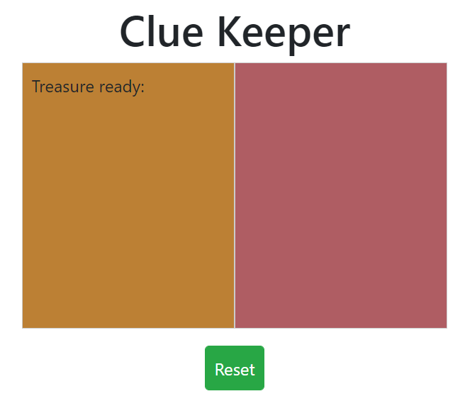
About the project
The main objective of this project is finding the treasure that is in different locations.
For that you will need to go the main page and click on the 1st color (i.e. , left hand side) to get the location of the treasure as shown below.

Slide 6
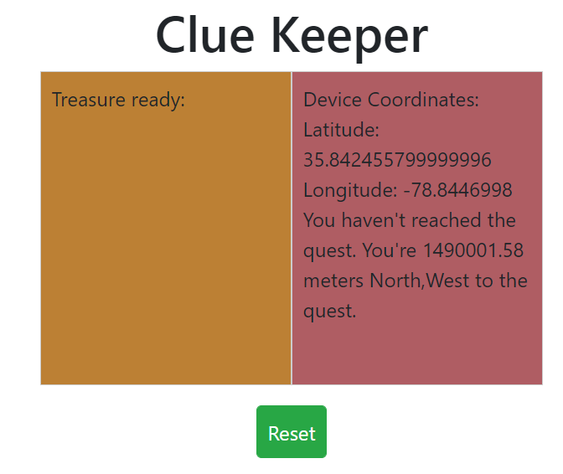
Then start walking through that location and when you clock on the 2nd color(i.e. , right hand side) to get the current coordinates of the location and it tells whether you are near to the treasure location or not.
If not reached you will get a speech that “You have not reached the quest.”
If you have reached the quest, you will get a speech saying “Congratulations!! You have reached the quest.”

Slide 7

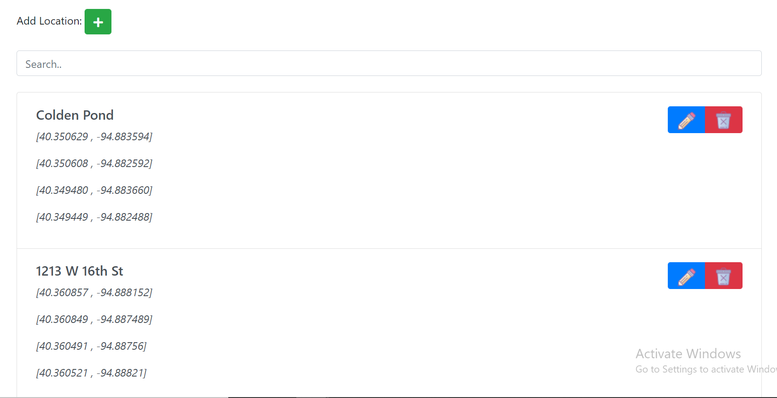
Also, you can get the locations list from the navbar as shown.
When you click on Location List, you will get the list of locations as shown

Slide 8
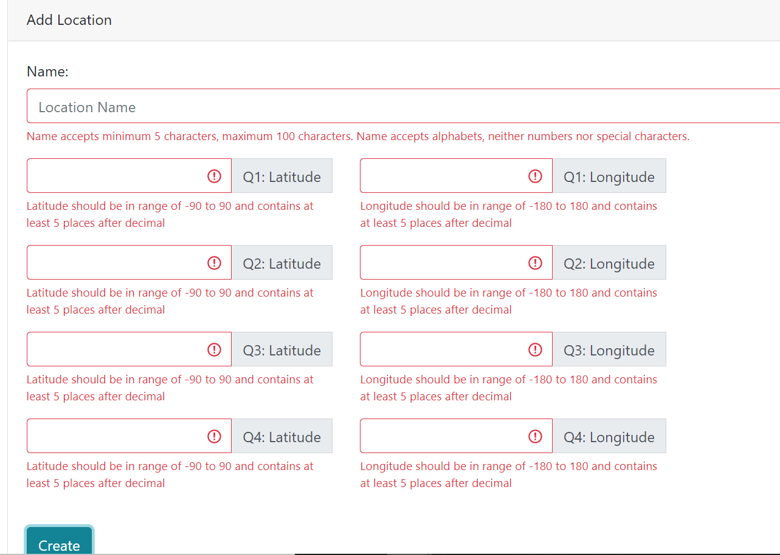
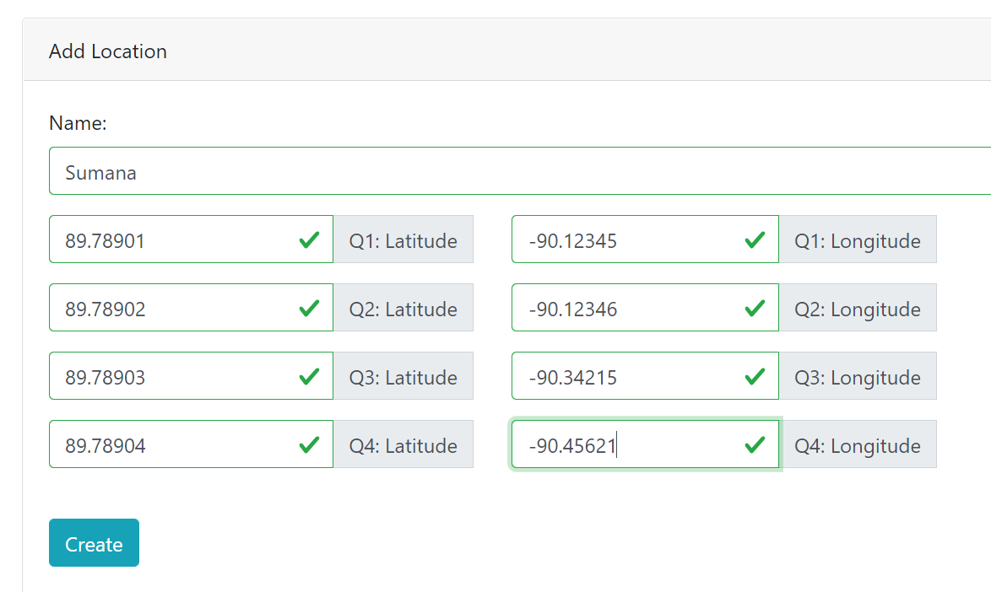
Add new Location & Validations

Slide 9
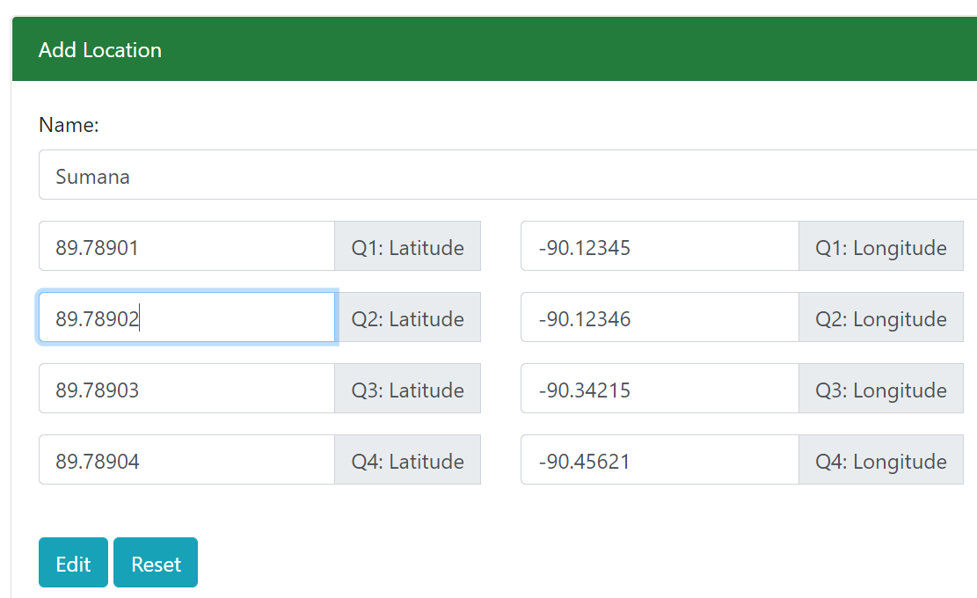
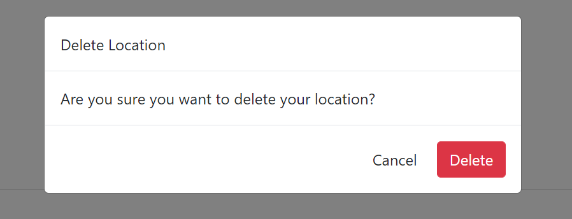
Edit & Delete Location
You can edit the location by clicking on edit icon and changing the coordinates and name of the location and click reset button.
To delete the location, click on delete icon and a pop up appears saying “are you sure you want to delete the location”. If yes you can click on delete or else, you can cancel.

Slide 10

Thank You!!

