Slide 1
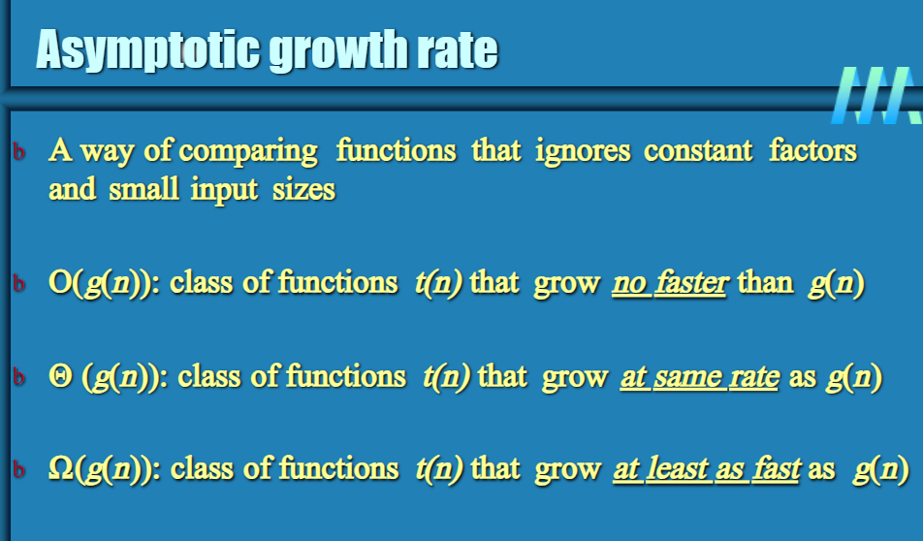

Slide 2
O-notation Definition: A function t(n) is said to be in O(g(n)), denoted t(n) ∈ O(g(n)), if t(n) is bounded above by some constant multiple of g(n) for all large n, i.e., if there exist some positive constant c and some nonnegative integer n0 such that t(n) ≤ cg(n) for all n ≥ n0
Ω-notation Definition: A function t(n) is said to be in Ω(g(n)), denoted t(n) ∈ Ω(g(n)), if t(n) is bounded below by some constant multiple of g(n) for all large n, i.e., if there exist some positive constant c and some nonnegative integer n0 such that t(n) ≥ cg(n) for all n ≥ n0
Θ-notation Definition: A function t(n) is said to be in Θ(g(n)), denoted t(n) ∈ Θ(g(n)), if t(n) is bounded both above and below by some constant multiples of g(n) for all large n, i.e., if there exist some positive constant c1 and c2 and some nonnegative integer n0 such that c2g(n) ≤ t(n) ≤ c1g(n) for all n ≥ n0.

Slide 3
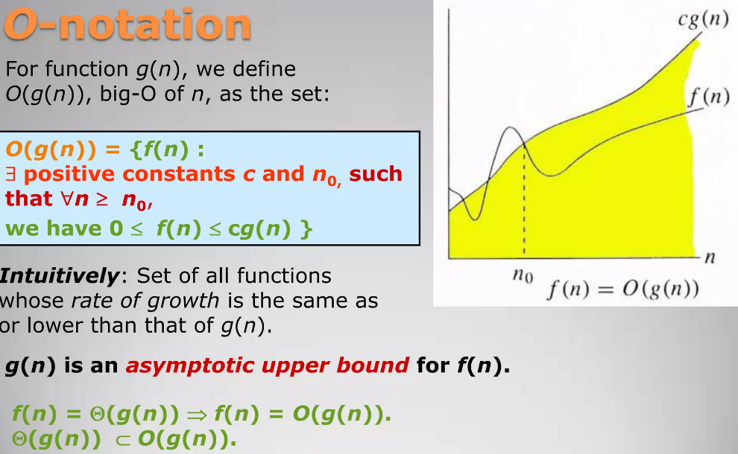

Slide 4
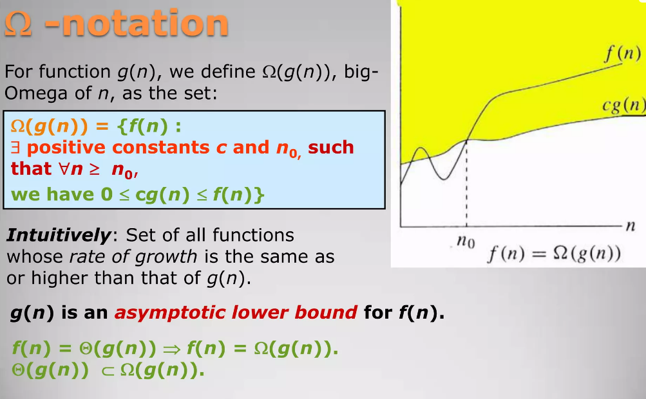

Slide 5
