Slide 1
DeepREAP
Integrating Regressive Ensemble Demand Prediction
with Deep Reinforcement Learning for Cloud Resource Allocation
Suma Nagral · Raghav Sharma
San José State University
Forecast-conditioned SJF imitation · latency–throughput operating point

Slide 2
The problem
Cloud allocation under dynamic demand
• Cloud resource allocation trades per-job latency against cluster throughput.
• SMEs feel this without hyperscale slack or dedicated capacity-planning staff.
• Two ML families address it separately:
• DRL schedulers (DeepRM / DeepRM_Plus) react to current cluster state.
• Regression ensembles (REAP) forecast future demand from telemetry.
• They are complementary — reactive vs anticipatory — but seldom combined.
DeepREAP · SJSU CMPE
2 / 12

Slide 3
The integration axis
What the scheduler knows about the future
Vanilla DRL
DeepREAP
• Observes current cluster load
• Sees the visible job queue
• No demand forecast in state
• Policy is purely reactive
• Same cluster + job image
• Plus REAP forecast channels
• Fused into state — not a hand-coded priority score
• Policy learns how much to trust the forecast
DeepREAP · SJSU CMPE
3 / 12

Slide 4
Research questions & contributions
Research questions
• RQ1 — How can REAP forecasts enter DeepRM_Plus state without a hand-coded predictor–scheduler contract?
• RQ2 — What latency / completion / throughput operating point does that integration produce, and which training regime realises it?
Contributions
• (i) Working DeepREAP system: REAP forecasts fused into a DeepRM-style CNN state, with REST + monitoring.
• (ii) Twin evaluation: forecast channels are the only difference → slowdown 8.27 / completion 19.04 vs 19.30 / 43.41.
• (iii) Practical recipe: SJF imitation with forecast-augmented state; short PPO does not improve it here.
DeepREAP · SJSU CMPE
4 / 12

Slide 5
Pipeline
Four stages; forecasts fused into state before the policy
1. Workload
2. REAP
3. State fusion
4. CNN policy
60-day telemetry
3,000-job Poisson trace
→
GA features →
5 regressors → inv-MSE
→
Cluster + jobs
⊕ CPU/mem forecasts
→
SJF imitation →
PPO (15 updates)
• Design choice: fuse forecasts into the state image — no hand-coded priority contract.
• Twin protocol: DeepREAP vs DeepRM_Plus differ only in those forecast channels.
• Environment: 2 resources × capacity 10, horizon T=20, M=5 visible jobs.
DeepREAP · SJSU CMPE
5 / 12

Slide 6
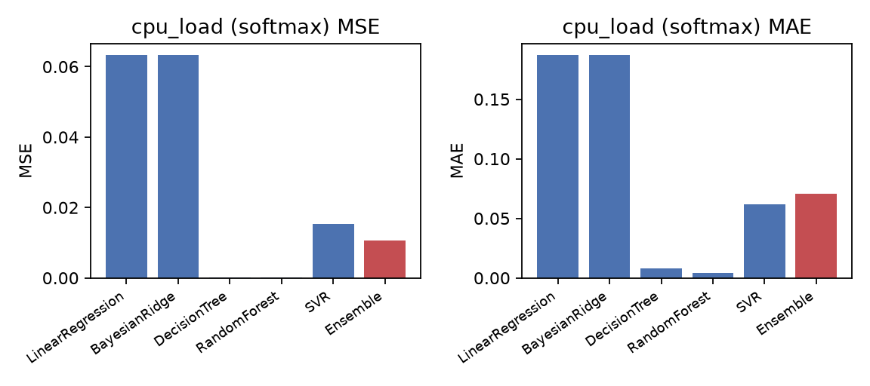
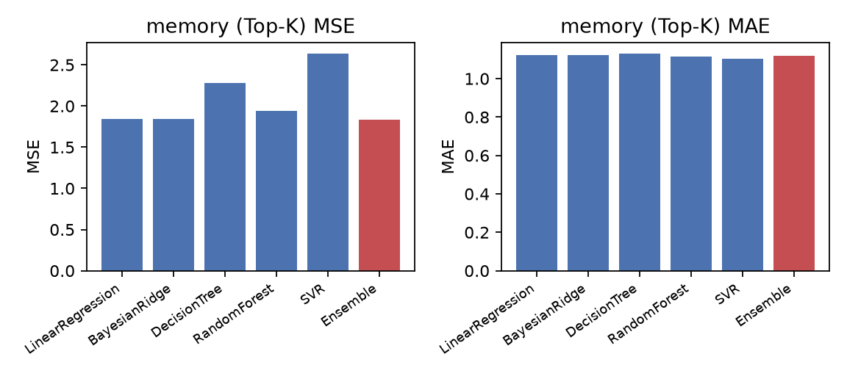
REAP prediction accuracy
60-day synthetic trace — ensemble vs base regressors
CPU: ensemble MSE 8.07 — best of all models. Memory: competitive (25.04) but SVR alone wins (24.49).
DeepREAP · SJSU CMPE
6 / 12

Slide 7
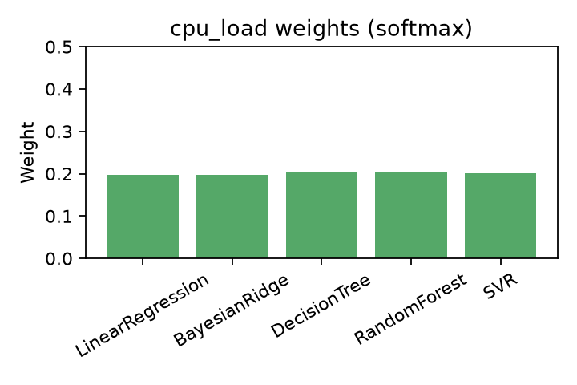
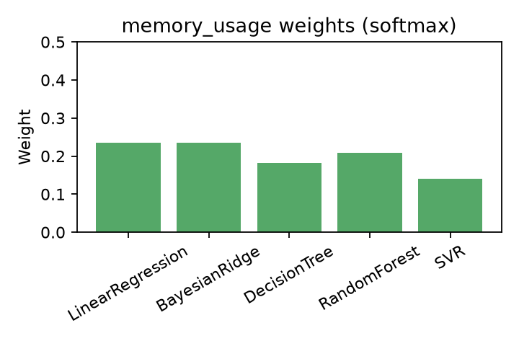
Why memory is competitive, not dominant
Inverse-MSE weights stay nearly flat
• Weights span only ~0.13–0.23 → weaker models keep non-trivial mass.
• Reasonable default when the best base model is unknown; sharper weighting is a natural next step.
DeepREAP · SJSU CMPE
7 / 12

Slide 8
Key result: twin ablation
Forecast channels are the only manipulated factor
8.27
19.30 → 8.27
19.04
DeepREAP slowdown
(imitation)
Slowdown with forecasts
vs DeepRM_Plus twin
Avg completion (slots)
vs 43.41 twin
Shared job trace (seed 123), 201-step budget, shared training recipe
FIFO / SJF / Packer
slowdown 18.76–20.20
completion ~48–50
DeepRM_Plus (imitation)
19.30
43.41
DeepREAP (imitation)
8.27 ← best
19.04 ← best
DeepREAP (PPO, 15 upd.)
18.12
42.05
DeepREAP · SJSU CMPE
8 / 12

Slide 9
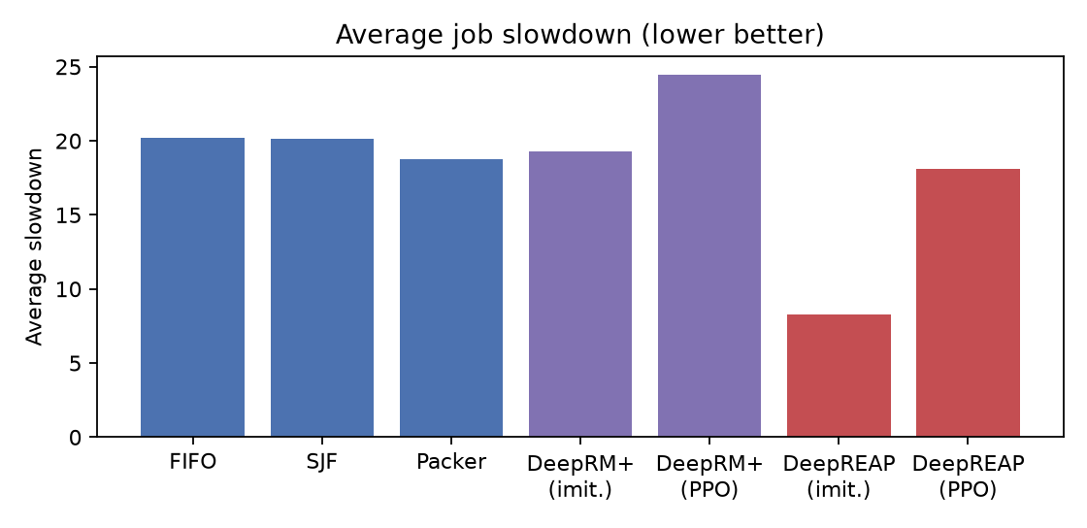
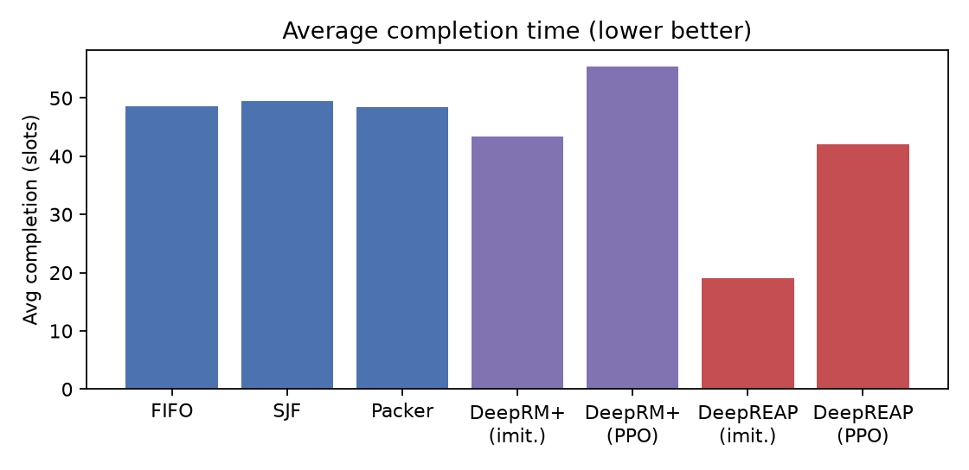
Scheduling metrics
Lower is better — DeepREAP-imitation leads on both latency metrics
Heuristics cluster ~18–20 slowdown; forecast-conditioned imitation is the clear latency winner.
DeepREAP · SJSU CMPE
9 / 12

Slide 10
Latency–throughput operating point
Not a claim of higher work-conserving throughput
25 jobs
52–54
−446.4
DeepREAP completed
in 201 steps
Heuristic n_done
(same budget)
Worst total reward
(backlog still charged)
• Policy defers long jobs into windows where REAP anticipates spare headroom.
• Finished jobs are much faster (slowdown / completion); raw throughput drops.
• Reward sums over all resident jobs — including backlog — so it is not a proxy for scheduling quality alone.
• Dollar cost = a rate card on this table; we leave the rate unspecified.
DeepREAP · SJSU CMPE
10 / 12

Slide 11
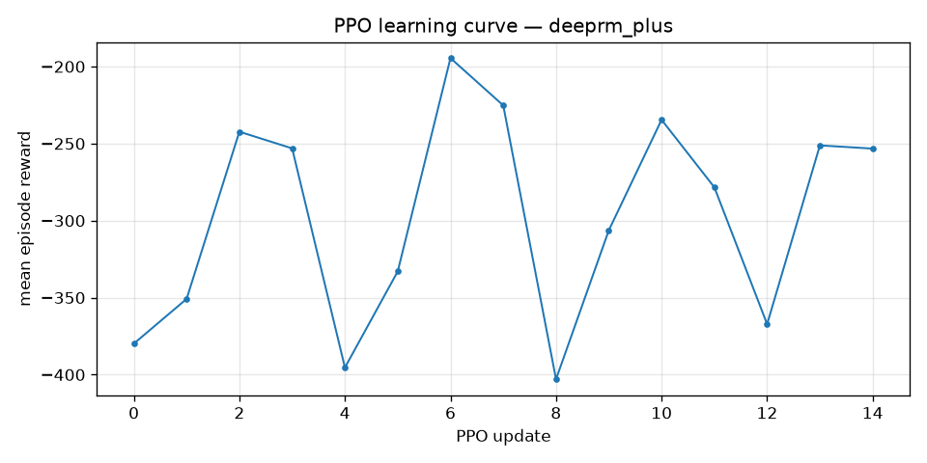
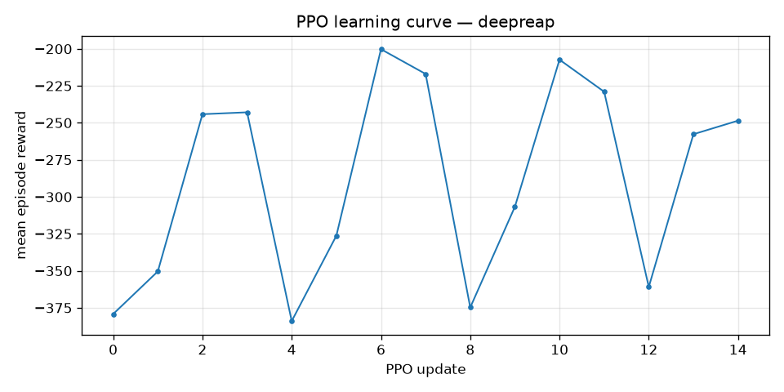
Training dynamics
Short PPO does not improve on imitation at this budget
• 15 PPO updates (~1.5×10⁴ transitions): reward oscillates; no clear upward trend.
• Reported recipe: forecast-conditioned SJF imitation. Whether larger PPO helps remains open.
DeepREAP · SJSU CMPE
11 / 12

Slide 12
Takeaways
Narrow, defensible claim
• DeepREAP = state-fusion of REAP forecasts into a DeepRM-style scheduler.
• Under controlled synthetic short-horizon eval, SJF imitation with forecasts reaches slowdown 8.27 and completion 19.04 — vs 19.30 / 43.41 for the no-forecast twin.
• That win is a latency–throughput operating point (fewer jobs finished under a fixed step budget).
• REAP ensemble wins on CPU load; competitive but not dominant on memory.
• Limitations: synthetic trace, fixed seed/trace, fixed horizon — public traces and longer drains are next.
Not “predictive DRL always wins” — a quantified forecast-in-state operating point under a fixed protocol.
DeepREAP · SJSU CMPE
12 / 12

