Slide 1



A CENTER FOR INTER-DISCIPLINARY RESEARCH
2021-22
TITLE
“FLIGHT FAIR PREDICTION USING RANDOM FOREST”
SUPERVISED BY
PRAGNA DATLA
GOKARAJU RANGARAJU
INSTITUTE OF ENGINEERING AND TECHNOLOGY
AUTONOMOUS

Slide 2
Advanced Academic Center
( A Center For Inter-Disciplinary Research )
This is to certify that the project titled
“FLIGHT FAIR PREDICTION USING RANDOM FOREST”
is a bonafide work carried out by the following students in partial fulfilment of the requirements for Advanced Academic Center intern, submitted to the chair, AAC during the academic year 2021-22.
NAME | ROLL NO. | BRANCH
MALLELA MOUNIKA REDDY | 20241A12E7 | IT
MEDISHETTY SUMANA | 20241A12F1 | IT
NIKHIL NYALAKANTI | 20241A12G0 | IT

Slide 3
NAME | ROLL N0 | BRANCH
SWALENKA SAI SHRADDHA | 20241A12H1 | IT
UPPU AKSHAY | 20241A12H5 | IT
YAMADRI AMBIKA | 20241A12H9 | IT
This work was not submitted or published earlier for any study
Dr/Ms./Mr.
Dr.B.R.K.Reddy
Program Coordinator
Dr. G. Ramesh
Dean, AAC
Project Supervisor

Slide 4
ACKNOWLEDGEMENTS
We express our deep sense of gratitude to our respected Director, Gokaraju Rangaraju Institute of Engineering and Technology, for the valuable guidance and for permitting us to carry out this project.
With immense pleasure, we extend our appreciation to our respected Principal, for permitting us to carry out this project.
We are thankful to the Associate Dean, Advanced Academic Centre, for providing us an appropriate environment required for the project completion.
We are grateful to our project supervisor who spared valuable time to influence us with their novel insights.
We are indebted to all the above mentioned people without whom we would not have concluded the project.

Slide 5
ABSTRACT
With the advent of the aviation travel industry, a large number of datamining technologies have been developed to increase profits for airlines in the past two decades. The implementation of the digital optimization strategy leads to price discrimination, for example, similar seats on the same flight are purchased at different prices, depending on the time of purchase, the supplier, and so on. Price fluctuations make the prediction of ticket prices have application value. For this project, Random forest algorithm is used to predict the price of an air ticket. The experimental results show that the model is more reliable by comparing the forecasting results with the actual results of each price model. The model is helpful for passengers to buy tickets and to save money.
Analyzing the flight fare prediction using Machine Learning dataset using essential exploratory data analysis techniques then will draw some predictions about the price of the flight based on some features such as what type of airline it is, what is the arrival time, what is the departure time, what is the duration of the flight, source, destination and more.

Slide 6

INTRODUCTION
The tourism industry is changing fast and this is attracting a lot more travelers each year. The airline industry is considered as one of the most sophisticated industries in using complex pricing strategies.
Now-a-days flight prices are quite unpredictable. Pricing alters dynamically owing to many variables, making it difficult for airlines to maintain prices. The ticket prices change frequently. Customers are seeking to get the lowest price for their ticket, while airline companies are trying to keep their overall revenue as high as possible.
Using technology it is actually possible to reduce the uncertainty of flight prices. So here we will be predicting the flight fair using efficient machine learning techniques. This can assist airlines in determining what rates they can keep. Customers can also use it to forecast future airline prices and plan their trips appropriately.

Slide 7
Introduction to Machine Learning
Machine learning (ML) is the study of computer algorithms that can improve automatically through experience and by the use of data. It is seen as a part of artificial intelligence. Machine learning algorithms build a model based on sample data, known as "training data", in order to make predictions or decisions without being explicitly programmed to do so. Machine learning algorithms are used in a wide variety of applications, such as in medicine, email filtering, speech recognition, and computer vision, where it is difficult or unfeasible to develop conventional algorithms to perform the needed tasks. Machine learning involves computers discovering how they can perform tasks without being explicitly programmed to do so. It involves computers learning from data provided so that they carry out certain tasks. For simple tasks assigned to computers, it is possible to program algorithms telling the machine how to execute all steps required to solve the problem at hand; on the computer's part, no learning is needed. For more advanced tasks, it can be challenging for a human to manually create the needed algorithms. In practice, it can turn out to be more effective to help the machine develop its own algorithm, rather than having human programmers specify every needed step.
Data in ML
Data can be any unprocessed fact, value, text, sound or picture that is not being interpreted and analyzed. Data is the most important part of all Data Analytic, Machine Learning, Artificial Intelligence. Without data, we can’t train any model and all modern research and automation will go vain.
Types of Data in ML:
Training Data: The part of data we use to train our model. This is the data which your model actually sees(both input and output) and learn from.
Validation Data: The part of data which is used to do a frequent evaluation of model, fit on training dataset along with improving involved hyperparameters (initially set parameters before the model begins learning). This data plays it’s part when the model is actually training.
Testing Data: Once our model is completely trained, testing data provides the unbiased evaluation. When we feed in the inputs of Testing data, our model will predict some values(without seeing actual output). After prediction, we evaluate our model by comparing it with actual output present in the testing data.

Slide 8
ML Algorithms
An “algorithm” in machine learning is a procedure that is run on data to create a machine learning “model.” Machine learning algorithms perform “pattern recognition.” Algorithms “learn” from data, or are “fit” on a dataset. There are many machine learning algorithms.
Classification in ML:
Classification is the task of “classifying things” into sub-categories. Classification is of two types:
Binary Classification : When we have to categorize given data into 2 distinct classes. Example – On the basis of given health conditions of a person, we have to determine whether the person has a certain disease or not.
Multi class Classification : The number of classes is more than 2. For Example – On the basis of data about different species of flowers, we have to determine which specie does our observation belong to.
Types of Classifiers (Algorithms): There are various types of classifiers. Some of them are :
Linear Classifiers : Logistic Regression.
Tree Based Classifiers : Decision Tree Classifier.
Support Vector Machines.
Artificial Neural Networks.
Bayesian Regression.
Gaussian Naive Bayes Classifiers.
Stochastic Gradient Descent (SGD) Classifier.
Ensemble Methods : Random Forests, AdaBoost, Bagging Classifier, Voting
Classifier, ExtraTrees Classifier
Random Forest:
Every decision tree has high variance, but when we combine all of them together in parallel then the resultant variance is low as each decision tree gets perfectly trained on that particular sample data and hence the output doesn’t depend on one decision tree but multiple decision trees. In the case of a classification problem, the final output is taken by using the majority voting classifier. In the case of a regression problem, the final output is the mean of all the outputs. This part is Aggregation.
Step 1 : Import the required libraries.
Step 2 : Import and print the dataset

Slide 9
Step 3 : Select all rows and column 1 from dataset to x and all rows and column 2 as y
Step 4 : Fit Random forest regressor to the dataset
Step 5 : Predicting a new result
Step 6 : Visualizing the result
Applications of ML:
Machine Learning in Education
Advances in AI are enabling teachers to realize a far better understanding of how their students are progressing with learning. AI will make big and positive changes in education helping students to enjoy the training process and have a far better understanding with their teachers. Students will not feel apprehensive towards their teachers and be frightened of being judged.
b. Machine learning in Search Engine
Search engines rely on machine learning to improve their services is no secret today. Implementing these Google has introduced some amazing services. Such as voice recognition, image search and many more. Google services like its image search and translation tools use sophisticated machine learning which permit computers to ascertain , listen and speak in much an equivalent way as human do.
c. Machine Learning in Digital Marketing
This is where machine learning can help significantly. Machine Learning is being implemented in digital marketing departments round the globe It allows a more relevant personalization. Thus, companies can interact and engage with the customer. As consumer expectations grow for more personalized, relevant, and assistive experiences, machine learning is becoming a useful tool to assist meet those demands. Sophisticated segmentation focus on the appropriate customer at the right time. Also, with the right message.
d. Machine Learning in Health Care
Machine learning, simply put, may be a sort of AI when computers are programmed to find out information without human intervention. The foremost common healthcare use cases for machine learning are automating medical billing, clinical decision support and therefore the development of clinical care guidelines. More importantly, scientists and researchers are using machine learning (ML) to churn out variety of smart solutions which will ultimately help in diagnosing and treating an illness

Slide 10
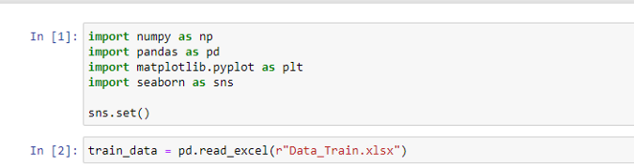
PROJECT WORKFLOW
In the project workflow we are going to walk through how we trained a model that predict the prices of air tickets.
Flight ticket prices can be something hard to guess. We have been provided with prices of flight tickets for various airlines between the months of March and June of 2019 and between various cities, using which we aim to build a model which predicts the prices of the flights using various input features.
We have 2 datasets here — training set and test set.
The training set contains the features, along with the prices of the flights. It contains 10683 records, 10 input features and 1 output column —‘Price’.
The test set contains 2671 records and 10 input features. The output ‘Price’ column needs to be predicted in this set. We used Regression techniques here, since the predicted output will be a continuous value.
Following is the features available in the dataset – Airline, Date_of_Journey, Source, Destination,
Route, Dep_Time, Arrival_Time ,Duration, Total_Stops, Additional_Info, Price.
All the Lifecycle In A Data Science Project is divided into four parts:
Exploratory Data Analysis
Feature Engineering
Feature selection
Model Deployment
Exploratory Data Analysis
Now, let’s start with the task of machine learning to predict Flight fare. We import all the necessary libraries that we need for this task and import the train dataset.
1) Importing libraries
2) Importing the dataset

Slide 11
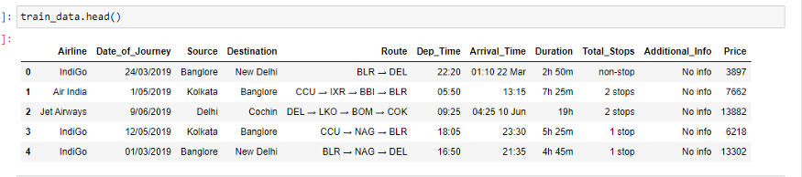
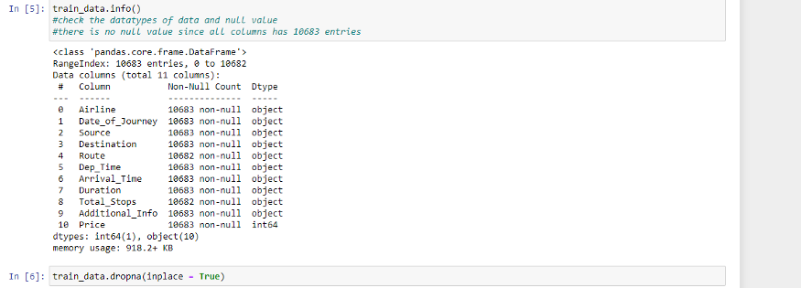
All correlations within the variables and the output ‘price’ were monitored.
The Route column contains a list of cities which are need to be separated, since that have multiple combinations in our dataset.
The Arrival_time column has dates attached along with, which are need to be separated.
The Duration, Date_of_Journy column are in a string format, which need to convert to integer type.
The Total_stops column has word ‘stops’ added along with the number of stops, and Dep_Time, Duration columns are also not in an appropriate form which are need to be converted into integer.
Data Analysis includes:
Missing Values in the dataset.
2. All the Numerical variables and Distribution of the numerical variables
3. Categorical Variables
4. Outliers
5. Relationship between an independent and dependent feature(price)

Slide 12
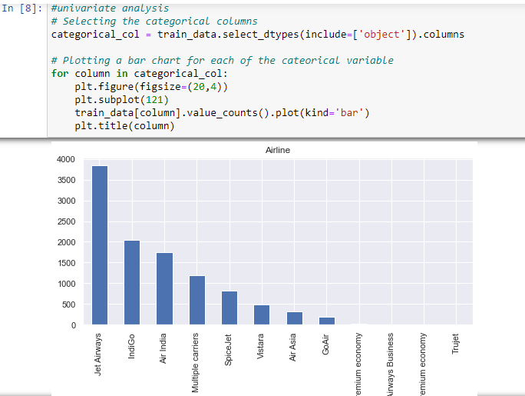
There is no missing value in our train dataset because all columns has 10683 entries.As in train_data.info() all the dependent column are “object” datatype so as to use these columns properly for model convert these datatype into appropriate form. Exploratory data analysis is cross-classified in two different ways where each method is either graphical or non-graphical. And then, each method is either univariate, bivariate or multivariate.
Univariate Analysis
In univariate analysis, there is only one dependable variable. The objective of univariate analysis is to derive the data and analyze the pattern present in it. here in a train dataset, it explores each categorical columns separately.
The bar graph is very convenient while comparing categories of data . It helps to track changes over time. It is best for visualizing discrete data.

Slide 13
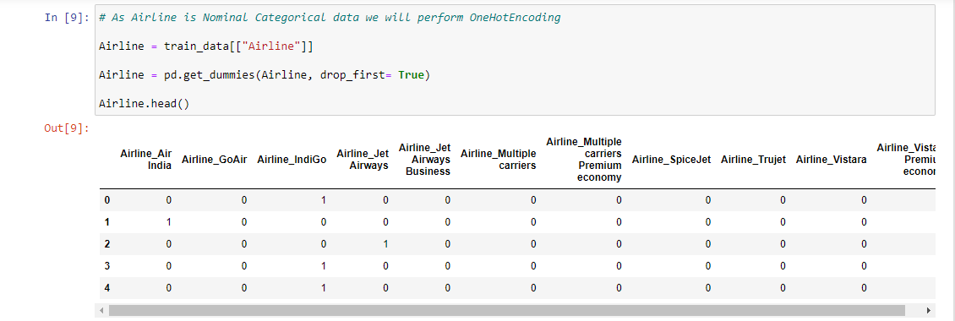
Jet Airways is the most preferred airline with the highest row count, followed by Indigo and Air India. Jet Airways business is the costliest airways.
Count for Vistara Premium economy, Trujet, Multiple carries premium economy and Jet airways business is quite low.
Feature Engineering
These are the steps in Feature Engineering:
Substitution of Categorical variables
All the columns are as ‘object’ data types, and only ‘Price’ column is of integer type. One can find many ways to handle categorical data. Some of them categorical data are,
Nominal data→ data are not in any order → OneHotEncoder is used in this case
Ordinal data → data are in order → Label Encoder is used in this case.
Airline column has 12 unique values — ‘IndiGo’ , ‘Air India’, ‘Jet Airways’ , ‘SpiceJet’ , ‘Multiple carriers’ , ‘GoAir’, ‘Vistara’, ‘Air Asia’, ‘Vistara Premium economy’ , ‘Jet Airways Business’, ‘Multiple carriers Premium economy’, ‘Trujet’.
Airline column is nominal categorical data and there is less cardinality, so One Hot Encoding is performed.
From .info() we know that Date_of_Journey is a object data type. To deal with this categorical data we use feature extraction method where we derived new features using Date_of_Journey .For this we require pandas to_datetime to convert object data type to datetime dtype.so we get two new feature that is:
Day_of_Journey 2. month_of _Journey
Similary, we extract values from Dep_Time and Arrival_Time and create separate columns for departure hours[”Dep_hour”] and minutes [“Dep_min”], Arrival_hour, Arrival_min.

Slide 14
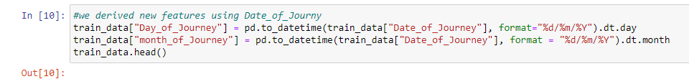
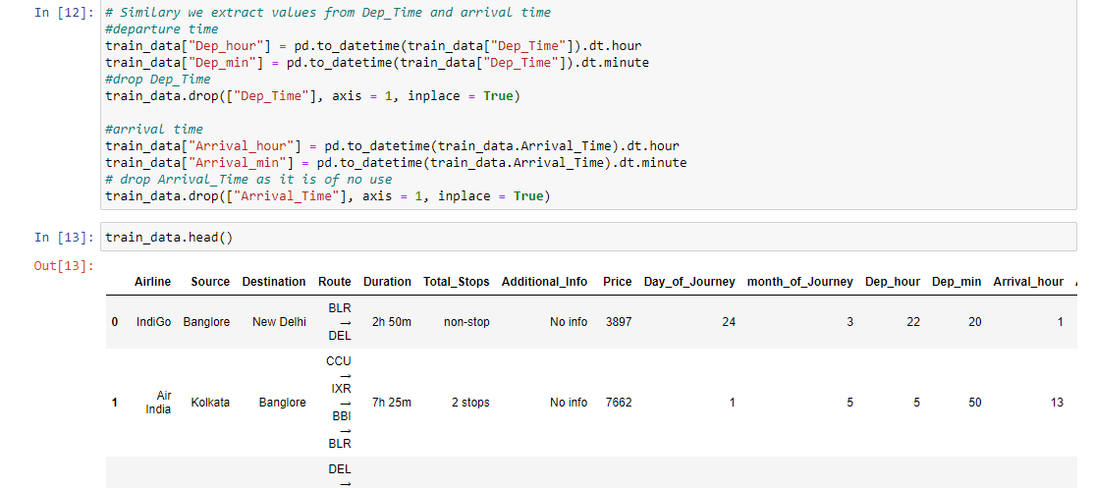
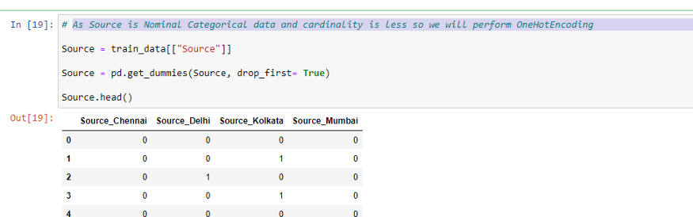
Since we have converted Date_of_Journey, Dep_Time and Arrival_Time columns into integers, Now we can drop it as it is of no use.
Duration column is not in an appropriate form to help predict machine learning model. We have to bring it in a same format. There in dataset some flight duration could be just “30m” so write it as “0h 30m” .So we extract two new columns “Duration hours” and “Duration_mins” from “Duration”.
Source column has 5 unique values — ‘Bangalore’, ‘Kolkata’, ‘Chennai’, ‘Delhi’ and ‘Mumbai’. As Source is Nominal Categorical data and cardinality is less so we will perform OneHotEncoding.

Slide 15
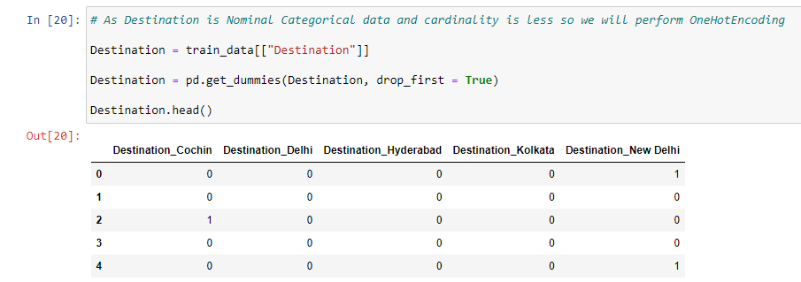
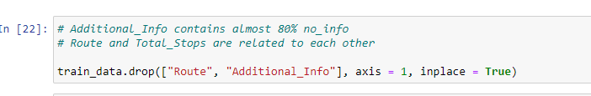
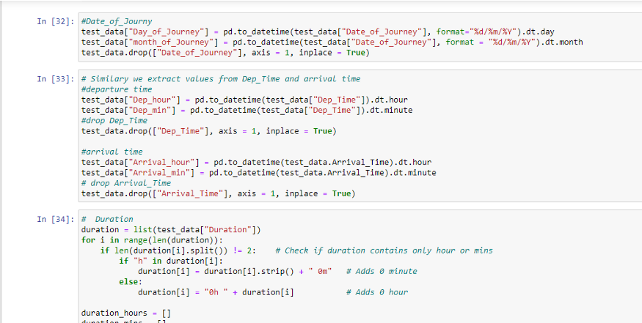
Destination column has 6 unique values — ‘New Delhi’, ‘Banglore’, ‘Cochin’, ‘Kolkata’, ‘Delhi’ , ‘Hyderabad’. Destination is Nominal Categorical data and cardinality is less so OneHotEncoding is performed.
Additional_Info contains almost 80% no_info ,also Route and Total_Stops are related to each other. so both the columns are dropped.
Total_Stops has 5 unique value — ‘1 stop’ , ‘’ , ‘2 stops’ , ‘3 stops’ , ‘4 stops’. In this is case of Ordinal Categorical type we perform Label Encoder. Values are assigned with corresponding keys.
The train and test data is already stored in different file . The test dataset and train dataset are not combined which could lead data leakage .
Similarly, all feature engineering that we did for train dataset same we will do for test dataset.

Slide 16
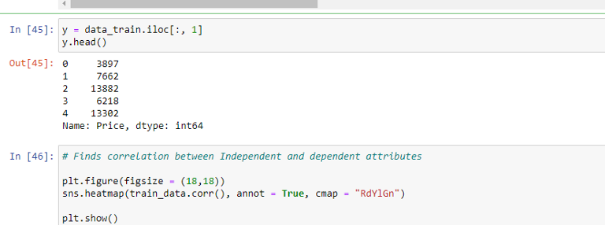
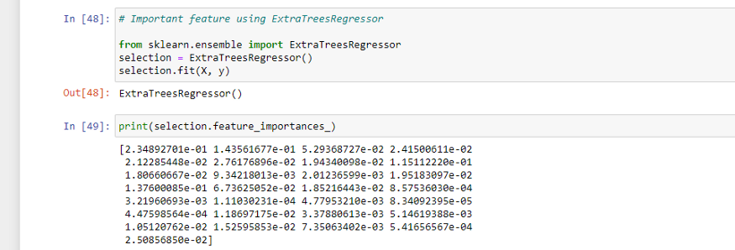
Feature Selection
Model Training:
We used Extra tree Regressor, Random Forest Regression Model (Feature Selection) on the train set. We drop the “price” column from train dataset and make (y)independent variable to find correlation between dependent and independent data. After cleaning the data,
visualize the data and better understand the relationships between different variables. There are many more visualizations like scatterplots, histograms, boxplots, etc .
Using sns.heatmap(), the ‘Total_Stops’ is positively correlated with ‘Price’ which leads to increase in cost of fuel and increase the price. Also Total_stops is highly correlated with Duration_hours means if the no.of stops would increase, the duration hours of the flight will also increase.
ExtraTreesRegressor model

Slide 17
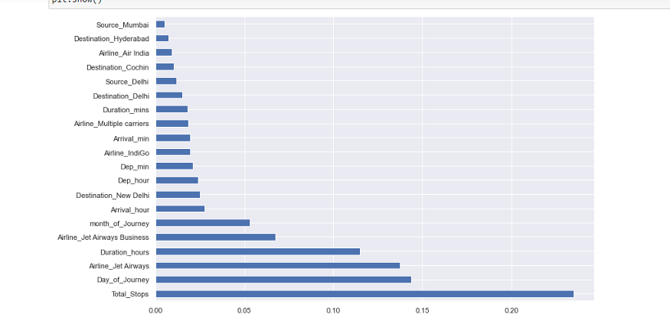
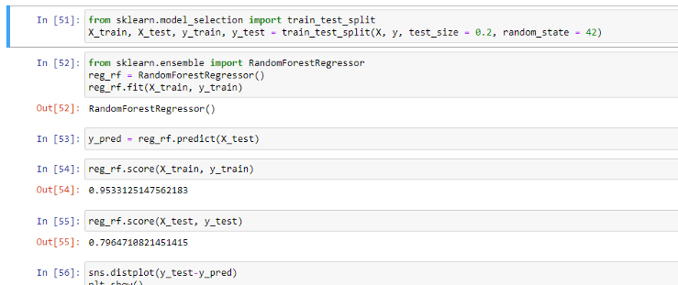
The total_stops is the feature with the highest feature importance in deciding Price.
Fitting model using Random Forest
Fitting parametric distributions
We also used distplot()to fit a parametric distribution to a dataset and visually evaluate how closely it corresponds to the observed data. it should be a closed Gaussian distributed graph and the difference between ‘y_test’(real value)and ‘predictions’ should also be minimal.Here most of the residuals are 0, which means our model is generalizing well.

Slide 18
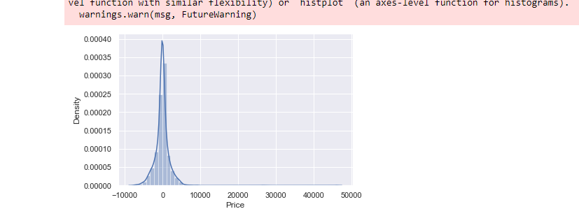
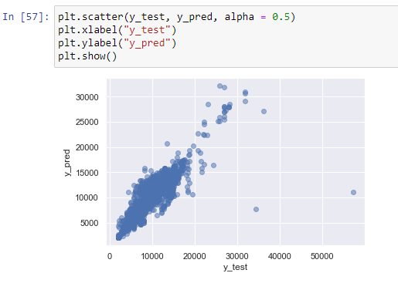
Plotting y_test vs predictions.
Scatter plots are used to observe relationships between variables and uses dots to represent the relationship between them. here points are nearly aligned in a line.

Slide 19
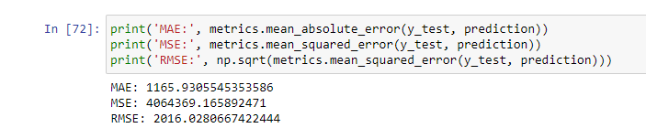
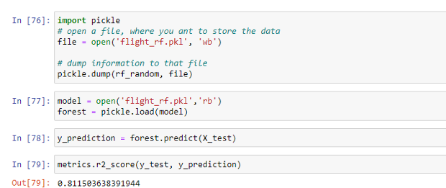
Hyperparameter Tuning
We used the Randomized SearchCV for the best hyperparameters. A random search of parameters, using 5 fold cross-validation search across 100 different combinations.
Checking accuracy of the model
Evaluating the model accuracy is an essential part of the process of creating machine learning models to describe how well the model is performing in its predictions. The MSE, MAE, and RMSE metrics are mainly used to evaluate the prediction error rates and model performance in regression analysis.
MAE (Mean absolute error) represents the difference between the original and predicted values extracted by averaged the absolute difference over the data set.
MSE (Mean Squared Error) represents the difference between the original and predicted values extracted by squared the average difference over the data set.
RMSE (Root Mean Squared Error) is the error rate by the square root of MSE.
Regressor saved as pickle file for faster execution speed in future.
Saving model

Slide 20
Model Deployment
Model Deployment is one of the last stages of any machine learning project. Here, a user interface is designed. We used a flask to make an HTML file for flight price prediction. this takes the input value for each feature and calculate the price for a flight as shown in the image in the results.
Deployment of the model is made on Heroku through the GitHub link.

Slide 21
CODE
import numpy as np
import pandas as pd
import matplotlib.pyplot as plt
import seaborn as sns sns.set()
train_data = pd.read_excel("C:/Users/suman/Downloads/Data_Train.xlsx")
pd.set_option('display.max_columns',None)
train_data.head()
train_data.info()
train_data["Duration"].value_counts()
train_data.dropna(inplace = True)
train_data.isnull().sum()
train_data.shape
train_data["Journey_day"] = pd.to_datetime(train_data.Date_of_Journey, format="%d/%m/%Y").dt.day
train_data["Journey_month"] = pd.to_datetime(train_data["Date_of_Journey"], format = "%d/%m/%Y").dt.month
train_data.head()
train_data.drop(["Date_of_Journey"], axis = 1, inplace = True)
# Since we have converted Date_of_Journey column into integers, Now we can drop as it is of no use.
# Departure time is when a plane leaves the gate.
# Similar to Date_of_Journey we can extract values from Dep_Time
# Extracting Hours
train_data["Dep_hour"] = pd.to_datetime(train_data["Dep_Time"]).dt.hour

Slide 22
# Extracting Minutes
train_data["Dep_min"] = pd.to_datetime(train_data["Dep_Time"]).dt.minute
# Now we can drop Dep_Time as it is of no use
train_data.drop(["Dep_Time"], axis = 1, inplace = True)
train_data.head()
# Arrival time is when the plane pulls up to the gate.
# Similar to Date_of_Journey we can extract values from Arrival_Time
# Extracting Hours
train_data["Arrival_hour"] = pd.to_datetime(train_data.Arrival_Time).dt.hour
# Extracting Minutes
train_data["Arrival_min"] = pd.to_datetime(train_data.Arrival_Time).dt.minute
# Now we can drop Arrival_Time as it is of no use
train_data.drop(["Arrival_Time"], axis = 1, inplace = True)
train_data.head()
# Time taken by plane to reach destination is called Duration
# It is the differnce betwwen Departure Time and Arrival time
# Assigning and converting Duration column into list
duration = list(train_data["Duration"])
for i in range(len(duration)):
if len(duration[i].split()) != 2: # Check if duration contains only hour or mins
if "h" in duration[i]:
duration[i] = duration[i].strip() + " 0m" # Adds 0 minute
else:
duration[i] = "0h " + duration[i] # Adds 0 hour
duration_hours = []
duration_mins = []
for i in range(len(duration)):
duration_hours.append(int(duration[i].split(sep = "h")[0])) # Extract hours from
duration
duration_mins.append(int(duration[i].split(sep = "m")[0].split()[-1])) # Extracts only
minutes
from duration

Slide 23
# Adding duration_hours and duration_mins list to train_data dataframe
train_data["Duration_hours"] = duration_hours
train_data["Duration_mins"] = duration_mins
train_data.drop(["Duration"], axis = 1, inplace = True)
train_data.head()
train_data["Airline"].value_counts()
sns.catplot(y = "Price", x = "Airline", data = train_data.sort_values("Price", ascending = False), kind="boxen", height = 6, aspect = 3)
plt.show()
# As Airline is Nominal Categorical data we will perform OneHotEncoding
Airline = train_data[["Airline"]]
Airline = pd.get_dummies(Airline, drop_first= True)
Airline.head()
train_data["Source"].value_counts()
sns.catplot(y = "Price", x = "Source", data = train_data.sort_values("Price", ascending = False), kind="boxen", height = 4, aspect = 3)
plt.show()
Source = train_data[["Source"]]
Source = pd.get_dummies(Source, drop_first= True)
Source.head()
train_data["Destination"].value_counts()
Destination = train_data[["Destination"]]
Destination = pd.get_dummies(Destination, drop_first = True)

Slide 24
Destination.head()
train_data["Route"]
train_data.drop(["Route", "Additional_Info"], axis = 1, inplace = True)
train_data["Total_Stops"].value_counts()
train_data.replace({"non-stop": 0, "1 stop": 1, "2 stops": 2, "3 stops": 3, "4 stops": 4}, inplace = True)
train_data.head()
data_train = pd.concat([train_data, Airline, Source, Destination], axis = 1)
data_train.head()
data_train.drop(["Airline", "Source", "Destination"], axis = 1, inplace = True)
data_train.head()
data_train.shape
test_data = pd.read_excel("C:/Users/suman/Downloads/Test_set.xlsx")
test_data.head()
print("Test data Info")
print("-"*75)
print(test_data.info())
print()
print()
print("Null values :")
print("-"*75)
test_data.dropna(inplace = True)
print(test_data.isnull().sum())

Slide 25
# EDA
# Date_of_Journey
test_data["Journey_day"] = pd.to_datetime(test_data.Date_of_Journey, format="%d/%m/%Y").dt.day
test_data["Journey_month"] = pd.to_datetime(test_data["Date_of_Journey"], format = "%d/%m/%Y").dt.month
test_data.drop(["Date_of_Journey"], axis = 1, inplace = True)
# Dep_Time
test_data["Dep_hour"] = pd.to_datetime(test_data["Dep_Time"]).dt.hour
test_data["Dep_min"] = pd.to_datetime(test_data["Dep_Time"]).dt.minute
test_data.drop(["Dep_Time"], axis = 1, inplace = True)
# Arrival_Time
test_data["Arrival_hour"] = pd.to_datetime(test_data.Arrival_Time).dt.hour
test_data["Arrival_min"] = pd.to_datetime(test_data.Arrival_Time).dt.minute
test_data.drop(["Arrival_Time"], axis = 1, inplace = True)
# Duration
duration = list(test_data["Duration"])
for i in range(len(duration)):
if len(duration[i].split()) != 2: # Check if duration contains only hour or mins
if "h" in duration[i]:
duration[i] = duration[i].strip() + " 0m" # Adds 0 minute
else:
duration[i] = "0h " + duration[i] # Adds 0 hour
duration_hours = []
duration_mins = []
for i in range(len(duration)):
duration_hours.append(int(duration[i].split(sep = "h")[0])) # Extract hours from duration
duration_mins.append(int(duration[i].split(sep = "m")[0].split()[-1])) # Extracts only minutes from duration
# Adding Duration column to test set
test_data["Duration_hours"] = duration_hours
test_data["Duration_mins"] = duration_mins
test_data.drop(["Duration"], axis = 1, inplace = True)

Slide 26
# Categorical data
print("Airline")
print("-"*75)
print(test_data["Airline"].value_counts())
Airline = pd.get_dummies(test_data["Airline"], drop_first= True)
print()
print("Source")
print("-"*75)
print(test_data["Source"].value_counts())
Source = pd.get_dummies(test_data["Source"], drop_first= True)
print()
print("Destination")
print("-"*75)
print(test_data["Destination"].value_counts())
Destination = pd.get_dummies(test_data["Destination"], drop_first = True)
# Additional_Info contains almost 80% no_info
# Route and Total_Stops are related to each other
test_data.drop(["Route", "Additional_Info"], axis = 1, inplace = True)
# Replacing Total_Stops
test_data.replace({"non-stop": 0, "1 stop": 1, "2 stops": 2, "3 stops": 3, "4 stops": 4}, inplace = True)
# Concatenate dataframe --> test_data + Airline + Source + Destination
data_test = pd.concat([test_data, Airline, Source, Destination], axis = 1)
data_test.drop(["Airline", "Source", "Destination"], axis = 1, inplace = True)
print()
print()
print("Shape of test data : ", data_test.shape)
data_test.head()
data_train.shape
data_train.columns

Slide 27
X = data_train.loc[:, ['Total_Stops', 'Journey_day', 'Journey_month', 'Dep_hour',
'Dep_min', 'Arrival_hour', 'Arrival_min', 'Duration_hours',
'Duration_mins', 'Airline_Air India', 'Airline_GoAir', 'Airline_IndiGo',
'Airline_Jet Airways', 'Airline_Jet Airways Business',
'Airline_Multiple carriers',
'Airline_Multiple carriers Premium economy', 'Airline_SpiceJet',
'Airline_Trujet', 'Airline_Vistara', 'Airline_Vistara Premium economy',
'Source_Chennai', 'Source_Delhi', 'Source_Kolkata', 'Source_Mumbai',
'Destination_Cochin', 'Destination_Delhi', 'Destination_Hyderabad',
'Destination_Kolkata', 'Destination_New Delhi']]
X.head()
y = data_train.iloc[:, 1]
y.head()
plt.figure(figsize = (18,18))
sns.heatmap(train_data.corr(), annot = True, cmap = "RdYlGn")
plt.show()
from sklearn.ensemble import ExtraTreesRegressor
selection = ExtraTreesRegressor()
selection.fit(X, y)
print(selection.feature_importances_)
plt.figure(figsize = (12,8))
feat_importances = pd.Series(selection.feature_importances_, index=X.columns)
feat_importances.nlargest(20).plot(kind='barh')
plt.show()
from sklearn.model_selection import train_test_split
X_train, X_test, y_train, y_test = train_test_split(X, y, test_size = 0.2, random_state = 42)
from sklearn.ensemble import RandomForestRegressor
reg_rf = RandomForestRegressor()
reg_rf.fit(X_train, y_train)
y_pred = reg_rf.predict(X_test)

Slide 28
reg_rf.score(X_train, y_train)
reg_rf.score(X_test, y_test)
sns.distplot(y_test-y_pred)
plt.show()
plt.scatter(y_test, y_pred, alpha = 0.5)
plt.xlabel("y_test")
plt.ylabel("y_pred")
plt.show()
from sklearn import metrics
print('MAE:', metrics.mean_absolute_error(y_test, y_pred))
print('MSE:', metrics.mean_squared_error(y_test, y_pred))
print('RMSE:', np.sqrt(metrics.mean_squared_error(y_test, y_pred)))
2090.5509/(max(y)-min(y))
metrics.r2_score(y_test, y_pred)
from sklearn.model_selection import RandomizedSearchCV
n_estimators = [int(x) for x in np.linspace(start = 100, stop = 1200, num = 12)]
max_features = ['auto', 'sqrt']
min_samples_split = [2, 5, 10, 15, 100]
min_samples_leaf = [1, 2, 5, 10]
max_depth = [int(x) for x in np.linspace(5, 30, num = 6)]
random_grid = {'n_estimators': n_estimators,
'max_features': max_features,
'max_depth': max_depth,
'min_samples_split': min_samples_split,
'min_samples_leaf': min_samples_leaf}
rf_random = RandomizedSearchCV(estimator = reg_rf, param_distributions = random_grid,scoring='neg_mean_squared_error', n_iter = 10, cv = 5, verbose=2, random_state=42, n_jobs = 1)
rf_random.fit(X_train,y_train)
rf_random.best_params_

Slide 29
prediction = rf_random.predict(X_test)
plt.figure(figsize = (8,8))
sns.distplot(y_test-prediction)
plt.show()
plt.figure(figsize = (8,8))
plt.scatter(y_test, prediction, alpha = 0.5)
plt.xlabel("y_test")
plt.ylabel("y_pred")
plt.show()
print('MAE:', metrics.mean_absolute_error(y_test, prediction))
print('MSE:', metrics.mean_squared_error(y_test, prediction))
print('RMSE:', np.sqrt(metrics.mean_squared_error(y_test, prediction)))
import pickle
# open a file, where you want to store the data
file = open('flight_rf.pkl', 'wb')
# dump information to that file
pickle.dump(reg_rf, file)
model = open('C:/Users/suman/Downloads/flight_rf.pkl','rb')
forest = pickle.load(model)
y_prediction = forest.predict(X_test)
metrics.r2_score(y_test, y_prediction)

Slide 30
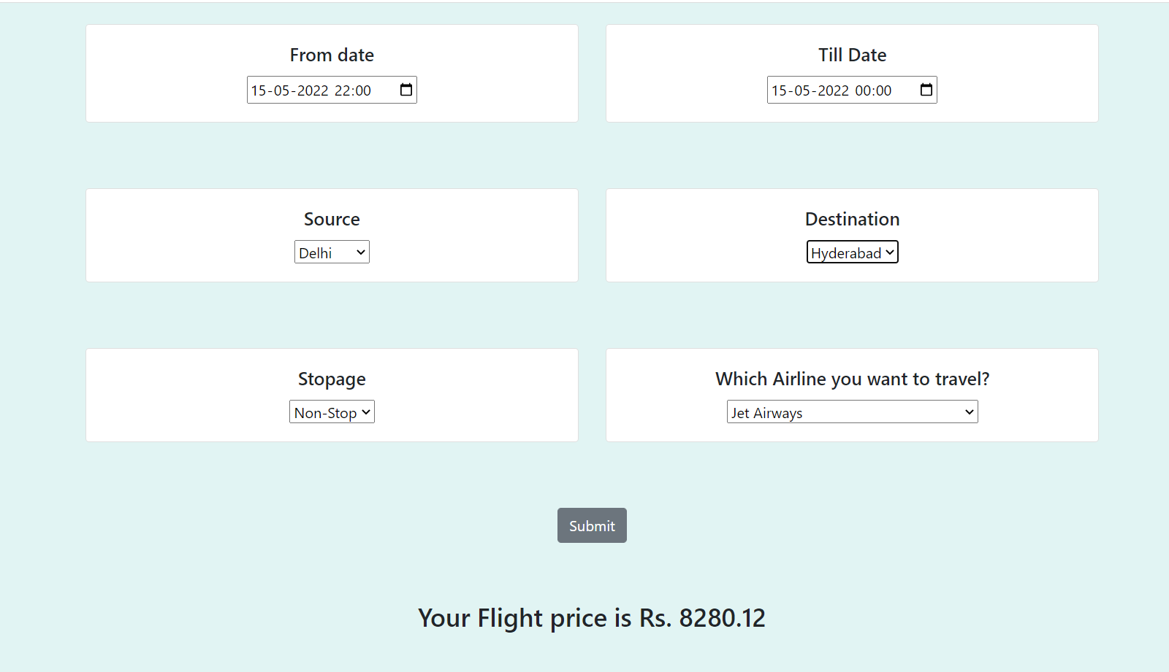
RESULTS

Slide 31
FUTURE DEVELOPMENTS
From the studies, the feature that influences the prices of the ticket are to be considered. In future the details about number of available seats can improve the performance of the model.Predicting the time when the customer should book the flight to get the lowest fair, so that the customer can have a budget friendly journey.
The high or low price of a flight ticket can be predicted according the days, weekend and time of the day that is morning, evening and night.

Slide 32
REFERENCES
Flight Fare Prediction Using Machine Learning - Analytics Vidhya
A Survey on Flight Pricing Prediction using Machine Learning – IJERT
Airfare prices prediction using machine learning techniques | IEEE Conference Publication | IEEE Xplore
MLproject.pdf - ML PROJECT REPORT FLIGHT TICKET FARE PREDICTION USING MACHINE LEARNING TECHNIQUES ABSTRACT: Airline Industry is one of the most s | Course Hero
Flight Fare Prediction Using Machine Learning - Analytics Vidhya
Regression — Flight Price prediction | by Nitika Verma | Analytics Vidhya | Medium
Flight Fare Prediction System Using Machine Learning (ijraset.com)
Flight Fare Prediction using Random Forest Algorithm (researchgate.net)
L. Bierman, Random forests, Machine Learning, vol. 45, pp. 5-32,2001.

